Slide 1
Pre-instruction diagnostic tests can help predict probability of obtaining high or low course grades in introductory physics
David E. Meltzer¹ and Dakota H. King²
¹Arizona State University
²University of Arizona College of Veterinary Medicine
Supported in part by NSF DUE #1504986 and #1914712

Slide 2
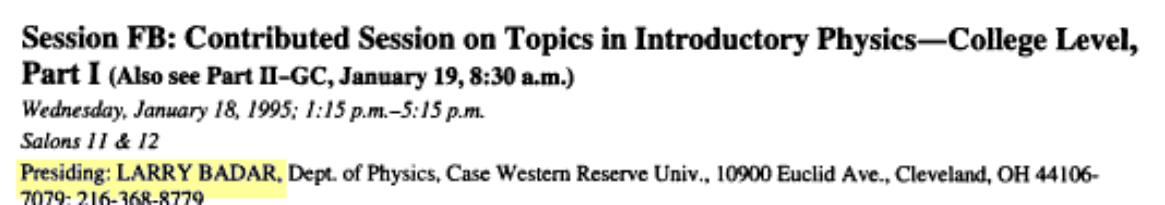

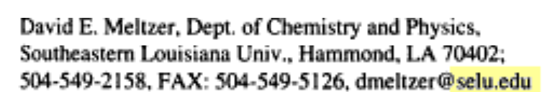
30 years ago today (+1 day): My first AAPT talk
“A Pilot Project for an Elementary Physics Course Based on Guided Inquiry, with the Theme of ‘Energy’”
One year later, I reported some concerning findings…

Slide 3
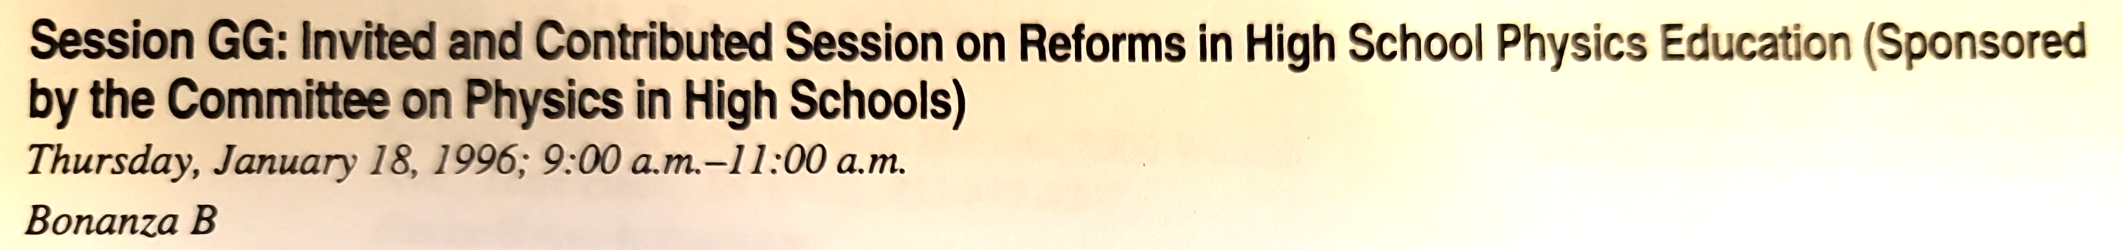
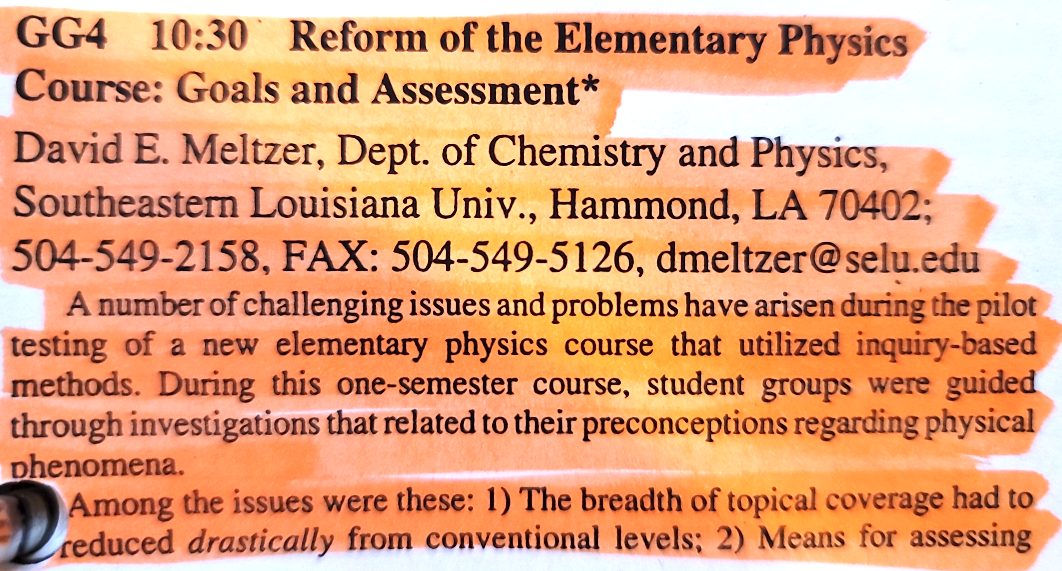
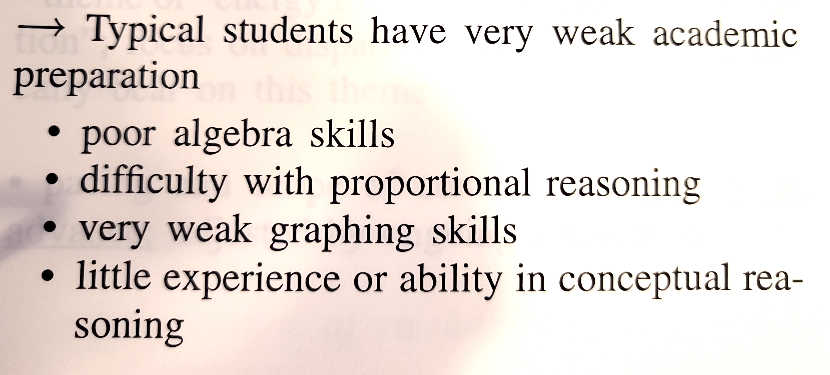
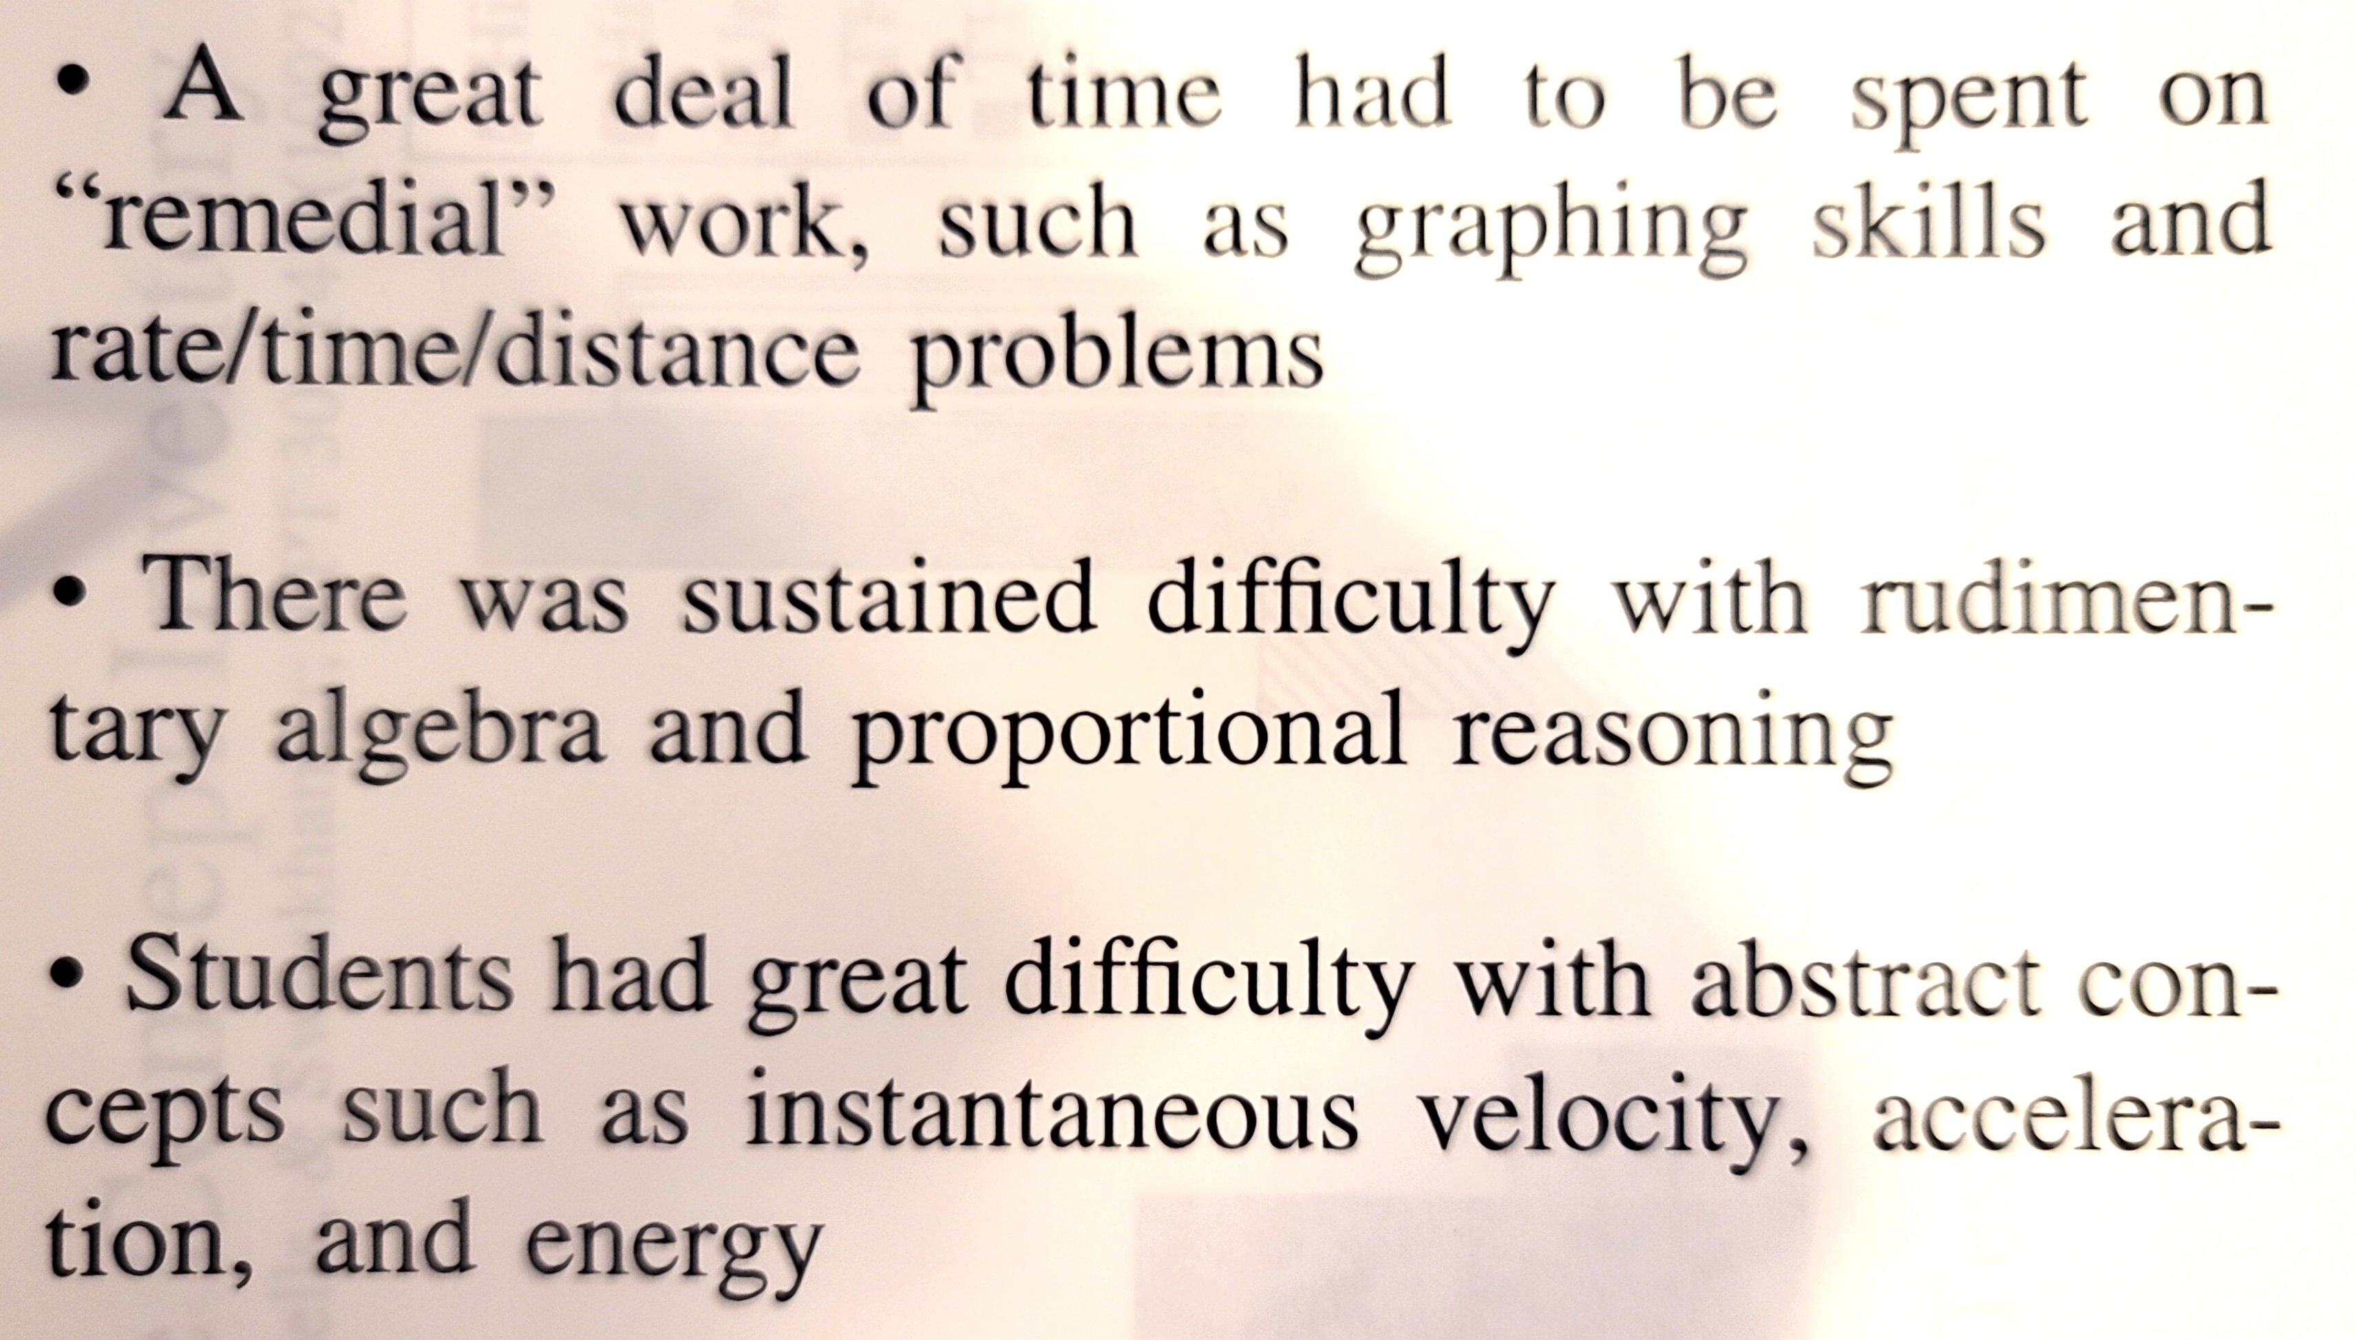
“A number of challenging issues and problems have arisen during the pilot testing of a new elementary physics course…”

Slide 4
Are effects of these same issues evident in the general physics course?
We administered a variety of diagnostic pretests to students in introductory general physics courses
We assessed the degree to which performance on the pretests is associated with students’ final grades in physics

Slide 5
Assessment Pretests
Diagnostic pretest covering pre-college mathematics (“Math”)
  calculators allowed
Pre-instruction tests of scientific reasoning skill and physics concept knowledge:
  Lawson Test of Scientific Reasoning (“Lawson”)
  Force Concept Inventory (FCI)
Why do this? Perhaps ultimately we can offer special assistance to those students who need it most.

Slide 6
Sample Description
31 introductory physics classes from 4 universities, 8 different instructors; over 2000 total students.
Instruction in most classes was “non-traditional,” generally highly interactive using research-based instructional materials and methods

Slide 7
Acknowledgments
Diagnostic data have been provided by (among others):
Vince Coletta (Loyola Marymount University)
Steven Pollock (University of Colorado, Boulder)
Christopher Varney (University of West Florida)

Slide 8
Course and Institution Code
Alg-1: Algebra-based course, first semester
Alg-2: Algebra-based course, second semester
Calc-1: Calculus-based course, first semester
Calc-2: Calculus-based course, second semester
ASU-P: Arizona State University, Polytechnic campus
ASU-T: Arizona State University, Tempe campus
LMU: Loyola Marymount University
UWF: University of West Florida
CU: University of Colorado, Boulder

Slide 9
Comparing probabilities of high and low grades
What is the probability of a student with a high score on a pre-instruction assessment getting a high grade in the class?
How does that compare to a low-scoring student’s probability of getting a high grade?
(and, same questions for probabilities of getting a low grade)

Slide 10
Consistent result:
High (top-quartile) scorers on any one of the diagnostic pretests were much more likely to get high (top-quartile) grades and much less likely to get low (bottom-quartile) grades than were low scorers.
But how much more (or less) likely?…

Slide 11
High scorers on any one of the pretests were much more likely (400-600%) to receive high grades than were low scorers.
High scorers were much less likely (20-30%) to receive low grades than were low scorers.
This general pattern held for 113 out of 116 comparisons (97%) and for all four universities, although the quantitative range was large.

Slide 12
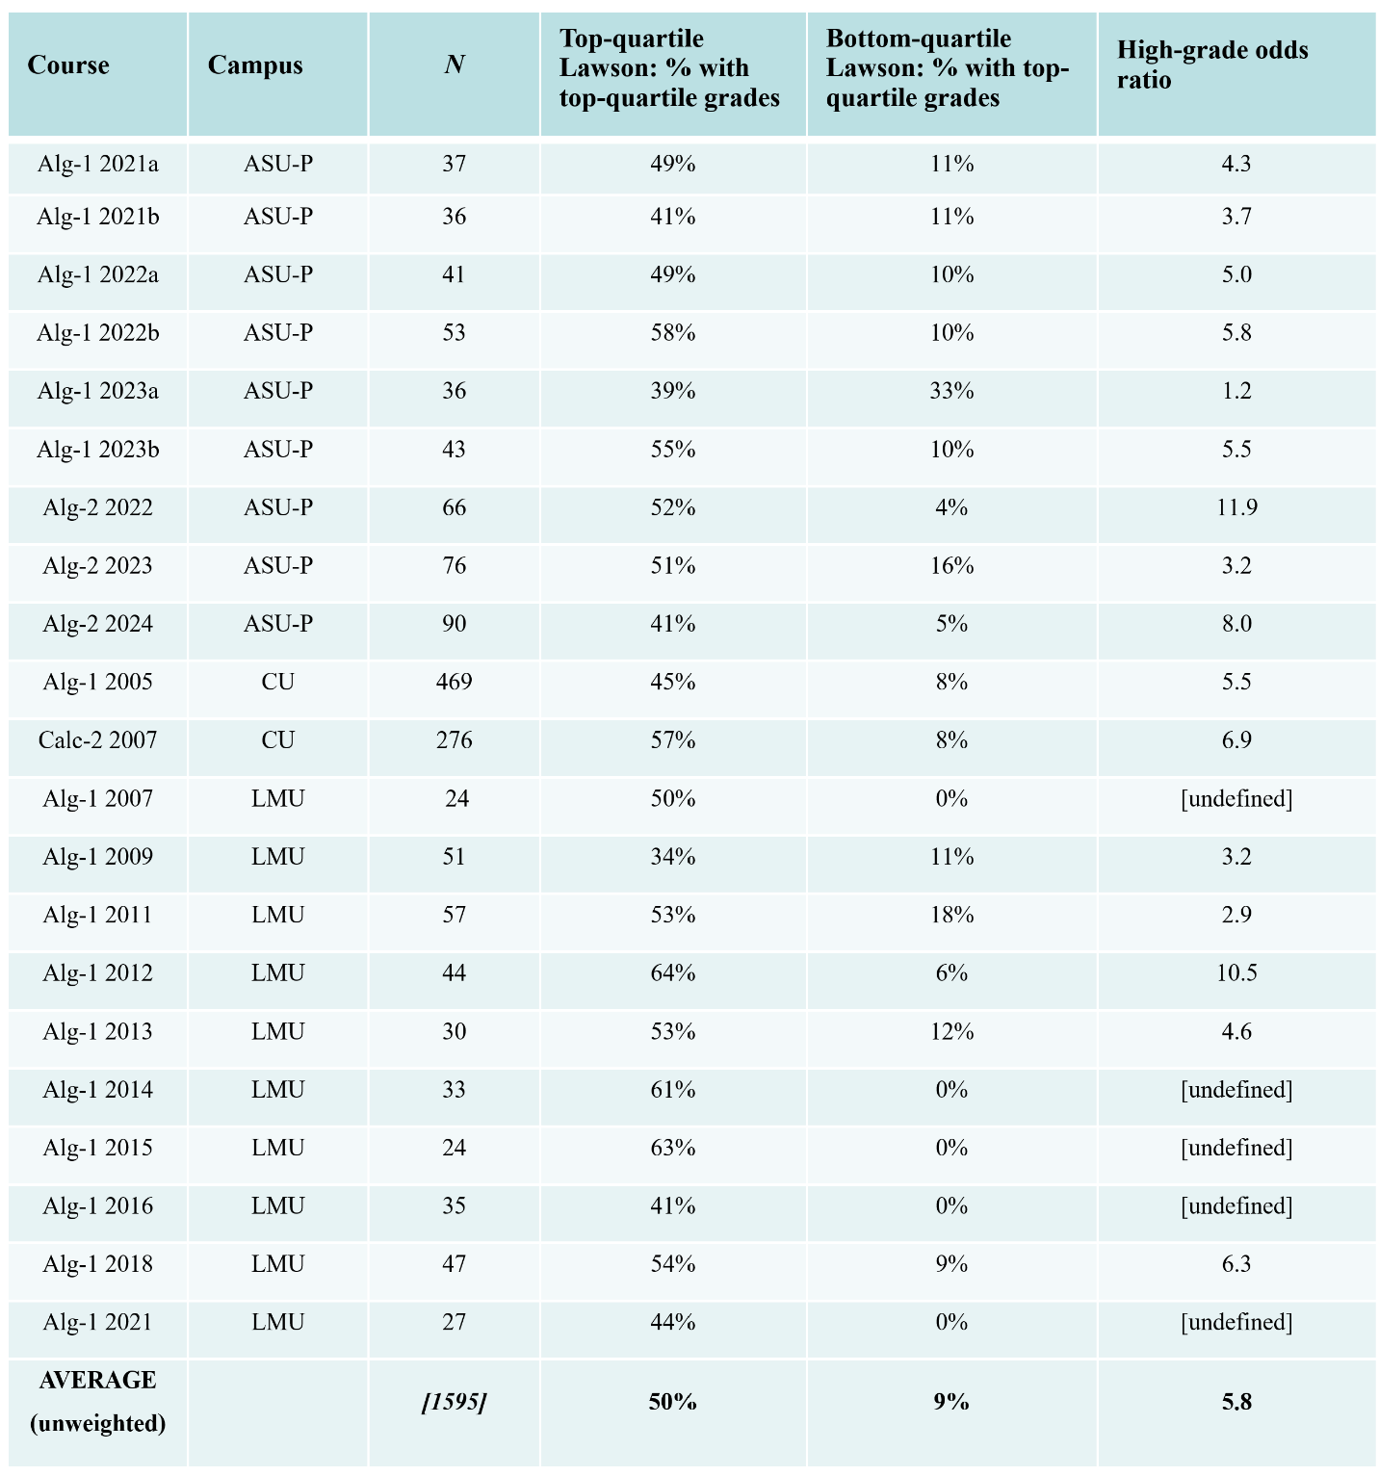
High-Grade Probability vs. Lawson Pretest Score
High scorers almost 6 times as likely to get top-quartile grades as low scorers

Slide 13
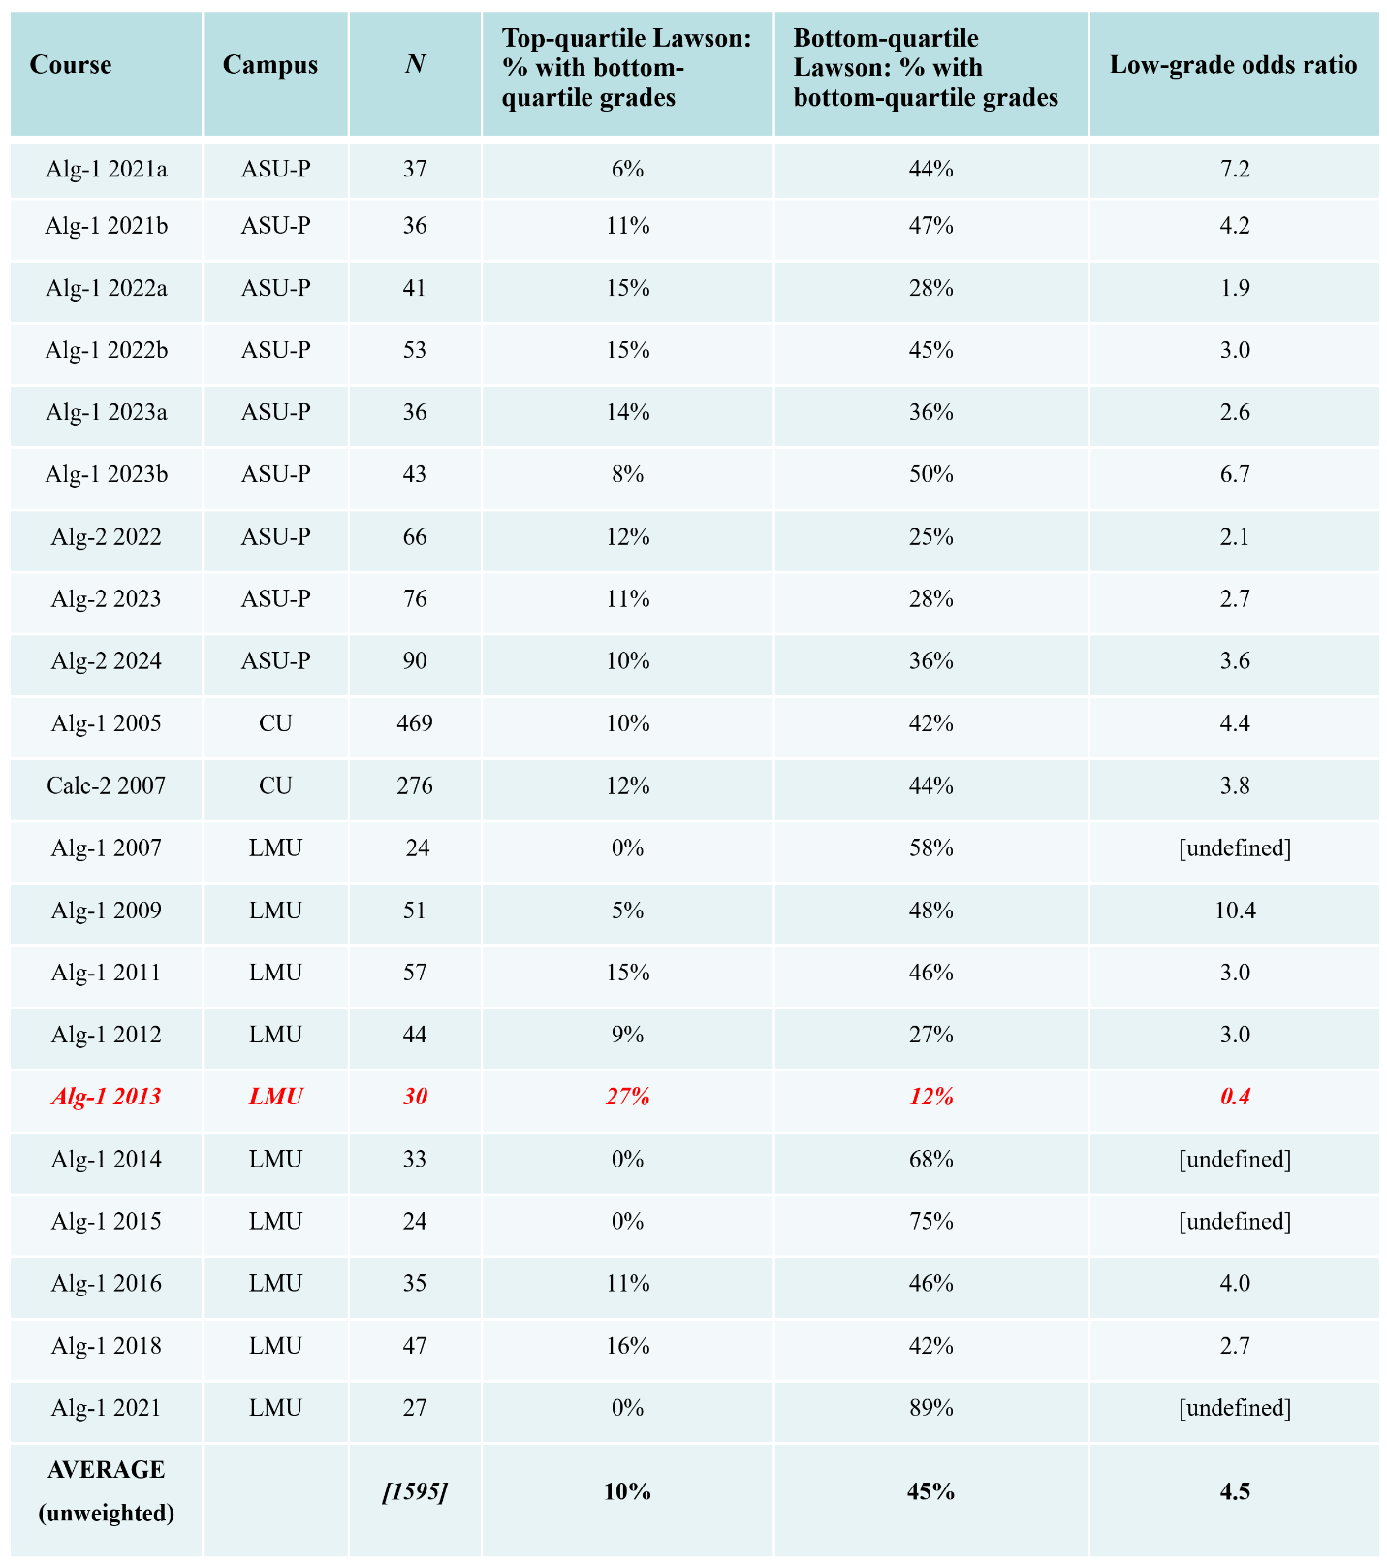
Low-Grade Probability vs. Lawson Pretest Score
Low scorers 4.5 times as likely to get bottom-quartile grades as high scorers

Slide 14
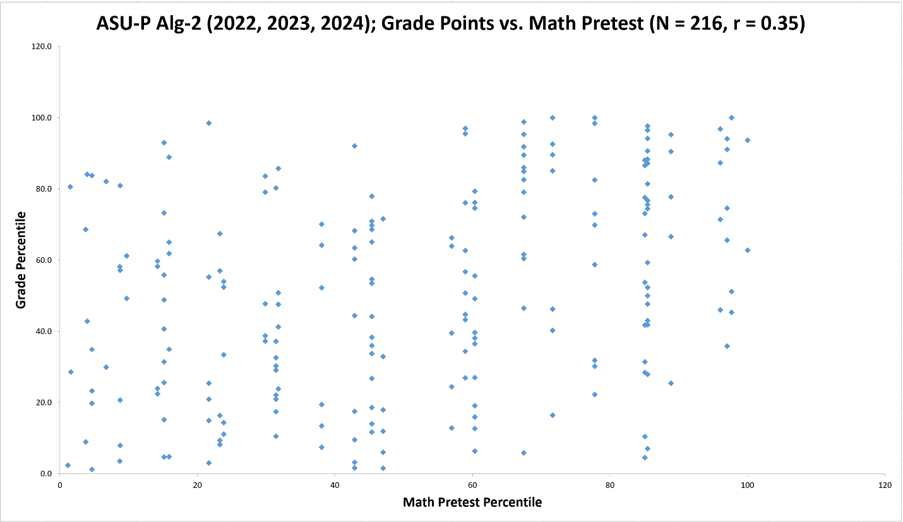
Grades vs. Math Pretest Score for “Combined” Sample

Slide 15
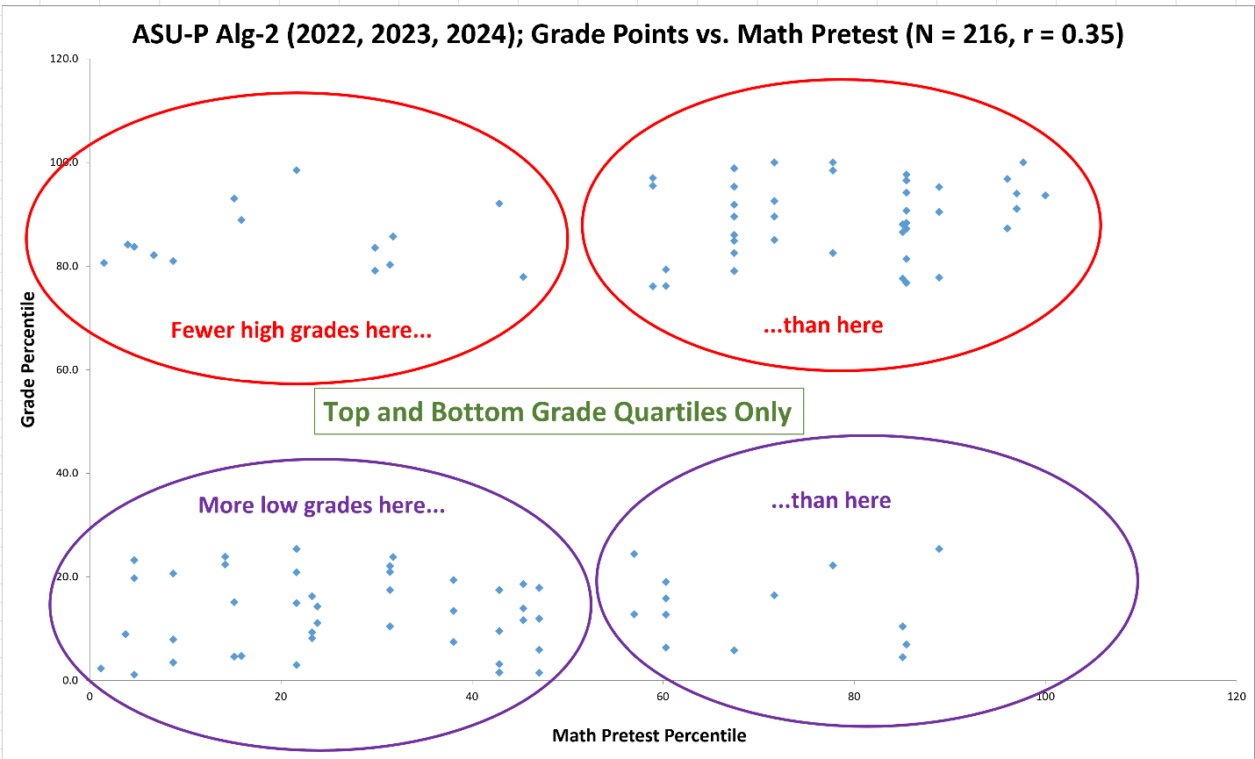
Grades vs. Math Pretest Score for “Combined” Sample

Slide 16
Grades vs. Math Pretest Score for “Combined” Sample

Slide 17
Grades vs. Math Pretest Score for “Combined” Sample

Slide 18
Grades vs. Math Pretest Score for “Combined” Sample

Slide 19
Grades vs. Math Pretest Score for “Combined” Sample

Slide 20
Grades vs. Lawson Pretest Score for Alg-1 2005 CU Sample
For Alg-1 CU, our largest sample (N = 469):
How do students’ median course grades vary depending on their pretest scores on the Lawson test of scientific reasoning?

Slide 21
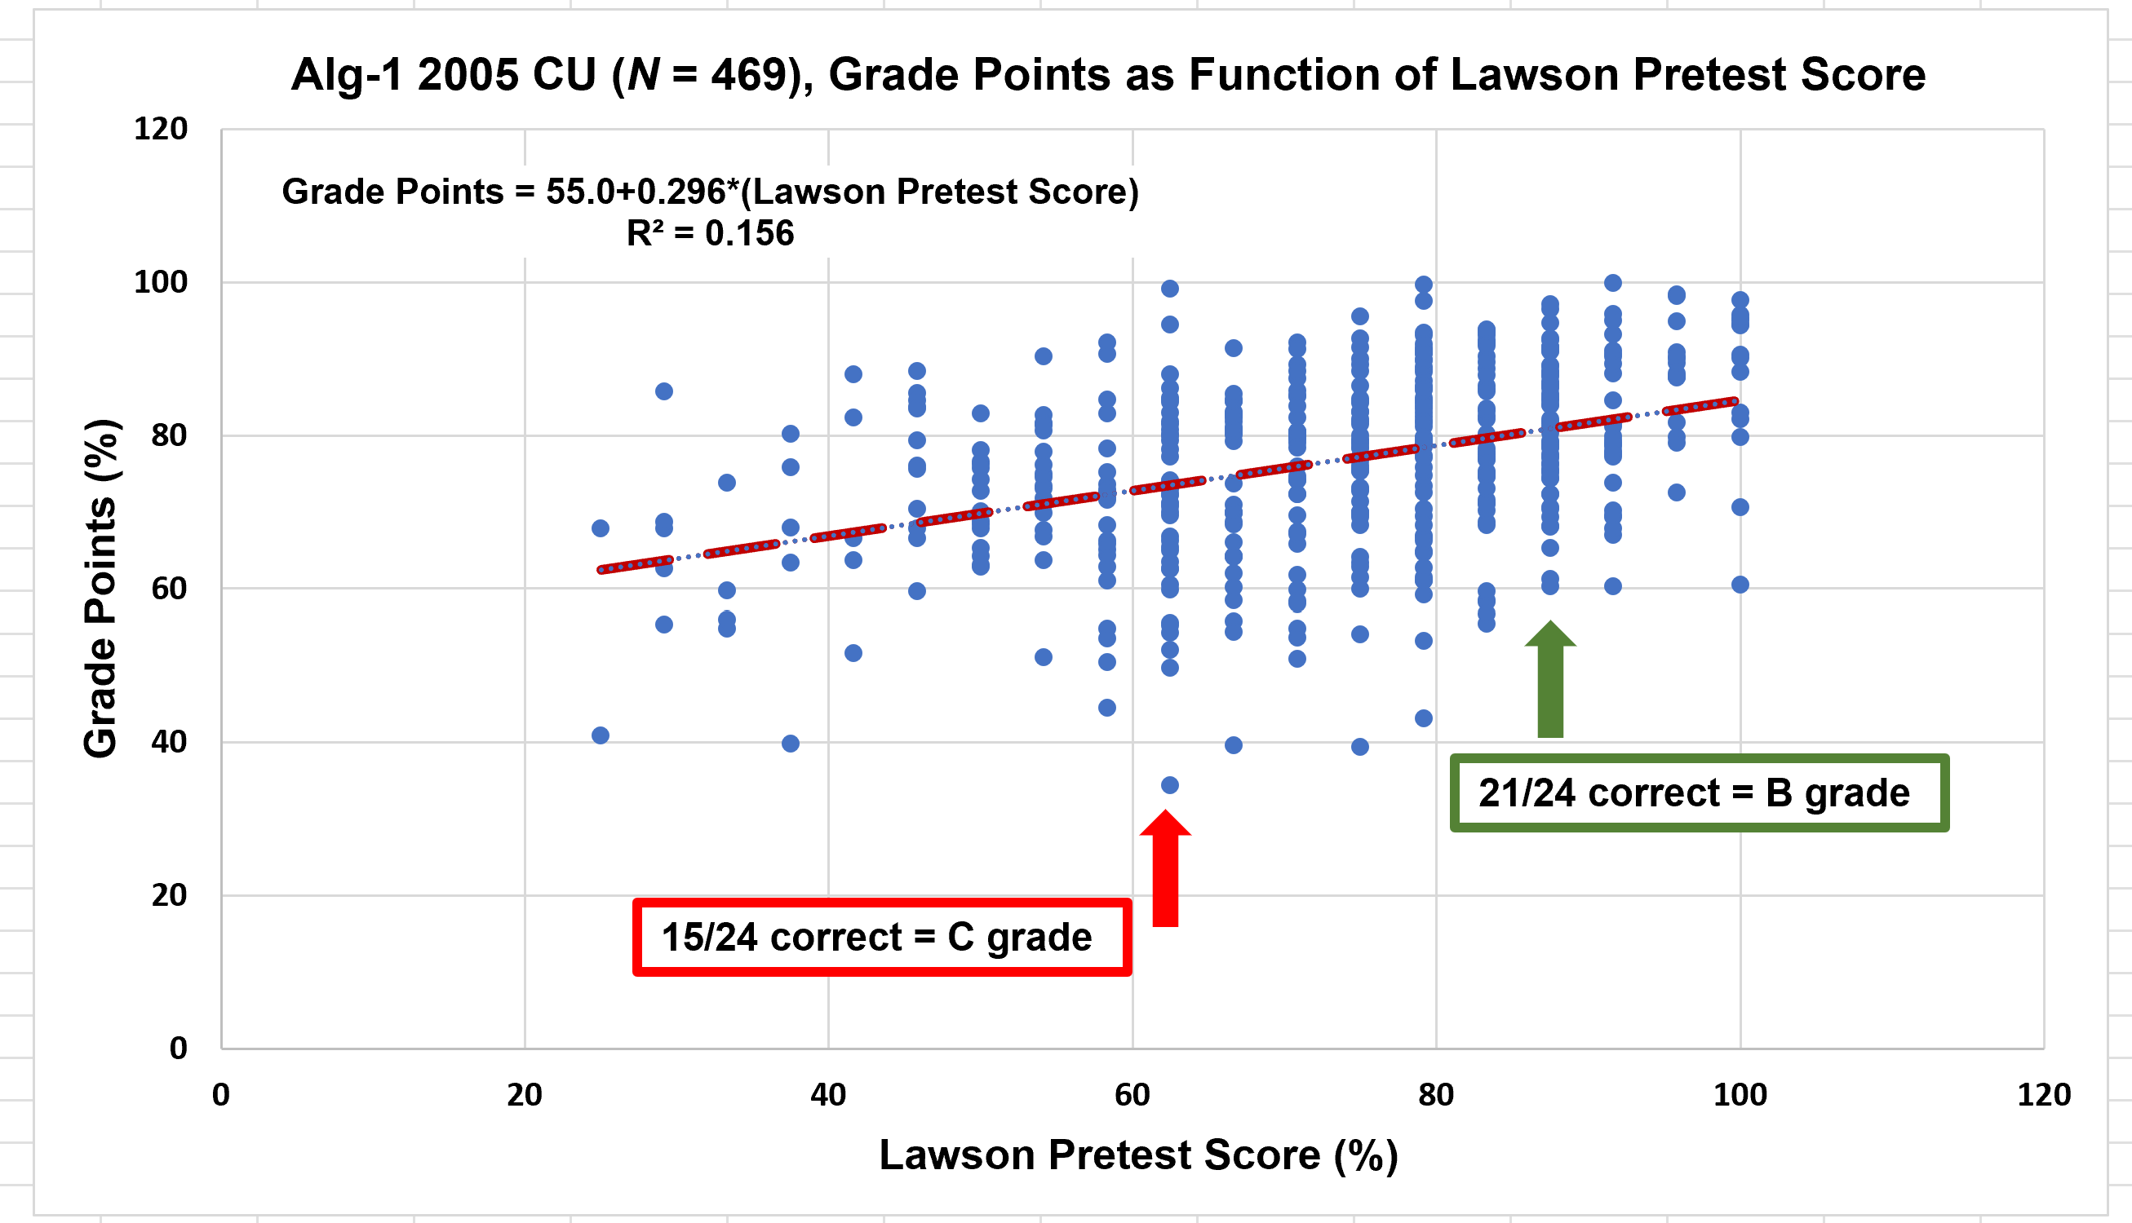
Grades vs. Lawson Pretest Score for Alg-1 2005 CU Sample

Slide 22
Some “answers” to relevant questions
Which, if any, of the diagnostic pretests is most predictive of students’ performance?
Does using multiple predictor variables offer greater predictive power than using just one of them?
Does better performance on one predictor variable indicate that another variable is more (or less) predictive? (This would be an “interaction” effect.)
Varies with the course
Yes, sometimes
Maybe
[if student gets a high score on one pretest, score on the other pretest adds predictive power; if low score on one pretest, other pretest is not very predictive]

Slide 23
Prediction by Salehi et al. (2019)* based on their theoretical model and empirical observations in similar courses:
“These …[model-fit] values may seem modest to some, but they have career-altering implications for students who are poorly prepared….for [a typical value of the model-fitting parameter]…a student who comes in with preparation in the bottom quartile has about a factor of 4 higher probability of being in the bottom quartile of the grade distribution than a student who starts the course in the upper quartile of preparation. If one considers bottom quartile exam scores as failing, this means that poorly prepared students are 4 times more likely to fail their physics 1 final exams than peers with good incoming preparation.” [Salehi et al. (2019), p. 020114-6]
Our results: “poorly prepared” students (i.e., low scorers) are 2-5 times more likely to get bottom-quartile course grades than peers with “good” preparation (i.e., high scorers)
*Shima Salehi, Eric Burkholder, G. Peter Lepage, Steven Pollock, and Carl Wieman, “Demographic gaps or preparation gaps?: The large impact of incoming preparation on performance of students in introductory physics,” Phys. Rev. Phys. Educ. Res. 15(2), 020114 (2019).

Slide 24
Summary
Regardless of group probabilities, the course performance outcome for any individual student remains highly uncertain and depends on many factors.
It is reasonable to acknowledge that the course performance expected for the group of low-scorers on these pretests must be very different from that expected for the high-scorers.
Question: Can these findings be used to offer modified or supplemental instruction for the more “at-risk” group to improve their course outcomes?

