Slide 1
Utility of pre-instruction diagnostic tests for estimating probabilities of final course grades in introductory physics
David E. Meltzer and Dakota H. King
Arizona State University
Supported in part by NSF DUE #1504986 and #1914712

Slide 2
Acknowledgments
Diagnostic data have been provided by (among others):
Vince Coletta (Loyola Marymount University)
Steven Pollock (University of Colorado, Boulder)
Christopher Varney (University of West Florida)

Slide 3
Assessment Pretests
Diagnostic pretest covering pre-college mathematics (“Math”)
calculators allowed
Pre-instruction tests of scientific reasoning skill and physics concept knowledge:
Lawson Test of Scientific Reasoning (“Lawson”)
Force Concept Inventory (FCI)

Slide 4
Mathematics Diagnostic Pretest

Slide 5
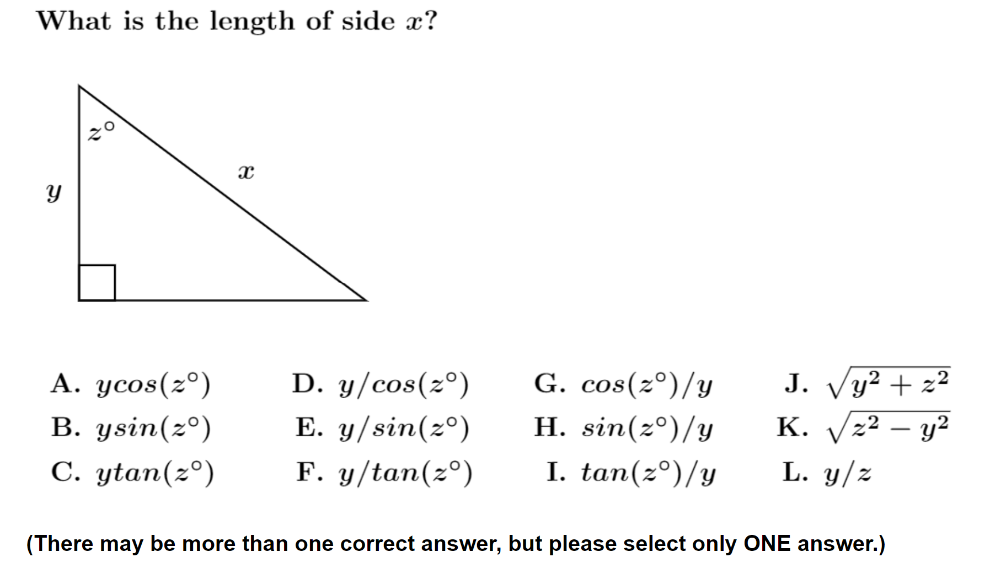
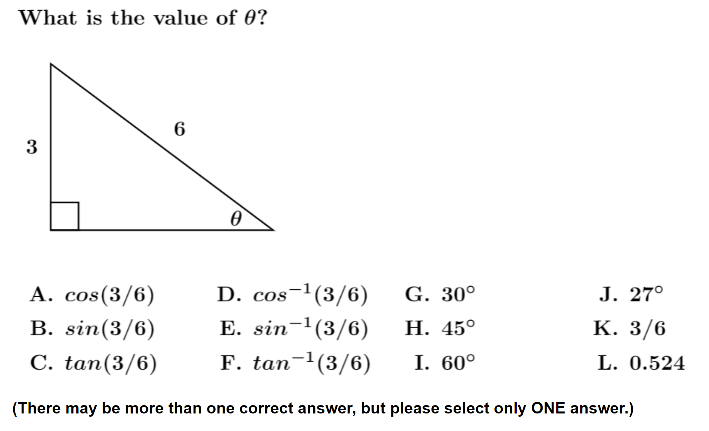
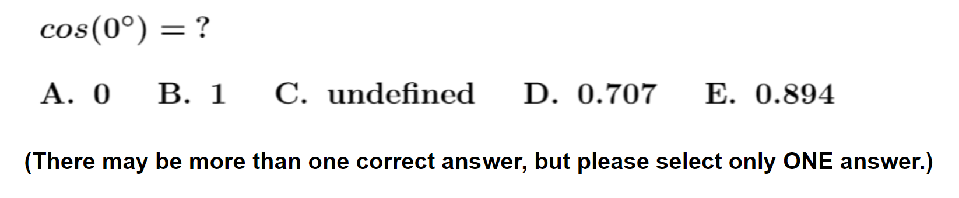
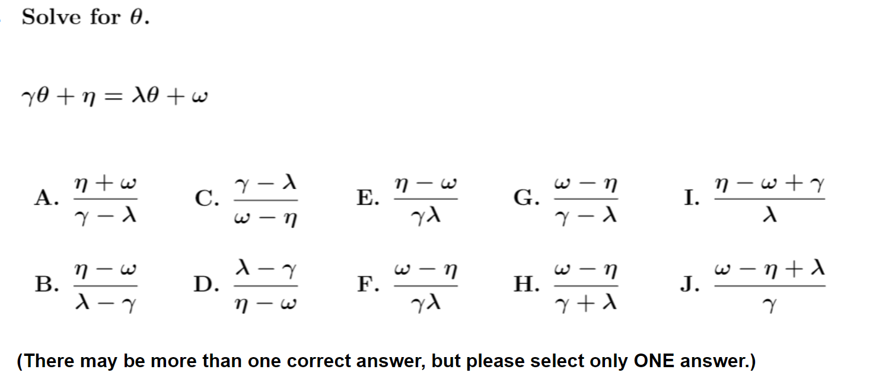
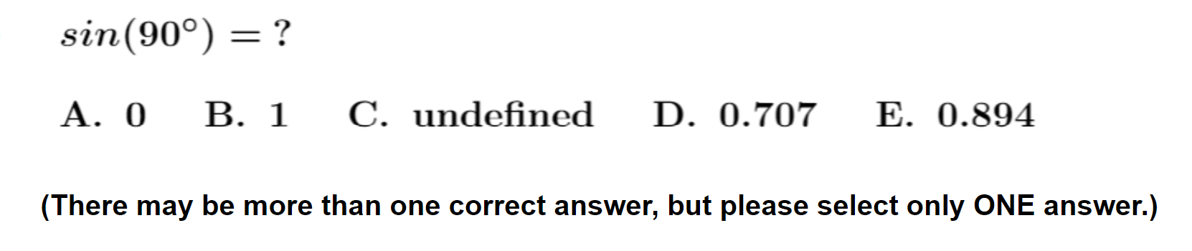
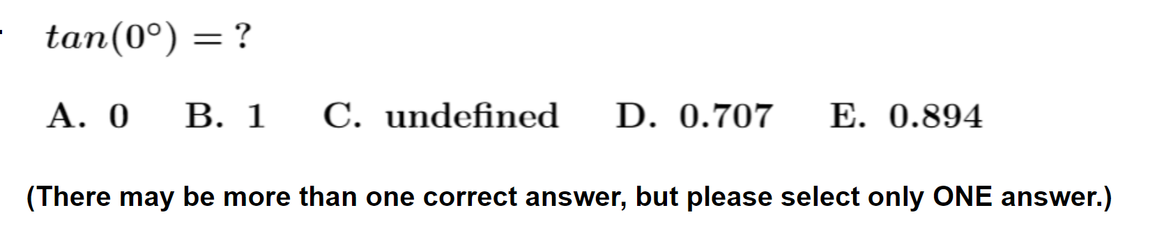

Slide 6
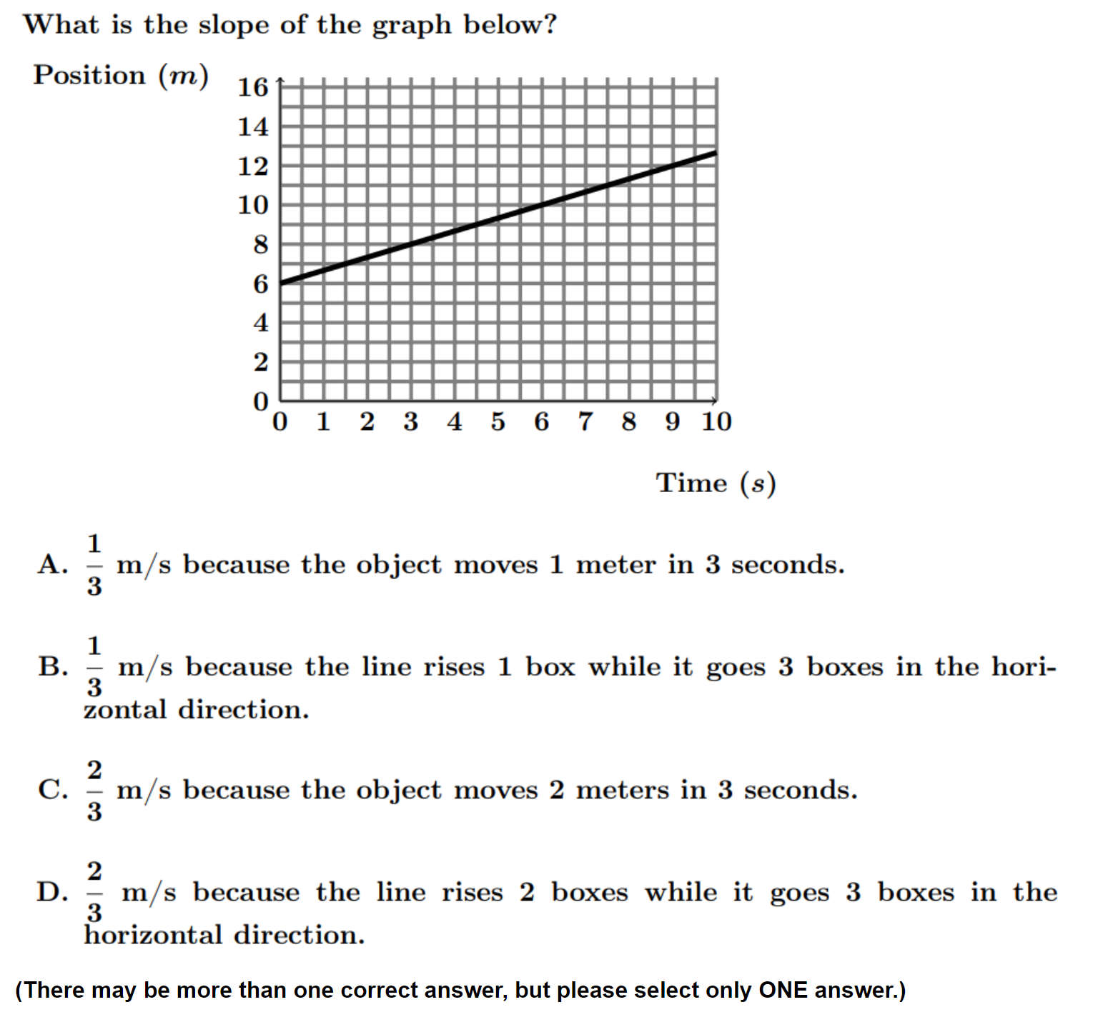
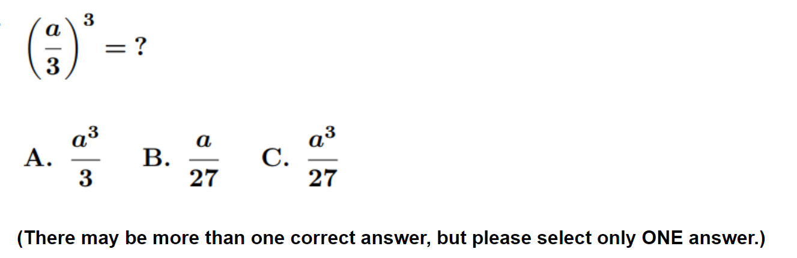
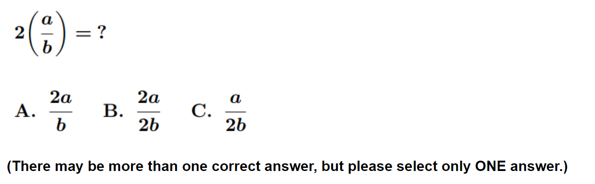
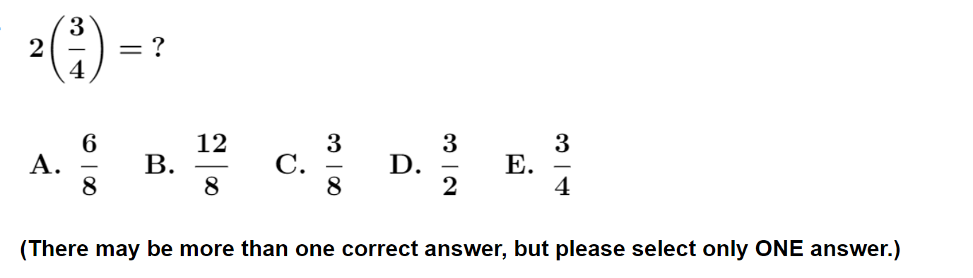
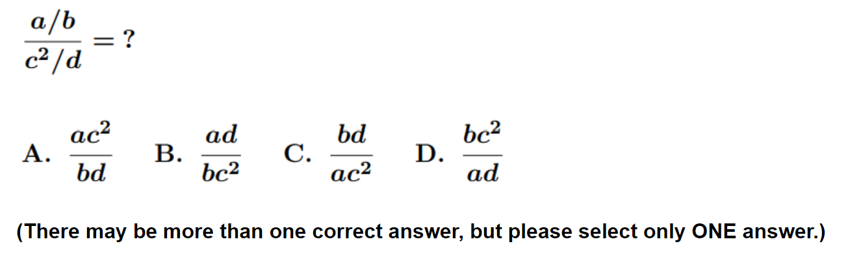

Slide 7
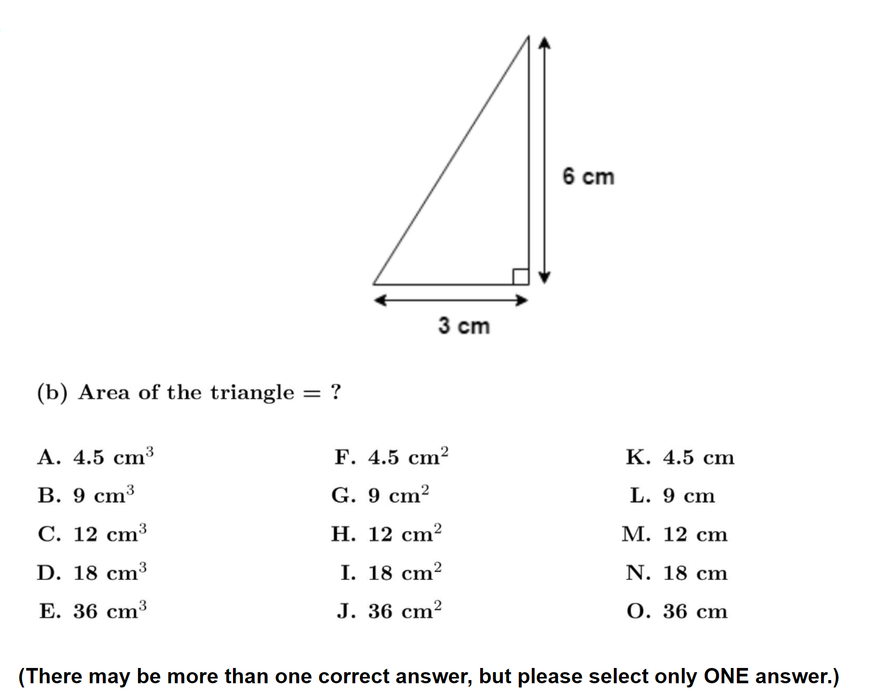
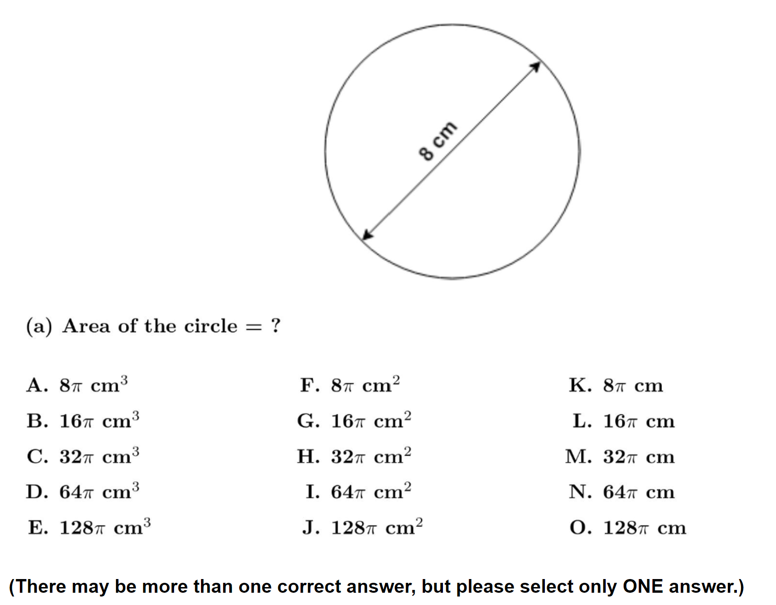
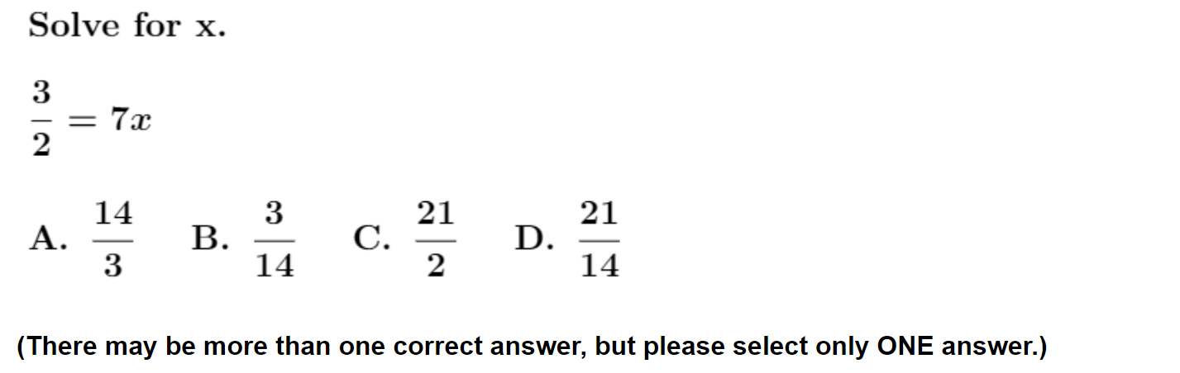
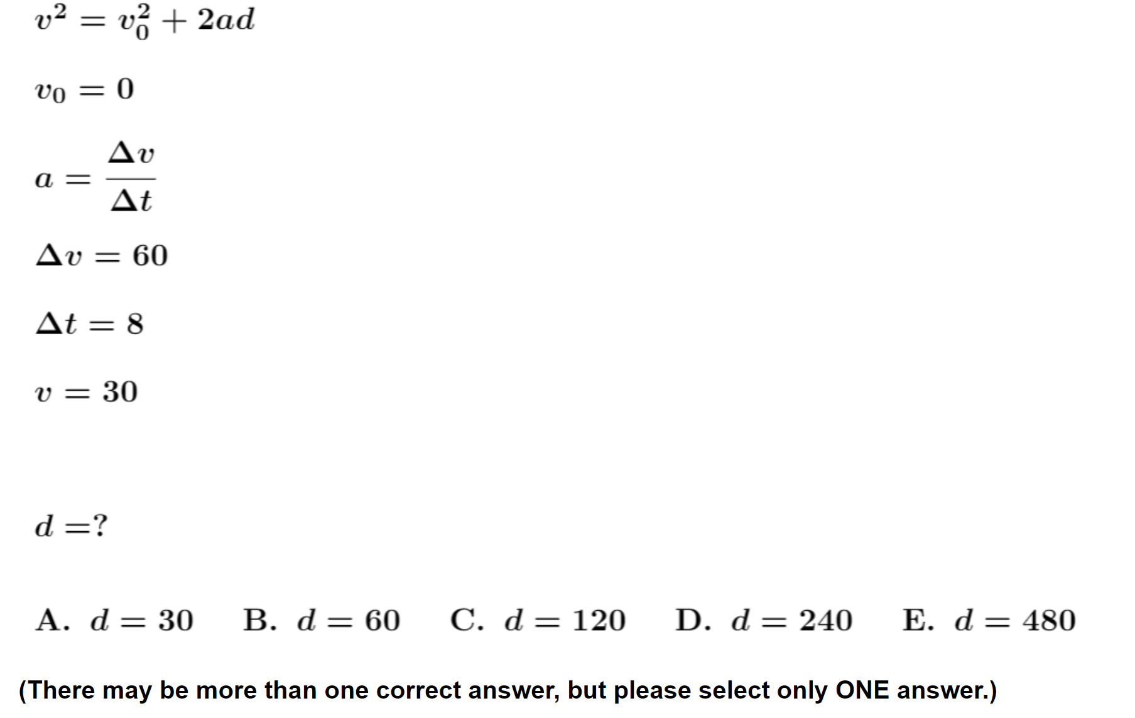
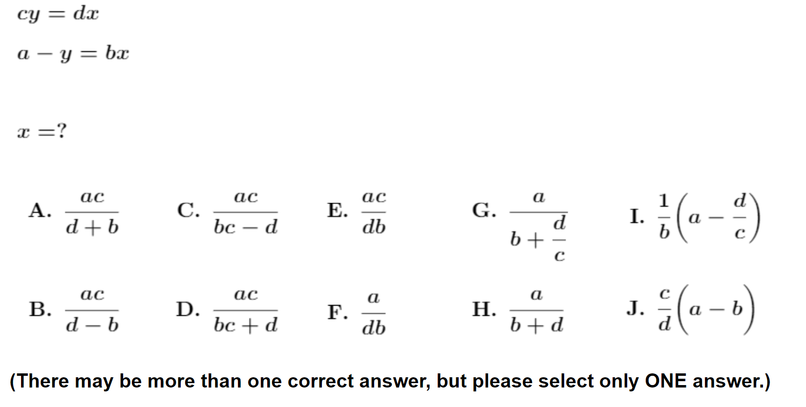

Slide 8
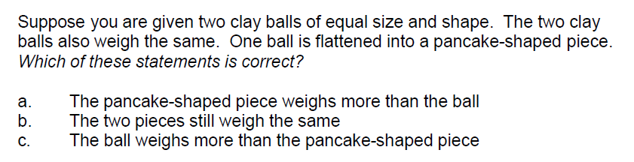
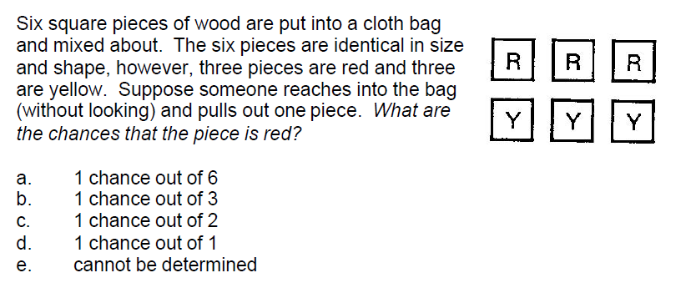
Scientific reasoning skills: The 24-item Lawson test
Understanding shape-independence of mass
Probabilistic reasoning

Slide 9
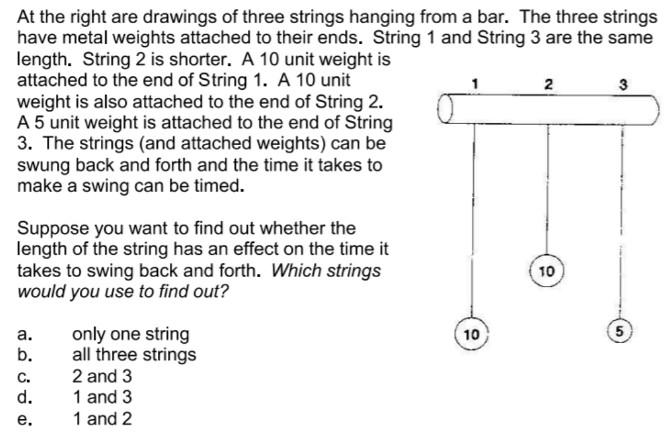
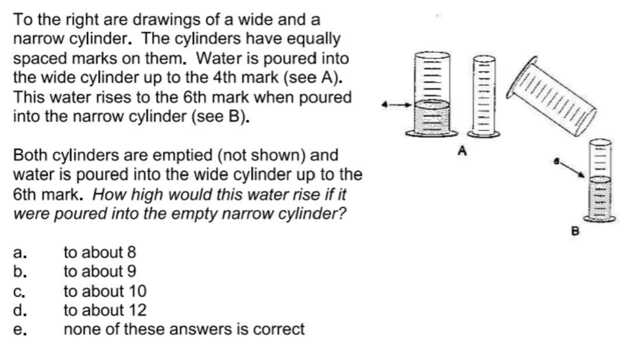
Proportional reasoning
Control of variables

Slide 10
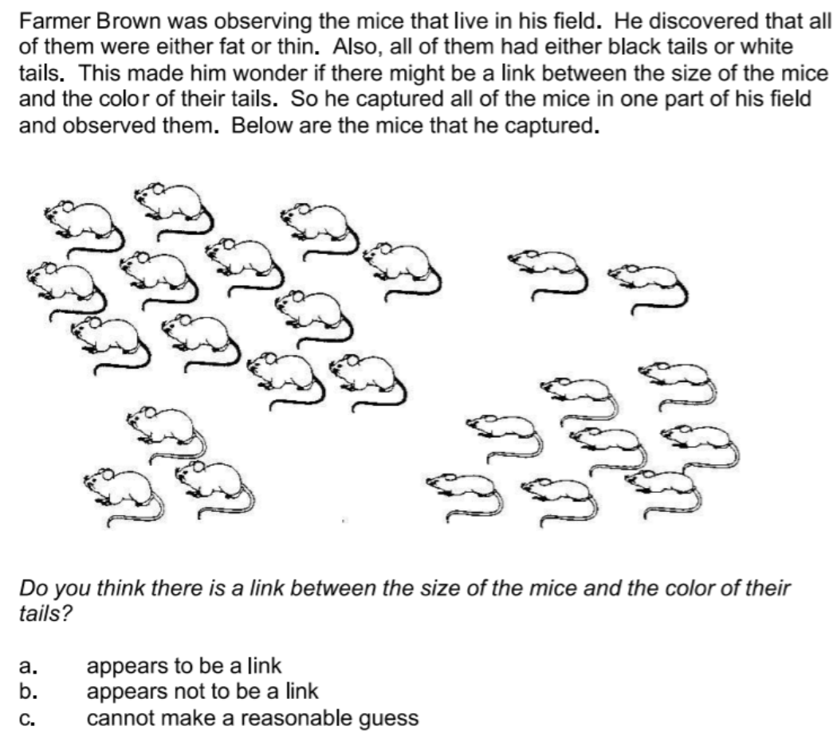
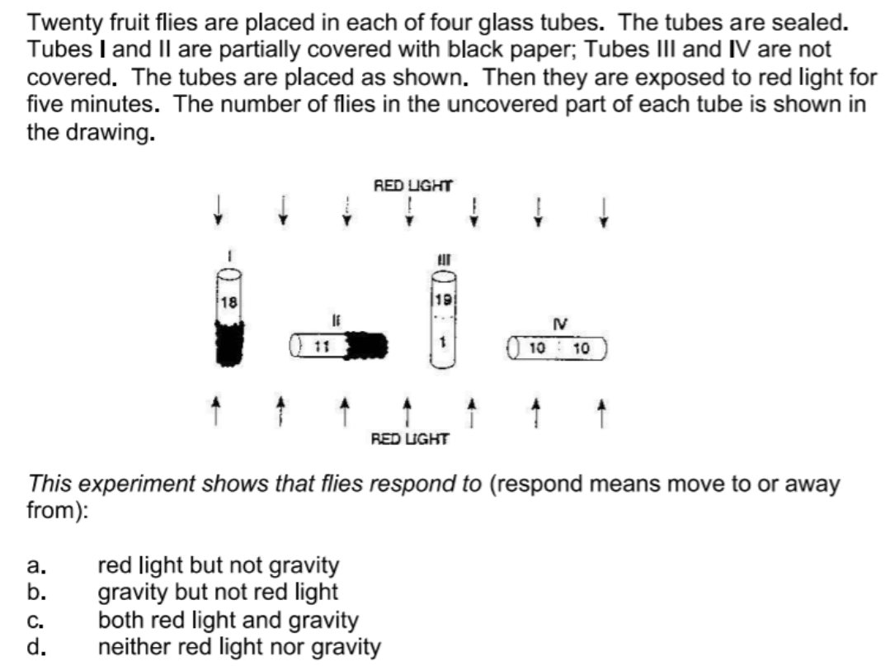
Correlational reasoning

Slide 11
Relation Between Scores and Grades
Correlation coefficients between pretest scores and final course grades vary greatly from course to course:
r ≈ +0.10 - +0.50.
However, slopes of fit lines for grades vs. pretest score are relatively high, therefore…
…pretest scores on diagnostic assessments can approximately predict probabilities of final course grades

Slide 12
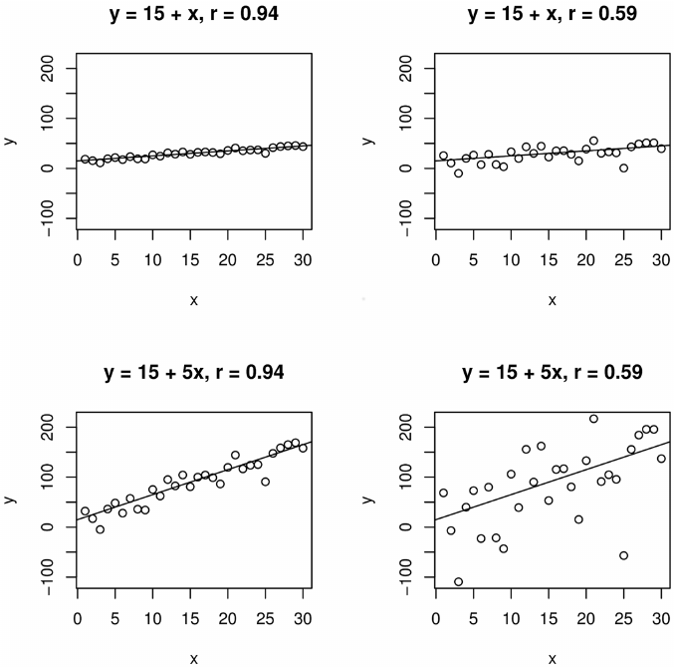
High correlation, small slope:
Changes in predictor variable have little effect (though highly predictable)

Slide 13
High correlation, small slope:
Changes in predictor variable have little effect (though highly predictable)
Low correlation, large slope:
Changes in predictor variable have large effect (despite large scatter)

Slide 14
High correlation, small slope:
Changes in predictor variable have little effect (though highly predictable)
Low correlation, large slope:
Changes in predictor variable have large effect (despite large scatter)

Slide 15
What varies from class to class?
Specific sets of variables that yield best fit in multivariable linear regressions—there is no universal “best fit” model.

Slide 16
What does not vary from class to class?
Students with high scores on diagnostic pretests have much higher probability of receiving high grades than students with low pretest scores, and much lower probability of receiving low grades.

Slide 17
What does not vary¹ from class to class?
Students with high scores on diagnostic pretests have much higher probability of receiving high grades than students with low pretest scores, and much lower probability of receiving low grades.
¹true in 95% of cases observed

Slide 18
What does not vary¹ from class to class?
Students with high² scores on diagnostic pretests have much higher probability of receiving high² grades than students with low pretest scores, and much lower probability of receiving low grades.
¹true in 95% of cases observed
²top quartile in their class

Slide 19
What does not vary¹ from class to class?
Students with high² scores on diagnostic pretests have much³ higher probability of receiving high² grades than students with low pretest scores, and much³ lower probability of receiving low grades.
¹true in 95% of cases observed
²top quartile in their class
³generally between 200-500%

Slide 20
What does not vary¹ from class to class?
Students with high² scores on diagnostic pretests have much³ higher probability of receiving high² grades than students with low⁴ pretest scores, and much³ lower probability of receiving low⁴ grades.
¹true in 95% of cases observed
²top quartile in their class
³generally between 200-500%
⁴bottom quartile in their class

Slide 21
Comparing probabilities of high and low grades
What is the probability of a student with a high score on a pre-instruction assessment getting a high grade in the class?
How does that compare to a low-scoring student’s probability of getting a high grade?
What is the probability of a student with a high score on a pre-instruction assessment getting a low grade in the class?
How does that compare to a low-scoring student’s probability of getting a low grade?

Slide 22
Sample Description
25 introductory physics classes from 4 universities, over 2000 total students
Instruction in most classes was “non-traditional,” generally highly interactive using research-based instructional materials and methods

Slide 23
Course and Institution Code
Alg-1: Algebra-based course, first semester
Alg-2: Algebra-based course, second semester
Calc-1: Calculus-based course, first semester
Calc-2: Calculus-based course, second semester
ASU-P: Arizona State University, Polytechnic campus
ASU-T: Arizona State University, Tempe campus
LMU: Loyola Marymount University
UWF: University of West Florida
CU: University of Colorado, Boulder

Slide 24
Consistent result:
High (top-quartile) scorers on the diagnostic pretests were much more likely to get high (top-quartile) grades than were low scorers

Slide 25
High Course Grade vs. Mathematics Diagnostic Pretest Score
Course | Campus | N | Top-quartile Math: % with top-quartile grades | Bottom-quartile Math: % with top-quartile grades | High-grade odds ratio
Alg-1 2021a | ASU-P | 39 | 51% | 10% | 5.0
Alg-1 2021b | ASU-P | 42 | 44% | 10% | 4.6
Alg-1 2022a | ASU-P | 40 | 27% | 6% | 4.4
Alg-1 2022b | ASU-P | 52 | 49% | 10% | 5.1
Alg-1 2023a | ASU-P | 42 | 39% | 10% | 4.1
Alg-1 2023b | ASU-P | 46 | 64% | 9% | 7.3
Alg-2 2022 | ASU-P | 75 | 46% | 21% | 2.2
Alg-2 2023 | ASU-P | 92 | 41% | 13% | 3.2
Alg-2 2021 | ASU-T | 129 | 30% | 39% | 0.8
Calc-1 2021a | UWF | 53 | 43% | 0% | “∞”
Calc-1 2021b | UWF | 42 | 43% | 0% | “∞”
Calc-2 2021 | UWF | 58 | 43% | 14% | 3.1
AVERAGE | (unweighted) | (710) | 43% | 12% | 3.7

Slide 26
High Course Grade vs. Mathematics Diagnostic Pretest Score
Course | Campus | N | Top-quartile Math: % with top-quartile grades | Bottom-quartile Math: % with top-quartile grades | High-grade odds ratio
Alg-1 2021a | ASU-P | 39 | 51% | 10% | 5.0
Alg-1 2021b | ASU-P | 42 | 44% | 10% | 4.6
Alg-1 2022a | ASU-P | 40 | 27% | 6% | 4.4
Alg-1 2022b | ASU-P | 52 | 49% | 10% | 5.1
Alg-1 2023a | ASU-P | 42 | 39% | 10% | 4.1
Alg-1 2023b | ASU-P | 46 | 64% | 9% | 7.3
Alg-2 2022 | ASU-P | 75 | 46% | 21% | 2.2
Alg-2 2023 | ASU-P | 92 | 41% | 13% | 3.2
Alg-2 2021 | ASU-T | 129 | 30% | 39% | 0.8
Calc-1 2021a | UWF | 53 | 43% | 0% | “∞”
Calc-1 2021b | UWF | 42 | 43% | 0% | “∞”
Calc-2 2021 | UWF | 58 | 43% | 14% | 3.1
AVERAGE | (unweighted) | (710) | 43% | 12% | 3.7

Slide 27
High Course Grade vs. Mathematics Diagnostic Pretest Score
Course | Campus | N | Top-quartile Math: % with top-quartile grades | Bottom-quartile Math: % with top-quartile grades | High-grade odds ratio
Alg-1 2021a | ASU-P | 39 | 51% | 10% | 5.0
Alg-1 2021b | ASU-P | 42 | 44% | 10% | 4.6
Alg-1 2022a | ASU-P | 40 | 27% | 6% | 4.4
Alg-1 2022b | ASU-P | 52 | 49% | 10% | 5.1
Alg-1 2023a | ASU-P | 42 | 39% | 10% | 4.1
Alg-1 2023b | ASU-P | 46 | 64% | 9% | 7.3
Alg-2 2022 | ASU-P | 75 | 46% | 21% | 2.2
Alg-2 2023 | ASU-P | 92 | 41% | 13% | 3.2
Alg-2 2021 | ASU-T | 129 | 30% | 39% | 0.8
Calc-1 2021a | UWF | 53 | 43% | 0% | “∞”
Calc-1 2021b | UWF | 42 | 43% | 0% | “∞”
Calc-2 2021 | UWF | 58 | 43% | 14% | 3.1
AVERAGE | (unweighted) | (710) | 43% | 12% | 3.7

Slide 28
High Course Grade vs. Mathematics Diagnostic Pretest Score
Course | Campus | N | Top-quartile Math: % with top-quartile grades | Bottom-quartile Math: % with top-quartile grades | High-grade odds ratio
Alg-1 2021a | ASU-P | 39 | 51% | 10% | 5.0
Alg-1 2021b | ASU-P | 42 | 44% | 10% | 4.6
Alg-1 2022a | ASU-P | 40 | 27% | 6% | 4.4
Alg-1 2022b | ASU-P | 52 | 49% | 10% | 5.1
Alg-1 2023a | ASU-P | 42 | 39% | 10% | 4.1
Alg-1 2023b | ASU-P | 46 | 64% | 9% | 7.3
Alg-2 2022 | ASU-P | 75 | 46% | 21% | 2.2
Alg-2 2023 | ASU-P | 92 | 41% | 13% | 3.2
Alg-2 2021 | ASU-T | 129 | 30% | 39% | 0.8
Calc-1 2021a | UWF | 53 | 43% | 0% | “∞”
Calc-1 2021b | UWF | 42 | 43% | 0% | “∞”
Calc-2 2021 | UWF | 58 | 43% | 14% | 3.1
AVERAGE | (unweighted) | (710) | 43% | 12% | 3.7

Slide 29
High Course Grade vs. Mathematics Diagnostic Pretest Score
Course | Campus | N | Top-quartile Math: % with top-quartile grades | Bottom-quartile Math: % with top-quartile grades | High-grade odds ratio
Alg-1 2021a | ASU-P | 39 | 51% | 10% | 5.0
Alg-1 2021b | ASU-P | 42 | 44% | 10% | 4.6
Alg-1 2022a | ASU-P | 40 | 27% | 6% | 4.4
Alg-1 2022b | ASU-P | 52 | 49% | 10% | 5.1
Alg-1 2023a | ASU-P | 42 | 39% | 10% | 4.1
Alg-1 2023b | ASU-P | 46 | 64% | 9% | 7.3
Alg-2 2022 | ASU-P | 75 | 46% | 21% | 2.2
Alg-2 2023 | ASU-P | 92 | 41% | 13% | 3.2
Alg-2 2021 | ASU-T | 129 | 30% | 39% | 0.8
Calc-1 2021a | UWF | 53 | 43% | 0% | “∞”
Calc-1 2021b | UWF | 42 | 43% | 0% | “∞”
Calc-2 2021 | UWF | 58 | 43% | 14% | 3.1
AVERAGE | (unweighted) | (710) | 43% | 12% | 3.7

Slide 30
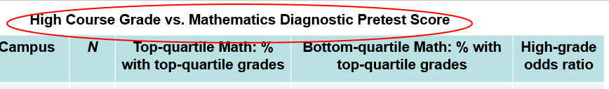
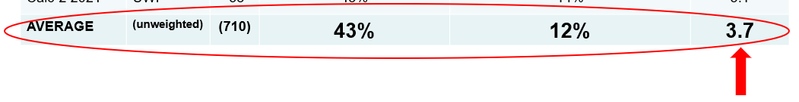
High scorers on math pretest were 3.7 times more likely to get a high grade than were low scorers

Slide 31
High Course Grade vs. Lawson Test of Scientific Reasoning Pretest Score
Course | Campus | N | Top-quartile Lawson: % with top-quartile grades | Bottom-quartile Lawson: % with top-quartile grades | High-grade odds ratio
Alg-1 2021a | ASU-P | 35 | 46% | 23% | 2.0
Alg-1 2021b | ASU-P | 38 | 32% | 8% | 4.0
Alg-1 2022a | ASU-P | 41 | 49% | 10% | 5.0
Alg-1 2022b | ASU-P | 54 | 57% | 10% | 5.6
Alg-1 2023a | ASU-P | 36 | 39% | 33% | 1.2
Alg-1 2023b | ASU-P | 44 | 55% | 9% | 6.0
Alg-2 2022 | ASU-P | 73 | 41% | 6% | 7.6
Alg-2 2023 | ASU-P | 92 | 52% | 10% | 5.0
Alg-1 | CU | 469 | 45% | 8% | 5.5
Calc-2 | CU | 276 | 57% | 8% | 6.9
Alg-1 2007 | LMU | 24 | 50% | 0% | “∞”
Alg-1 2009 | LMU | 51 | 34% | 11% | 3.2
Alg-1 2011 | LMU | 57 | 53% | 18% | 2.9
Alg-1 2012 | LMU | 44 | 64% | 6% | 10.5
Alg-1 2013 | LMU | 30 | 53% | 12% | 4.6
Alg-1 2014 | LMU | 33 | 61% | 0% | “∞”
Alg-1 2015 | LMU | 24 | 63% | 0% | “∞”
Alg-1 2016 | LMU | 35 | 41% | 0% | “∞”
Alg-1 2018 | LMU | 47 | 54% | 9% | 6.3
Alg-1 2021 | LMU | 27 | 44% | 0% | “∞”
AVERAGE | (unweighted) | (1530) | 50% | 9% | 5.5

Slide 32
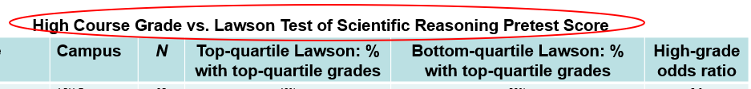
High scorers on Lawson pretest were 5.5 times more likely to get a high grade than were low scorers

Slide 33
High scorers on Math pretest were 3.7 times more likely to get a high grade than were low scorers
High scorers on Lawson pretest were 5.5 times more likely to get a high grade than were low scorers
High scorers on FCI pretest were 5.4 times more likely to get a high grade than were low scorers

Slide 34
Q: What about probabilities of getting low grades?
A: Low scorers on pretests were more likely to get low grades than were high scorers

Slide 35
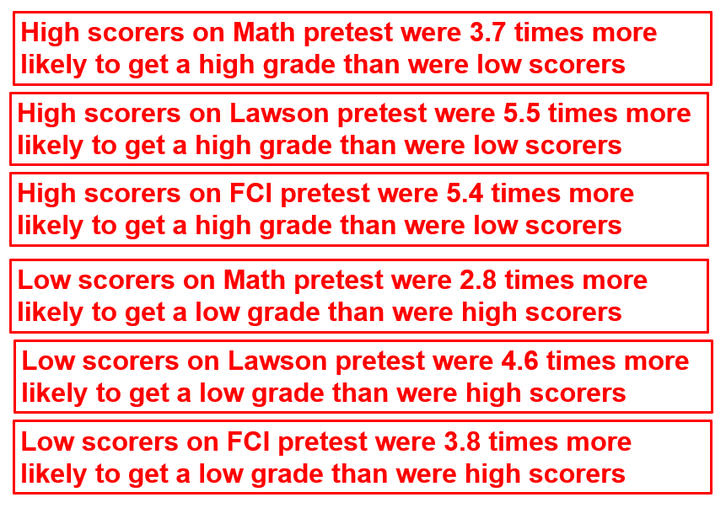
High and low grades for high and low scorers were compared in 12 classes for the math diagnostic, 20 classes for the Lawson pretest, and 23 classes for the FCI, a total of 110 high/low comparisons. The quartile ratios were greater than 1.0 in 107 of the 110 cases (97%).

Slide 36
Regression analysis can be misleading
High scatter in the data leads to relatively low correlation
However, quartile comparison can reveal highly significant differences between low and high scorers

Slide 37
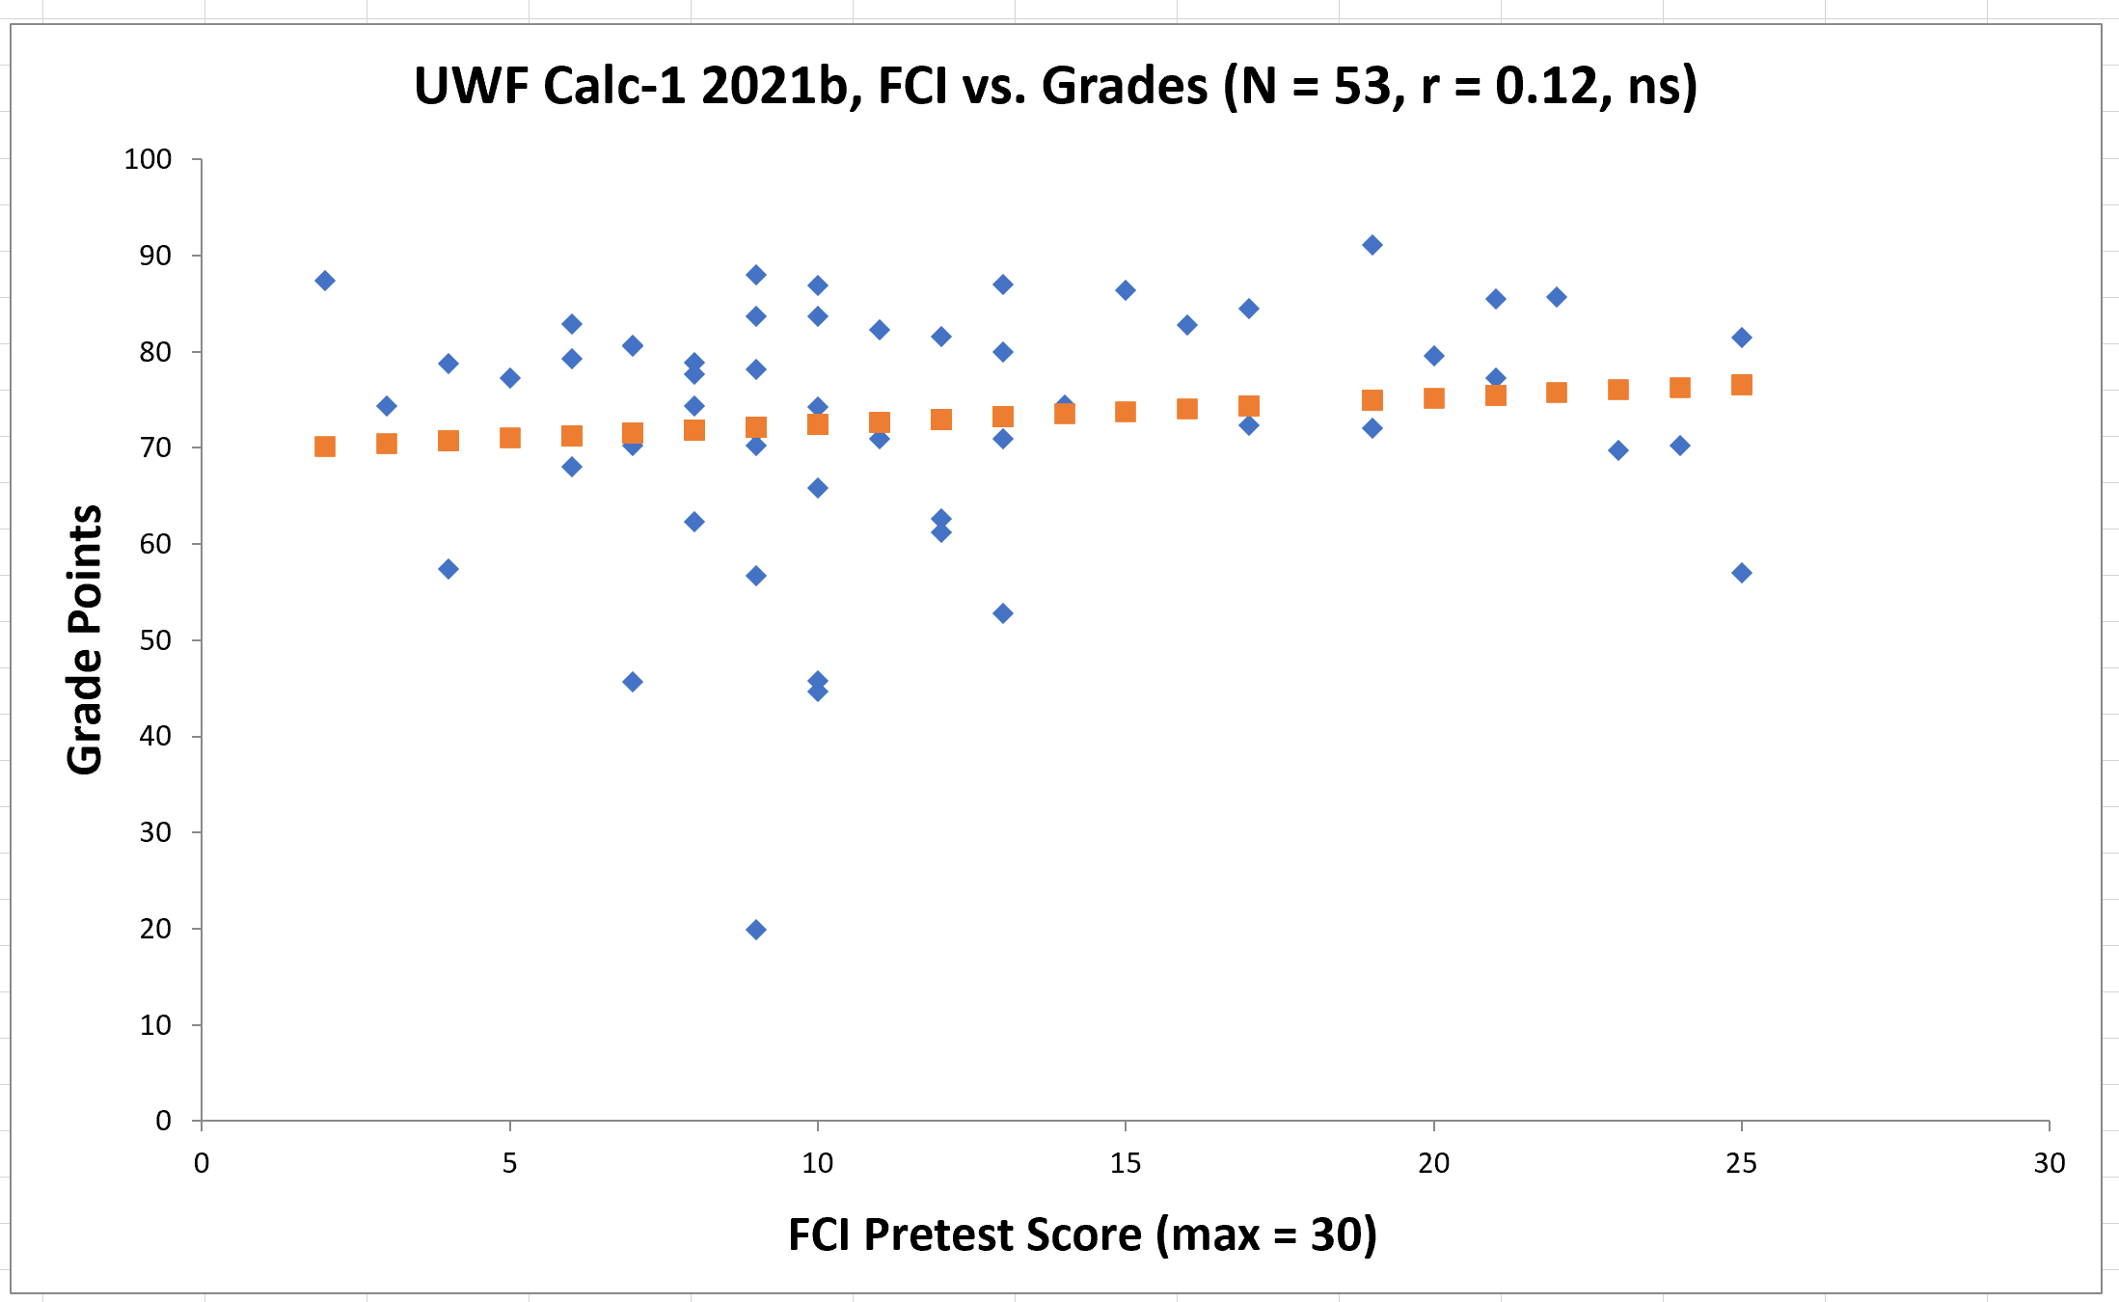

Slide 39
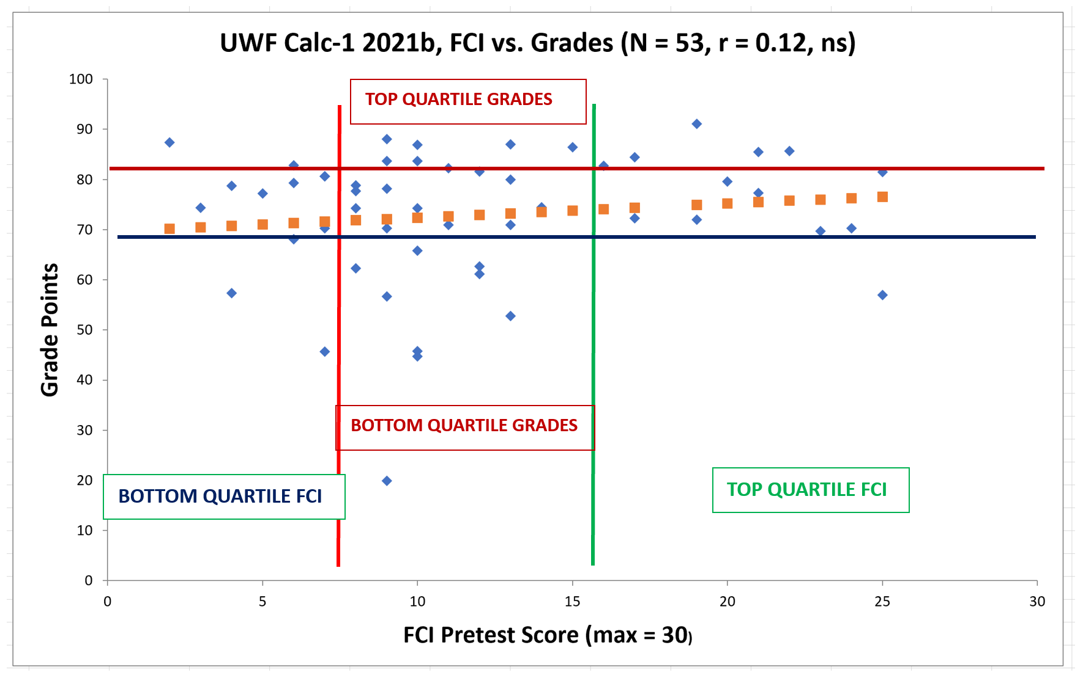

Slide 41
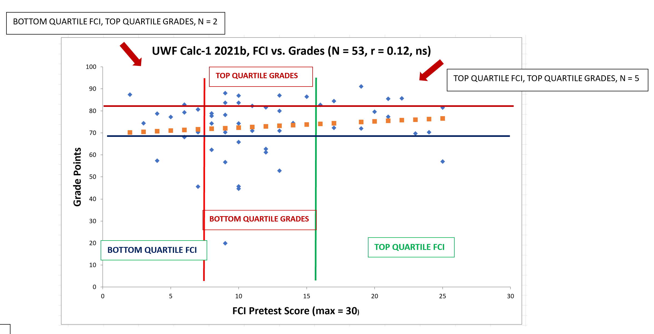

Slide 43
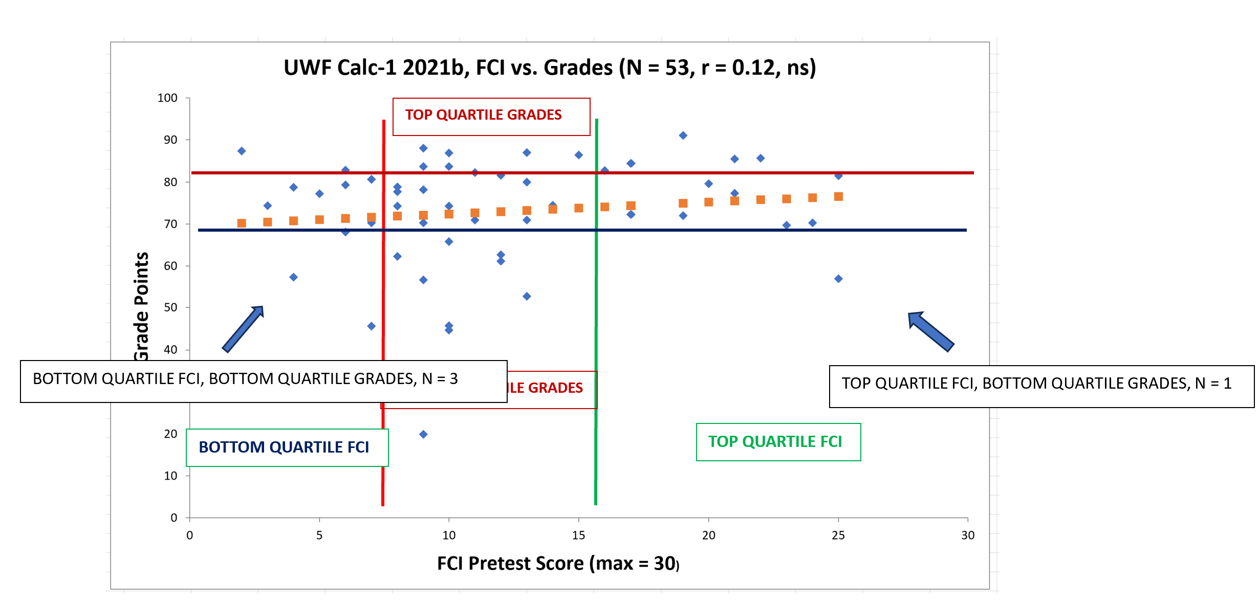

Slide 45
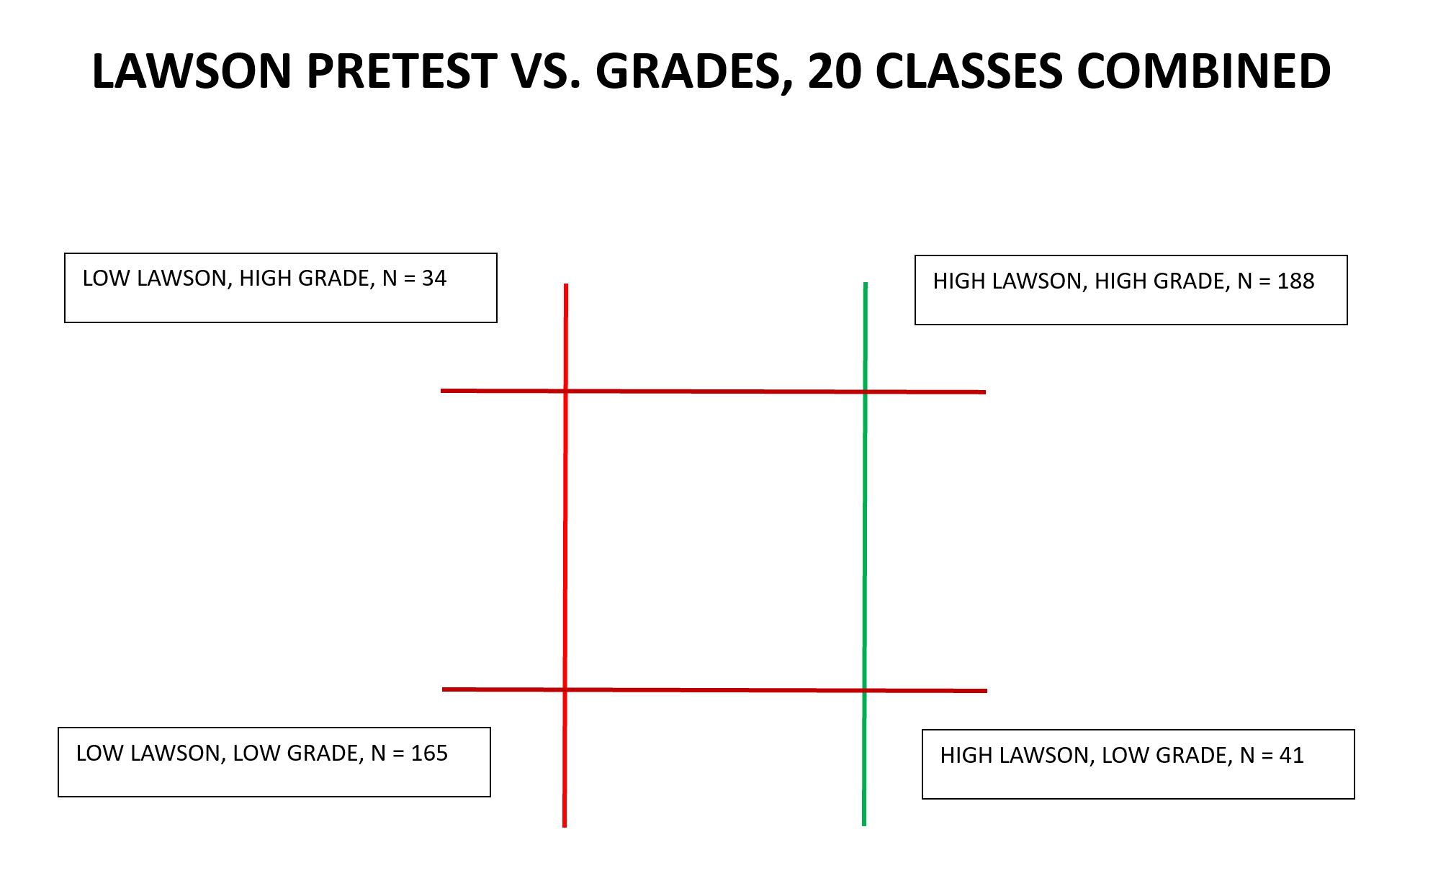

Slide 46
N = 353

Slide 48
N = 75

Slide 49
Ratio = 353/75 = 4.7
N = 75

Slide 50
Alternative to Regression Analysis
Stratify sample into “high” and “low” scorers on pretest measure #1 (e.g, FCI), then separate each group further into high and low scorers on pretest measure #2 (e.g, Lawson test).
We already know that the measure #1 groups differ in grade probabilities
Compare high/low grade probabilities to see whether pretest measure #2 offers additional predictive power regarding grade probabilities

Slide 51
Further Analysis of Alg-1 CU sample (N = 466)
Probability of top-quartile grade
Probability of bottom-quartile grade
15%
26%
1.8
Top-half on Lawson pretest
60%
26%
2.3
Top-Quartile on FCI Pretest
Bottom-half on Lawson pretest
Ratio
15%
26%
1.8
Top-half on Lawson pretest
23%
0%
--
Bottom-Quartile on FCI Pretest
Bottom-half on Lawson pretest
Ratio

Slide 52
Even within a sample separated into high and low FCI pretest scores, Lawson pretest score was an additional reliable predictor of high/low grades.

Slide 53
Multiple Linear Regression Perspective: Which pre-instruction indicators are “most predictive” of final grades?
Final Grade = c₁*Lawson Pretest + c₂*Math Pretest + c₃*FCI Pretest

Slide 54
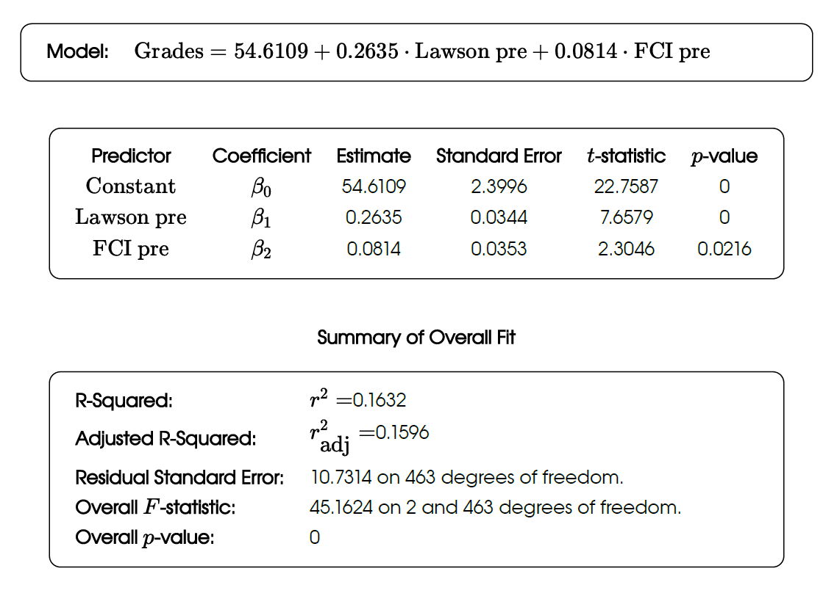
Alg-1 CU (N = 466)
Lawson heavier weight than FCI?
(Including interaction effects does not improve R²)

Slide 55
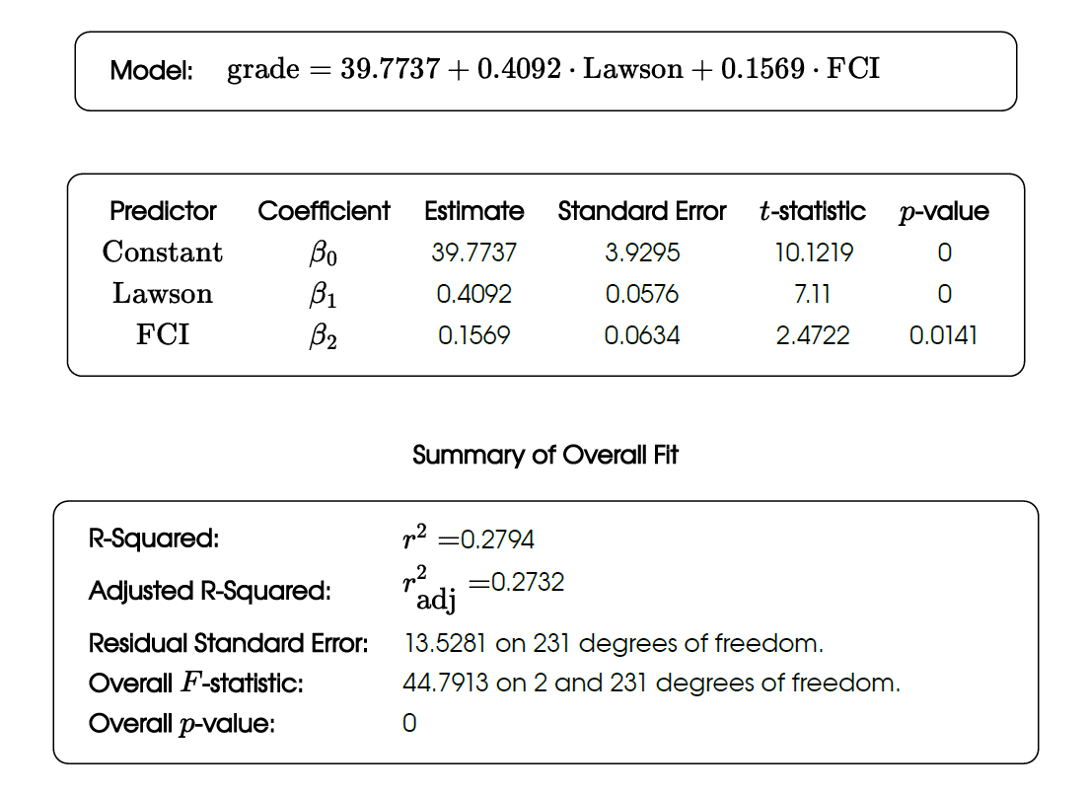
Alg-1 CU: Top and bottom grade quartiles only (N = 234)

Slide 56
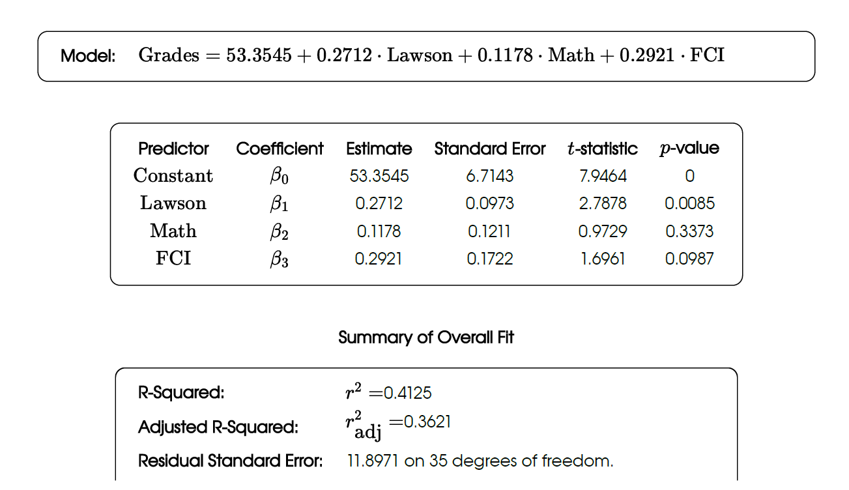
ASU-P Alg-1 2023(b): All three pretests (N = 39)
FCI equal weight as Lawson but not significant?

Slide 57
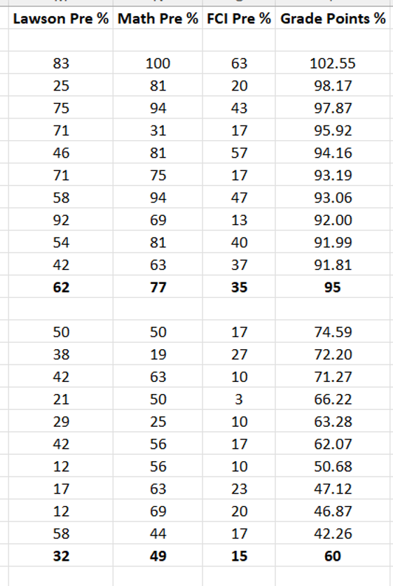
ASU-P Alg-1 2023(b)
(Top and bottom grade quartiles only)
← Top grade-quartile averages
← Bottom grade-quartile averages

Slide 58
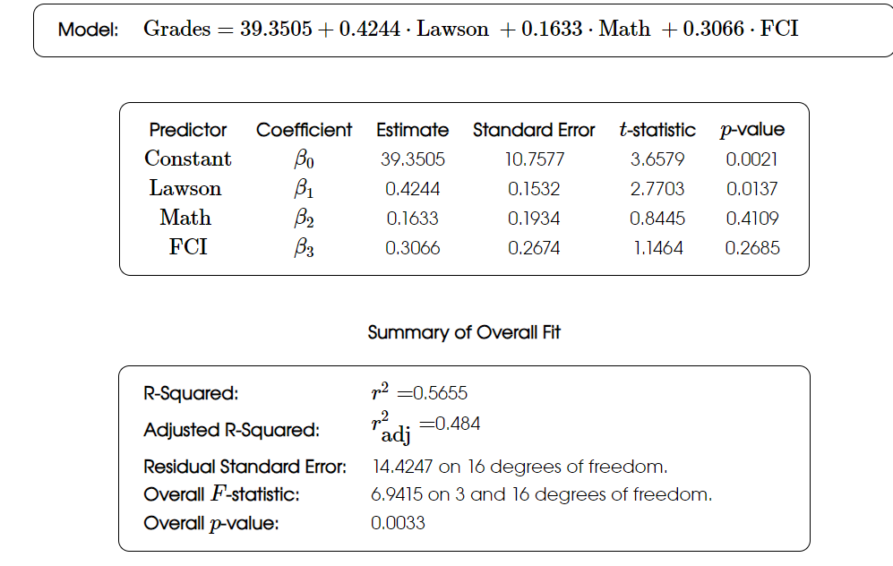
ASU-P Alg-1 2023(b): Top and bottom grade quartiles only (N = 20)
Only Lawson significant? (small sample)

Slide 59
Important Note
Motivational factors can also be highly influential, in some cases overcoming the “disadvantages” revealed by low pretest scores.

Slide 60
Summary
Numerous factors influence students’ physics course performance
Relative weight of calculational skill, reasoning, and physics concept knowledge may vary from class to class
Our results are consistent with findings reported by:
L. Ding, PRPER 10, 023101 (2014)]
Salehi et al., PRPER 15, 020114 (2019)
Stewart et al., PRPER 17, 010107 (2021)

