Slide 1
The Internees Speak:
Remembrances of Jerome and Rohwer
Walter Imahara and David E. Meltzer

Slide 2




2022
2025

Slide 3
Jerome and Rohwer (2022): First book-length collection of remembrances by former Jerome and Rohwer internees and their families
Remembrances of the Japanese American Internment Camps, 1942-1945 (2025): Remembrances by former internees of nine of the 10 internment centers, along with their families and associates

Slide 4
Timeline for Jerome-Rohwer
2019: Imahara begins to solicit stories from friends and acquaintances who were interned in the camps; expands search to participants in the annual Pilgimages. We edit the stories and assemble them into manuscript form.
January 2020: We contact University of Arkansas Press to see if they might be interested in publishing “a manuscript that [we] believe to be an unusual--if not unique--historical document related to Arkansas during the Second World War.”
March 2020: Letter from the Editor-in-Chief: “The University of Arkansas Press would be honored to publish this collection as part of its ongoing effort to bring awareness, reconciliation, and humanity to both the injustice and the perseverance of the Japan American community that survived this experience.” Formal contract signed April 8th.

Slide 5
Timeline for Jerome-Rohwer
2020-2022: Lengthy editing process begins, working for complete stylistic consistency and maximum accuracy of the final printed pages. Collaboration between University of Arkansas editors and Meltzer which extends for almost two years.
December 2020: With agreement from the University of Arkansas press, Imahara and Meltzer publish special preliminary proof copies of the book for distribution to those who contributed stories and their families. Cover art by Amy Metz Hebert. All production work done “in-house” by Imahara and team; publication via Lulu self-publishing. (Not for sale to the public.)

Slide 6


Slide 7
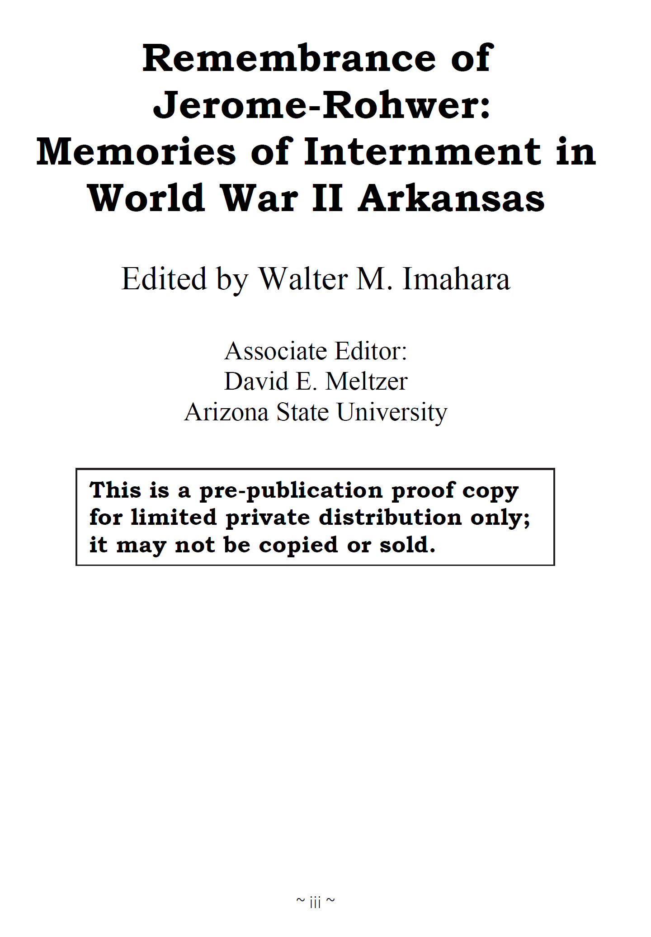
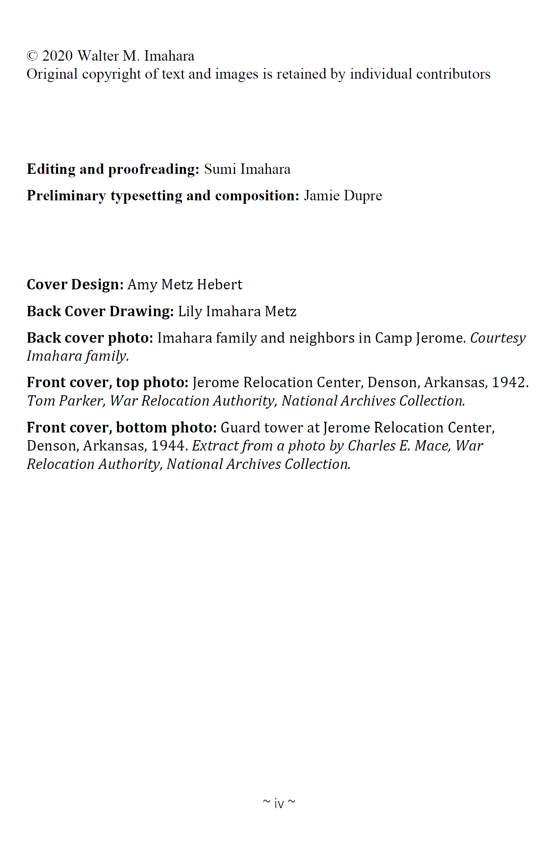

Slide 8
Timeline for Jerome-Rohwer
February 2022: Jerome and Rohwer is published by The University of Arkansas Press.

Slide 9
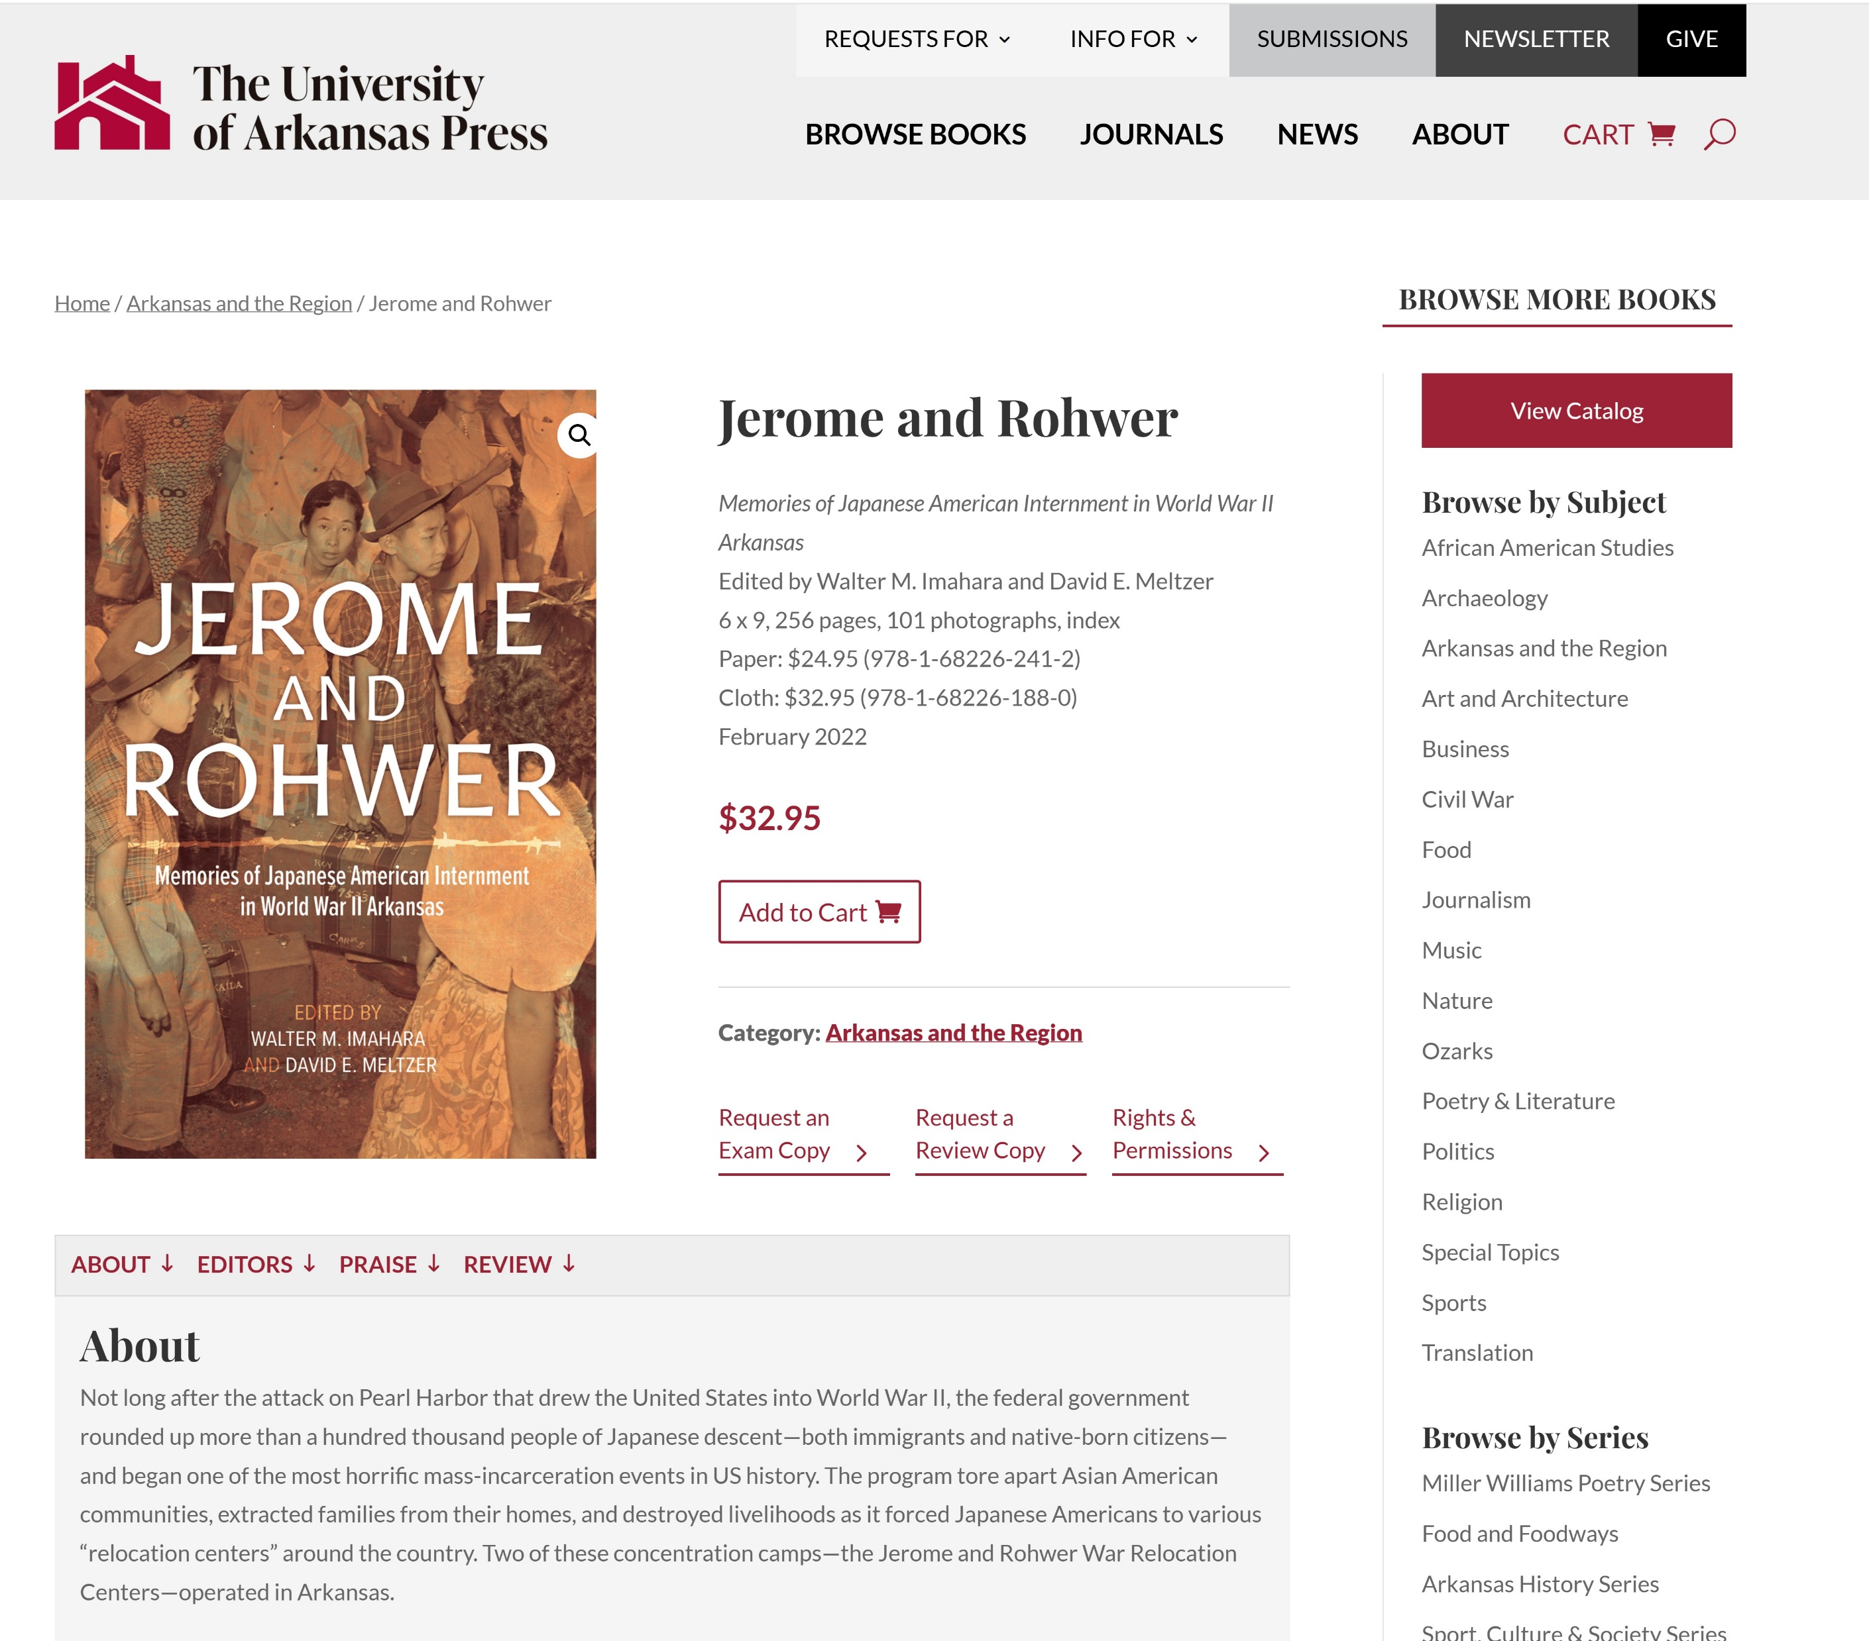

Slide 10

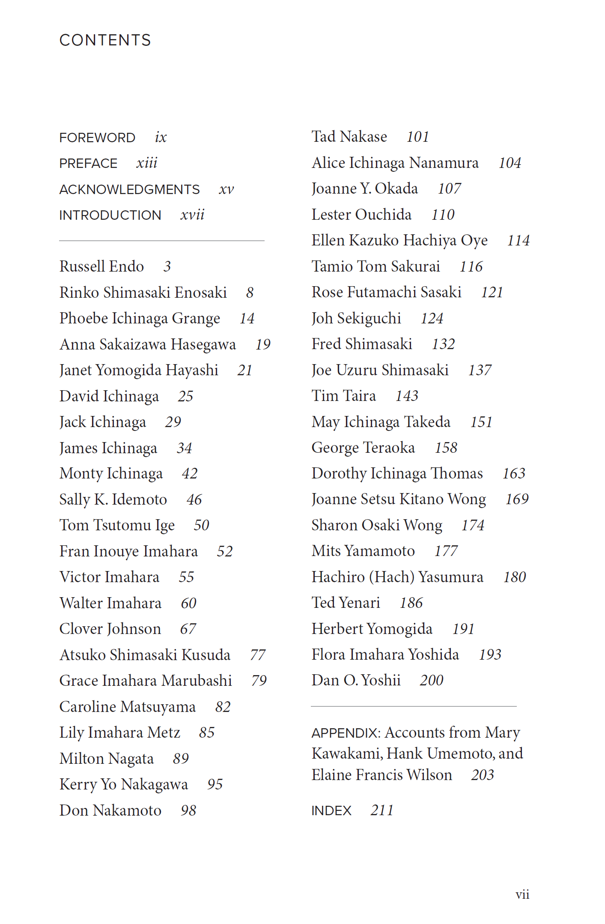

Slide 11
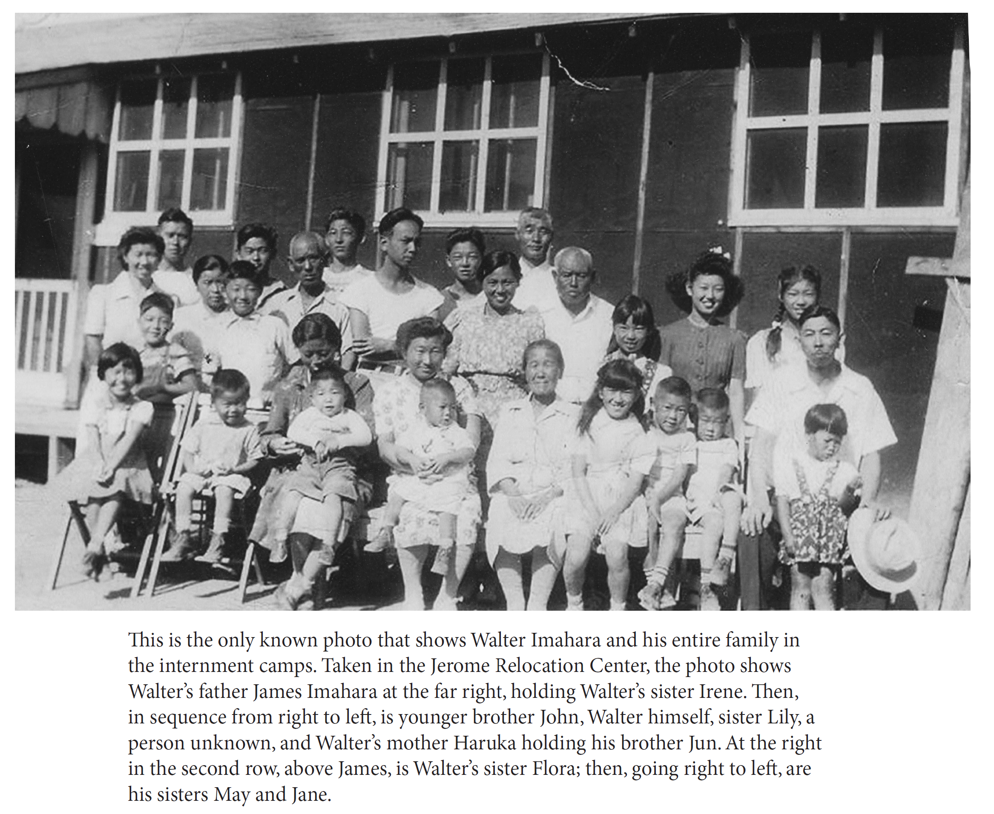

Slide 12
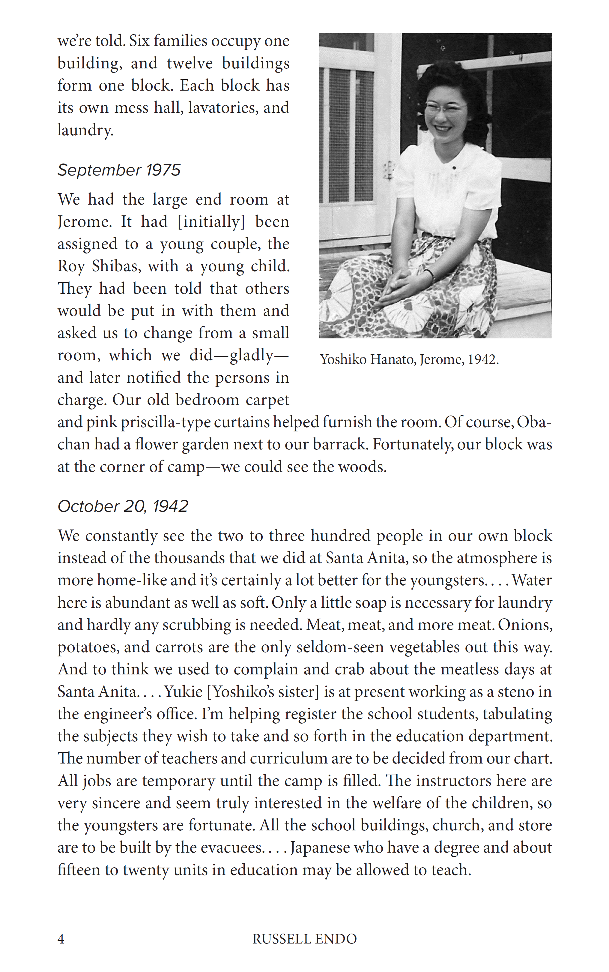
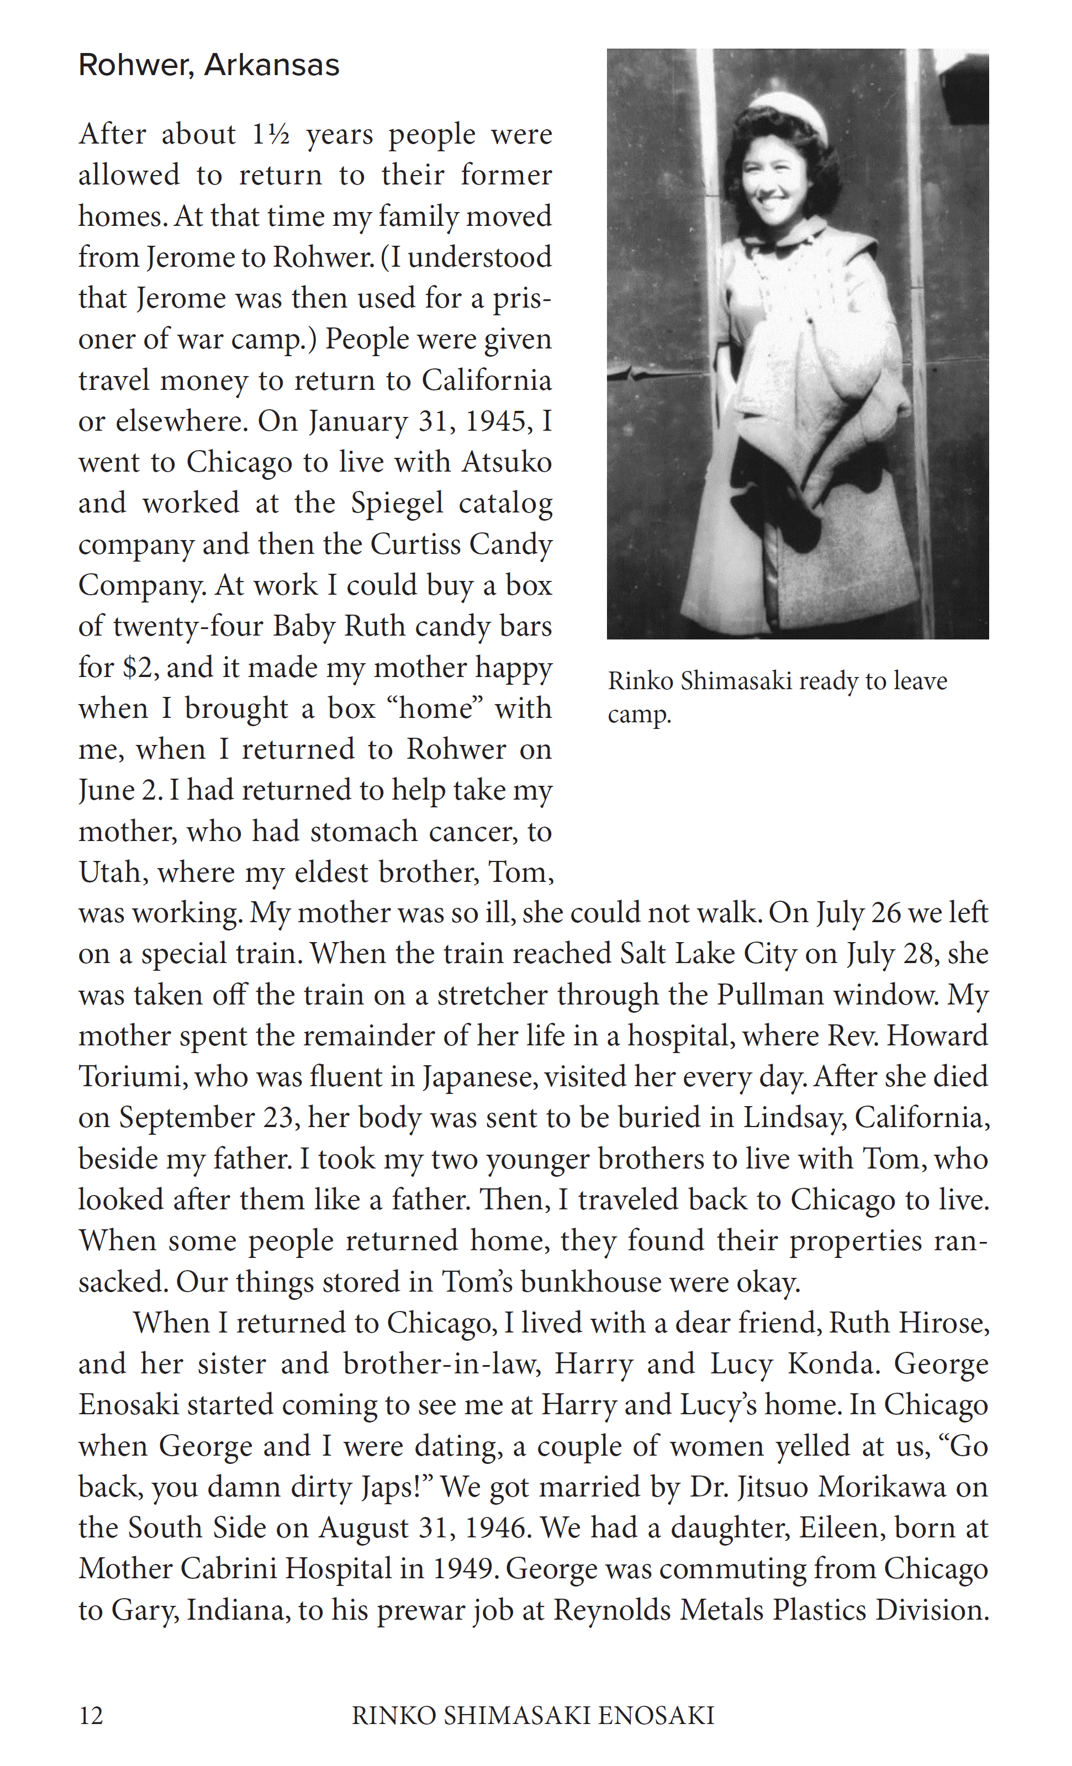

Slide 13
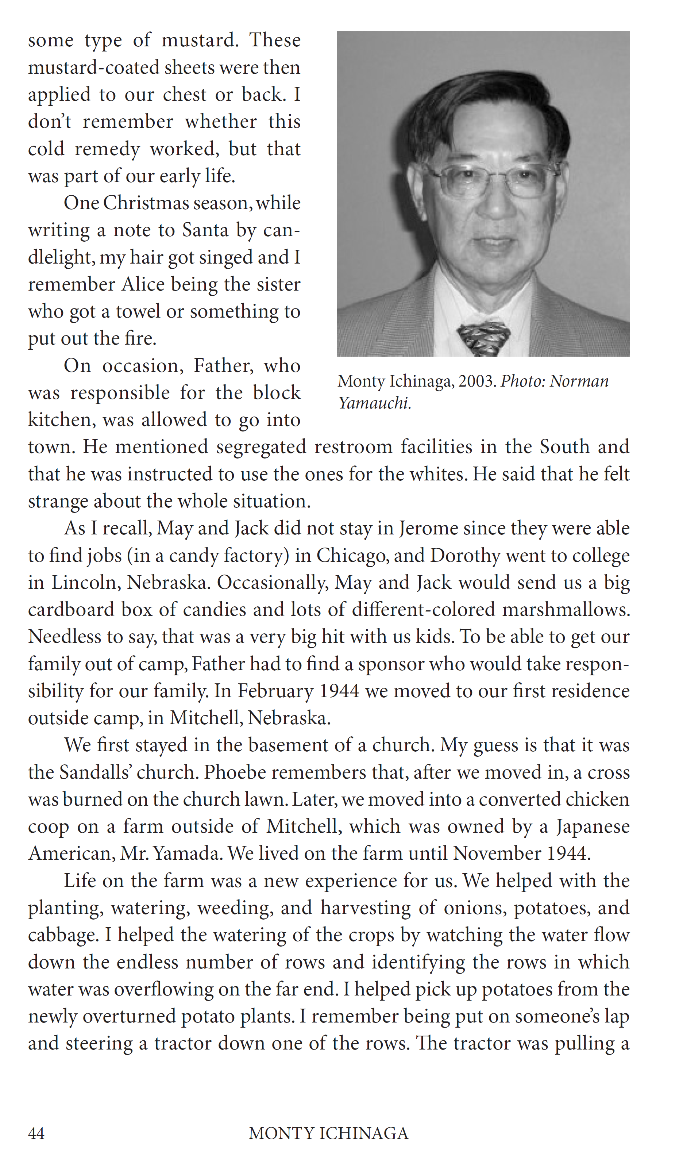
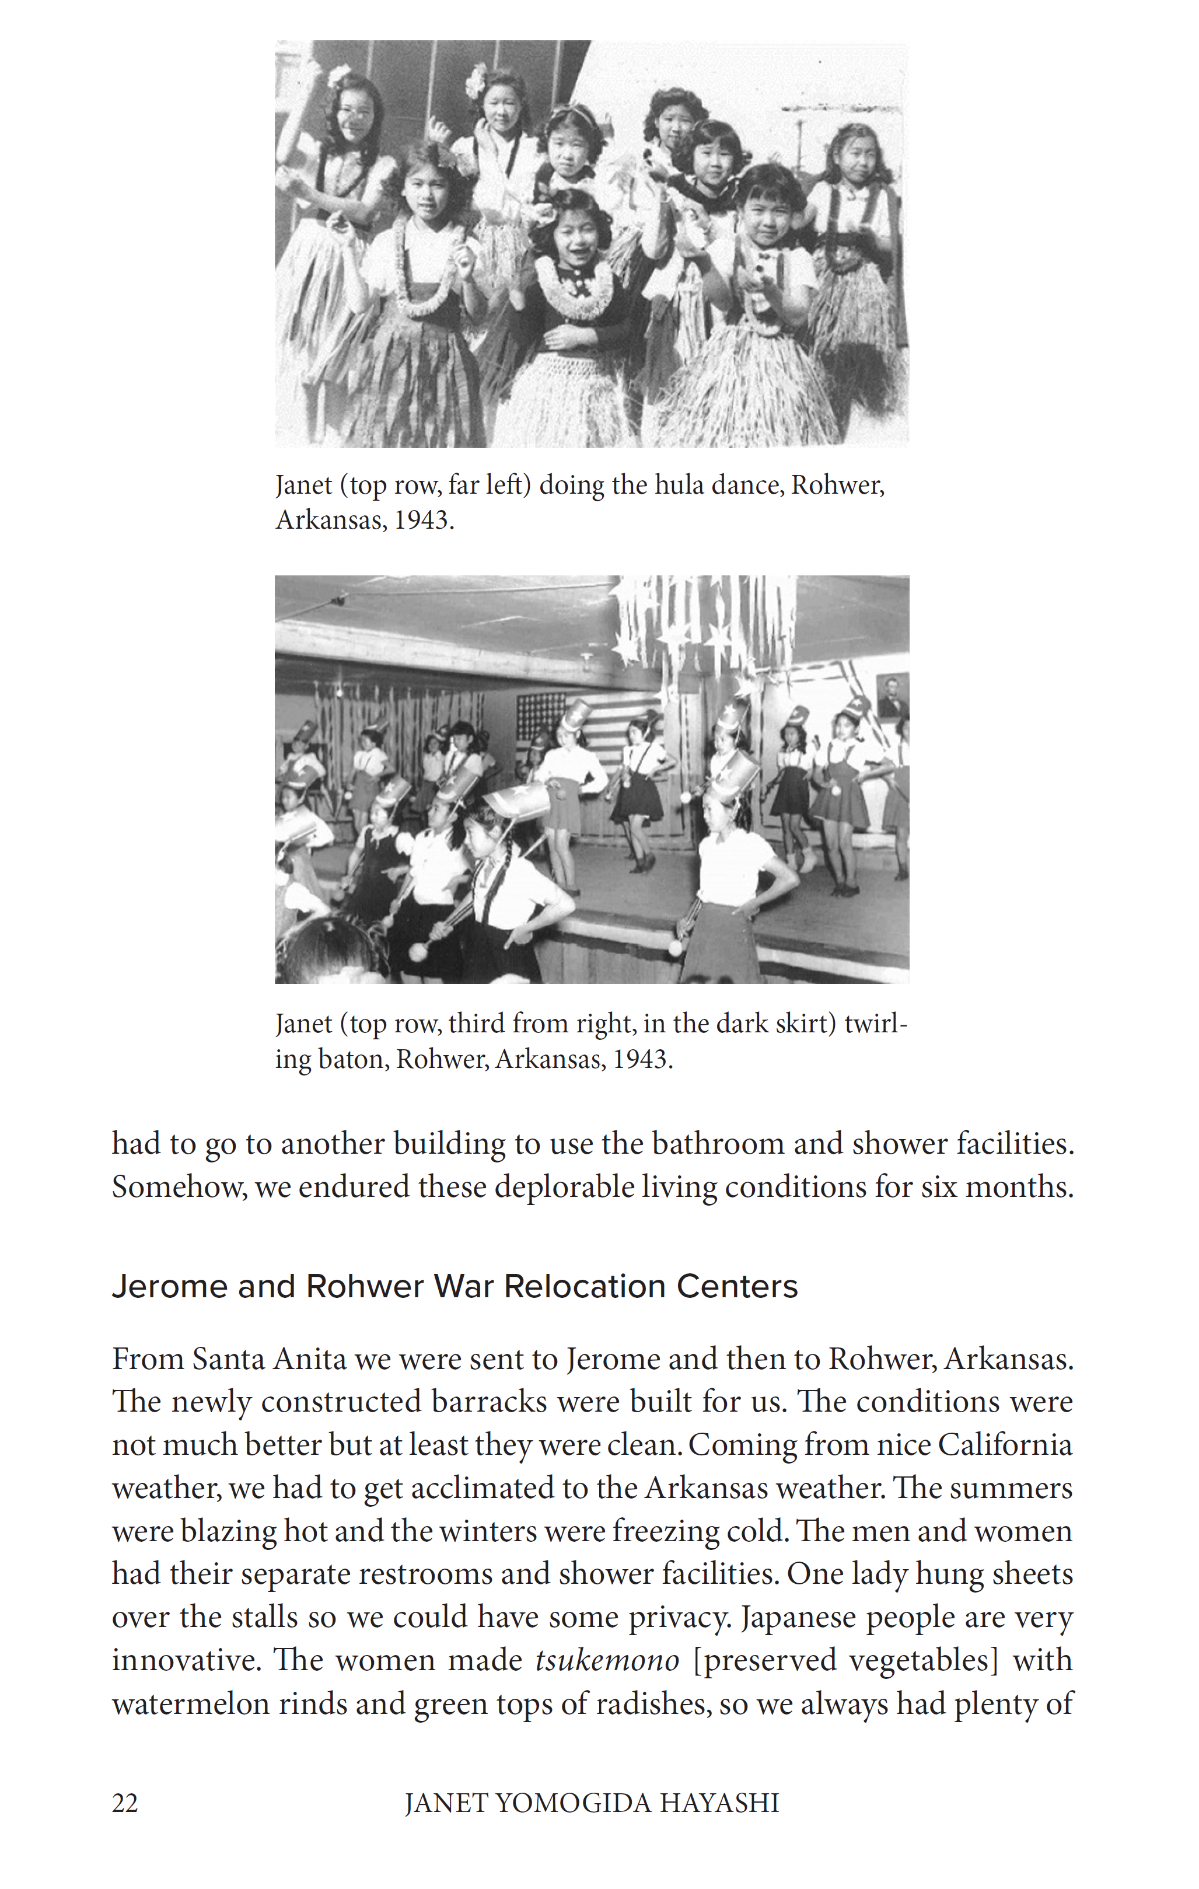

Slide 14
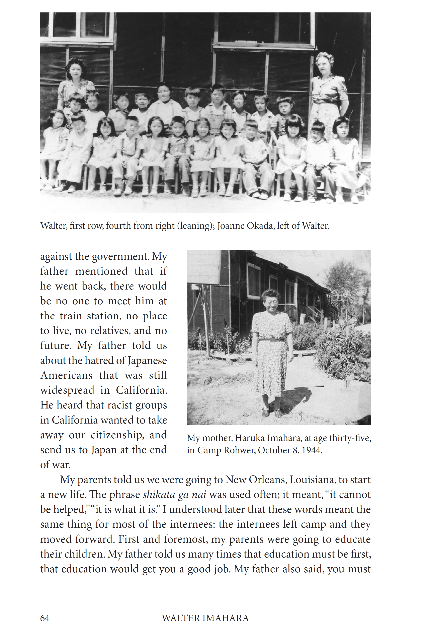
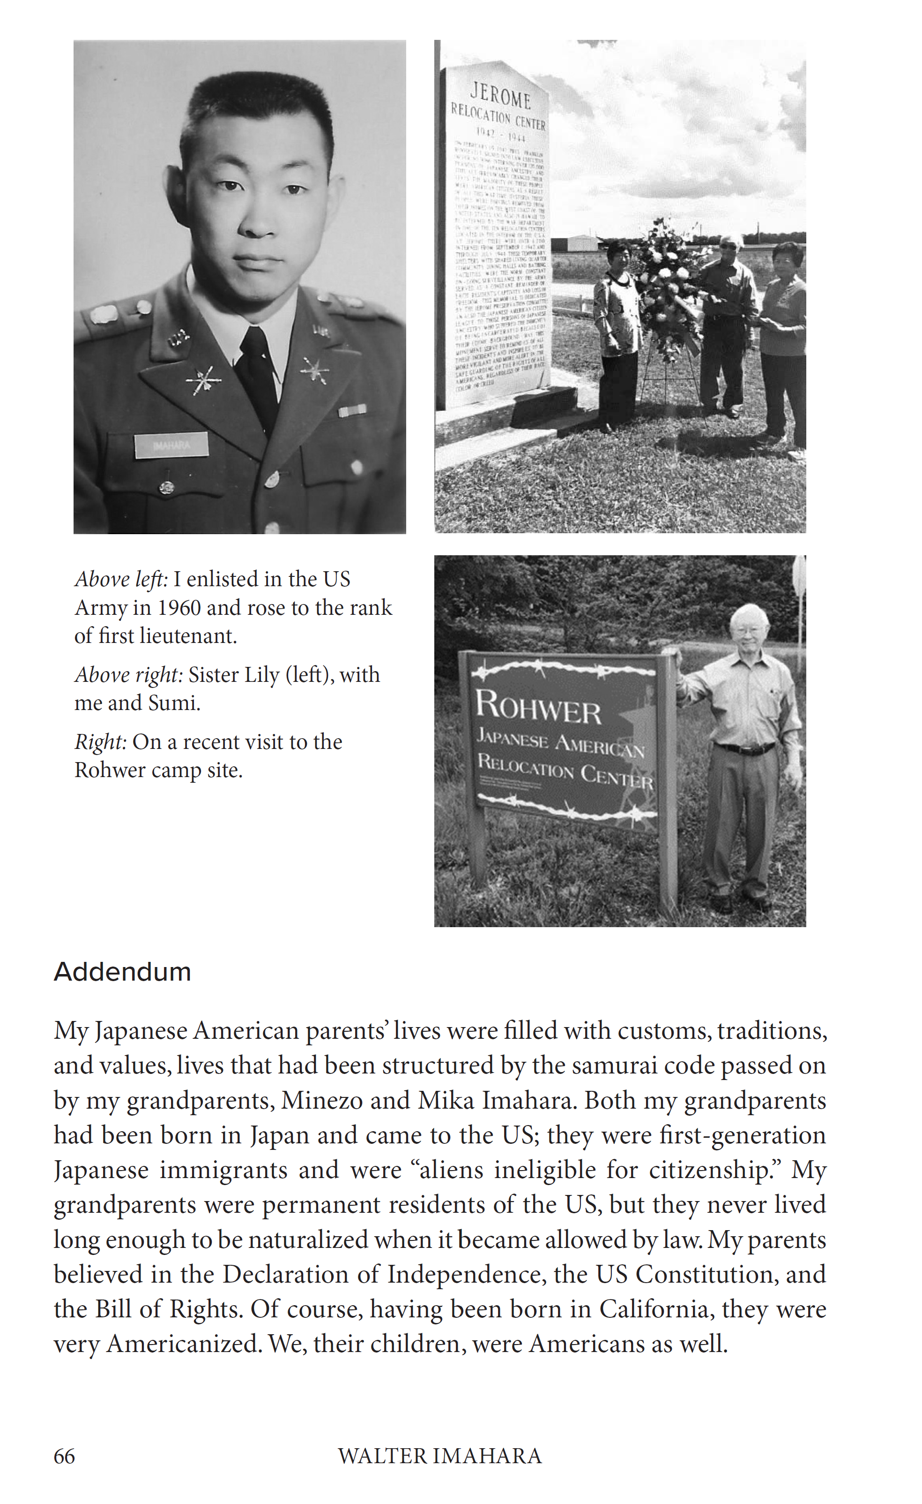

Slide 15
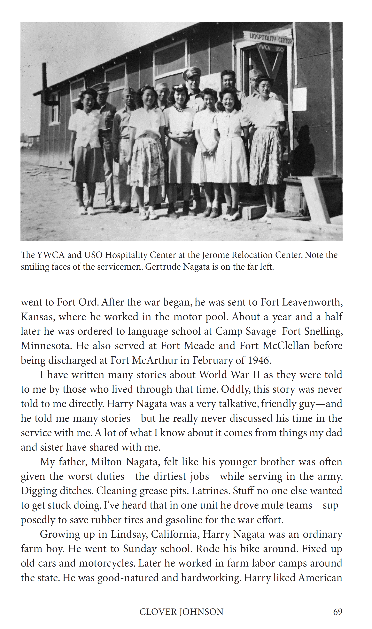
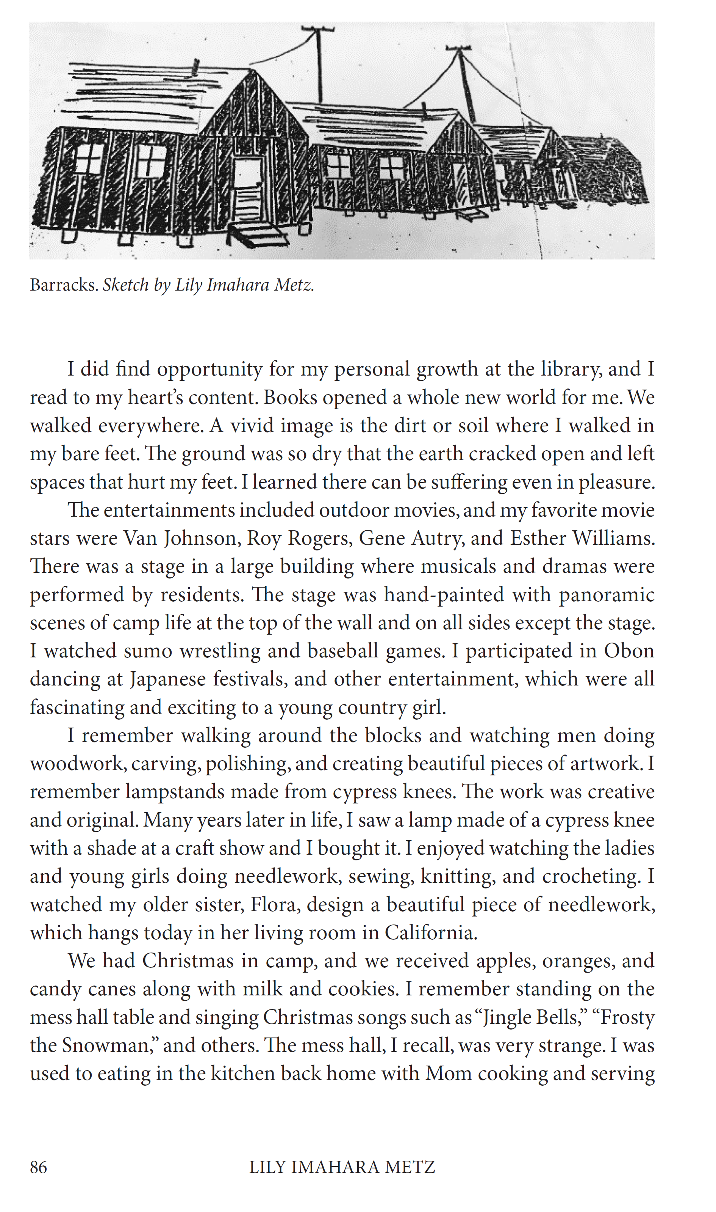

Slide 16
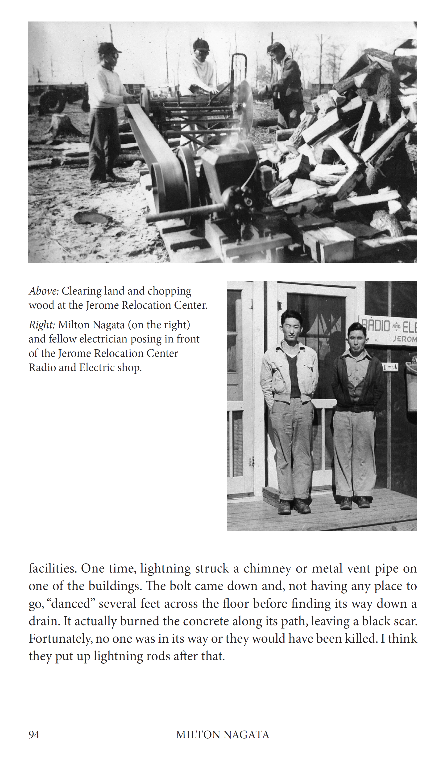
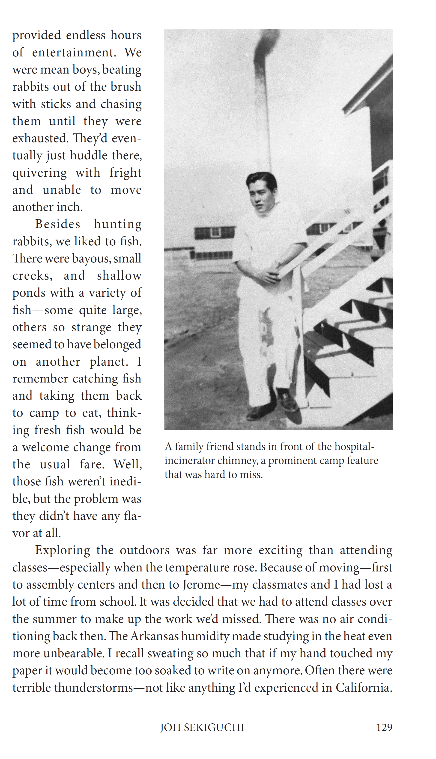

Slide 17
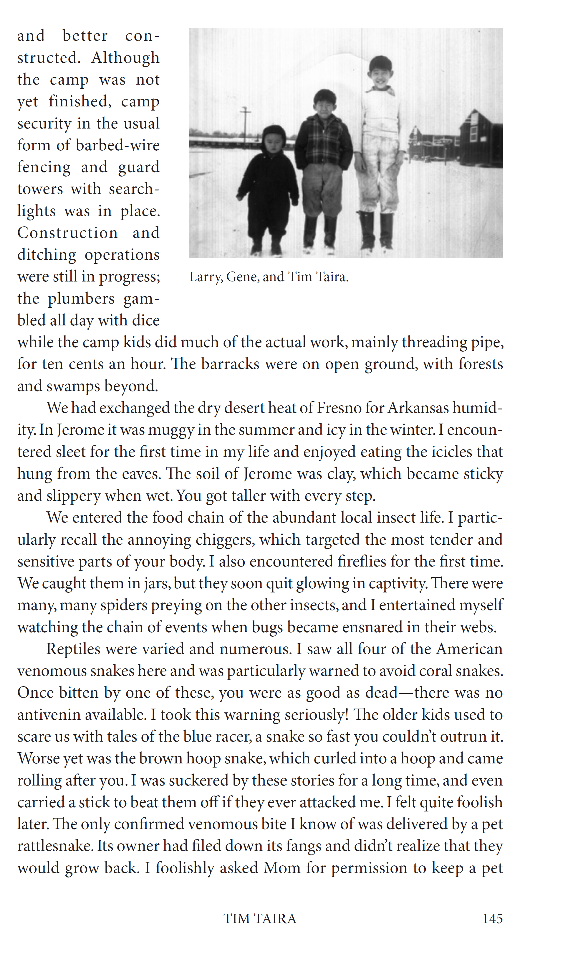
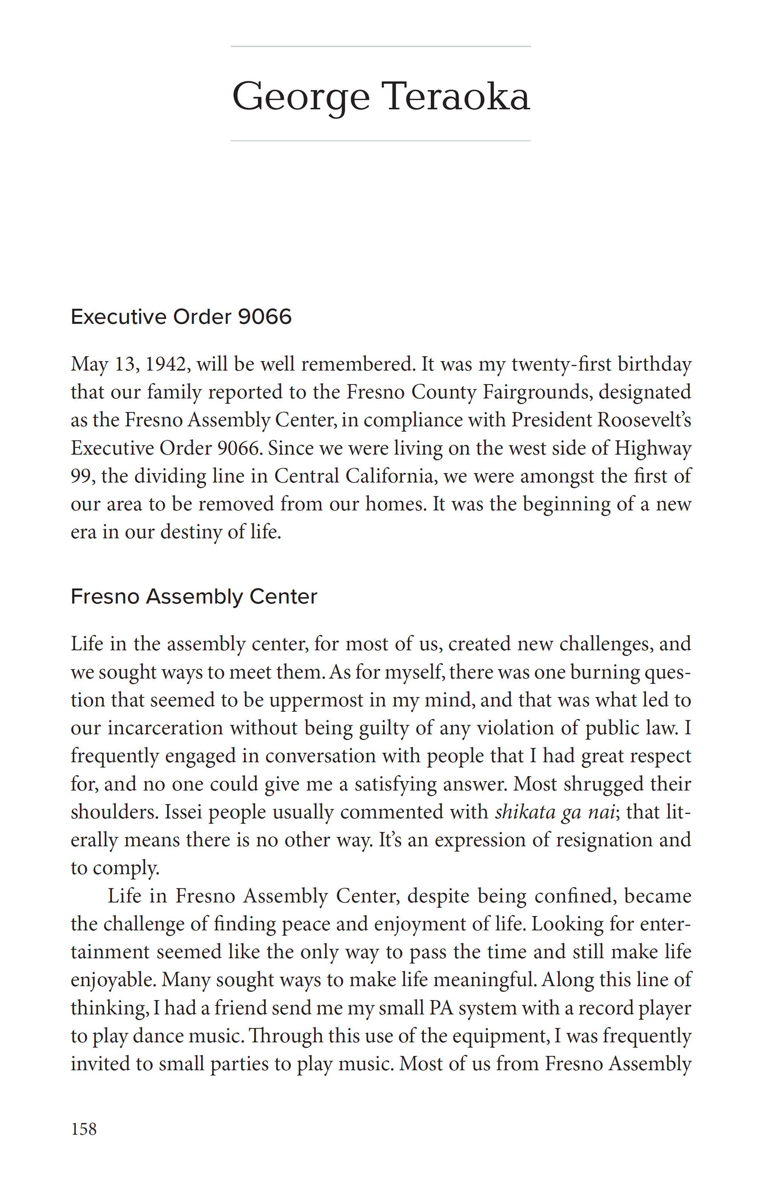

Slide 18
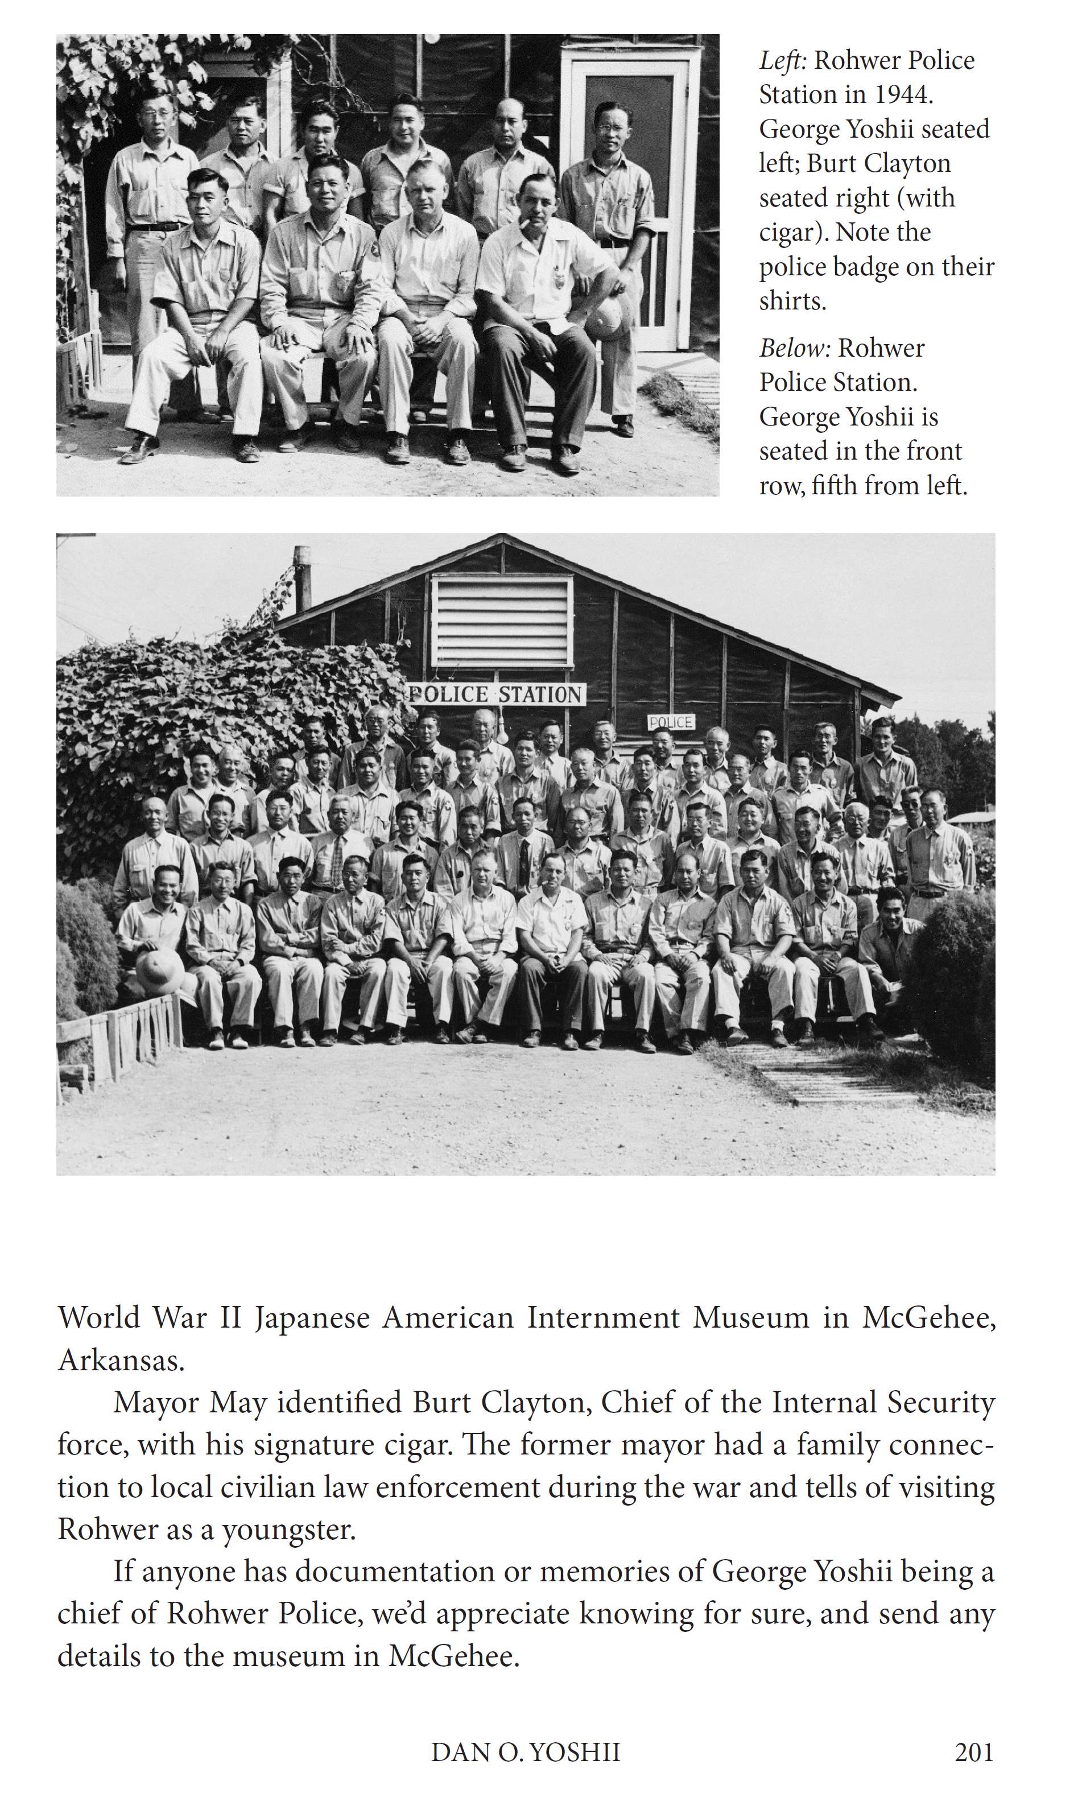
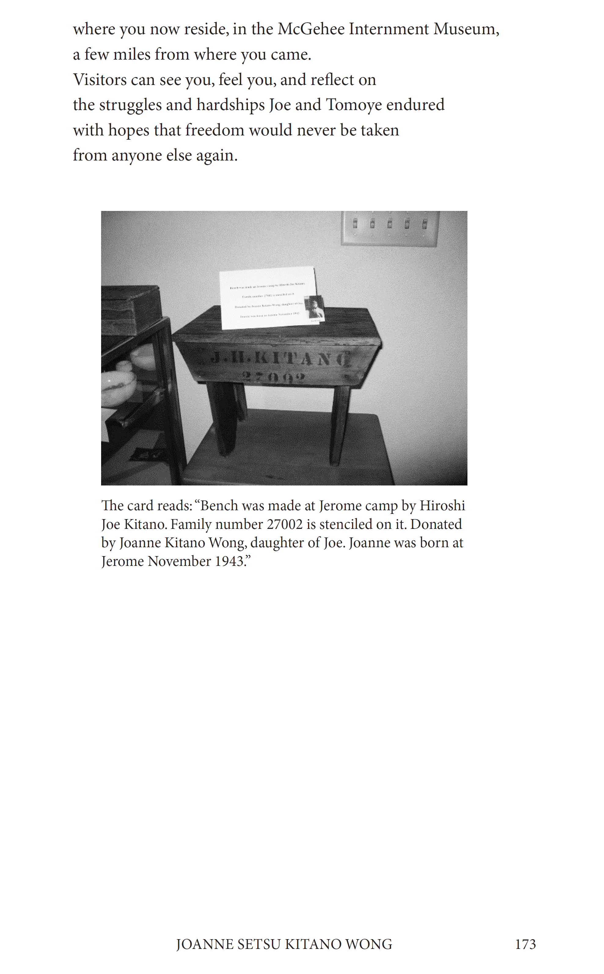

Slide 19
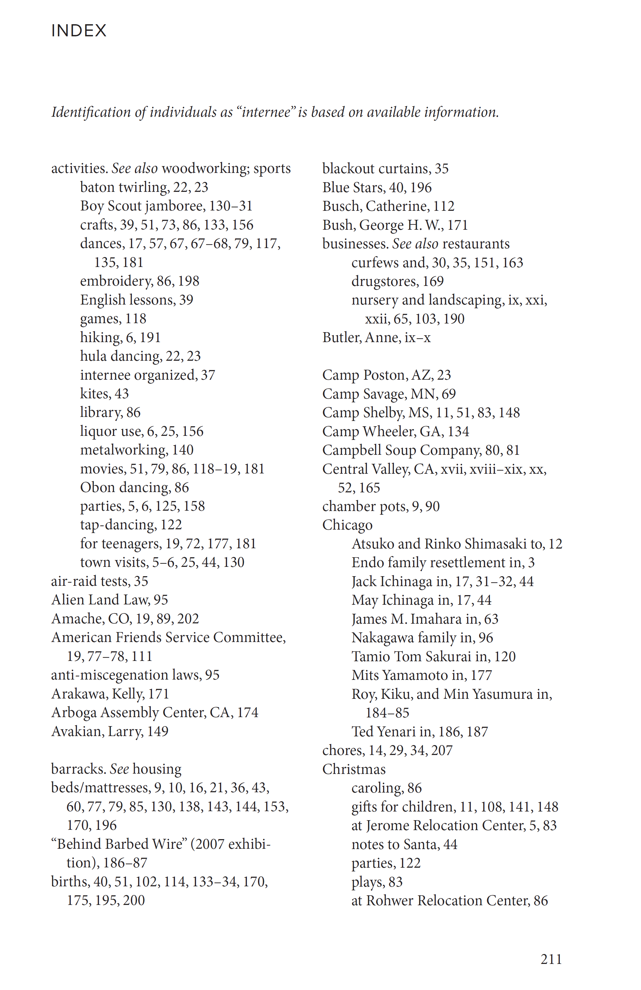
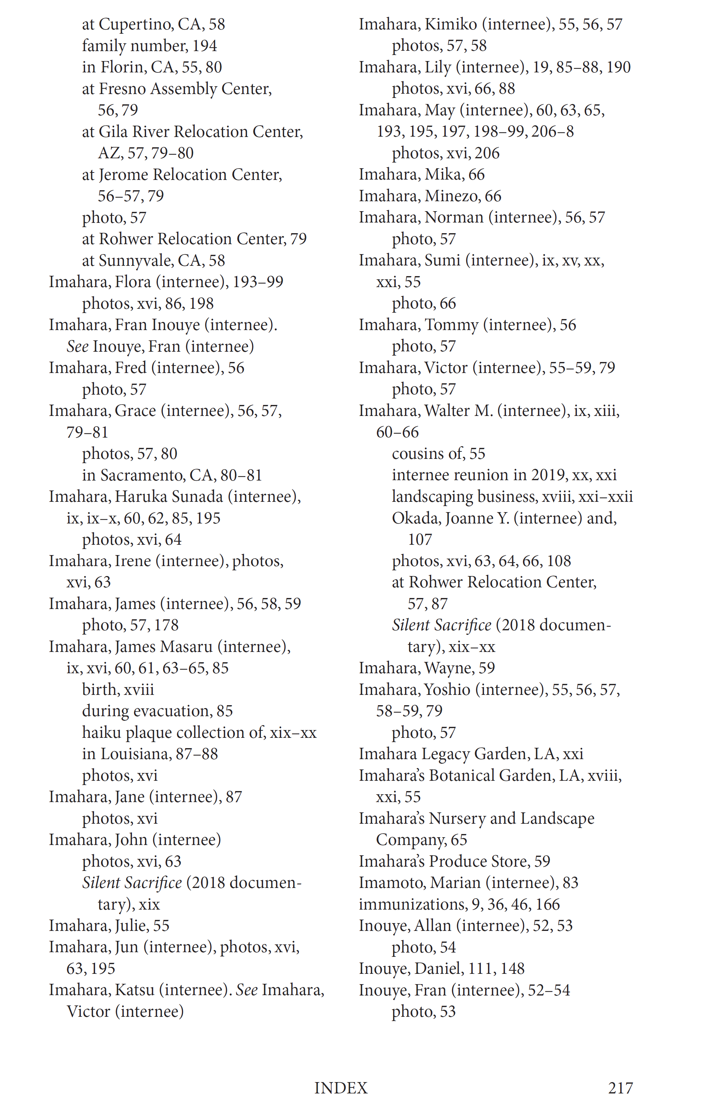

Slide 20
Phase Two: A second book gets started
Imahara begins work on new collection of stories from “all camps”
Spreads the word via the 2023 Pilgrimage participants and friends
Final publication in 2025 by Gatekeeper Press

Slide 21


Slide 23


Slide 24
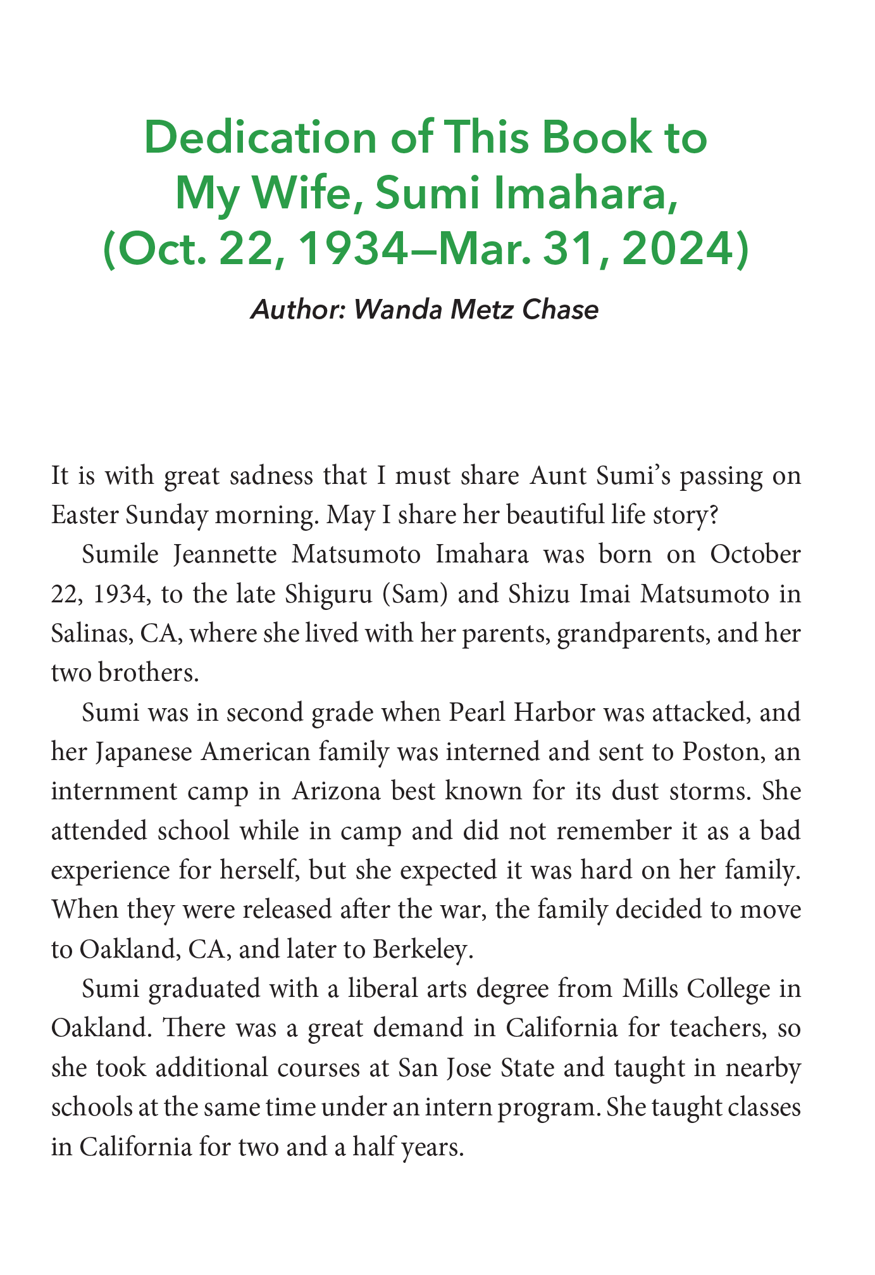

Slide 25
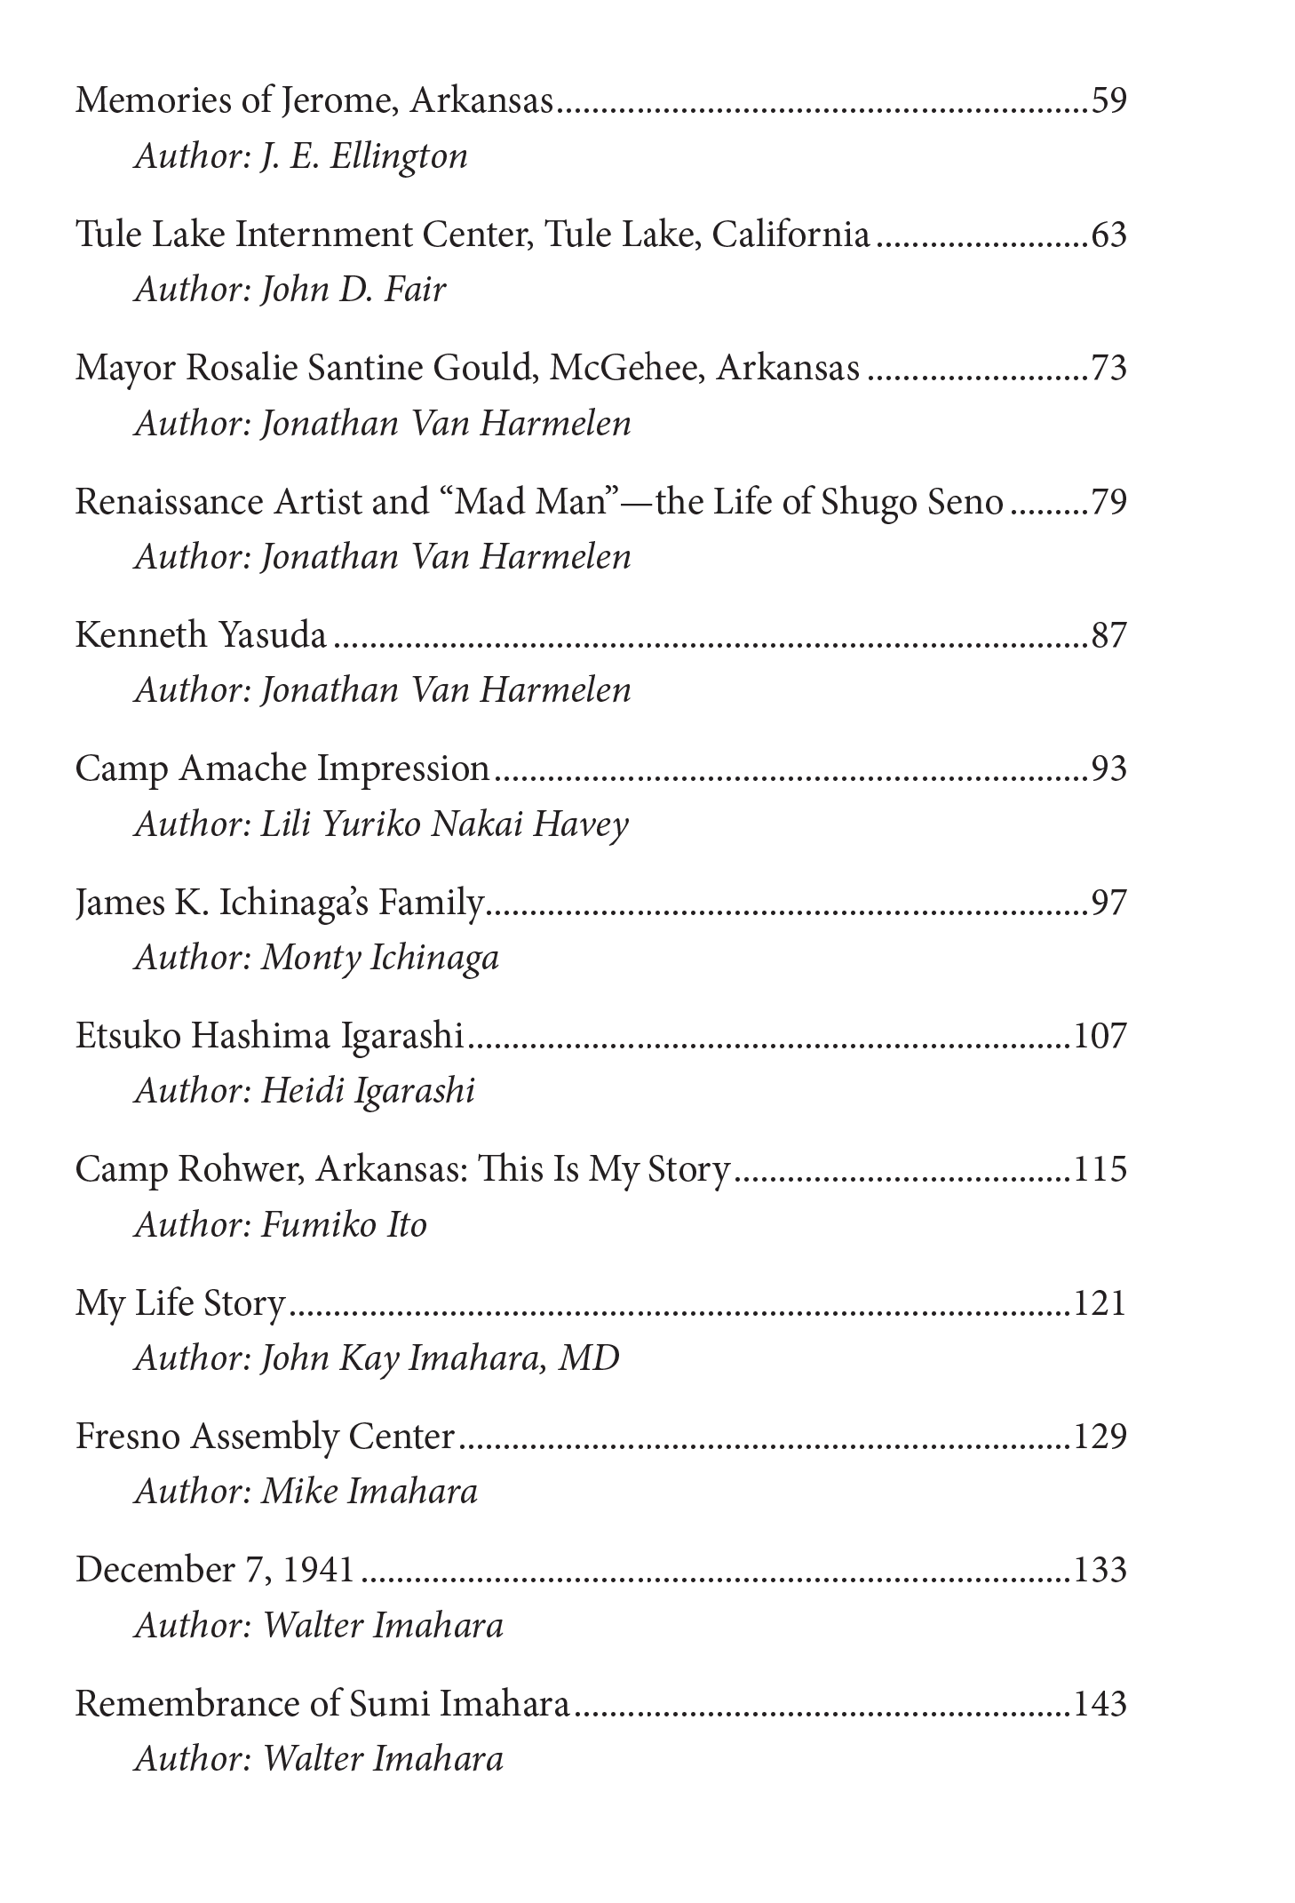
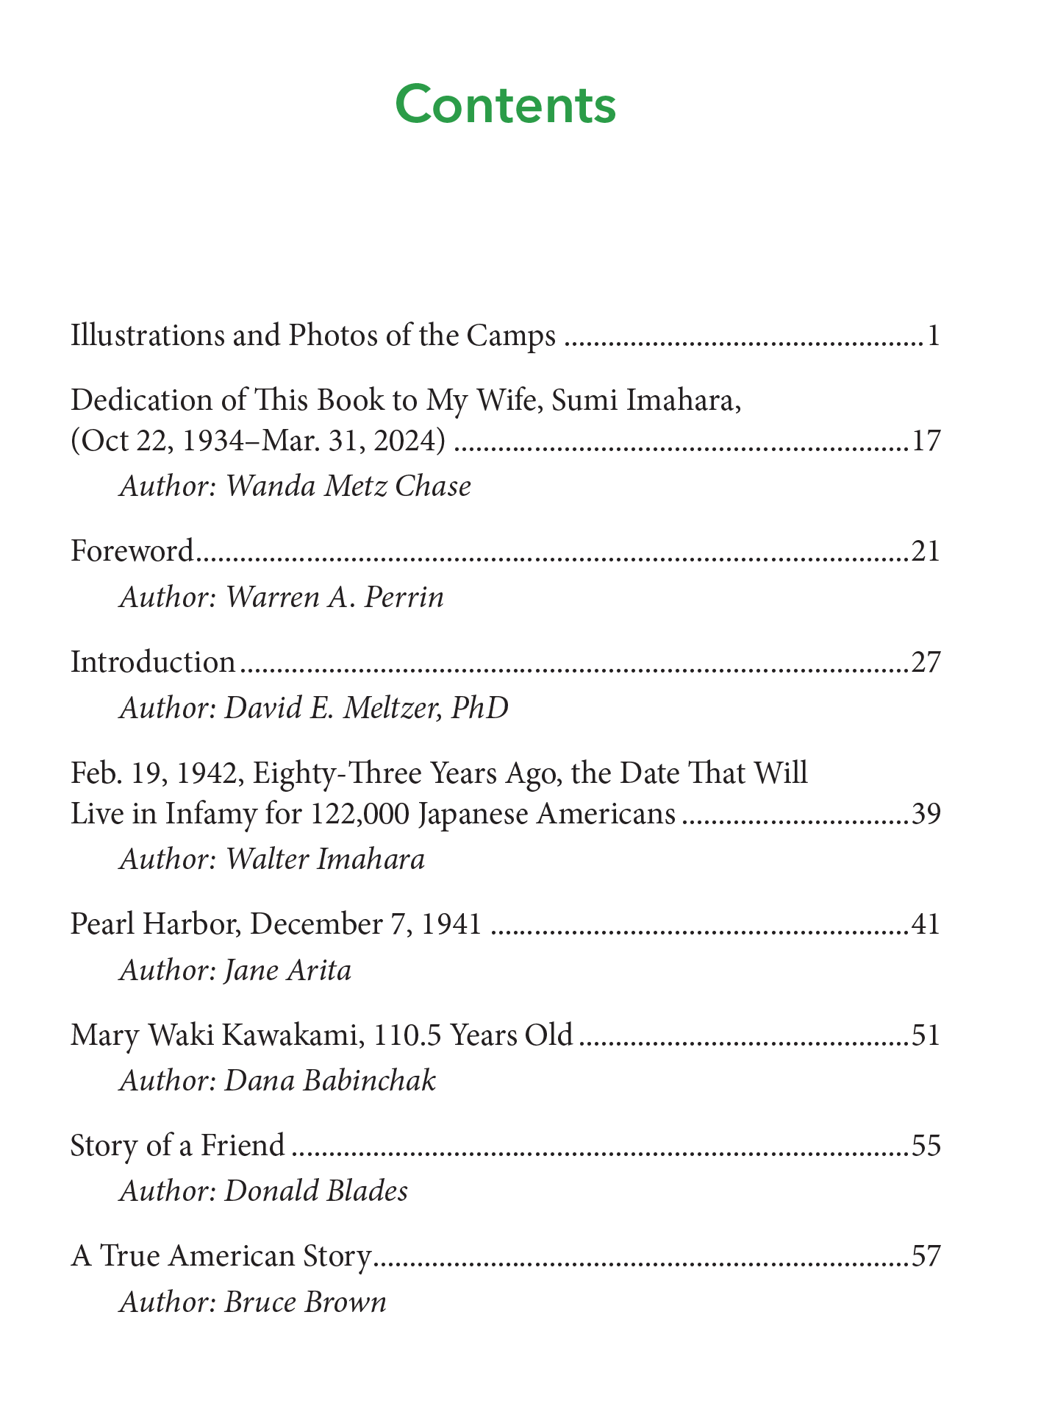

Slide 26
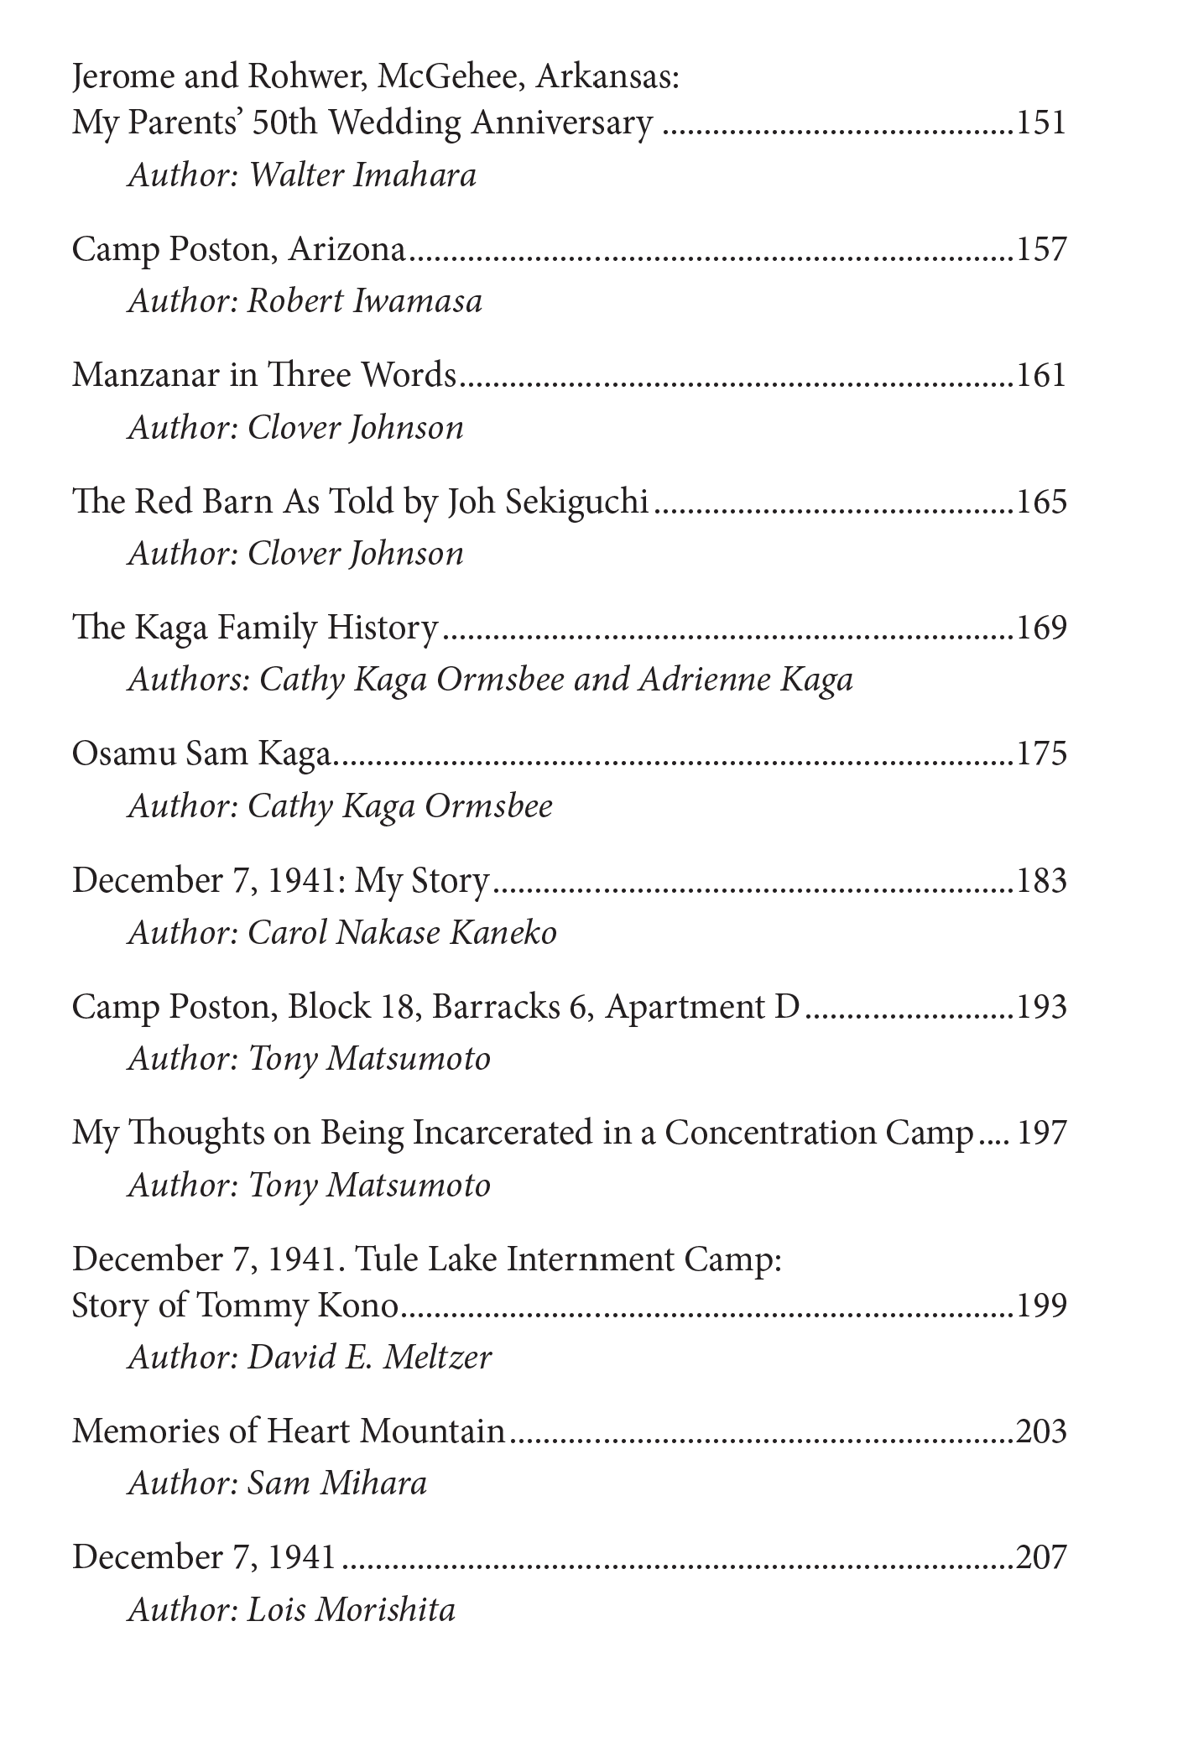


Slide 27
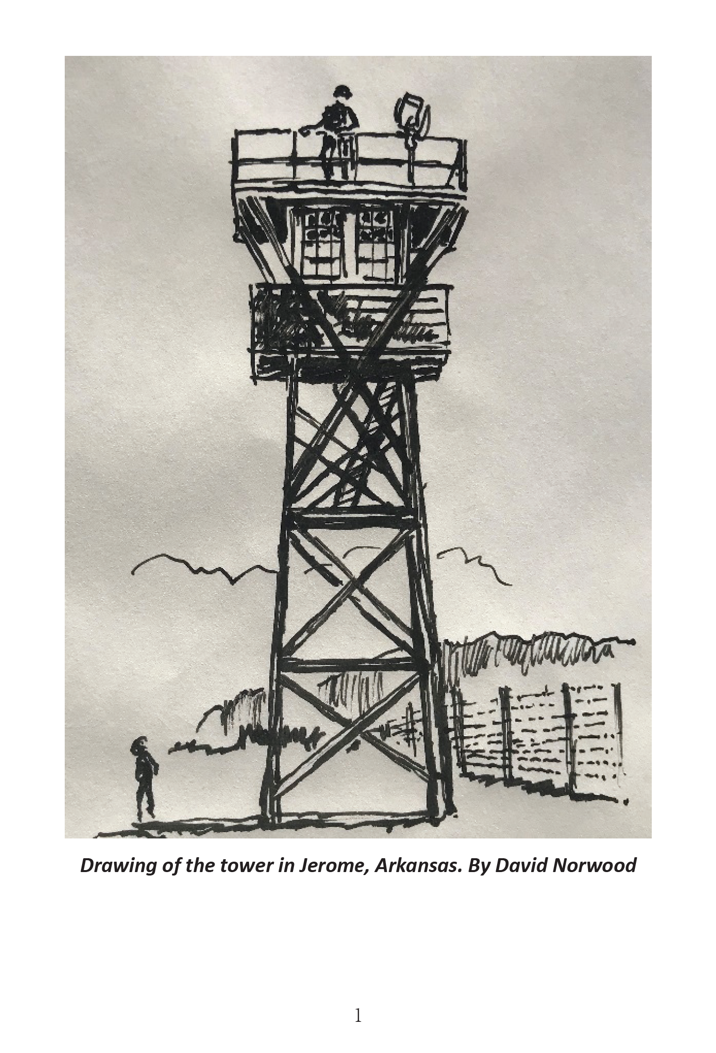


Slide 28
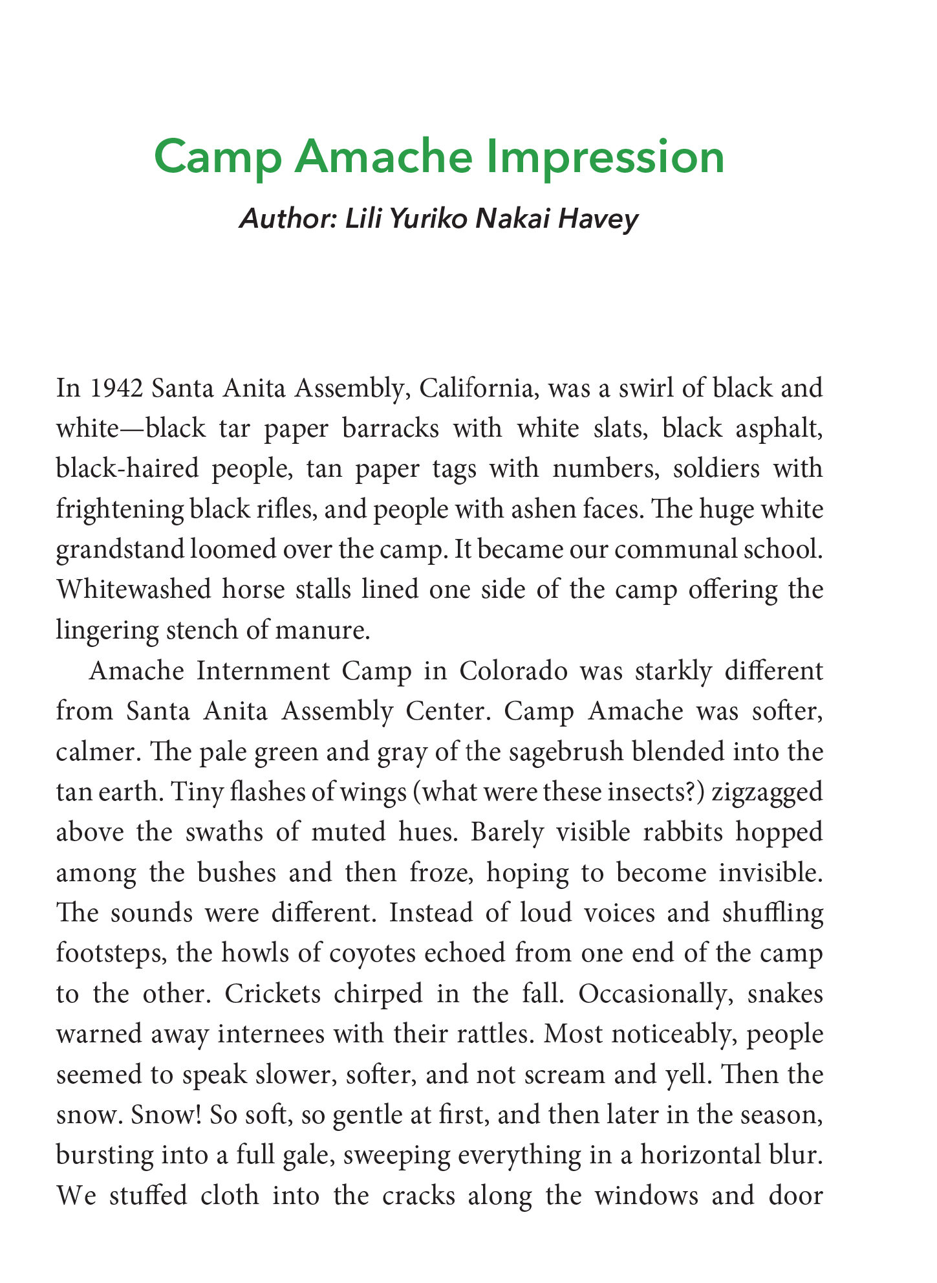
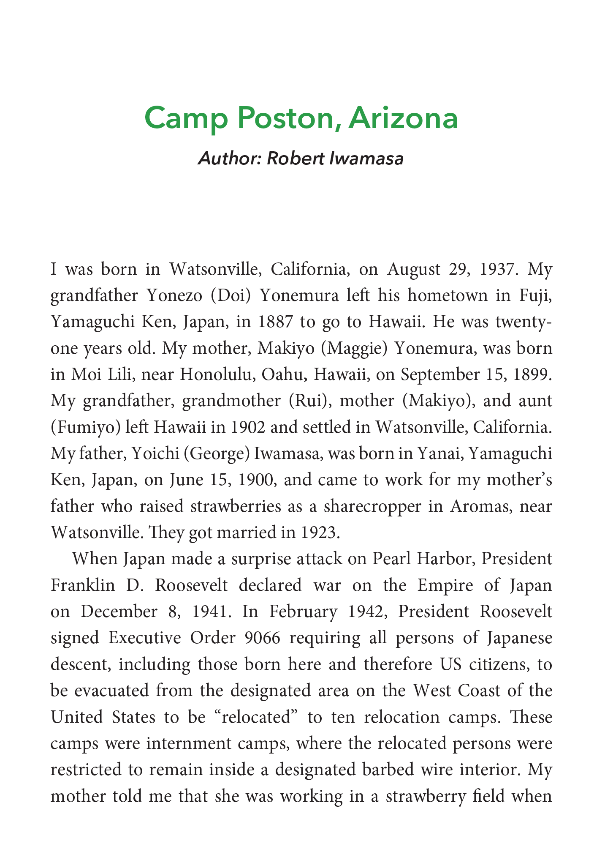

Slide 29
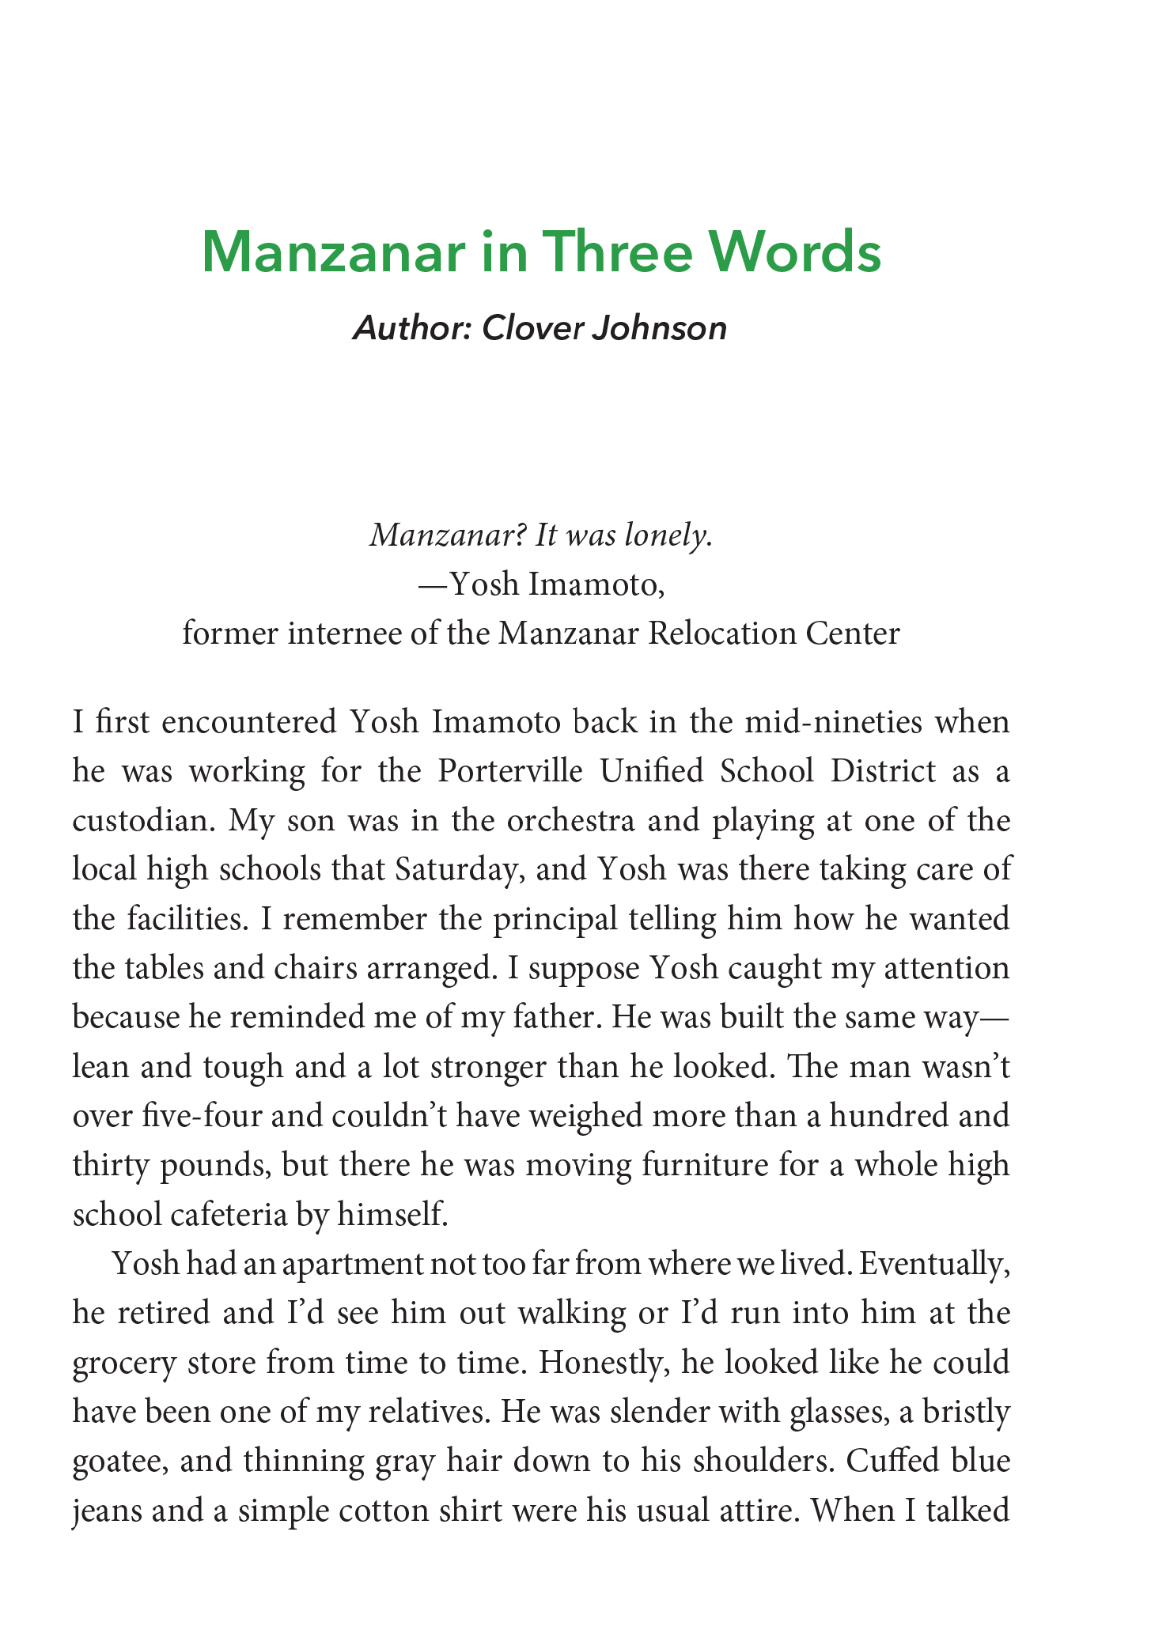
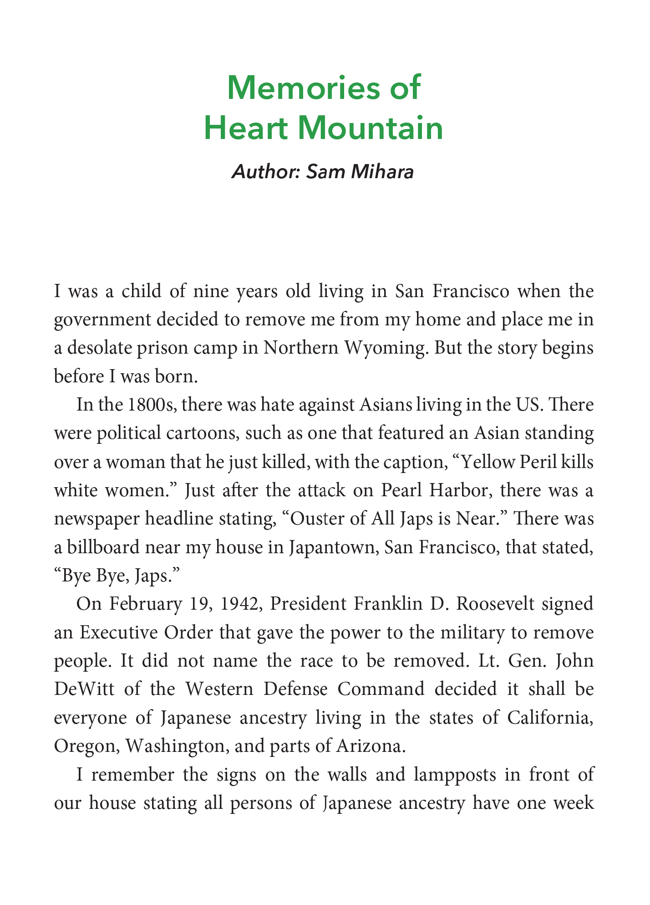

Slide 30
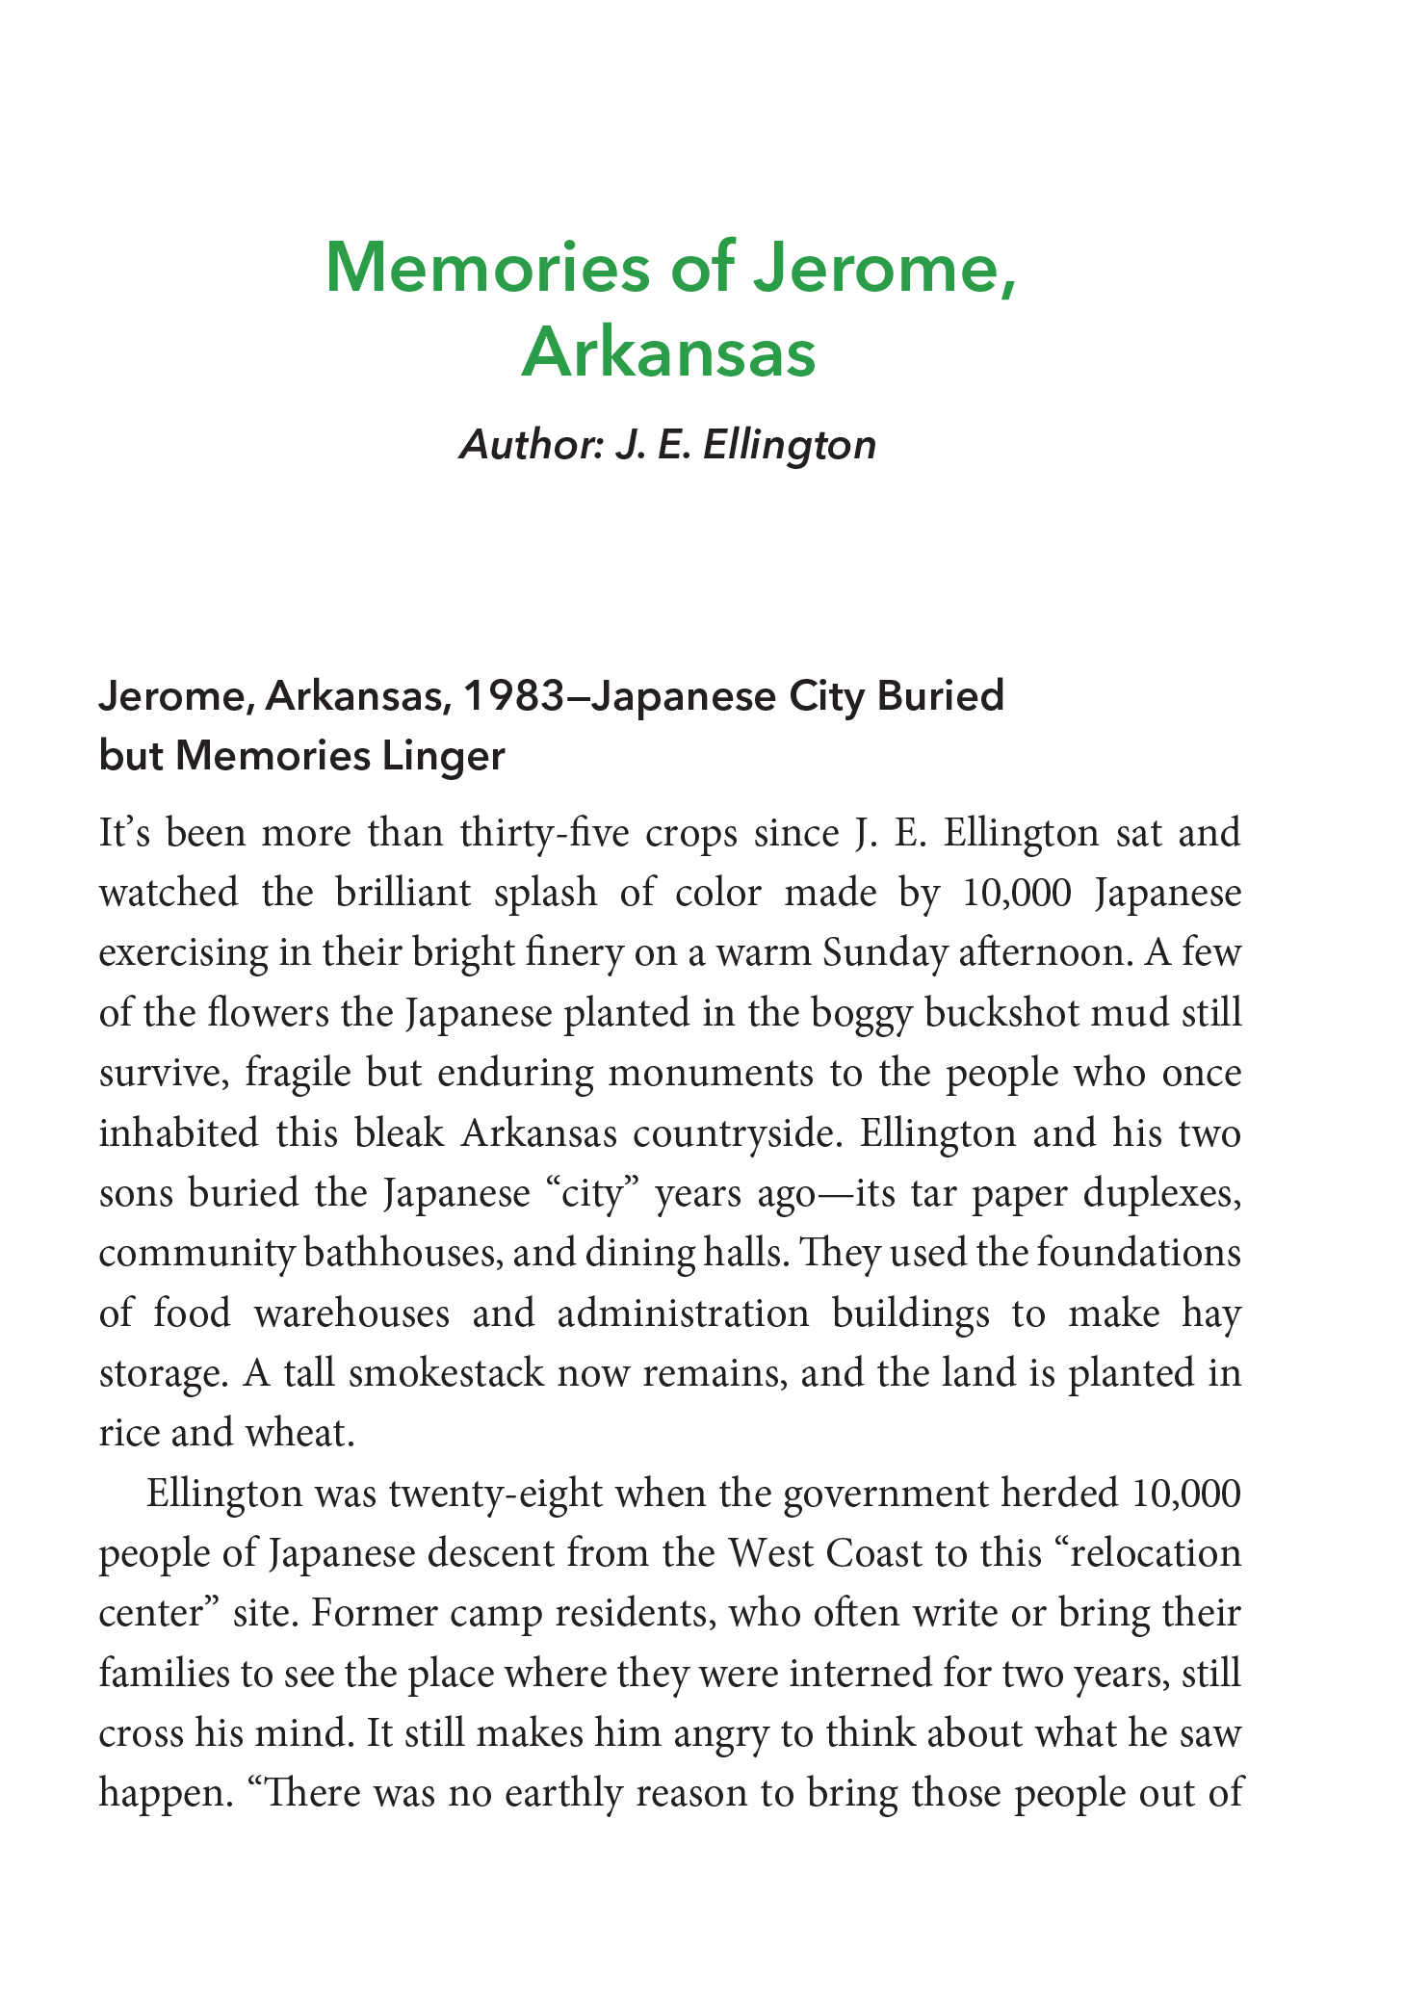
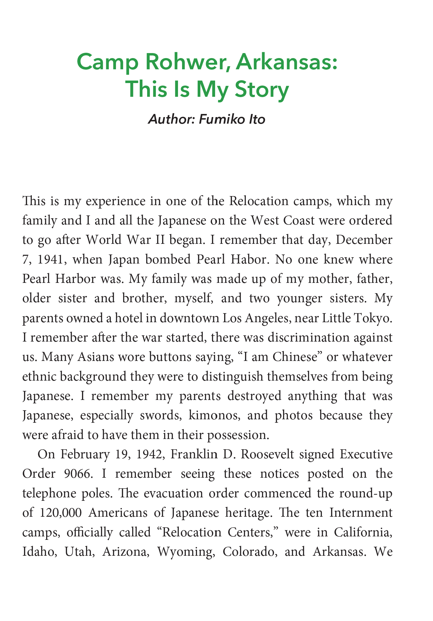

Slide 31
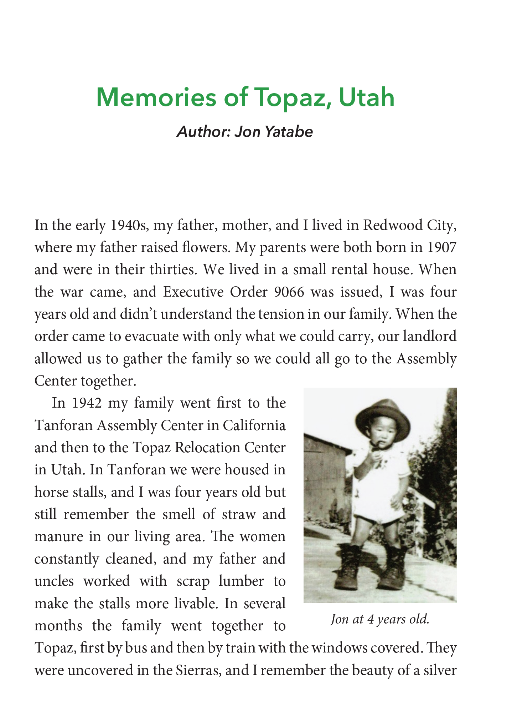
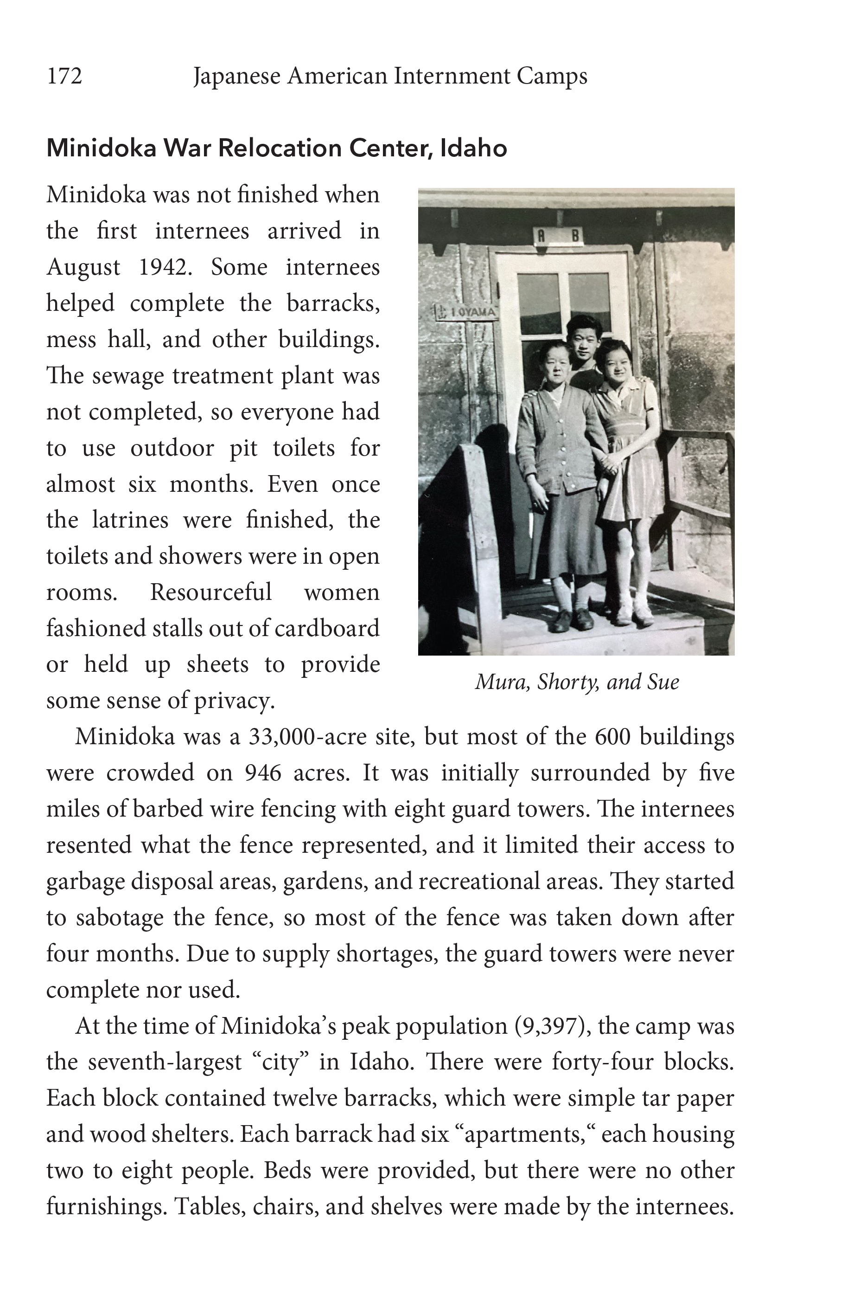

Slide 32
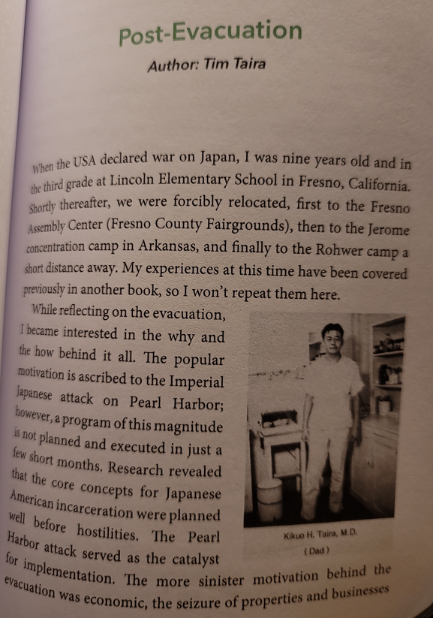
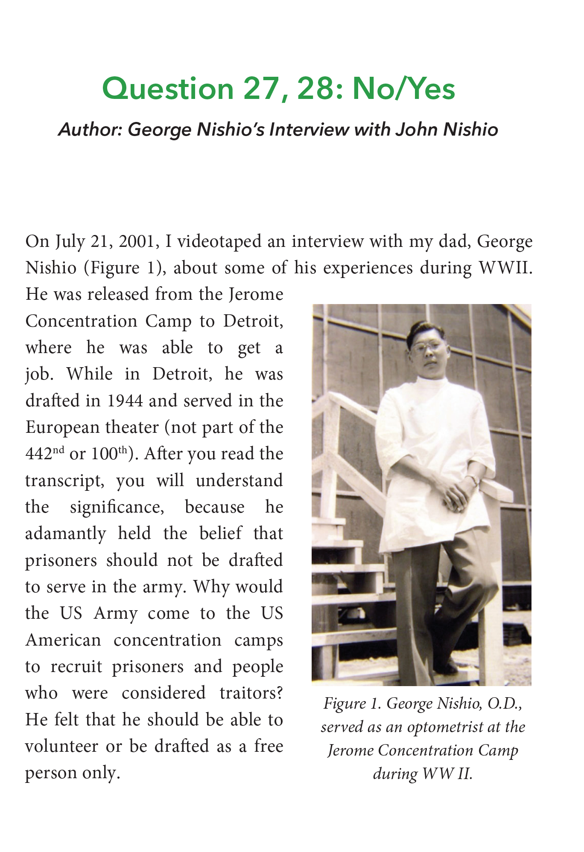

Slide 33


Slide 34
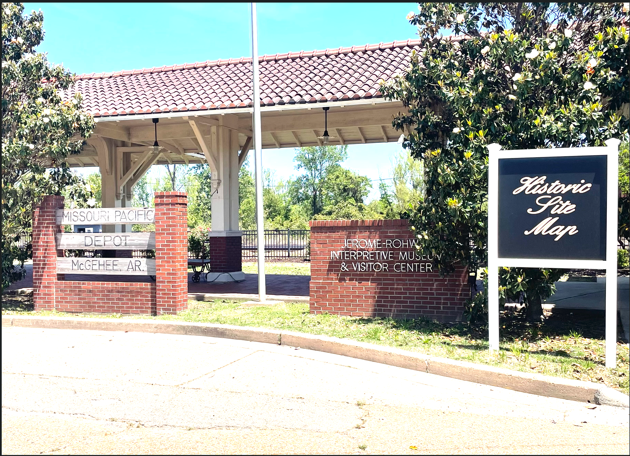
Books on sale at:
…and:

Slide 35
