Slide 1
Physics Students’ Difficulties with Introductory Mathematics
David E. Meltzer and Dakota H. King
Arizona State University
Supported in part by NSF DUE #1504986 and #1914712

Slide 2
Outline
Weak skills with basic pre-college mathematics can severely impact physics students’ course performance
We have explored the nature and prevalence of physics students’ difficulties with elementary mathematics, using “stripped-down” problems with little or no physics context

Slide 3
Work to Date
Administer (and analyze) written diagnostic quiz, given to > 4000 students in ≈ 30 algebra- and calculus-based physics classes over seven semesters at Arizona State University during 2016-2019; calculators are allowed
Carry out individual interviews with 75 students enrolled in those or similar courses during same period (Primary interviewer: Matt Jones)
Topics: trigonometry, algebra, vectors, graphing, geometry
Comparison data: University of Colorado, algebra-based course

Slide 4
Our 4 Sample Populations
PHY 111: Algebra-based; 1st semester
PHY 112: Algebra-based; 2nd semester
PHY 121: Calculus-based; 1st semester
PHY 131: Calculus-based; 2nd semester

Slide 5
Our 8 Sample Populations
PHY 111: Algebra-based; 1st semester
PHY 112: Algebra-based; 2nd semester
PHY 121: Calculus-based; 1st semester
PHY 131: Calculus-based; 2nd semester
Tempe
Poly
Tempe
Poly
Tempe
Poly
Tempe
Poly

Slide 6
Our 8 Sample Populations
PHY 111: Algebra-based; 1st semester
PHY 112: Algebra-based; 2nd semester
PHY 121: Calculus-based; 1st semester
PHY 131: Calculus-based; 2nd semester
Tempe
Poly
Tempe
Poly
Tempe
Poly
Tempe
Poly
On average, students in the Tempe courses have more extensive background and preparation (and different majors) than those in the corresponding Poly courses.

Slide 7
Our 8 Sample Populations
PHY 111: Algebra-based; 1st semester
PHY 112: Algebra-based; 2nd semester
PHY 121: Calculus-based; 1st semester
PHY 131: Calculus-based; 2nd semester
Tempe
Poly
Tempe
Poly
Tempe
Poly
Tempe
Poly

Slide 8
Our 16 Sample Populations
PHY 111: Algebra-based; 1st semester
PHY 112: Algebra-based; 2nd semester
PHY 121: Calculus-based; 1st semester
PHY 131: Calculus-based; 2nd semester
Tempe
Poly
Tempe
Poly
Tempe
Poly
Tempe
Poly
Fall
Spring
Fall
Spring
Fall
Spring
Fall
Spring
Fall
Spring
Fall
Spring
Fall
Spring
Fall
Spring

Slide 9
Our 16 Sample Populations
PHY 111: Algebra-based; 1st semester
PHY 112: Algebra-based; 2nd semester
PHY 121: Calculus-based; 1st semester
PHY 131: Calculus-based; 2nd semester
Tempe
Poly
Tempe
Poly
Tempe
Poly
Tempe
Poly
Fall
Spring
Fall
Spring
Fall
Spring
Fall
Spring
Fall
Spring
Fall
Spring
Fall
Spring
Fall
Spring
Each of the 16 sample populations has distinct and consistent differences from all of the others!

Slide 10
Our 16 Sample Populations
PHY 111: Algebra-based; 1st semester
PHY 112: Algebra-based; 2nd semester
PHY 121: Calculus-based; 1st semester
PHY 131: Calculus-based; 2nd semester
Tempe
Poly
Tempe
Poly
Tempe
Poly
Tempe
Poly
Fall
Spring
Fall
Spring
Fall
Spring
Fall
Spring
Fall
Spring
Fall
Spring
Fall
Spring
Fall
Spring
Our data-collection period (2016-19) included 4 spring semesters and 4 fall semesters, and several of the 16 populations were only sampled once or twice, some with low N. So, even with total N > 4000, confirmation of consistent patterns is challenging.

Slide 11
Primary Findings
Regardless of course (algebra- or calculus-based), campus (Tempe or Poly), or semester (Spring or Fall):
Difficulties with basic mathematical operations are widespread; average error rates range from 20-70%;
Performance on algebraic problems using symbols for constants is significantly worse than on problems using numbers;
During problem-solving interviews, students self-correct approximately 50% of errors following minimal prompts.

Slide 12
Variations in Student Performance
Even in the same course, diagnostic scores on individual test items can vary substantially from one year to the next
Variations are often larger than expected based purely on statistical uncertainty
Example: Class Size = 100, score = 50%, 80%-confidence interval is ±6.4% (based on binomial proportions)

Slide 13
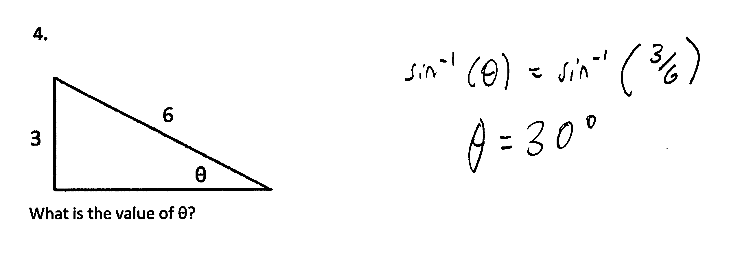
“Find Unknown Angle”
3.

Slide 14
“Find Unknown Angle”
3.

Slide 15
Performance Variations: Examples
Same course, same campus, same semester, same question—three different years.
(Algebra-based physics, 1st semester, Polytechnic campus, spring semester; “find unknown angle”)
2016: 36% correct (N = 72)
2018: 47% correct (N = 88)
2019: 39% correct (N = 54)

Slide 16
Performance Variations: Examples
Same course, same campus, same semester, same question—three different years.
(Calculus-based physics, 1st semester, Tempe campus, spring semester; “find unknown angle”)
2017: 77% correct (N = 98)
2018: 87% correct (N = 903)
2019: 88% correct (N = 99)

Slide 17
Performance Variations: Examples
Same course, same campus, same semester, same question—three different years.
(Calculus-based physics, 1st semester, Polytechnic campus, spring semester; “find unknown angle”)
2016: 70% correct (N = 105)
2017: 71% correct (N = 42)
2019: 42% correct (N = 69)

Slide 18
Significant Variations Between Campuses
Students at the Tempe and Polytechnic campuses:
  generally follow different majors with different course sequences
  have different average levels of preparation

Slide 19
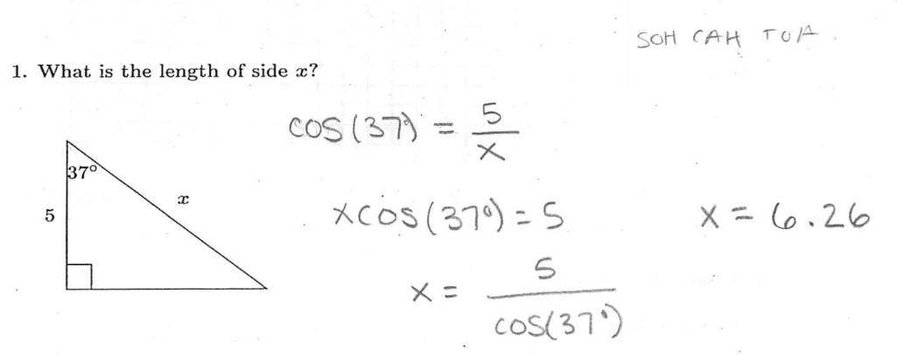
“Find Unknown Side”

Slide 20
“Find Unknown Side”

Slide 21
Comparison: Tempe campus vs. Polytechnic campus
Take average of (fall + spring) semesters; Year 2018:
Algebra-based course, 1st semester
  Example #1: Find unknown side of triangle
  Polytechnic campus: 25% correct (N = 121)
  Tempe campus: 57% correct (N = 376)
  Example #2: Find unknown angle of triangle
  Polytechnic campus: 35% correct (N = 152)
  Tempe campus: 52% correct (N = 533)
Superior performance on Tempe campus

Slide 22
Some Basic Operations:
Area, Graphing, Algebra
Find area of circle
Find slope of graph
Solve two simultaneous equations

Slide 23
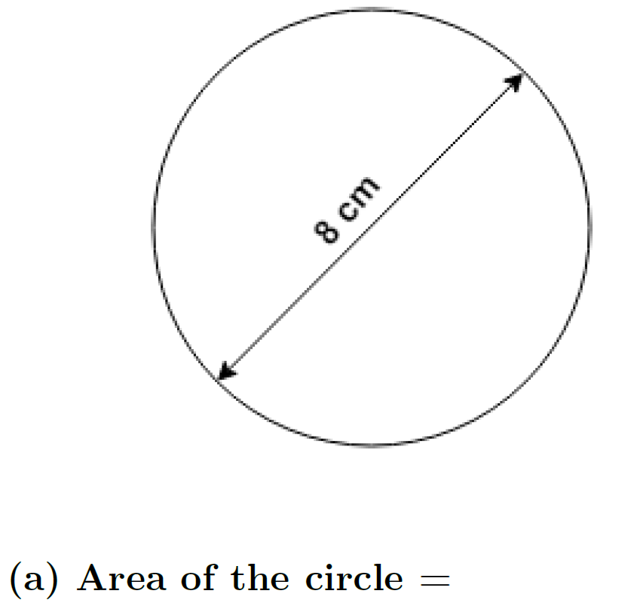

Algebra- and Calculus-based Courses Combined
(% correct responses)
Polytechnic campus: 57% (N = 250)
(5 classes, range 48-61%)
….with correct units: 29%
Tempe campus: 76% (N = 1086)
(5 classes, range 74-79%)
….with correct units: 45%
$[Area=πr^{2}$=16$π$ cm²]
Little difference between algebra- and calculus-based courses
Interchanging radius and diameter was NOT most-common error

Slide 24
[Some physics content]

Slide 25
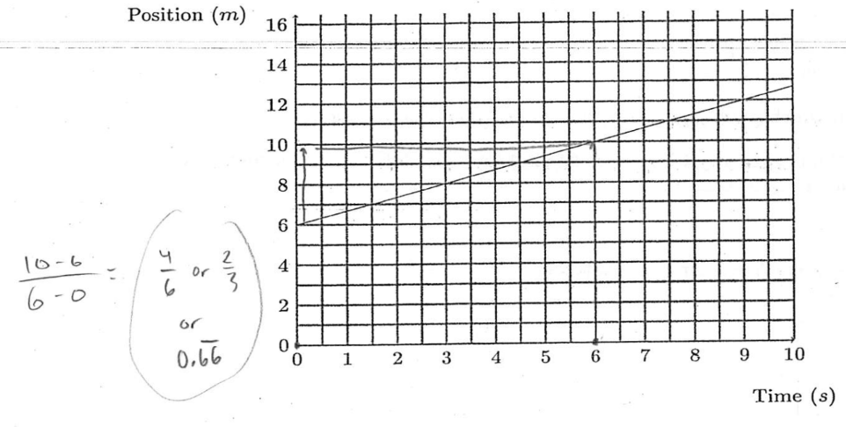
Note: Units missing

Slide 26
Answer: 2/3 m/s
Accepted as correct response: “2/3”
[less than 10% of respondents included proper units in their answer]

Slide 27
Correct-response rate: 30-60% (N > 2000);
nearly independent of course or campus
Most common error: counting grid squares and ignoring numbers on axes

Slide 28
Algebra: Simultaneous Equations
Do differences in students’ success rate between numerical and symbolic versions of same problem persist when simultaneous equations are involved? (E.g., two equations, two unknowns)

Slide 29
From Torigoe and Gladding (2011):
Mg − T = Ma
TR = Iα
[I = ½ MR²; α = a/R]
…→
Mg − T = Ma
TR = [½ MR²][a/R]
a = ?
F_{net} = ma
τ_{net} = I α

Slide 30
From Torigoe and Gladding (2011):
Mg − T = Ma
TR = Iα
[I = ½ MR²; α = a/R]
…→
Mg − T = Ma
TR = [½ MR²][a/R]
a = ?
Numeric version

Slide 31
From Torigoe and Gladding (2011):
Mg − T = Ma
TR = Iα
[I = ½ MR²; α = a/R]
…→
Mg − T = Ma
TR = [½ MR²][a/R]
a = ?
Symbolic version

Slide 32
Results on #10
[Torigoe and Gladding, 2011]
Numeric version: 49% correct (N ≈ 380)
Symbolic version: 53% correct (N ≈ 380)
  No significant difference
  (“…because students are forced to use the same procedure to solve both the numeric and symbolic versions.” Torigoe and Gladding, 2011)

Slide 33
From Torigoe and Gladding (2011):
Mg − T = Ma
TR = Iα
[I = ½ MR²; α = a/R]
…→
Mg − T = Ma
TR = [½ MR²][a/R]
a = ?
Symbolic version

Slide 34
From Torigoe and Gladding (2011):
Mg − T = Ma
TR = Iα
[I = ½ MR²; α = a/R]
…→
Mg − T = Ma
TR = [½ MR²][a/R]
a = ?
a – y = bx
cy = dx
x =?
Rename to simplify:
“Mg” → “a”
“M” → “b”
“R” → “c”
“½MR” → “d”
“T” → “y”
“a” → “x”
Our Symbolic version

Slide 35
From Torigoe and Gladding (2011):
Mg − T = Ma
TR = Iα
[I = ½ MR²; α = a/R]
…→
Mg − T = Ma
TR = [½ MR²][a/R]
a = ?
78.4 – y = 8x
0.5y = 2x
x =?
Our Numeric version

Slide 36
Results on Our Versions (Tempe)
Calculus-based course, 1st semester:
Numeric version: 87% correct (N = 733)
Symbolic version: 63% correct (N = 733)
  Large and highly significant difference
  (Because [?] many of the students who can’t do the physics, can do the math—but only when posed in numerical form)

Slide 37
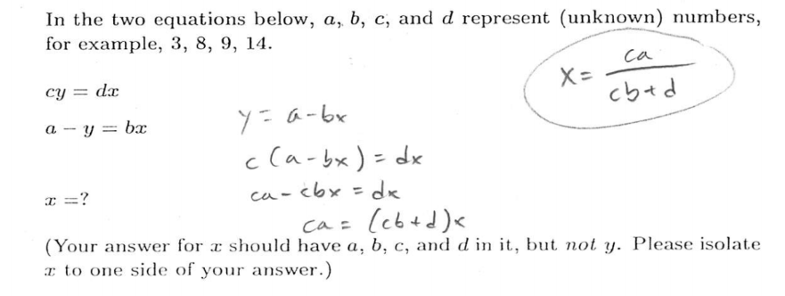
“Symbolic” Version

Slide 38
“Symbolic” Version

Slide 39
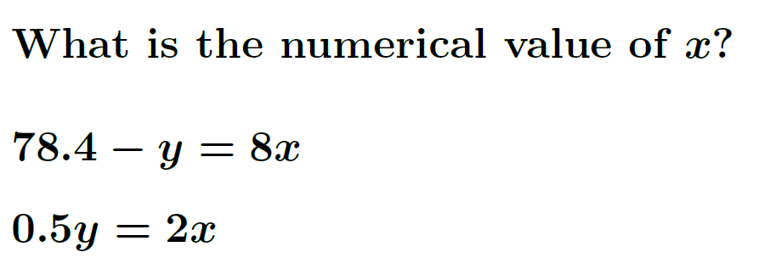
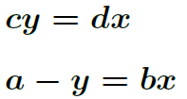

Algebra: Simultaneous Equations
Algebra-based course, 1st semester (% correct; 2018 fall + spring average)
  Polytechnic campus: 40% (N = 104)
  Tempe campus: 61% (N = 335)
  Polytechnic campus: 10% (N = 63)
  Tempe campus: 32% (N = 241)
Numeric version
≈20% higher correct-response-rate at Tempe
on both versions;
Symbolic version
≈30% lower correct-response-rate on symbolic version on both campuses

Slide 40
Algebra: Simultaneous Equations
Calculus-based course, 1st semester (% correct; 2018 fall + spring average)
  Tempe campus: 79% (N = 1043)
  Tempe campus: 55% (N = 862)
Numeric version
18% higher correct-response-rate than in algebra-based course
Symbolic version
24% lower correct-response-rate on symbolic version

Slide 41
Why the Difficulties with Symbols?
Some Suggestions Arising from the Interviews
In elementary math courses, “simplified forms” of equations are emphasized (i.e., few messy symbols and functions).
Many students get “overloaded” by seeing all the variables, and are unable to carry out procedures that they do successfully with numbers.
Many students have had insufficient practice with algebraic operations to avoid being overwhelmed by standard algebraic manipulations.
  Students tend to become careless

Slide 42
Possible Origins of Errors
We assume several different possible sources for students’ errors:
  Difficulty with operations: Inadequate learning or expertise with fundamental operations
  Difficulty accessing knowledge: Students don’t connect context of problem to context in which operations were learned
  “Careless” errors, due to simple inattention, lack of checking, etc.; can be corrected (in principle) by greater attentiveness.
    (Note: ≈50% of errors were “self-corrected” during interviews)
Through interviews and diagnostic items, we probe these items.

Slide 43
Diagnostics for Operations with Fractions

Slide 44
Diagnostics for Operations with Fractions

Slide 45
Diagnostics for Operations with Fractions

Slide 46
Diagnostics for Operations with Fractions

Slide 47
“Symbolic” Versus “Numeric”
Torigoe and Gladding (2007; 2011) investigated differences in students’ responses to physics problems in both numeric and symbolic form
  “Numeric” and “symbolic” refer to the nature of the constant coefficients
Starting in 2018, we asked paired problems in both symbolic and numeric form
  Our problems were stripped of physics context and asked as pure math problems
  Focused on trigonometry and algebra

Slide 48
Students’ Difficulties with Symbols
    Confusion of symbolic meaning: Students perform worse on solving problems when symbols are used to represent common physical quantities in equations, e.g., “m” instead of “1.5 kg” [Torigoe and Gladding, 2007; 2011)
    Example [University of Illinois]:
Version #1: A car can go from 0 to 60 m/s in 8 s. At what distance d from the start at rest is the car traveling 30 m/s?
Version #2: A car can go from 0 to v₁ in t₁ seconds. At what distance d from the start at rest is the car traveling (v₁/2)?
[93% correct]
[57% correct]
Much worse!

Slide 49
From Torigoe & Gladding (2011):

Slide 50
Results on #2
[Torigoe and Gladding, 2007; 2011]
Numeric version: 93% correct (N ≈ 380)
Symbolic version*: 57% correct (N ≈ 380)
  *numerical values of v₁ and t₁ not provided
  Highly significant difference

Slide 51
Torigoe and Gladding (2011), Findings
Significantly higher proportion of correct responses on some types of numerical questions, not on others
Difference was greater for students in bottom quarter of class
Larger difference linked to difficulties with multiple and simultaneous equations, symbol confusion, and misuse of compound expressions.

Slide 52
“Symbolic” Versus “Numeric”
Torigoe and Gladding (2007; 2011) investigated differences in students’ responses to physics problems in both numeric and symbolic form
  “Numeric” and “symbolic” refer to the nature of the constant coefficients
Starting in 2018, we asked paired problems in both symbolic and numeric form
  Our problems were stripped of physics context and asked as pure math problems
  Focused on trigonometry and algebra

Slide 53
Students’ Difficulties with Symbols
    Torigoe and Gladding (2011):
A car can go from 0 to 60 m/s in 8 s. At what distance d from the start at rest is the car traveling 30 m/s?
A car can go from 0 to v₁ in t₁ seconds. At what distance d from the start at rest is the car traveling (v₁/2)?
Numeric version:
Symbolic version:

Slide 54
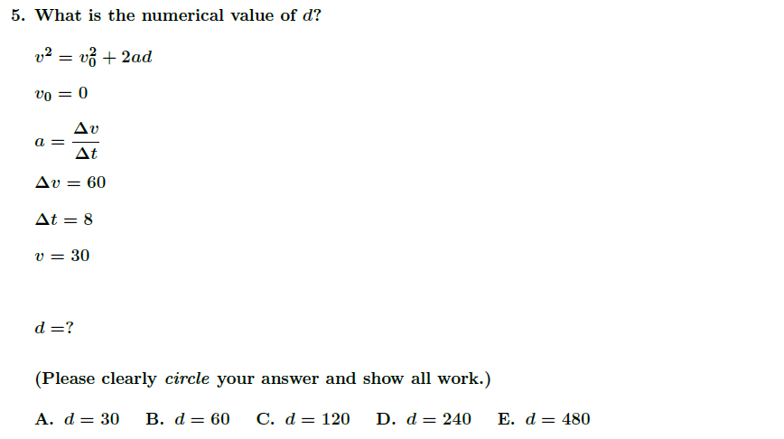
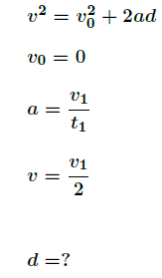
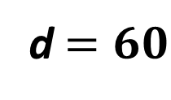
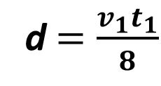
Kinematic Equation Problem
Numeric:
Symbolic:
(Multiple Choice)
(Multiple Choice)
Correct answer:
d$=\frac{v_{1}t_{1}}{8}$
Correct answer:
d$=60$

Slide 55
Correct-Response-Rate Differences
First Semester algebra-based (PHY 111) Tempe Campus:
First Semester calculus-based (PHY 121) Tempe Campus:

Slide 56
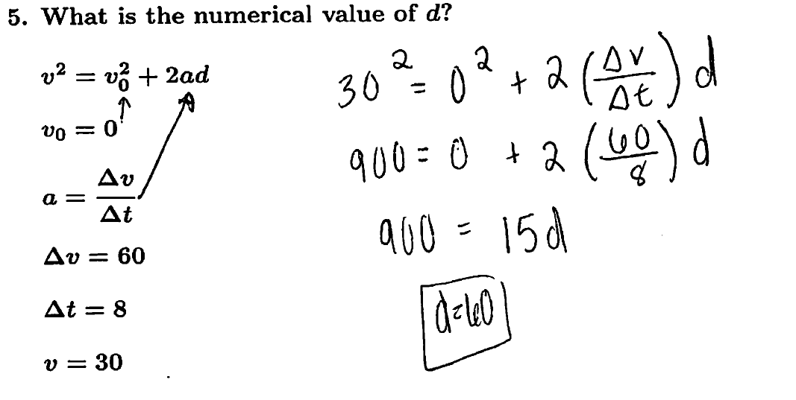
Differences in Procedure
Numeric:
Example of student work
Arithmetic used on both sides of equation

Slide 57
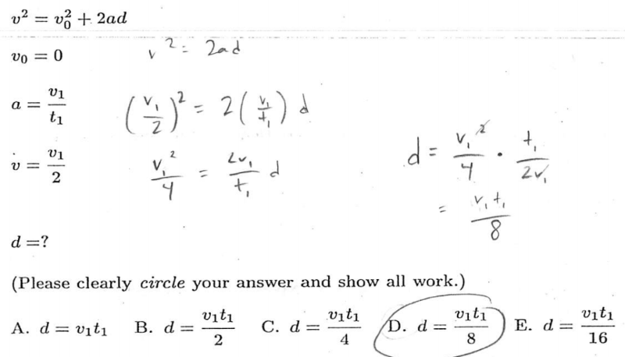
Differences in Procedure
Symbolic:
Dividing Fraction
Squaring Fraction

Slide 58
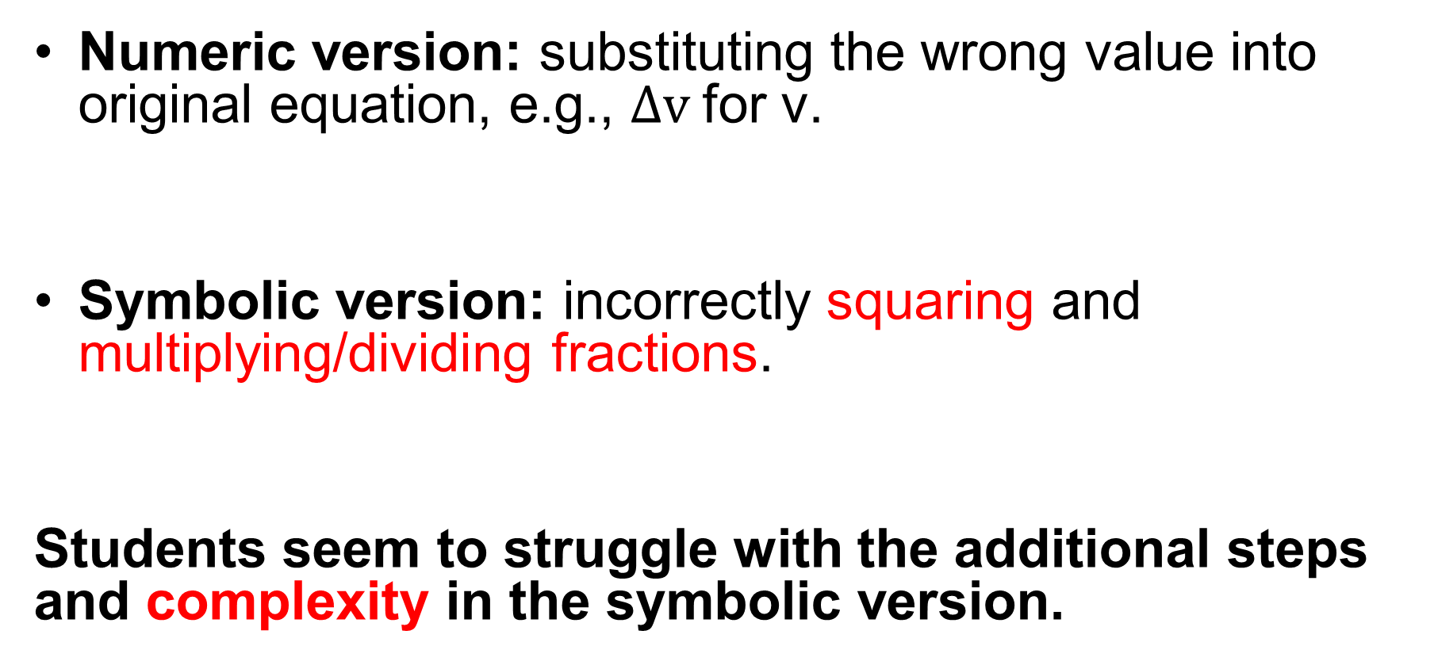
Errors Observed
Numeric version: substituting the wrong value into original equation, e.g., $∆v$for v.
Symbolic version: incorrectly squaring and multiplying/dividing fractions.
Students seem to struggle with the additional steps and complexity in the symbolic version.

Slide 59
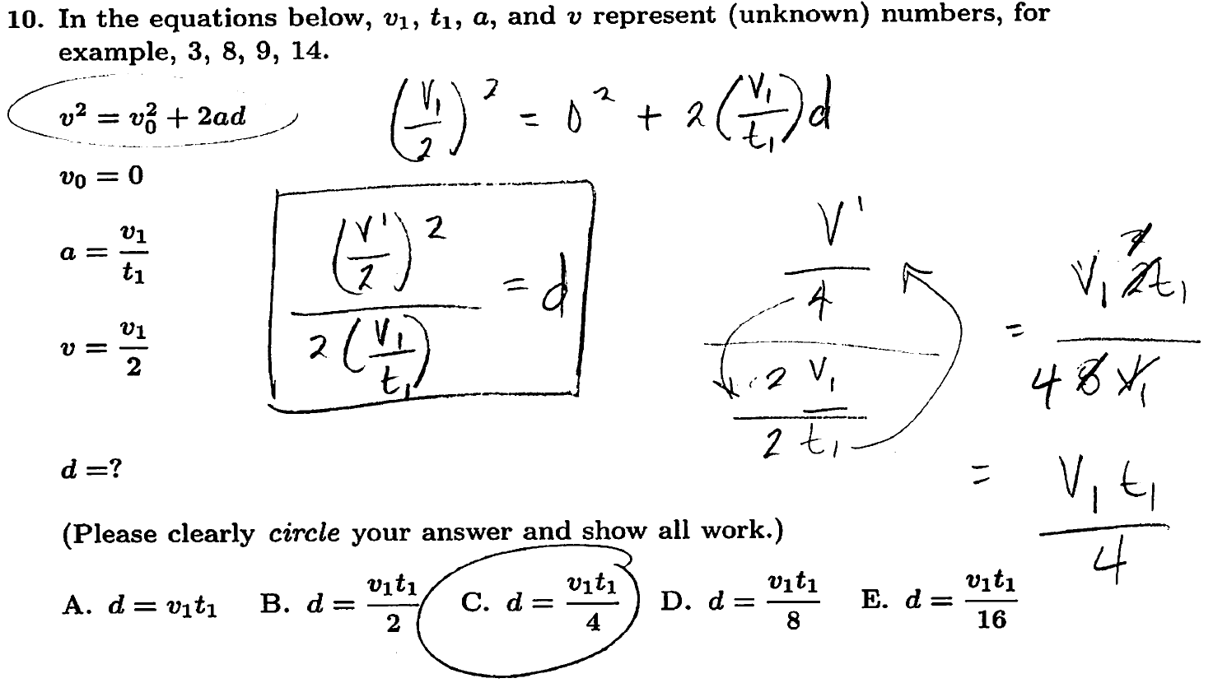
Example of Multiplication Error
Error
Correct expression

Slide 60
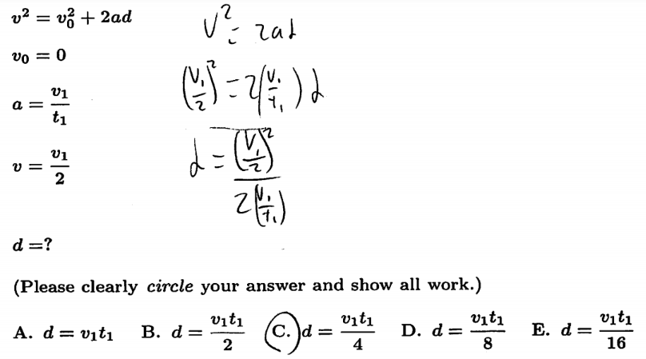
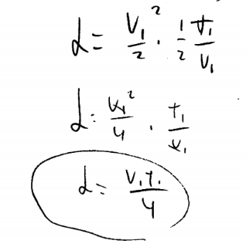
Example of Squaring Error
Not squaring the denominator

Slide 61
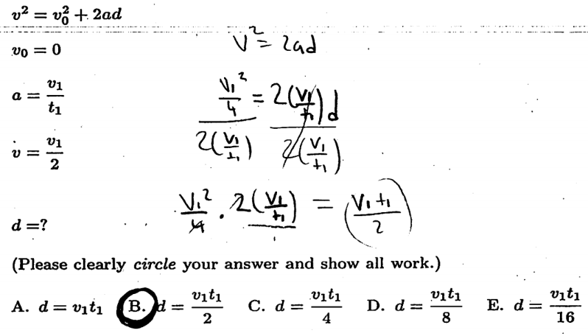
Example of Division Error
Division of fractions error

Slide 62
Testing Operational Skills
To help better understand the errors occurring on the symbolic problem, we asked basic questions to test math skills at the middle-school level
We wanted to reduce the complexity of the problem in order to isolate errors
  “Complexity” implies, among other things, the number of steps involved in the problem
We administered three problems on the manipulation of fractions which were directly related to the kinematic equation algebra problem

Slide 63
Fractions – 3 Problems
Symbolic Multiplication
Symbolic Division
(1)
(2)
Exponent
(3)

Slide 64
(1) Correct Response Rates (multiplication)
ASU Tempe campus averages:
1st semester calculus-based course, (N=95): 96%
ASU Polytechnic campus averages:
1st semester calculus-based course, (N=69): 75%

Slide 65
(2) Correct Response Rates (division)
ASU Tempe campus averages:
1st semester calculus-based course, (N=95): 92%
ASU Polytechnic campus averages:
1st semester calculus-based course, (N=69): 68%

Slide 66
(3) Correct Response Rates (exponent)
ASU Tempe campus averages:
1st semester calculus-based course, (N=95): 100%
ASU Polytechnic campus averages:
1st semester calculus-based course, (N=69): 91%

Slide 67
Weak Operational Skills, or Carelessness?
We define “non-operational errors” as all errors that occur when the student apparently has knowledge of the mathematical operations needed to solve individual steps of a multi-step problem, but fails to solve the problem correctly, e.g., from not accessing previously learned skills, or not exercising sufficient care.
Knowledge of how to solve each fraction problem is essential to work the kinematic equation problem correctly
With certain assumptions, we can then estimate the percentage of students that solved the kinematic equation problem incorrectly because of “non-operational errors”

Slide 68
Measuring “Non-Operational Errors”
We hypothesize, based on analysis of thousands of written diagnostics, that the majority of errors on the symbolic version were due to errors on one or more of the three “fraction” operations
Therefore, we assume that, if a student responds incorrectly to any of the three fraction problems, they would probably give an incorrect response to the kinematics problem; we call this an “operational” error
We define any other error as a “non-operational” error

Slide 69

Calculation Example
$$40\%+X=60\% ⇒X=20\%$$
Percentage of errors that are “operational” errors
Percentage of errors that are
“non-operational” errors
Total incorrect response rate (kinematics problem)

Slide 70

Calculation Example
$$\frac{X}{60\%} \sim 35\%$$
Percentage of errors that are
“non-operational” errors
Proportion of errors that are “non-operational” errors
Total incorrect response rate (kinematics problem)

Slide 71
Table of Results: “Non-Operational Errors”
1st semester algebra-based course:
1st semester calculus-based course:
2nd semester calculus-based course:

Slide 72
Summary and Relation to Interviews
Students’ tend to self-correct their errors during problem-solving interviews approximately 50% of the time, consistent with findings on the written diagnostics
Therefore, we conclude that students often posses the operational tools necessary to solve a problem, but make non-operational mistakes due to “carelessness”, inability to access relevant knowledge, etc.
We see the possibility of significant improvement through implementation and improvement of work-checking strategies

Slide 73
Primary Findings
Regardless of course (algebra- or calculus-based), campus (Tempe or Poly), or semester (Spring or Fall):
Difficulties with basic mathematical operations are widespread; average error rates range from 20-70%;
Performance on problems using symbols for constants is significantly worse than on problems using numbers;
During problem-solving interviews, students self-correct approximately 50% of errors following minimal prompts;

Slide 74
Student Self-Correction of Errors
Our Interview Findings: Almost half of students’ errors on algebra problems were self-corrected by students during interviews, as a consequence of interviewer prompts or unprompted auto-correction.
Prompts Leading to Self-Correction
“Explain that step”
“Clarify what you mean.”
“What does the problem ask you to do?”
[No specific prompt: Students asked to explain all work]

Slide 75
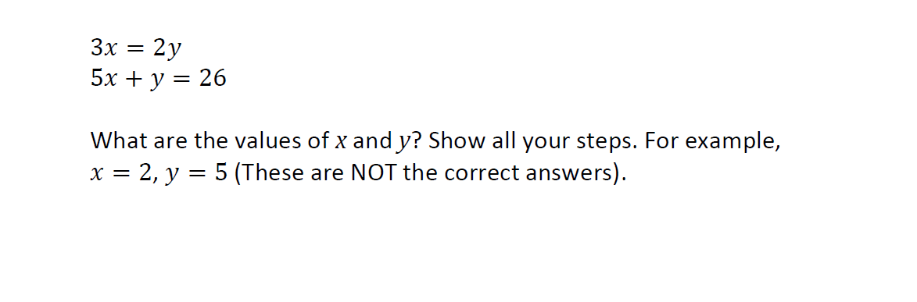
Interview Results: N = 53
Correct: 83%
Error, Self-corrected: 9%
Error, Uncorrected: 8%

Slide 76
Interview Results: N = 53
x cos (20°) = y cos (70°)
x cos (70°) + y cos (20°) = 10
What are the values of x and y? Show all your steps. Note: The value for x should NOT include y, and the value for y should NOT include x.
Correct: 57%
Error, Self-corrected: 19%
Error, Uncorrected: 25%

Slide 77
Interview Results: N = 53
ax = by
bx + ay = c
a, b, and c are constants.
What are the values of x and y in terms of a, b, and c? Show all your steps. Note: The value for x should NOT include y, and the value for y should NOT include x.
Correct: 55%
Error, Self-corrected: 21%
Error, Uncorrected: 25%

Slide 78
Comparison Population:
University of Colorado
In Fall 2019, our diagnostic was administered in the algebra-based general physics course at the University of Colorado (N = 388). Results were broadly consistent with ASU results from the Tempe campus.

Slide 79
Fall 2019 Diagnostic Results with Comparisons to Colorado University

Slide 80
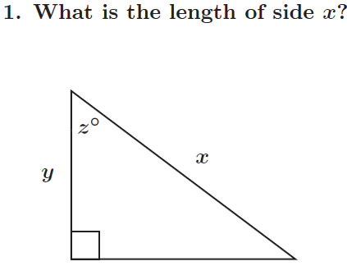
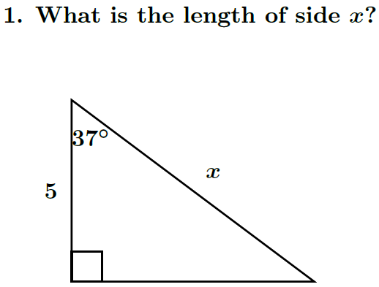
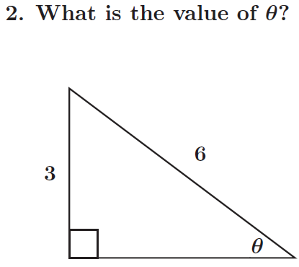
Trigonometry Problems
“symbolic” hypotenuse problem
“numeric” hypotenuse problem
Solving for the angle problem

Slide 81
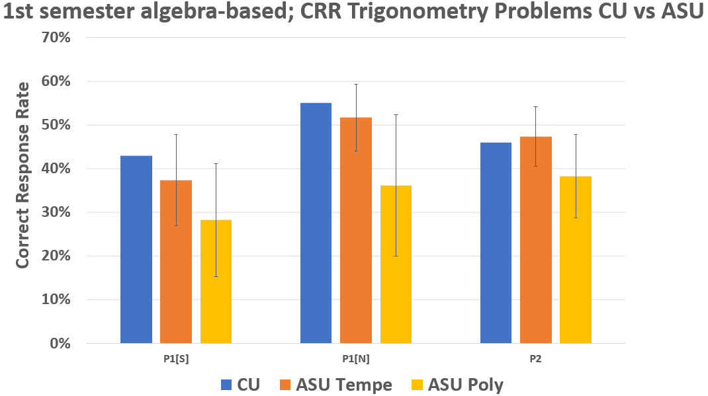
CU: N=197, 191, 388
ASU Tempe: N≈500 (average from 3 semesters)
ASU Poly: N≈300 (average from 5 semesters)
Error bars are ±σ

Slide 82
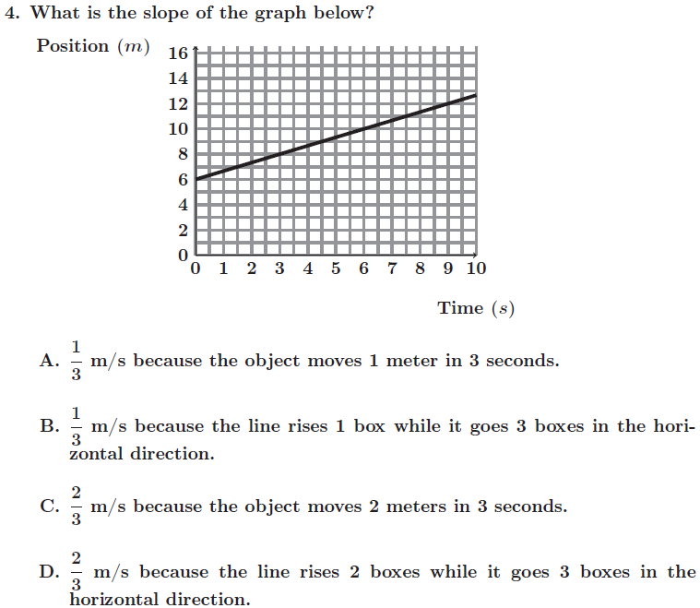
Slope Problem

Slide 83
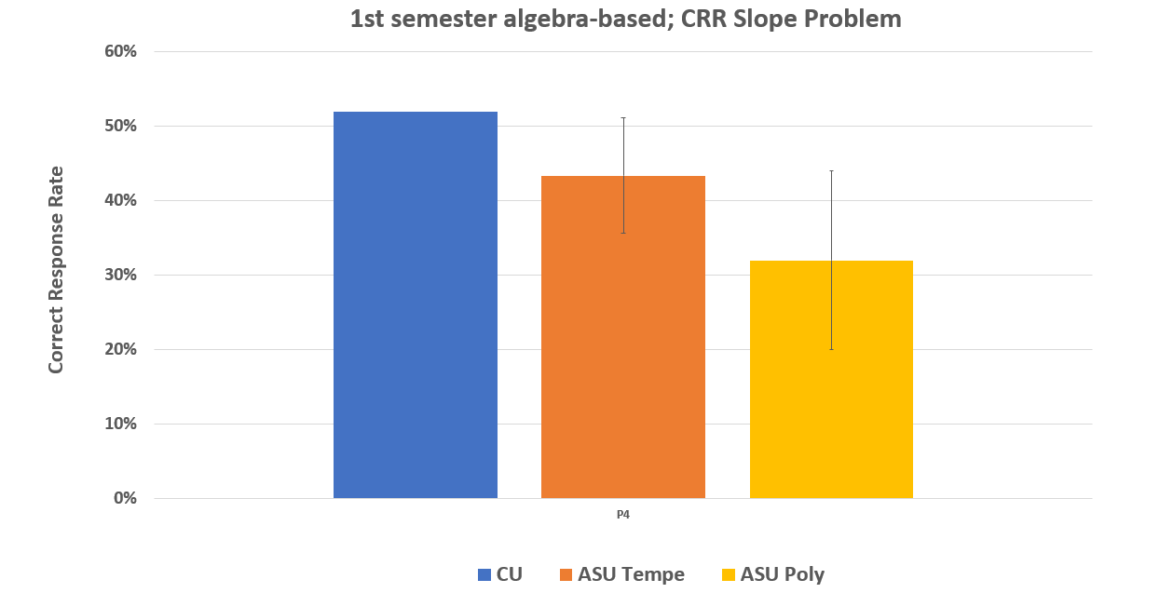
CU: N=388
ASU Tempe: N≈750 (average from 3 semesters)
ASU Poly: N≈200 (average from 3 semesters)
Error bars are ±σ

Slide 84
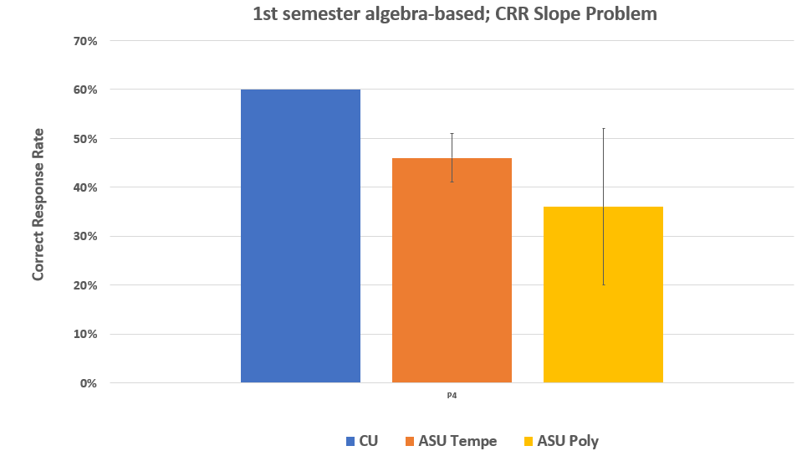
Numbers based on including all multiple-choice responses of “2/3” as correct
CU: N=388
ASU Tempe: N≈750 (average from 3 semesters)
ASU Poly: N≈200 (average from 3 semesters)
Error bars are ±σ

Slide 85
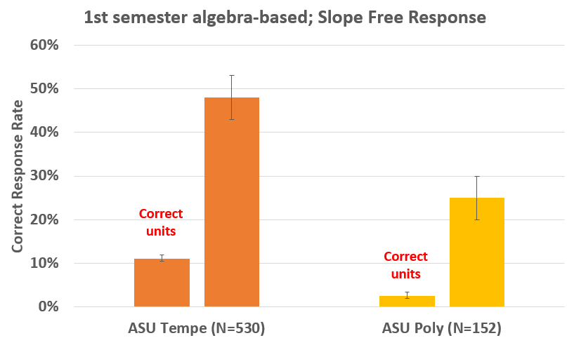

Slide 86
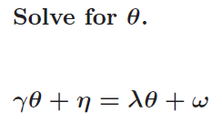
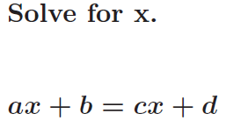
Symbolic Single Equation Algebra Problems

Slide 87
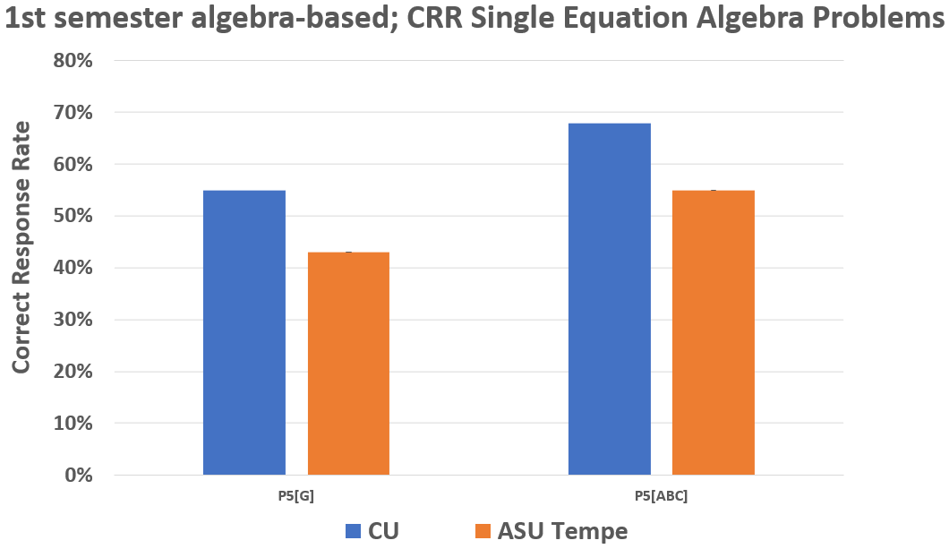
CU: N≈200
ASU Tempe: N≈100

Slide 88
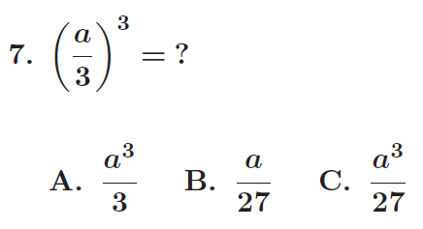
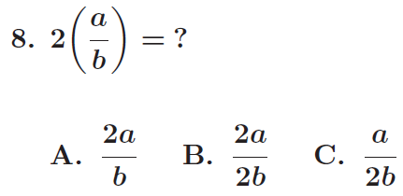

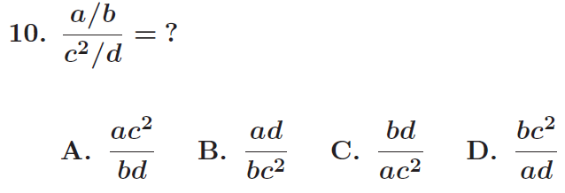
Fraction Problems

Slide 89
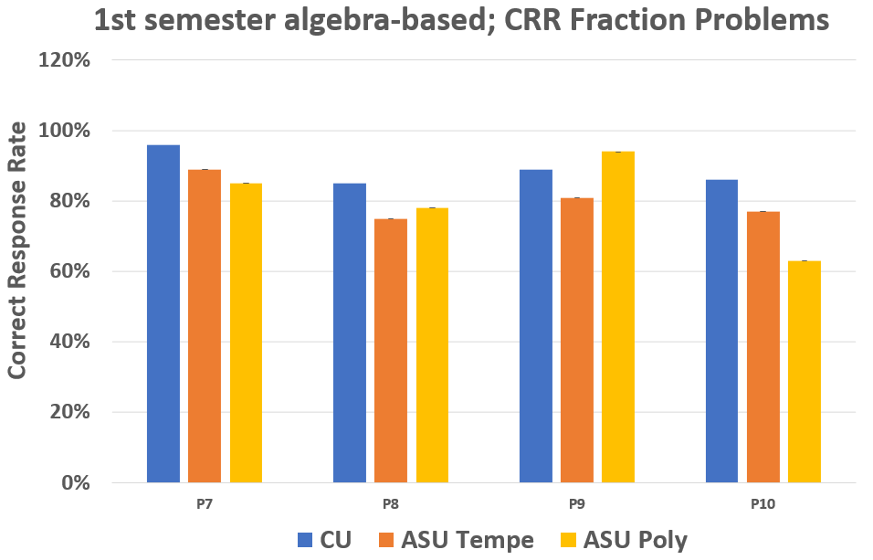
CU: N=388
ASU Tempe: N≈200
ASU Poly: N=54

Slide 90
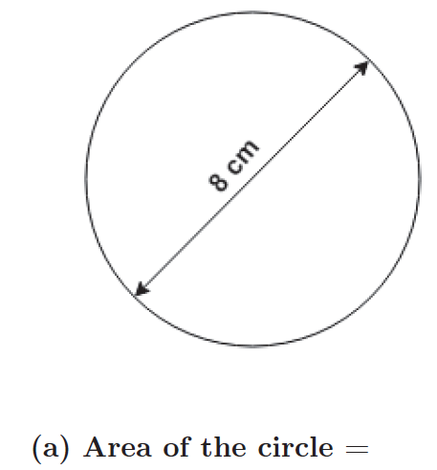
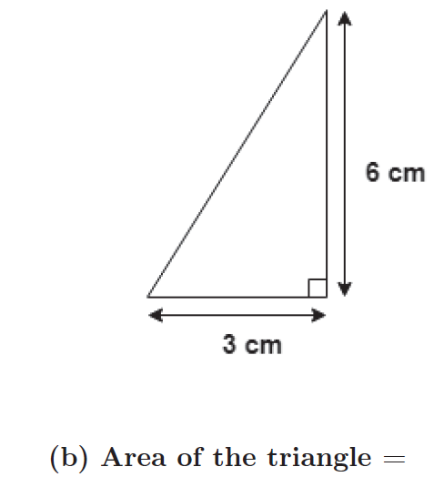
Finding The Area Problems

Slide 91
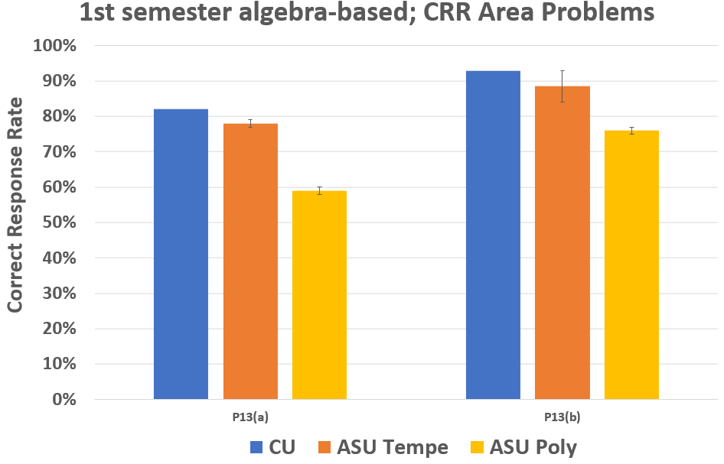
CU: N=383, 382
ASU Tempe: N≈500 (average from 3 semesters)
ASU Poly: N ≈100 (average from 2 semesters)
Error bars are ±σ

Slide 92
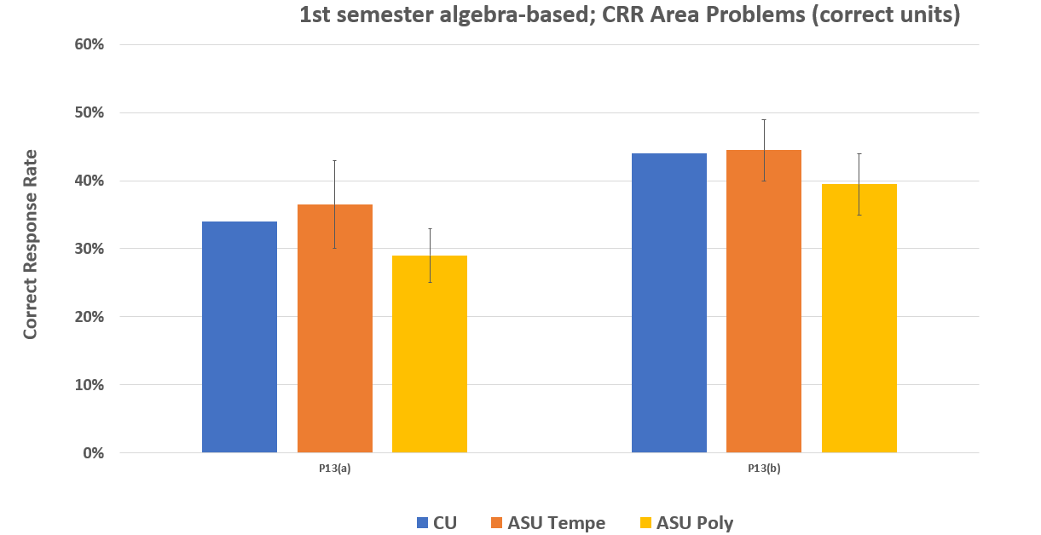
Numbers based on requiring units to be correct
CU: N=383, 382
ASU Tempe: N≈500 (average from 3 semesters)
ASU Poly: N ≈100 (average from 2 semesters)
Error bars are ±σ

Slide 93
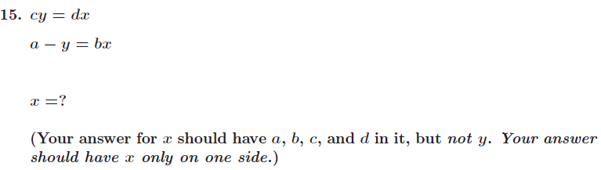
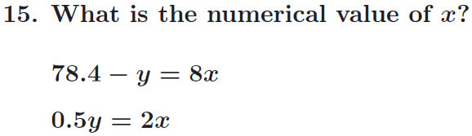
Simultaneous Equations

Slide 94
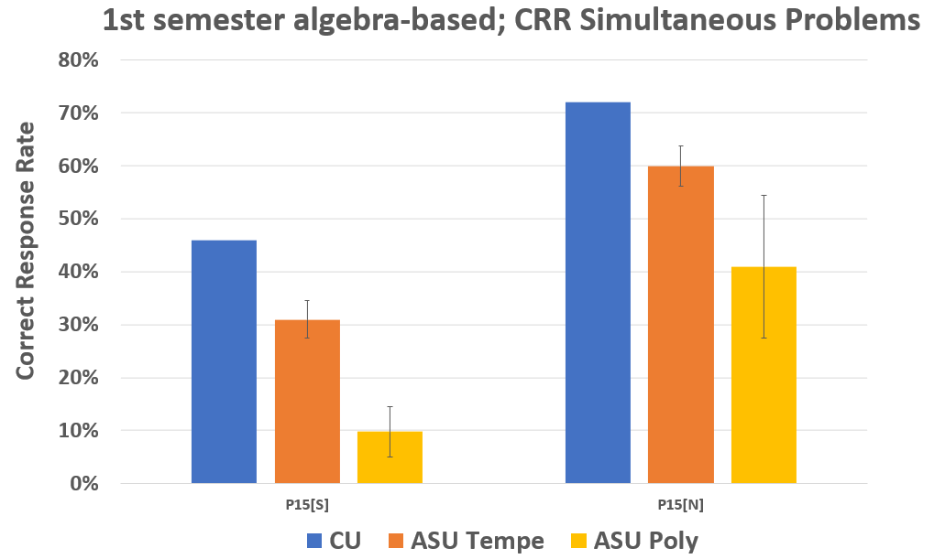
CU: N=167, 180
ASU Tempe: N=326, 423 (average from 3 semesters)
ASU Poly: N =169, 166 (average from 4 semesters)
Error bars are ±σ

Slide 95
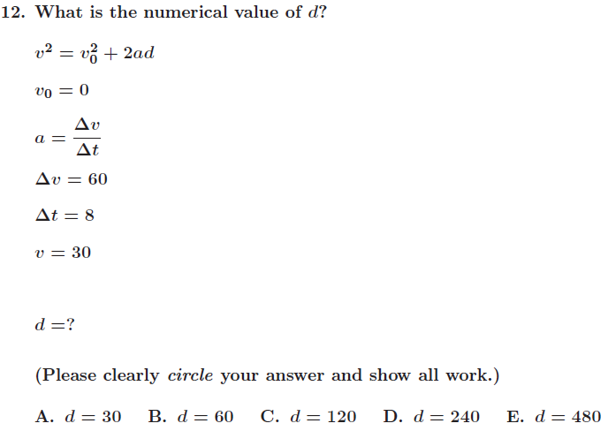
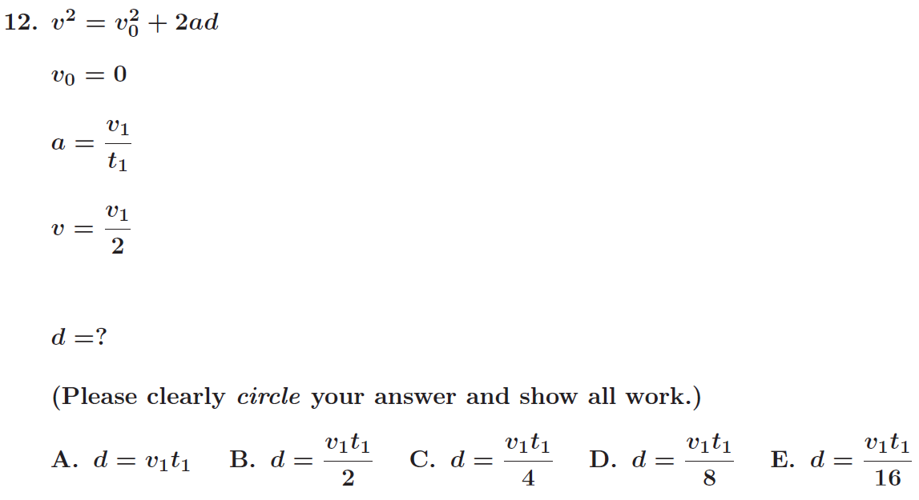
Kinematic Equations

Slide 96
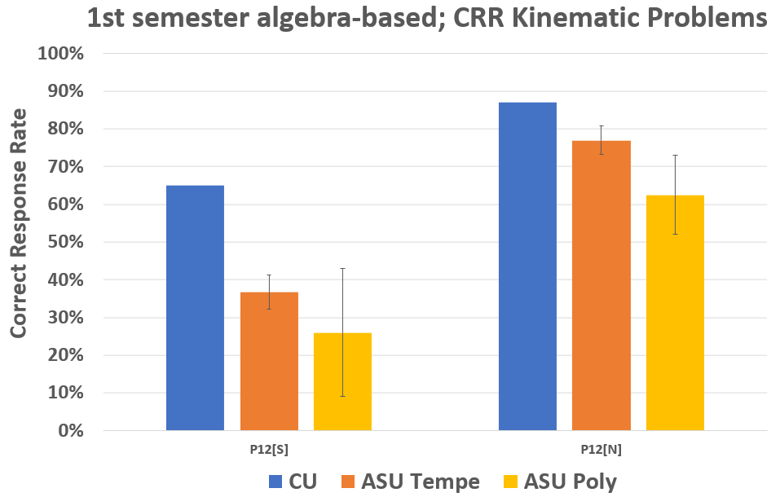
symbolic
numeric
CU: N=191, 196
ASU Tempe: N=461, 471 (average from 3 semesters)
ASU Poly: N =136, 147 (average from 3 semesters)
Error bars are ±σ

Slide 97
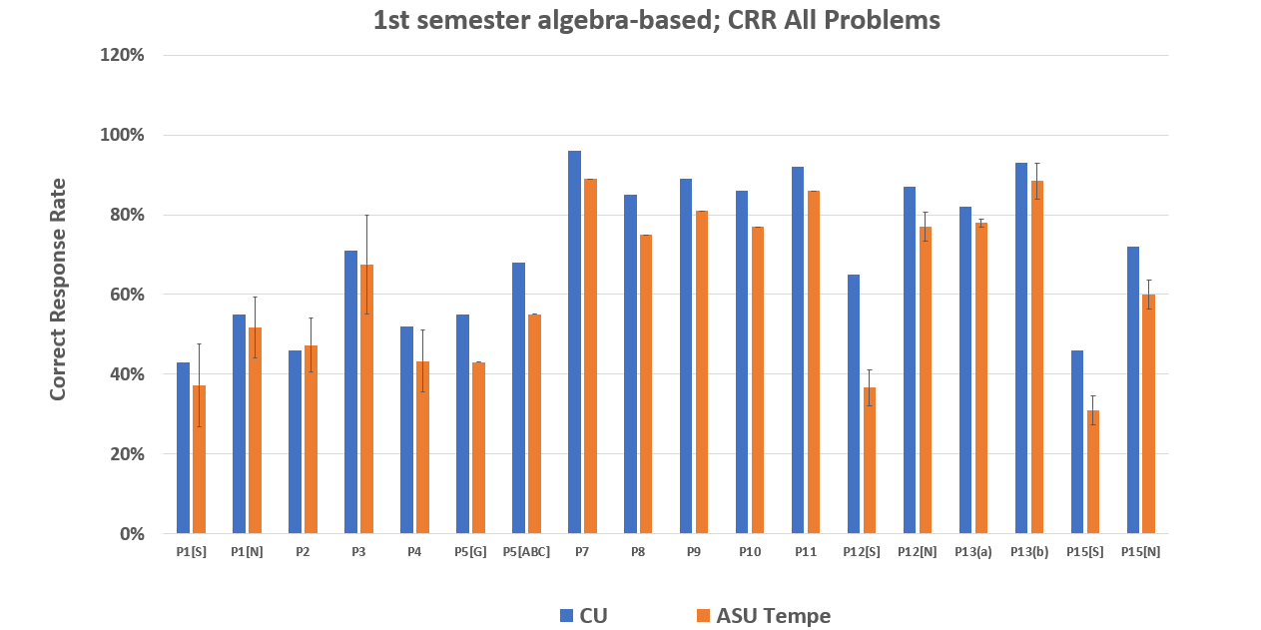

Slide 98
Summary: Implications for Instruction
Difficulties due to skill-practice deficits might be addressed by short-term, in- and out-of-class tutorials and assignments, designed to refresh students’ previously learned knowledge and skills (e.g., Mikula and Heckler, 2017)
  Current project, OSU + ASU, NSF DUE #1914709/1914712
Difficulties due to “carelessness” might be addressed by guiding students to (1) carefully check and re-check key steps in their calculation; (2) slow down, review problem statements, and re-solve when possible

