Slide 1
Physical science instruction and assessment in the middle-school: Comparisons and contrasts with college-level instruction
David E. Meltzer
College of Integrative Sciences and Arts
Arizona State University
Notes:
1

Slide 2
Background and Context
My experience: 29 years of (mostly) college physics teaching, supplemented by:
  One year teaching 8th grade science in private middle school (10 contact hours per week)
  Four years teaching weekly science classes to 5th-8th grade students at ASU-sponsored middle school
    (80-150 students per week; each student one class hour per week; 3-5 contact hours per week)
About 1000 total contact hours teaching middle-school science

Slide 3
Overall Goals
Generate enthusiasm for engaging in science
  For 5/6th graders: no problem, they love it
  For 7/8th graders: more challenges
Develop abilities for engaging in science
  Not formally assessed, but students become habituated to need for arguing from evidence based on experimental observation
Build understanding of science concepts: what are reasonable conceptual goals?
  Highly challenging; the focus of this talk

Slide 4
General Issues
Classroom management
Student motivation
Logistics

Slide 5
Classroom Management Issues
If the students are not attempting to participate in class or engage with the activities, they will learn nothing
Learning classroom management skills is done on the job or with previous equivalent experience; it is a highly nontrivial task

Slide 6
General Observations
A lot of hands-on instructor assistance is needed to keep kids on task and on track;
Logistics of handling supplies and maintaining equipment is a major concern;
Written worksheets can be used if they are carefully edited and accompanied by frequent check-ins by the instructor.
Students’ progress toward conceptual learning goals is extremely slow compared to college class

Slide 7
General Impressions of Student Reactions to Activities
College students (pre-service teachers): burdensome tasks that had to be gotten through
College students (STEM majors): generally enjoyable tasks, moderately enthusiastic
7th/8th graders: Time to socialize with each other; moderate engagement and enjoyment
5th/6th graders: Playtime: fun and high engagement

Slide 8
Additional Context, 2010-2011
Generally one instructor, sometimes helped by graduate student aide
Homework assigned and corrected most weeks; occasional quizzes (graded only for 7/8th grade)
In the previous year I had taught many of the same students, including some of the same activities

Slide 9
Topics Covered, 2010-2011
Grades 7/8: Major focus on motion and force (to prepare for Arizona 8th-grade science test); also did solar system astronomy, electromagnetism, some review of properties of matter, energy concepts, some chemistry
Grades 5/6: solar system astronomy, optics, motion and force, energy concepts, electromagnetism, some biology
Small-to-moderate variations on this set of topics during other years, 2009-2013

Slide 10
Topics Covered, 2010-2011
Grades 7/8: Major focus on motion and force (to prepare for Arizona 8th-grade science test); also did solar system astronomy, electromagnetism, some review of properties of matter, energy concepts, some chemistry
Grades 5/6: solar system astronomy, optics, motion and force, energy concepts, electromagnetism, some biology
Small-to-moderate variations on this set of topics during other years, 2009-2013

Slide 11
Motion and Force with 7/8th Graders
Approximately 10-15 hours of activities, beginning with graph paper and stopwatches, moving on to dynamics carts and tracks, fan carts, motion sensors and GLX’s (hand-held graphing computers).
Many of the students had previous experience using GLX for position/time and velocity/time graphs.
Typical sequence: explore with equipment; predict graphs for various motions; carry out series of experiments; describe and report results; explain and generalize.

Slide 12
Goals Tuned to Arizona 8th-Grade Science Standard
Create a graph devised from measurements of moving objects and their interactions, including:
  position-time graphs
  velocity-time graphs
Describe the various effects forces can have on an object (e.g., cause motion, halt motion, change direction of motion, cause deformation).
Describe how the acceleration of a body is dependent on its mass and the net applied force (Newton’s 2nd Law of Motion).

Slide 13
Cautionary Note: These ideas and skills are challenging for college students
In our studies of college students, we have found that both the mathematical skills and the physical concepts can be challenging to learn and retain
An example from an ongoing study:

Slide 15
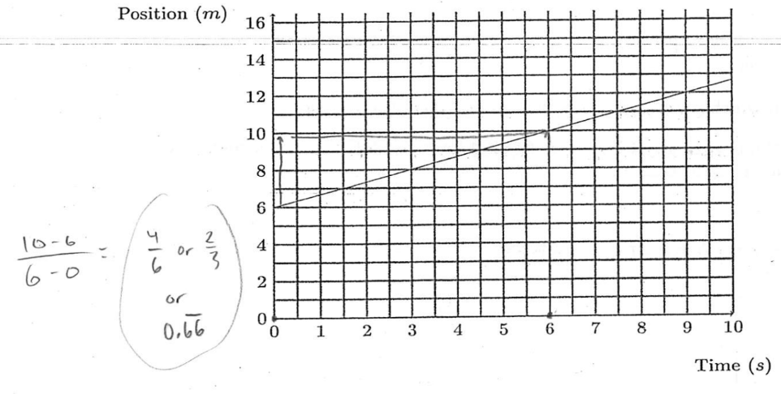
Desired answer: 2/3 m/s or 0.67 m/s
(Divide “rise” in meters by “run” in seconds)
Note: Units missing

Slide 16
Around half of all students ignore numbers on axes, and just count grid squares
Most common incorrect answer: 1/3
Correct Response Rate, Arizona State University; Fall 2018
Algebra-based physics course, first semester: 43% (N = 305)
Calculus-based physics course, first semester: 56% (N = 329)

Slide 17
Force and Motion Activities
Phase I: Extensive work on kinematics, including position-time and velocity-time graphs using GLX graphing devices
Phase II: Students introduced to measurement of “pushes” and “pulls,” use calibrated spring scales to pull on low-friction carts; measure pushing force of fan cart;
Phase III: Administer and discuss pretest: Students use fan carts to determine shape of velocity vs. time graph of an object being acted upon by a force of unchanging magnitude.
Phase IV: Circular motion activities; marble rolling on circular track with cut-out, analysis of hammer-throw video.

Slide 18
[Pretest]
A cart on a low-friction surface is being pushed by
a fan mounted on the cart. The instantaneous velocity
of the cart is measured throughout a time period,
beginning when the cart has already started moving.
The experiment is done twice, and the pushing
force is 0.1 N for the first trial and 0.2 N for the
second. (The mass of the cart is kept the same for
both trials.) During each trial the pushing force is
constant, so the strength of the push doesn’t change
while the cart moves along the track.
On a single set of v-t axes, sketch the
appropriate lines for velocity versus time for the two
trials, and label them 0.1 N and 0.2 N.

Slide 19
A cart on a low-friction surface is being pulled by a string attached to a spring scale. The velocity of the cart is measured as a function of time.
The experiment is done three times, and the pulling force is varied each time so that the spring scale reads 1 N, 2 N, and 3 N for trials #1 through #3, respectively. (The mass of the cart is kept the same for each trial.)
On the graph below, sketch the appropriate lines for velocity versus time for the three trials, and label them #1, #2, and #3.
velocity
0.2 N
0.1 N
time

Slide 20
A cart on a low-friction surface is being pulled by a string attached to a spring scale. The velocity of the cart is measured as a function of time.
The experiment is done three times, and the pulling force is varied each time so that the spring scale reads 1 N, 2 N, and 3 N for trials #1 through #3, respectively. (The mass of the cart is kept the same for each trial.)
On the graph below, sketch the appropriate lines for velocity versus time for the three trials, and label them #1, #2, and #3.
Pretest response: ~50%
velocity
0.2 N
0.1 N
time
[or with order inverted]

Slide 21
A cart on a low-friction surface is being pulled by a string attached to a spring scale. The velocity of the cart is measured as a function of time.
The experiment is done three times, and the pulling force is varied each time so that the spring scale reads 0.1 N, 0.2 N, and 0.3 N for trials #1 through #3, respectively. (The mass of the cart is kept the same for each trial.)
On the graph below, sketch the appropriate lines for velocity versus time for the three trials, and label them #1, #2, and #3.
Pretest Response: ~50%
velocity
0.2 N
0.1 N
time
[or with order inverted]

Slide 22
Assessment Issues
Different types of questions have advantages and disadvantages
Need for practicality and efficiency of grading can conflict with desire for in-depth probes of student thinking
Risky to draw conclusions about students’ performance without at least some “explain your answer” types of questions

Slide 23
Question Types
Multiple-choice questions can be efficient to administer and grade, but:
  they require careful design and revision to avoid ambiguous or misleading statements
  “correct” answers can obscure a great deal of actual confusion
“Free-” or “Open-response” questions can reveal details of students’ thinking, but they:
  require careful design to provide adequate guidance
  are time-consuming to answer, grade, and analyze

Slide 24
Quiz Taken from Arizona 8th Grade Sample Test

Slide 25
Quiz Taken from Arizona 8th Grade Sample Test
But why??

Slide 26
Item Taken from Widely Distributed Diagnostic Test

Slide 27
Item Taken from Widely Distributed Diagnostic Test
At constant speed??

Slide 28
Grade 7/8 Results for Mechanics Instruction
Good and consistent performance on position/time graphs

Slide 29
Position-time graph

Slide 30
Student response

Slide 31
Grade 7/8 Results for Mechanics Instruction
Good and consistent performance on position/time graphs
On velocity/time graphs, 40-50% qualitatively correct, 15-30% quantitatively correct

Slide 32
Position-time graph

Slide 33
velocity-time graph

Slide 34
velocity-time graph

Slide 35
Student response

Slide 36
Student response

Slide 37
Grade 7/8 Results for Mechanics Instruction
Good and consistent performance on position/time graphs
On velocity/time graphs, 40-50% qualitatively correct, 15-30% quantitatively correct
On acceleration graphs and force questions, 15-30% correct, 10-20% correct with correct explanations.
Overall impressions: State science standards are unrealistic, at least regarding mechanics

Slide 38
[A comment on NGSS…]
Disciplinary Core Ideas
PS2.A: Forces and Motion
The motion of an object is determined by the sum of the forces acting on it; if the total force on the object is not zero, its motion will change. The greater the mass of the object, the greater the force needed to achieve the same change in motion. For any given object, a larger force causes a larger change in motion.

Slide 39
Disciplinary Core Ideas
PS2.A: Forces and Motion
The motion of an object is determined by the sum of the forces acting on it; if the total force on the object is not zero, its motion will change. The greater the mass of the object, the greater the force needed to achieve the same change in motion. For any given object, a larger force causes a larger change in motion.

Slide 40
Students who demonstrate understanding can:
Plan an investigation to provide evidence that the change in an object’s motion depends on the sum of the forces on the object and the mass of the object.
What is that? How does one measure it?

Slide 41
Rubric Grading
Even on quantitative questions, it’s often useful to insert qualitative items and award correct answers with partial credit.
Example: Question on measuring power, for high school students in summer program carrying out lab activities

Slide 42
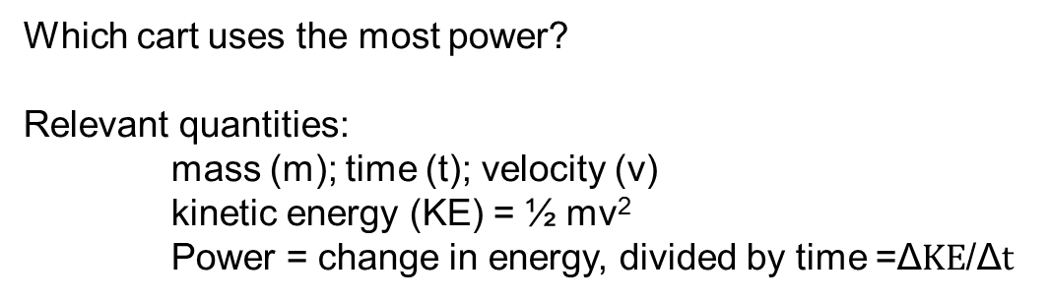
Which cart uses the most power?
Relevant quantities:
mass (m); time (t); velocity (v)
kinetic energy (KE) = ½ mv²
Power = change in energy, divided by time =Δ/Δ

Slide 44
c
c

Slide 53
Sample Student Response (High School)

Slide 54
Could now add numerical question by giving actual values for masses, velocities, times, etc. (But that was not done in this case.)

Slide 55
Electromagnetism Unit
Modeled in part on Physics by Inquiry, curriculum designed for pre-service teachers
  activity sequence followed, but original text not used
Extended over three months (~ 10 class hours)
Directed at goals of building, and understanding operation of, motor and generator.

Slide 56
Motor and Generator
Electric motor uses the principle that a coil of wire carrying an electric current behaves as a magnet itself (an “electromagnet”)
Electrical generator uses the principle that an electric current is “induced” in a coil of wire, if a magnet is moved into and out of that coil.
To understand these things, it’s helpful first to explore the magnetic field pattern of an ordinary magnet.

Slide 57
Field Mapping Activity
In the center of a blank sheet of paper, tape down a bar magnet and draw an outline of the magnet.
Place a small compass in contact with the magnet, and draw dots at the tip and tail of the compass needle. Remove the compass and draw an arrow to represent the direction of the needle.
Place the compass on the paper again, so the tail of the needle is at the position of the tip of the first arrow; draw a second arrow as you did the first. Continue this process until you run off the page or back into the magnet.
Repeat this process at different points on the magnet.

Slide 58
Assessment: Field Mapping Homework
On a blank sheet of paper, draw an outline of a bar magnet in the center of the paper.
Use your class notes to draw arrows representing the direction of all of the compass needles. You should have 20-30 small arrows drawn on your paper, along with the outline of the bar magnet.
Hand this in together with your class notes; make sure your name is on both sheets of paper.

Slide 59
Assessment: Field Mapping Homework
On a blank sheet of paper, draw an outline of a bar magnet in the center of the paper.
Use your class notes to draw arrows representing the direction of all of the compass needles. You should have 20-30 small arrows drawn on your paper, along with the outline of the bar magnet.
Hand this in together with your class notes; make sure your name is on both sheets of paper.

Slide 60
Field Mapping Activity/Homework
Outcome
In-class field maps were reasonably accurate and detailed
On homework, by contrast, there were many errors regarding relative direction of arrows at North and South magnet poles
On homework, only rarely were map details away from poles accurate

Slide 61
Class work, student A
Arrows point away from north pole of magnet
[Accurate map]
Arrows point toward south pole of magnet

Slide 62
Homework, student A
(Fairly accurate map)

Slide 63
Class work, student B
[Accurate map]

Slide 64
Homework, student B
[Less accurate map]

Slide 65
Class work, student C
[Fairly accurate map]

Slide 66
Homework, student C
[Incorrect map]

Slide 67
Short-lived Learning
Careful and accurate classroom observations reflected imperfectly on follow-up homework assignment

Slide 68
Caution:
Learning Gains May Be Temporary
I taught most of these students at least two consecutive years, some three or four
  Most did same or similar activities at least twice
  Short-lived nature of many apparent learning gains was surprising and disturbing (to me)
In several cases, students who had shown clear indications of learning of certain concepts in one year, when observed a year or two later, no longer retained their original understanding

Slide 69
Relevant Questions from Jean Piaget
“…some investigators have succeeded in teaching [certain things]. But, when I am faced with these facts, I always have three questions which I want to have answered before I am convinced….

Slide 70
“…The first question is: ‘Is this learning lasting? What remains two weeks or a month later?’
“The second question is: ‘How much generalization is possible?’ [that is, can the student apply the learning to other situations?]
“…the third question [is]: ‘…what was the…level of the subject before the experience and what…has this learning succeeded in achieving?’ [that is, can the student now learn other concepts of similar complexity?]”
Jean Piaget, J. Res. Sci. Teach. 2, 176 (1964)

Slide 71
Summary
There is great potential for significant physics learning at the middle-school level
The time required to achieve such outcomes is enormous and perhaps under-appeciated
There are grounds for skepticism regarding appropriateness of many common grade-level standards
Assessment of middle-school learning must take into account potentially large decay rates

