Slide 1
The Development of Efforts to Address Physics Students' Mathematical Difficulties
David E. Meltzer
Arizona State University
USA
Supported in part by NSF DUE #1504986

Slide 2
The Problem
Difficulties with basic math skills impact performance of introductory physics students
The difficulties are not resolved by students’ previous mathematical training
Students can’t effectively grapple with physics ideas when they feel overburdened in dealing with calculational issues

Slide 3
Our Approach
Assess nature and scope of difficulties using written diagnostic instruments and one-on-one oral interviews
Address students’ mathematical difficulties within the context of physics classes themselves, using in-class and out-of-class instructional materials

Slide 4
Overview: Requirements for Successful Application of Math to Physics
Understanding of mathematical concepts
Technical skill with mathematical procedures
Ability to apply in physical context
Ability to apply in problem-solving context

Slide 5
1. Understanding of Mathematical Concepts
Recognition of meaning and significance of mathematical operations
Example [trigonometry]: Unknown sides and angles of a right triangle may be found by applying sine, cosine, and tangent functions to known sides and angles
Example [vectors]: Direction of a vector may be defined as the angle with respect to some fixed coordinate system

Slide 6
1. Understanding of Mathematical Concepts
  Sherin (2001): Students’ understanding of the concepts underlying mathematical problem solving are central to success in physics
    Example [wave phenomena]: Steinberg, Wittmann, and Redish (1997) probed students’ understanding of mathematical concepts related to wave propagation
    Example [harmonic motion]: Galle and Meredith (2014) developed tutorial worksheets to address students’ confusion with meaning of, for example, x(t ) =15 cm cos (2π f t )
  How to address these problems: Have students practice explaining the meaning of the mathematical expressions (Galle and Meredith, 2014)

Slide 7
1. Understanding of Mathematical Concepts
  Trigonometry: Many students are confused or unaware (or have forgotten) about the relationships between sides and angles in a right triangle (Meltzer and Jones, 2016).
  Examples: Questions from a diagnostic math test administered at Arizona State University, 2016-2017 (Administered as no-credit quiz during first week labs and/or recitation sections; calculators allowed)

Slide 8
Trigonometry Questions with samples of correct student responses

Slide 9
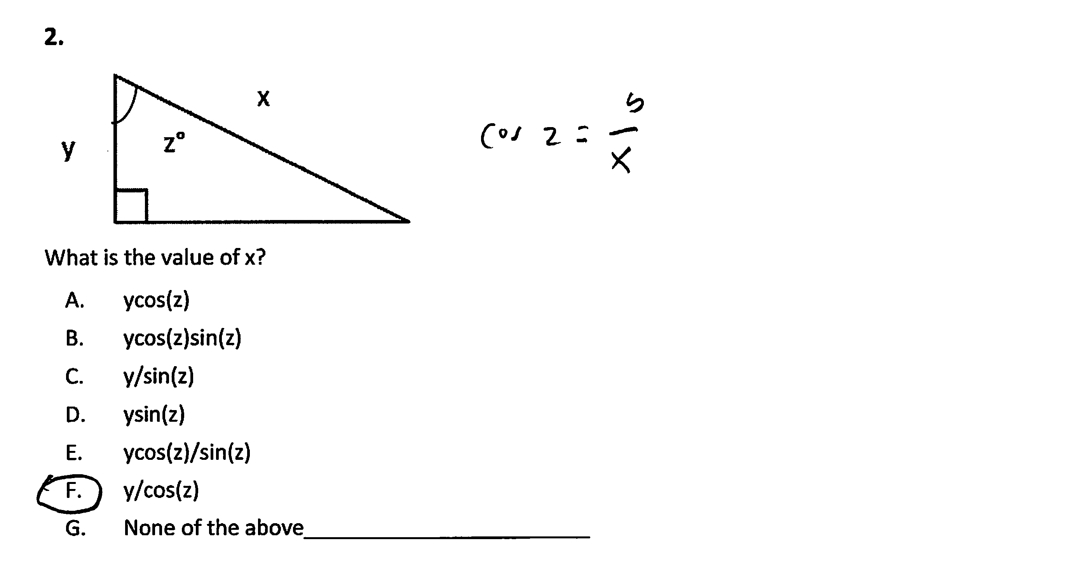

Slide 10
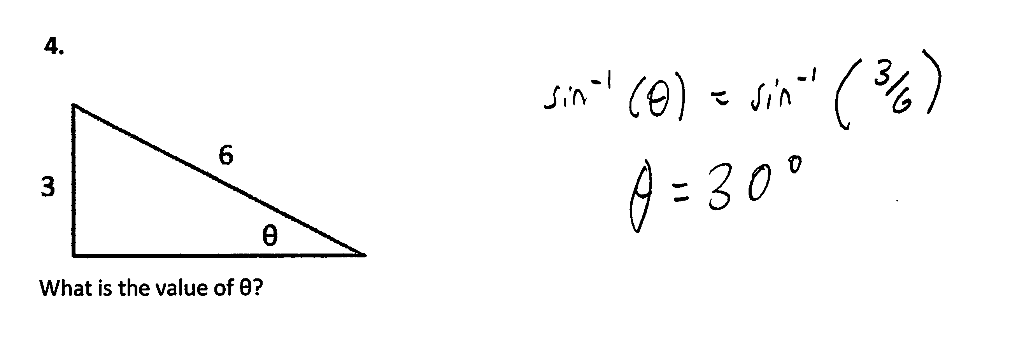
3.

Slide 11
Trigonometry Questions:
Correct Response Rate (% correct responses), #1-3 combined
ASU Polytechnic campus, Spring + Fall average:
  Algebra-based course, 1st semester, (N = 116): 37%
  Algebra-based course, 2nd semester, (N =79): 48%

Slide 12
Results on Trigonometry Questions
Errors oberved: use of incorrect trigonometric function (e.g., cosine instead of sine), calculator set on radians instead of degrees, algebra errors; unaware (or forgot) about inverse trigonometric functions, e.g., arctan, arcsin, arccos [tan⁻¹, sin⁻¹, cos⁻¹]
  How to address these problems: It seems that students require substantial additional practice and repetition with basic trigonometric procedures

Slide 13
1. Understanding of Mathematical Concepts
  Vector Concepts: Many students are confused about the fundamental meaning of vector direction, as well as the role of direction in determining the resultant of two or more vectors (Nguyen and Meltzer, 2003; Barniol and Zavala, 2014; Meltzer and Jones, 2016).

Slide 14
Vector Direction Question
(Meltzer and Jones, 2016)

Slide 15
Vector Direction Question
(Meltzer and Jones, 2016)
All same direction

Slide 16
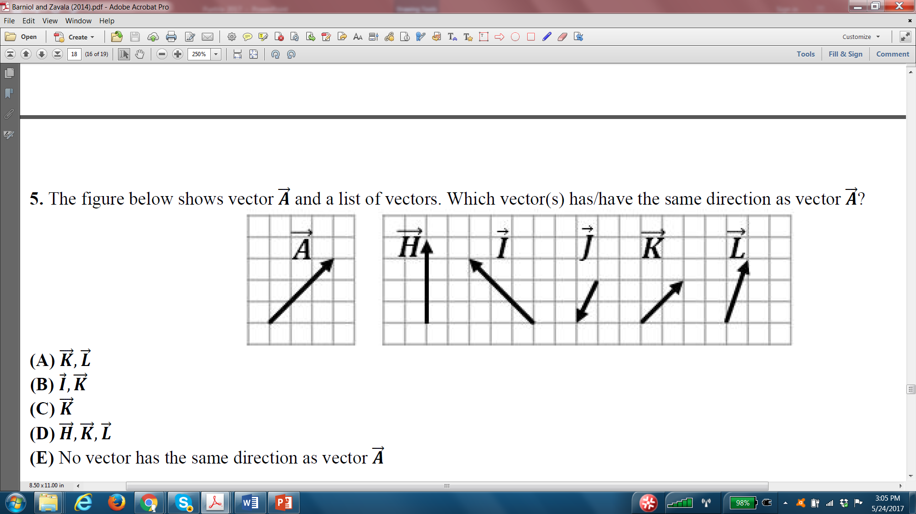
Vector Direction Question
(Barniol and Zavala, 2014)

Slide 17
Vector Direction Question
(Barniol and Zavala, 2014)

Slide 18
For comparison…
A very similar question administered to students at Iowa State University in 2003:

Slide 19
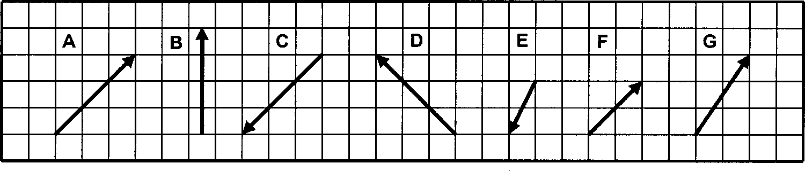
Vector Direction, ISU Diagnostic (Nguyen and Meltzer, 2003)
2. List all the vectors that have the same direction as the first vector listed, A. If there are none, please explain why.
Explain

Slide 20
Vector Direction, ISU Diagnostic (Nguyen and Meltzer, 2003)
2. List all the vectors that have the same direction as the first vector listed, A. If there are none, please explain why.
Explain

Slide 21
Results on Vector Direction
Percent Correct Responses
Calculus-based physics, third semester
  Tecnológico de Monterrey [N = 423] (2014): 86%
  [Barniol and Zavala, 2014]
Calculus-based physics, second semester
  Arizona State University [N = 29] (2016): 66%
  Iowa State University [N = 702] (2003): 77%
Calculus-based physics, first semester
  Arizona State University [N = 104] (2016): 51%
  Iowa State University [N = 608] (2003): 71%

Slide 22
Results on Vector Direction
Percent Correct Responses
Algebra-based physics, second semester
  Arizona State University [N = 52] (2016): 40%
  Iowa State University [N = 201] (2003): 64%
Algebra-based physics, first semester
  Arizona State University [N = 72] (2016): 40%
  Iowa State University [N = 520] (2003): 55%
Fewer correct responses in the algebra-based course

Slide 23
Vector Direction, Most Common Error

Slide 24
Vector Direction, Most Common Error
✓
X

Slide 25
1. Understanding of Mathematical Concepts
  Vector Concepts: Many students are confused about the fundamental meaning of vector direction, as well as the role of direction in determining the resultant of two or more vectors (Nguyen and Meltzer, 2003; Barniol and Zavala, 2014; Meltzer and Jones, 2016).
  How to address these problems: Students must first become aware of the “special” [very precise] meaning of “direction” in physics. They must practice problems to recognize that when adding or subtracting vectors, the exact angle of the vector with respect to some coordinate system must be preserved.

Slide 26
2. Technical Skill
Ability to recognize meaning of specific symbols, and to execute specific mathematical procedures and operations
Example [trigonometry]: Find hypotenuse of right triangle given one side and one angle
Example [vectors]: Add two vectors represented in graphical form [i.e., as arrows in two dimensions]
Example [algebra]: Given two equations with two unknown variables, solve to find value of the unknowns

Slide 27
2. Technical Skill: Symbols
    “Language mismatches”: Students are confused by the very different symbols and techniques used in physics classes, for identical operations first seen in mathematics classes (Dray and Manogue, 1999-2004)
    Unfamiliar symbols: Students are often confused by new symbols or representations used in physics that are not used in mathematics classes, e.g., “arrow” representation of electric fields and gravitational forces; motion graphs (velocity-time, acceleration-time); “flux” [Φ] of electric field through a surface [Meltzer, 2005; Gire and Price, 2013]
    Confusion of symbolic meaning: Students perform worse on solving problems when symbols are used to represent common physical quantities in equations, e.g., “m” (mass [masa]) instead of “1.5 kg” [Torigoe and Gladding, 2007; 2011)

Slide 28
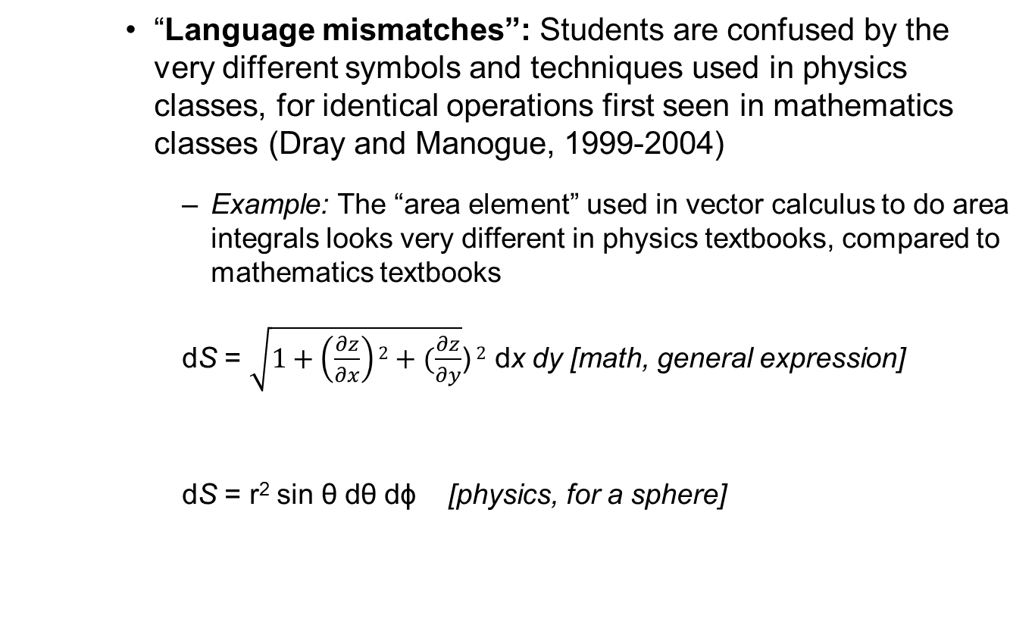
2. Technical Skill: Symbols
    “Language mismatches”: Students are confused by the very different symbols and techniques used in physics classes, for identical operations first seen in mathematics classes (Dray and Manogue, 1999-2004)
      Example: The “area element” used in vector calculus to do area integrals looks very different in physics textbooks, compared to mathematics textbooks
      dS = $\sqrt{1+\left(\frac{∂z}{∂x}\right)2+(\frac{∂z}{∂y}}$) $2$ dx dy [math, general expression]
      dS = r² sin θ dθ dϕ [physics, for a sphere]

Slide 29
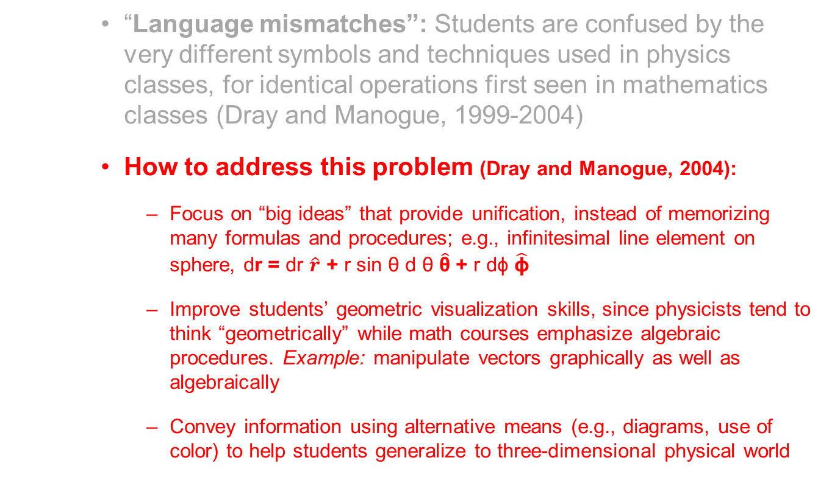
2. Technical Skill: Symbols
    “Language mismatches”: Students are confused by the very different symbols and techniques used in physics classes, for identical operations first seen in mathematics classes (Dray and Manogue, 1999-2004)
    How to address this problem (Dray and Manogue, 2004):
      Focus on “big ideas” that provide unification, instead of memorizing many formulas and procedures; e.g., infinitesimal line element on sphere, dr = dr $\hat{r}$ + r sin θ d θ $\hat{\text{θ}}$ + r dϕ $\hat{\text{ϕ}}$
      Improve students’ geometric visualization skills, since physicists tend to think “geometrically” while math courses emphasize algebraic procedures. Example: manipulate vectors graphically as well as algebraically
      Convey information using alternative means (e.g., diagrams, use of color) to help students generalize to three-dimensional physical world

Slide 30
2. Technical Skill: Symbols
    Unfamiliar symbols: Students are often confused by new symbols or representations used in physics that are not used in mathematics classes, e.g., “arrow” representation of electric fields and gravitational forces; motion graphs (velocity-time, acceleration-time); “flux” [Φ] of electric field through a surface [Meltzer, 2005; Gire and Price, 2013]
    How to address this problem:
      Ensure that students have ample practice with representations used specifically in physics (e.g., diagrams, graphs, charts);
      Include practice in “translating” between different representations (e.g., from “math” to “words” to “graphs”)
      Use “kinesthetic” activities to help students grasp geometrical meanings; Examples: “point fingers” in direction of vector gradient; use ruler and hoop to represent electrical flux (Gire and Price, 2012)

Slide 31
2. Technical Skill: Symbols
    Unfamiliar symbols: Students are often confused by new symbols used in physics that are not used in mathematics classes, e.g., “arrow” representation of electric fields and gravitational forces [Meltzer, 2005); Gire and Price, 2013]
    How to address this problem:
      Ensure that students have ample practice with representations used specifically in physics (e.g., diagrams, graphs, charts);
      Include practice in “translating” between different representations (e.g., from “math” to “words” to “graphs”)
      Use “kinesthetic” activities to help students grasp geometrical meanings; Examples: “point fingers” in direction of vector gradient; use ruler and hoop to represent electrical flux

Slide 32
2. Technical Skill: Symbols
    Confusion of symbolic meaning: Students perform worse on solving problems when symbols are used to represent common physical quantities in equations, e.g., “m” (mass [masa]) instead of “1.5 kg” [Torigoe and Gladding, 2007; 2011)
    Example [University of Illinois]:
Version #1: A car can go from 0 to 60 m/s in 8 s. At what distance d from the start at rest is the car traveling 30 m/s? [93% correct]
Version #2: A car can go from 0 to v₁ in t₁ seconds. At what distance d from the start at rest is the car traveling (v₁/2)? [57% correct]
Much worse!

Slide 33
2. Technical Skill: Symbols
    Confusion of symbolic meaning: Students perform worse on solving problems when symbols are used to represent common physical quantities in equations, e.g., “m” (mass [masa] instead of “1.5 kg”) [Torigoe and Gladding (2007; 2011)
    How to address this problem (Torigoe and Gladding, 2011):
      In order to emphasize meaningful symbolic representation (instead of “plug and chug”), practice with problems that include or require:
        compound expressions (such as 3m instead of m)
        subscripts (such as m_{A} and m_{B})
        multiple or simultaneous equations (e.g., a = Δv/t and v²=2ax)

Slide 34
2. Technical Skill: Procedures
    Vectors: Students have difficulty interpreting and manipulating vector quantities represented as arrows [Nguyen and Meltzer, 2003; Barniol and Zavala, 2014)
      Example: Add (or subtract) vectors A and B to find the resultant
    A B

Slide 35
Addition of Vectors
(From Math Diagnostic Test, Arizona State University)

Slide 36
Addition of Vectors
(From Math Diagnostic Test, Arizona State University)

Slide 37
Addition of Vectors
(Algebra-based Course, 2nd semester, ASU)
Percent correct, Free-response Version (N = 61): 36%

Slide 38
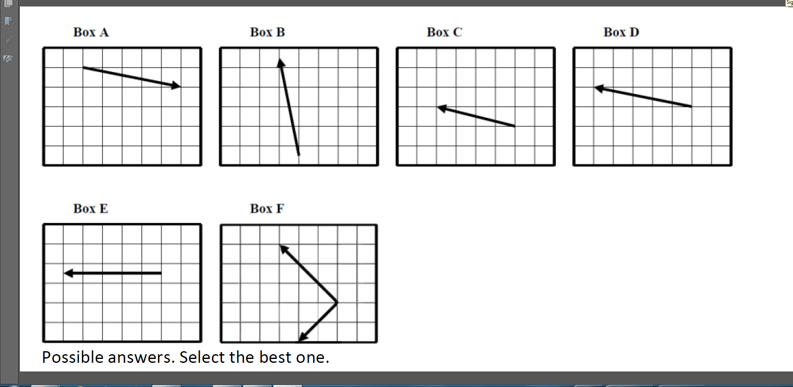
Addition of Vectors
(Algebra-based Course, 2nd semester, ASU)
Percent correct, Multiple-Choice Version (N = 62): 27%
X
✓

Slide 39
Addition of Vectors
Percent Correct Responses
Calculus-based course, first semester
  Arizona State University: 71%
    (multiple-choice: 68%)
  Iowa State University: 58%
Calculus-based course, second semester
  Arizona State University: --
    (similar problem, multiple-choice: 80%)
  Iowa State University: 73%

Slide 40
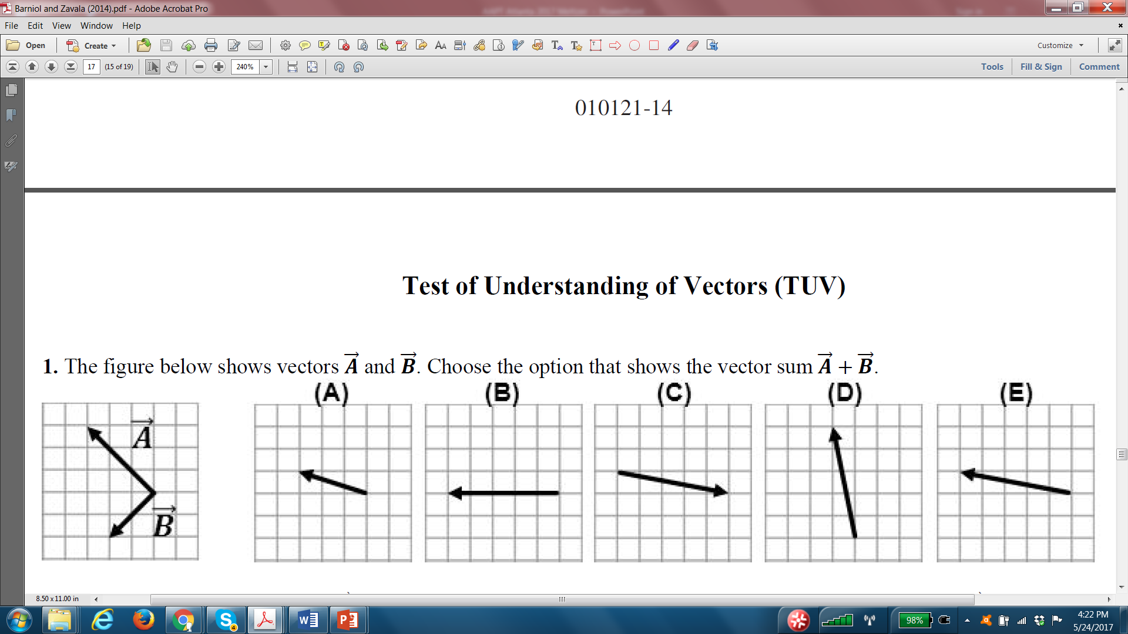
Addition of Vectors
(Calculus-based Course, 3rd semester)
Tecnológico de Monterrey (Barniol and Zavala, 2014)
Percent correct, Multiple-choice, N = 423: 74%

Slide 41
Common Student Errors With Vector Addition
“Split the Difference” or “Bisector Vector”:
“Tip-to-Tip”:
+
=
=
+

Slide 42
2. Technical Skill: Procedures
    Vectors: Students have difficulty interpreting and manipulating vector quantities represented as arrows [Nguyen and Meltzer, 2003; Barniol and Zavala, 2014)
    How to address this problem:
      Practice with a variety of vector orientations; introduce and use the “ijk” coordinate representation for vectors (Heckler and Scaife, 2015)
      Design tutorial worksheet to aid students’ understanding of scalar (“dot”) product of vectors (Barniol and Zavala, 2016)
      Provide extensive on-line practice and homework assignments related to frequently used vector procedures (Mikula and Heckler, 2017)

Slide 43
2. Technical Skill: Procedures
    Algebra: Students have difficulties in solving two simultaneous equations, and those difficulties are much greater when the equations are in symbolic form (Meltzer and Jones, 2016-2017)

Slide 44
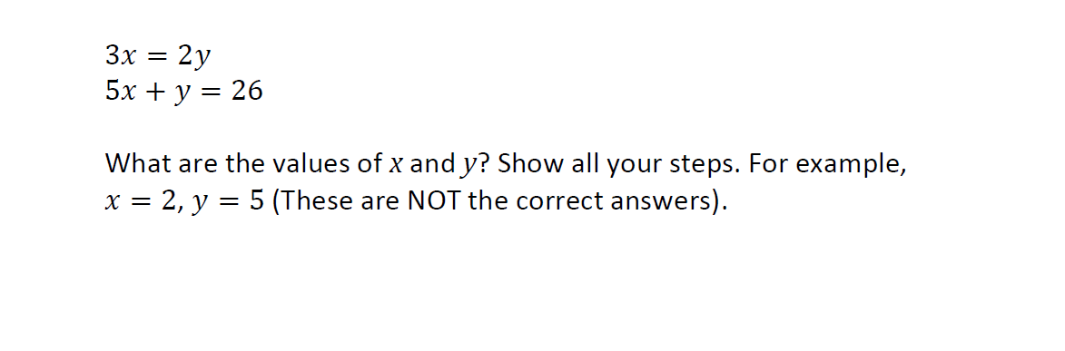
Algebra: Simultaneous Equations
Correct Response Rate, ASU (% correct responses)
Algebra-based course, second semester (N = 123): 70%

Slide 45
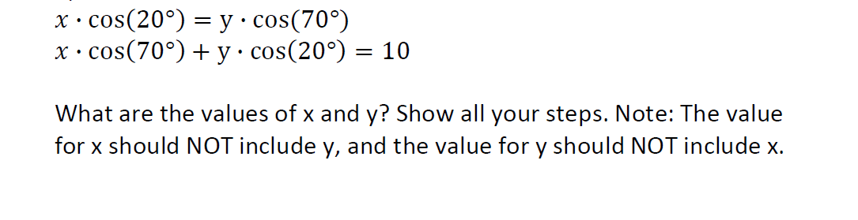
Algebra: Simultaneous Equations
Correct Response Rate, ASU (% correct responses)
Algebra-based course, second semester (N =150): 20-30%
(different campuses, slightly different versions)

Slide 46
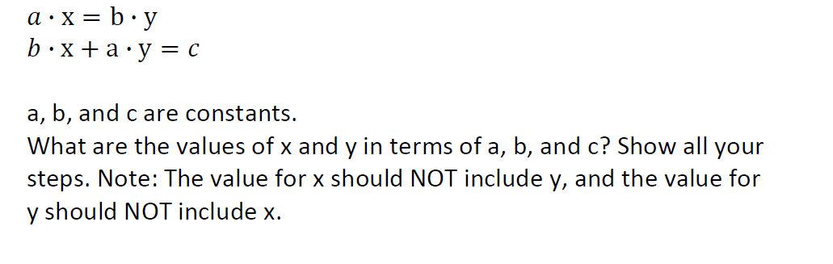
Algebra: Simultaneous Equations

Slide 47
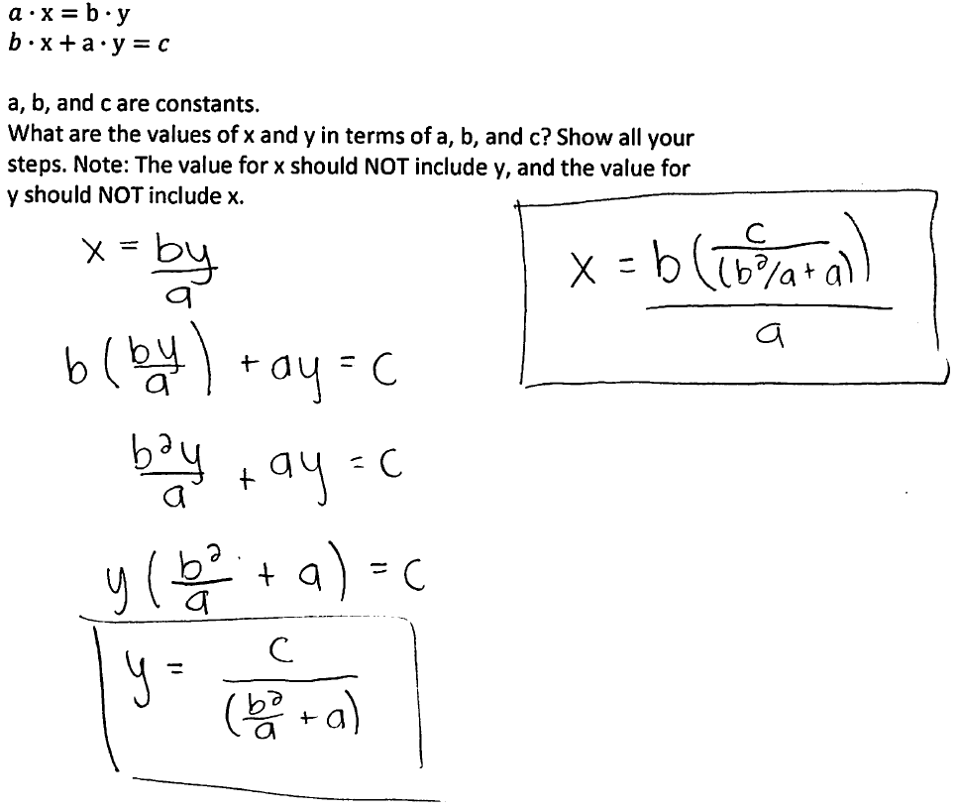
Algebra: Simultaneous Equations
Sample of Correct Student Response

Slide 48
Algebra: Simultaneous Equations
Correct Response Rate, ASU (% correct responses)
Algebra-based course, second semester (N =150): 10-20%
(different campuses, slightly different versions)
Only 10-20% correct responses!

Slide 49
Sources of Difficulties
Carelessness
  Students very frequently self-correct errors during interviews
  Evidence of carelessness on written diagnostic
Skill practice deficit: Insufficient repetitive practice with learned skills
  E.g., applying definitions of sine and cosine
Conceptual confusion
  E.g., not realizing that sides and angles of right triangle are related by trigonometric functions

Slide 50
How to Address Difficulties?
Carelessness:
  (1) review and check steps
  (2) find alternative solutions
  (3) habitual use of estimation
  (4) apply dimensional analysis (for physical problems)
Skill deficit: Practice and repetition
Conceptual confusion: Review and study of basic ideas

Slide 51
3. Ability to Apply Mathematics in a Physical Context
Student difficulties that appear to be mathematical in origin may actually be due in part to application in a physical context [Shaffer and McDermott, 2005; Christensen and Thompson, 2010-12; Thompson, Manogue, Roundy, and Mountcastle, 2012; Barniol and Zavala, 2010; Zavala and Barniol, 2013]
Example [calculus]: Finding and comparing the “area under the curve” by applying the definite integral may be more challenging in a thermodynamics context (thermodynamic process represented on a Pressure-Volume diagram) [Christensen and Thompson, 2010-2012]
Example [vectors]: The method used and the errors made by students when adding or subtracting vectors depend strongly on the specific physical context, and on whether there is a physical context [Shaffer and McDermott, 2005; Van Deventer and Wittmann, 2005; Barniol and Zavala, 2010]

Slide 52
3. Ability to Apply Mathematics in a Physical Context
Student difficulties that appear to be mathematical in origin may actually be due in part to application in a physical context
    How to address this problem:
      Mathematics procedures must be practiced in a variety of physical contexts, and students must be made aware of possible confusion introduced by the context

Slide 53
3. Ability to Apply Mathematics in a Problem-Solving Context
Students often fail to make use of specific mathematical tools that they do know how to use, because they don’t recognize their applicability to a physics problem [Bing and Redish, 2009; Gupta and Elby, 2011]
    How to address this problem:
      Ask open-ended questions, and vary the physical context, to provide a wide range of possible responses
      Become aware of how students interpret problems; “exaggerate” cues regarding appropriate solution pathways (Bing and Redish, 2009)
      Guide students to seek coherence between formal and “everyday” reasoning (Gupta and Elby, 2011)

Slide 54
Summary:
What Options do Physics Instructors Have for Dealing with Students’ Mathematics Difficulties?
Test to assess scope of problem
Take time to review basic math
Assign or suggest out-of-class math review practice
  [We will be developing appropriate instructional materials]
Reduce mathematical burden of syllabus
  more qualitative problems, fewer problems requiring algebraic manipulation
Nothing: Leave it up to the students

