Slide 1
Nature of Students’ Mathematical Difficulties in Introductory Physics Courses
David E. Meltzer and Dakota H. King
Arizona State University
Supported in part by NSF DUE #1504986

Slide 2
Outline
Weak skills with basic pre-college mathematics can severely impact physics students’ course performance
We have explored the nature and prevalence of physics students’ difficulties with elementary mathematics, using “stripped-down” problems with little or no physics context

Slide 3
Work to Date
Administer (and analyze) written diagnostic quiz, given to > 4000 students in ≈ 30 algebra- and calculus-based physics classes over seven semesters at Arizona State University during 2016-2019; calculators are allowed
Carry out individual interviews with 75 students enrolled in those or similar courses during same period (Primary interviewer: Matt Jones)
Topics: trigonometry, algebra, vectors, graphing, geometry

Slide 4
Our 4 Sample Populations
PHY 111: Algebra-based; 1st semester
PHY 112: Algebra-based; 2nd semester
PHY 121: Calculus-based; 1st semester
PHY 131: Calculus-based; 2nd semester

Slide 5
Our 8 Sample Populations
PHY 111: Algebra-based; 1st semester
PHY 112: Algebra-based; 2nd semester
PHY 121: Calculus-based; 1st semester
PHY 131: Calculus-based; 2nd semester
Tempe
Poly
Tempe
Poly
Tempe
Poly
Tempe
Poly

Slide 6
Our 8 Sample Populations
PHY 111: Algebra-based; 1st semester
PHY 112: Algebra-based; 2nd semester
PHY 121: Calculus-based; 1st semester
PHY 131: Calculus-based; 2nd semester
Tempe
Poly
Tempe
Poly
Tempe
Poly
Tempe
Poly
On average, students in the Tempe courses have more extensive background and preparation (and different majors) than those in the corresponding Poly courses.

Slide 7
Our 8 Sample Populations
PHY 111: Algebra-based; 1st semester
PHY 112: Algebra-based; 2nd semester
PHY 121: Calculus-based; 1st semester
PHY 131: Calculus-based; 2nd semester
Tempe
Poly
Tempe
Poly
Tempe
Poly
Tempe
Poly

Slide 8
Our 16 Sample Populations
PHY 111: Algebra-based; 1st semester
PHY 112: Algebra-based; 2nd semester
PHY 121: Calculus-based; 1st semester
PHY 131: Calculus-based; 2nd semester
Tempe
Poly
Tempe
Poly
Tempe
Poly
Tempe
Poly
Fall
Spring
Fall
Spring
Fall
Spring
Fall
Spring
Fall
Spring
Fall
Spring
Fall
Spring
Fall
Spring

Slide 9
Our 16 Sample Populations
PHY 111: Algebra-based; 1st semester
PHY 112: Algebra-based; 2nd semester
PHY 121: Calculus-based; 1st semester
PHY 131: Calculus-based; 2nd semester
Tempe
Poly
Tempe
Poly
Tempe
Poly
Tempe
Poly
Fall
Spring
Fall
Spring
Fall
Spring
Fall
Spring
Fall
Spring
Fall
Spring
Fall
Spring
Fall
Spring
Each of the 16 sample populations has distinct and consistent differences from all of the others!

Slide 10
Primary Findings
Regardless of course (algebra- or calculus-based), campus (Tempe or Poly), or semester (Spring or Fall):
Difficulties with basic mathematical operations are widespread; average error rates range from 20-70%;
Performance on algebraic problems using symbols for constants is significantly worse than on problems using numbers;
During problem-solving interviews, students self-correct approximately 50% of errors following minimal prompts.

Slide 11
Variations in Student Performance
Even in the same course, diagnostic scores on individual test items can vary substantially from one year to the next
Variations are often larger than expected based purely on statistical uncertainty
Example: Class Size = 100, score = 50%, 80%-confidence interval is ±6.4% (based on binomial proportions)

Slide 12
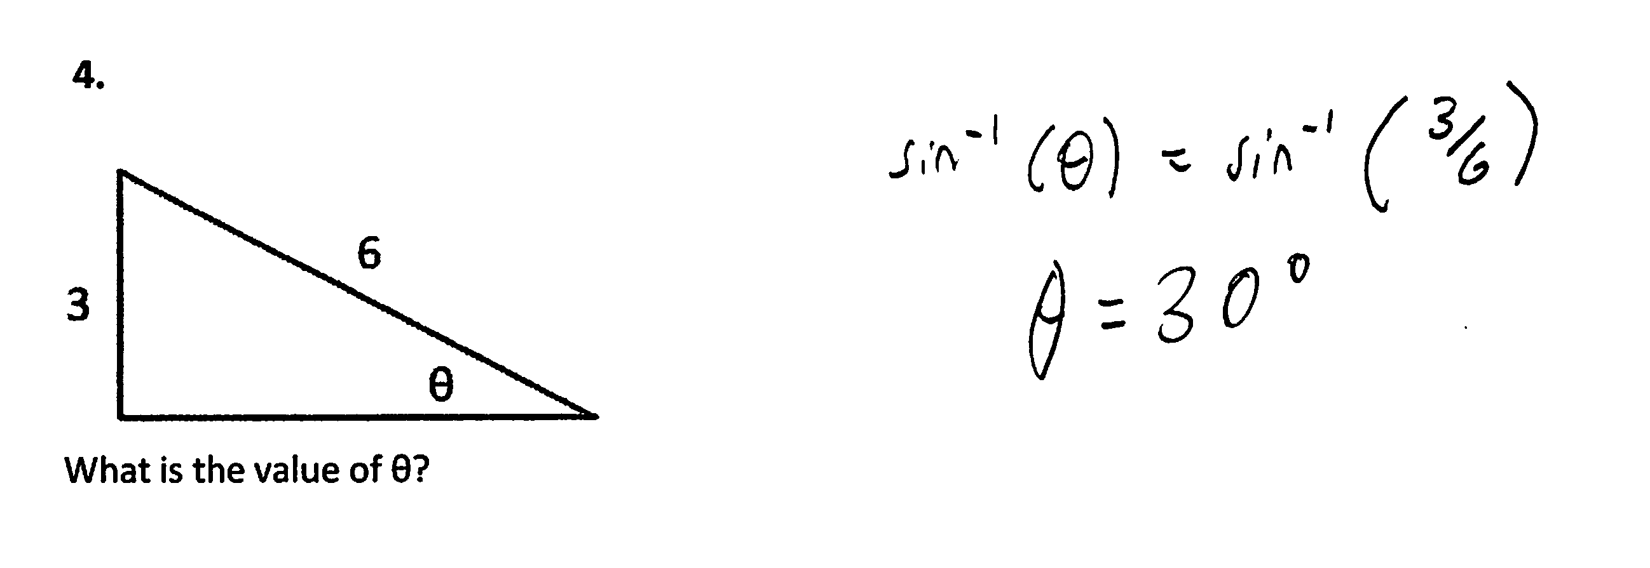
“Find Unknown Angle”
3.

Slide 13
“Find Unknown Angle”
3.

Slide 14
Performance Variations: Examples
Same course, same campus, same semester, same question—three different years.
(Algebra-based physics, 1st semester, Polytechnic campus, spring semester; “find unknown angle”)
2016: 36% correct (N = 72)
2018: 47% correct (N = 88)
2019: 39% correct (N = 54)

Slide 15
Performance Variations: Examples
Same course, same campus, same semester, same question—three different years.
(Calculus-based physics, 1st semester, Polytechnic campus, spring semester; “find unknown angle”)
2016: 70% correct (N = 105)
2017: 71% correct (N = 42)
2019: 42% correct (N = 69)

Slide 16
Performance Variations: Examples
Same course, same campus, same semester, same question—three different years.
(Calculus-based physics, 1st semester, Tempe campus, spring semester; “find unknown angle”)
2017: 77% correct (N = 98)
2018: 87% correct (N = 903)
2019: 88% correct (N = 99)

Slide 17
Significant Variations Between Campuses
Students at the Tempe and Polytechnic campuses:
generally follow different majors with different course sequences
have different average levels of preparation

Slide 18
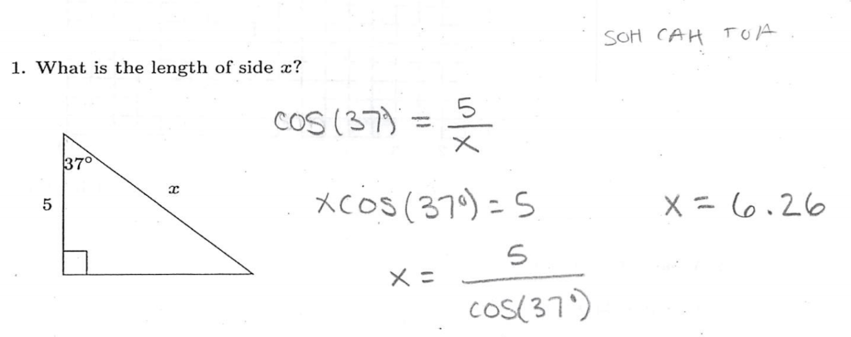
“Find Unknown Side”

Slide 19
“Find Unknown Side”

Slide 20
Comparison: Tempe campus vs. Polytechnic campus
Take average of (fall + spring) semesters; Year 2018:
Algebra-based course, 1st semester
Example #1: Find unknown side of triangle
Polytechnic campus: 25% correct (N = 121)
Tempe campus: 57% correct (N = 376)
Example #2: Find unknown angle of triangle
Polytechnic campus: 35% correct (N = 152)
Tempe campus: 52% correct (N = 533)
Superior performance on Tempe campus

Slide 21
Some Basic Operations: Area, Graphing, Algebra
Find area of circle
Find slope of graph
Solve two simultaneous equations

Slide 22
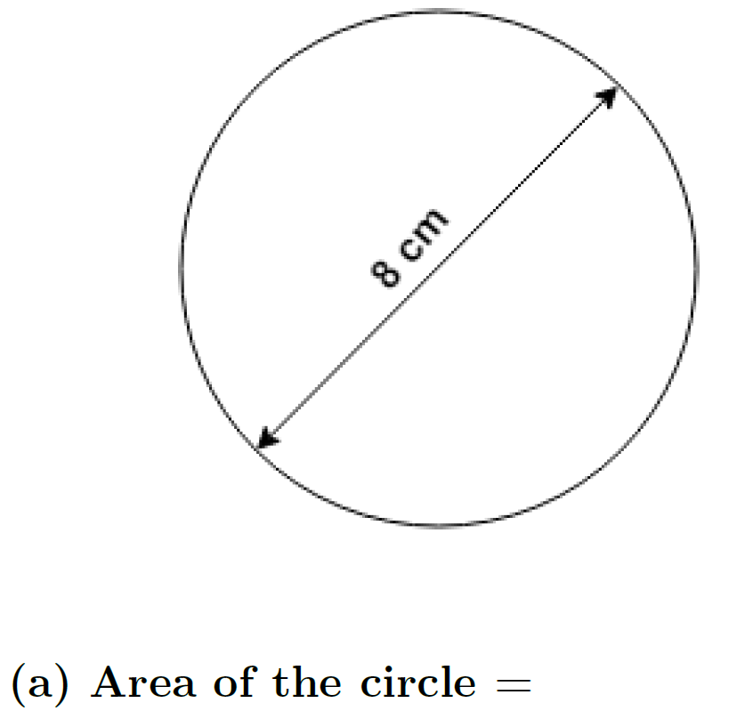
Algebra- and Calculus-based Courses Combined
(% correct responses)
Polytechnic campus: 57% (N = 250)
(5 classes, range 48-61%)
….with correct units: 29%
Tempe campus: 76% (N = 1086)
(5 classes, range 74-79%)
….with correct units: 45%
$[Area=πr^{2}$=16$π$ cm²]
Little difference between algebra- and calculus-based courses
Interchanging radius and diameter was NOT most-common error

Slide 23
Answer: 2/3 m/s
Accepted as correct response: “2/3”
[less than 5% of respondents included proper units in their answer]
Correct-response rate: 30-60% (N > 2000);
nearly independent of course or campus
Most common error: counting grid squares and ignoring numbers on axes

Slide 24
From Torigoe and Gladding (2011):

Slide 25
From Torigoe and Gladding (2011):
Mg − T = Ma
TR = Iα
[I = ½ MR²; α = a/R]
…→
Mg − T = Ma
TR = [½ MR²][a/R]
a = ?
78.4 – y = 8x
0.5y = 2x
x =?
Our Numeric version

Slide 26
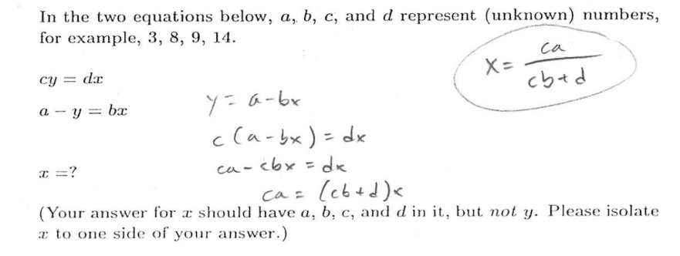
“Symbolic” Version

Slide 27
“Symbolic” Version

Slide 28
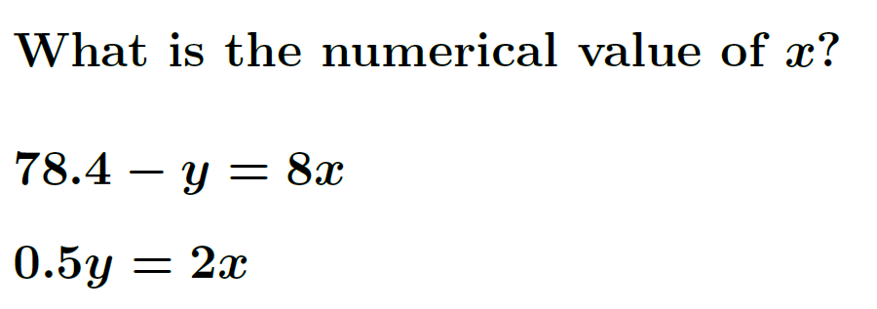
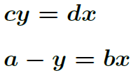
Algebra: Simultaneous Equations
Algebra-based course, 1st semester (% correct; 2018 fall + spring average)
Polytechnic campus: 40% (N = 104)
Tempe campus: 61% (N = 335)
Polytechnic campus: 10% (N = 63)
Tempe campus: 32% (N = 241)
Numeric version
≈20% higher correct-response-rate at Tempe
on both versions;
Symbolic version
≈30% lower correct-response-rate on symbolic version on both campuses

Slide 29
Algebra: Simultaneous Equations
Calculus-based course, 1st semester (% correct; 2018 fall + spring average)
Tempe campus: 79% (N = 1043)
Tempe campus: 55% (N = 862)
Numeric version
18% higher correct-response-rate than in algebra-based course
Symbolic version
24% lower correct-response-rate on symbolic version

Slide 30
Possible Origins of Errors
We assume several different possible sources for students’ errors:
Difficulty with operations: Inadequate learning or expertise with fundamental operations
Difficulty accessing knowledge: Students don’t connect context of problem to context in which operations were learned
“Careless” errors, due to simple inattention, lack of checking, etc.; can be corrected (in principle) by greater attentiveness.
(Note: ≈50% of errors were “self-corrected” during interviews)
Through interviews and diagnostic items, we probe these items.

Slide 31
Diagnostics for Operations with Fractions

Slide 32
Diagnostics for Operations with Fractions

Slide 33
Diagnostics for Operations with Fractions

Slide 34
Diagnostics for Operations with Fractions

Slide 35
Summary: Implications for Instruction
Difficulties due to skill-practice deficits might be addressed by brief out-of-class assignments (e.g., Mikula and Heckler, 2017)
Difficulties due to “carelessness” might be addressed by, e.g., guiding students to carefully check and re-check key steps in their calculation.

