Slide 1
Developing a Strategy to Address Physics Students’ Mathematical Difficulties
David E. Meltzer and Dakota H. King
Arizona State University
Supported in part by NSF DUE #1504986 and #1914712

Slide 2
Outline
Weak skills with basic pre-college mathematics can severely impact physics students’ course performance
We have explored the nature and prevalence of physics students’ difficulties with elementary mathematics, using “stripped-down” problems with little or no physics context
In collaboration with Ohio State University, we are developing and testing an online “skill-practice” tool to improve physics students’ mathematical problem-solving performance

Slide 3
Work to Date
Administer (and analyze) written diagnostic quiz, given to > 4000 students at Arizona State University; calculators are allowed
Carry out individual interviews with 75 students enrolled in those or similar courses during same period
Comparison data: University of Colorado, algebra-based course (N = 388)

Slide 4
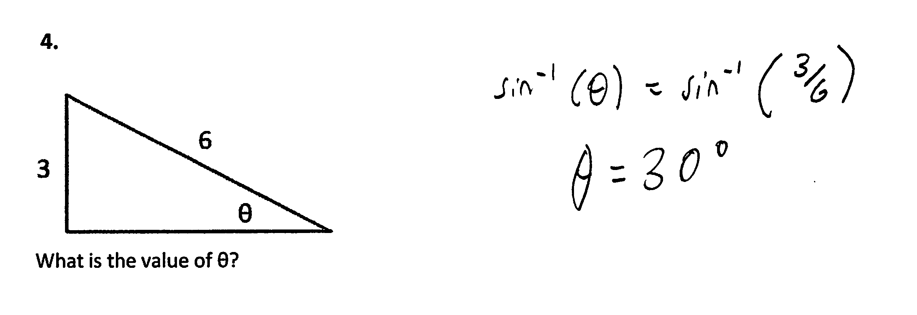
“Find Unknown Angle”
3.

Slide 5
“Find Unknown Angle”
3.

Slide 6
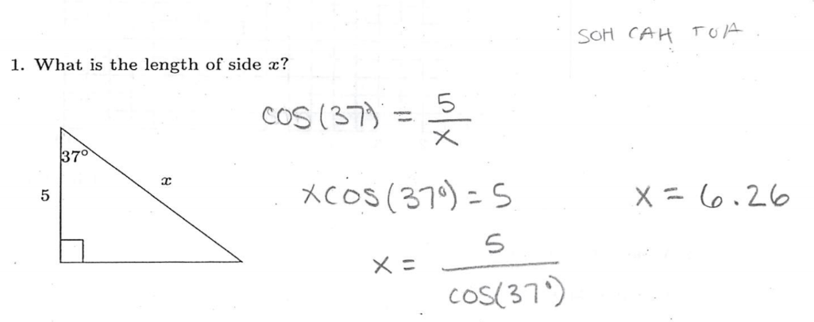
“Find Unknown Side”

Slide 7
“Find Unknown Side”

Slide 8
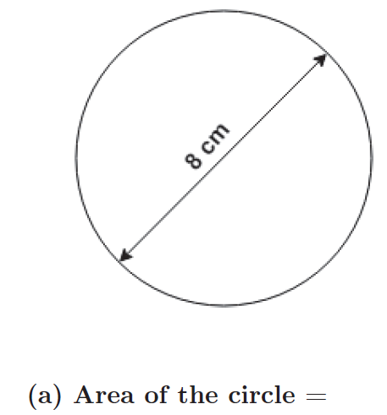
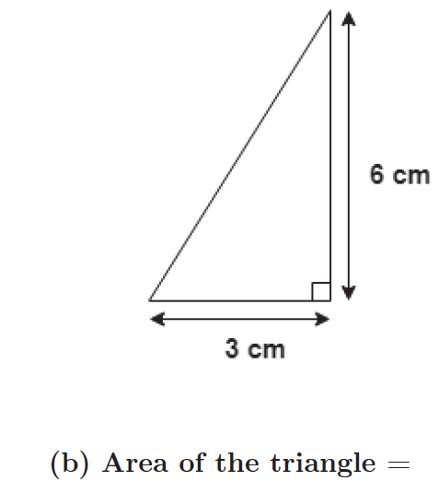
Find Area

Slide 10
Simultaneous Equations, “Numeric” Version

Slide 11
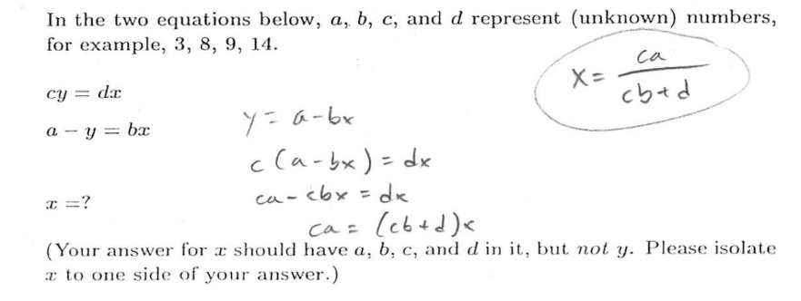
Simultaneous Equations, “Symbolic” Version

Slide 12
Simultaneous Equations, “Symbolic” Version
18.

Slide 13
Simultaneous Equations, “Symbolic” Version
“Multi-step” problem

Slide 14
“Symbolic Multiple Choice”

Slide 16
Our 4 Sample Populations
PHY 111: Algebra-based; 1st semester
PHY 112: Algebra-based; 2nd semester
PHY 121: Calculus-based; 1st semester
PHY 131: Calculus-based; 2nd semester

Slide 17
Our 8 Sample Populations
PHY 111: Algebra-based; 1st semester
PHY 112: Algebra-based; 2nd semester
PHY 121: Calculus-based; 1st semester
PHY 131: Calculus-based; 2nd semester
Tempe
Poly
Tempe
Poly
Tempe
Poly
Tempe
Poly

Slide 18
Our 8 Sample Populations
PHY 111: Algebra-based; 1st semester
PHY 112: Algebra-based; 2nd semester
PHY 121: Calculus-based; 1st semester
PHY 131: Calculus-based; 2nd semester
Tempe
Poly
Tempe
Poly
Tempe
Poly
Tempe
Poly
On average, students in the Tempe courses have more extensive background and preparation (and different majors) than those in the corresponding Poly courses.

Slide 19
Primary Findings
Regardless of course (algebra- or calculus-based), campus (Tempe or Poly), or semester (Spring or Fall):
Difficulties with basic mathematical operations are widespread; average error rates range from 20-70%;
Performance on algebraic problems using symbols for constants is significantly worse than on problems using numbers;
During problem-solving interviews, students self-correct approximately 50% of errors following minimal prompts.

Slide 20
Our 8 Sample Populations
PHY 111: Algebra-based; 1st semester
PHY 112: Algebra-based; 2nd semester
PHY 121: Calculus-based; 1st semester
PHY 131: Calculus-based; 2nd semester
Tempe
Poly
Tempe
Poly
Tempe
Poly
Tempe
Poly

Slide 21
Arizona State University: Algebra-based; 1st semester
Tempe
Poly

Slide 22
Our 3 Sample Populations
Arizona State University: Algebra-based; 1st semester
University of Colorado: Algebra-based, 1st semester
Tempe
Poly

Slide 24
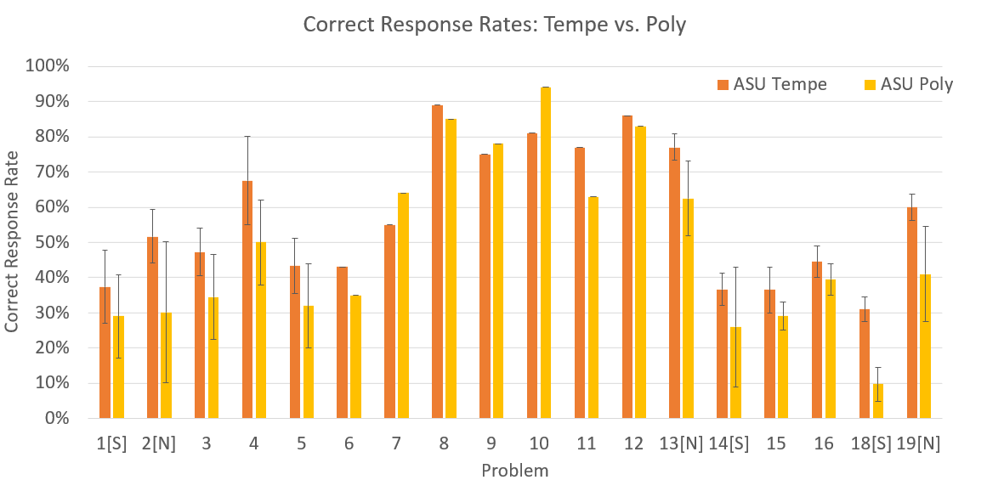

Slide 25
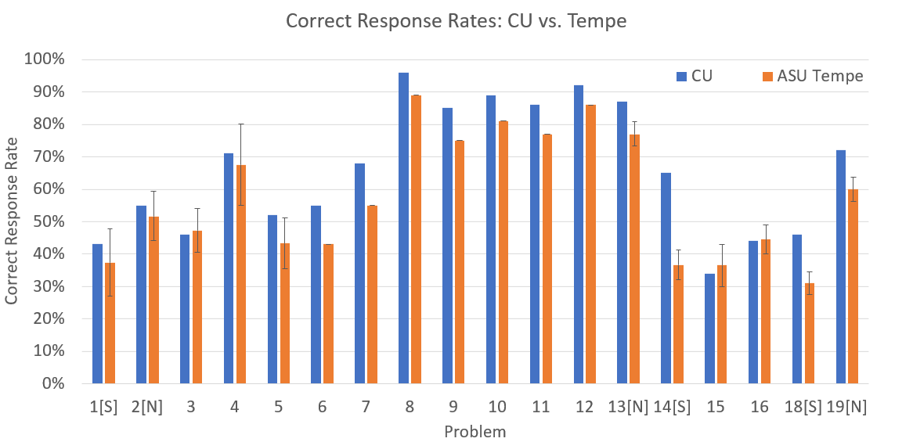

Slide 26
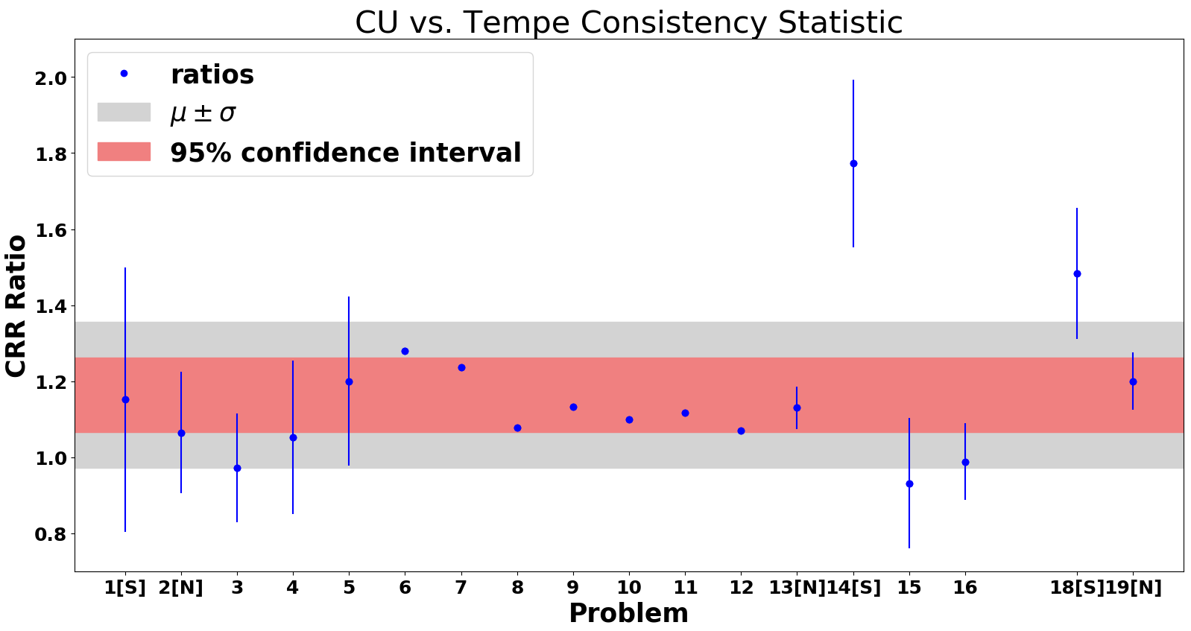

Slide 28
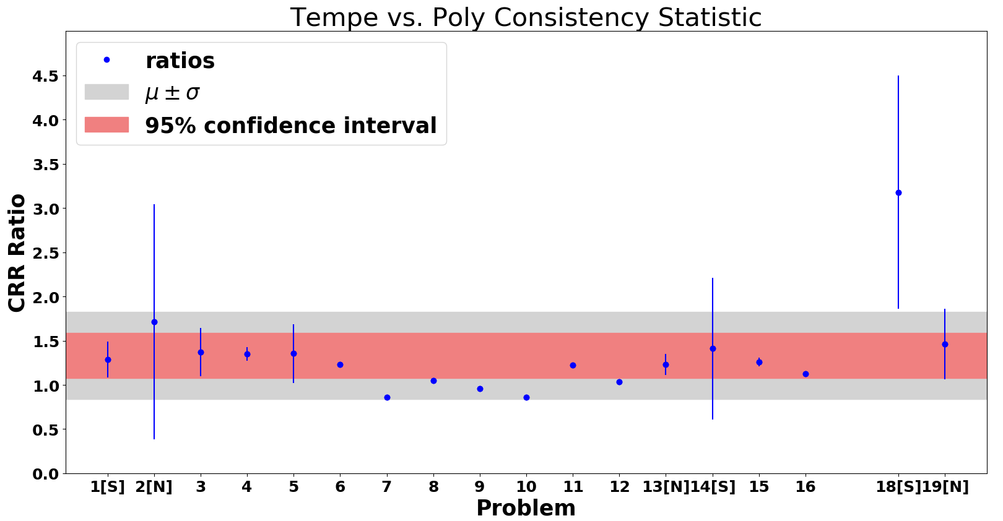

Slide 30
Item Responses Reflect Institutional Differences
The correct-response rate (CRR) for CU on the 19 test items averages 16% higher than those at ASU-Tempe, while Tempe averages 33% higher than Poly, with ratios of all but two test items falling within fairly narrow bands (mean +/− 1 sd).
Conjecture #1: The differences in mean CRRs reflect differences among the institutions’ student populations
Conjecture #2: Most of the (otherwise diverse) test items probe operational ability to similar “degrees”
Conjecture #3: Another “level” of operational-ability difference is probed by the multi-step symbolic test items

Slide 31
Error Types
“Operational” Errors: Inadequate learning or expertise with fundamental operations
Conceptual confusion, e.g., What is an inverse sine? What is slope?
Weak skills with numerical and/or algebraic operations (e.g., factoring)
Inadequate practice with symbolic operations (e.g., dividing fractions)
“Non-operational” Errors: Difficulties connecting context of problem to context in which operations were learned, or “carelessness”
Physics context, e.g., position-time graph with appropriate units
Problems involving multiple linked steps, each involving basic operations
Inattention to detail; failure to check work

Slide 32
Possible Instructional Strategies
Difficulties due to skill-practice deficits might be addressed by short-term, in- and out-of-class tutorials and assignments, designed to refresh students’ previously learned knowledge and skills (e.g., Mikula and Heckler, 2017)
Current project, OSU + ASU, NSF DUE #1914709/1914712
Regular low-stakes on-line homework assignments requiring multiple consecutive correct answers
Inclusion of multi-step contexts in these assignments may reduce the prevalence of non-operational errors as well.

Slide 33
Possible Instructional Strategies
Difficulties due to “carelessness” might be addressed by guiding students to (1) carefully check and re-check key steps in their calculation; (2) slow down, review problem statements, and re-solve when possible
Other studies (e.g., G. White) have shown that much practice and repetition is needed to induce students to adopt consistent error-checking habits

Slide 34
Summary
Physics students’ mathematical errors have a variety of causes
Errors due to skill-practice deficits with basic operations may (perhaps) be addressable through regular, brief online assignments
Errors due to “carelessness,” or difficulties in matching operational skills to physics or mathematics context, may require other corrective measures

