Slide 1
Investigation into the mathematical preparation of introductory physics students
David E. Meltzer,¹ Dakota H. King,¹ and John D. Byrd^{1,2}
¹Arizona State University
²Michigan State University (present address)
Supported in part by NSF DUE #1504986 and #1914712

Slide 2
Data Sources
Diagnostic pretests covering pre-college mathematics given to over 7000 introductory physics students (non-credit; calculators allowed):
More than 80 one-on-one problem-solving interviews
Pre-instruction tests of scientific reasoning skill and physics concept knowledge.

Slide 3
Examples of Test Items

Slide 4
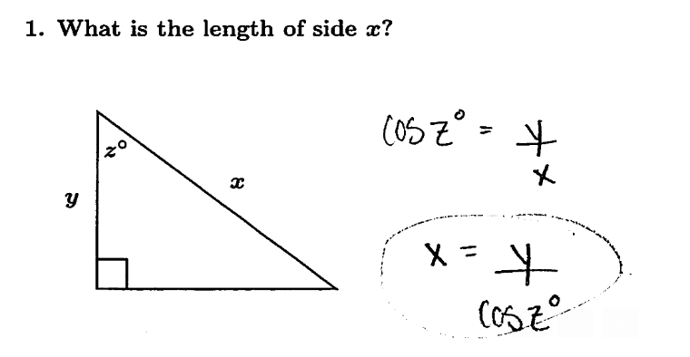
Find Unknown Side

Slide 5
Find Unknown Side

Slide 6
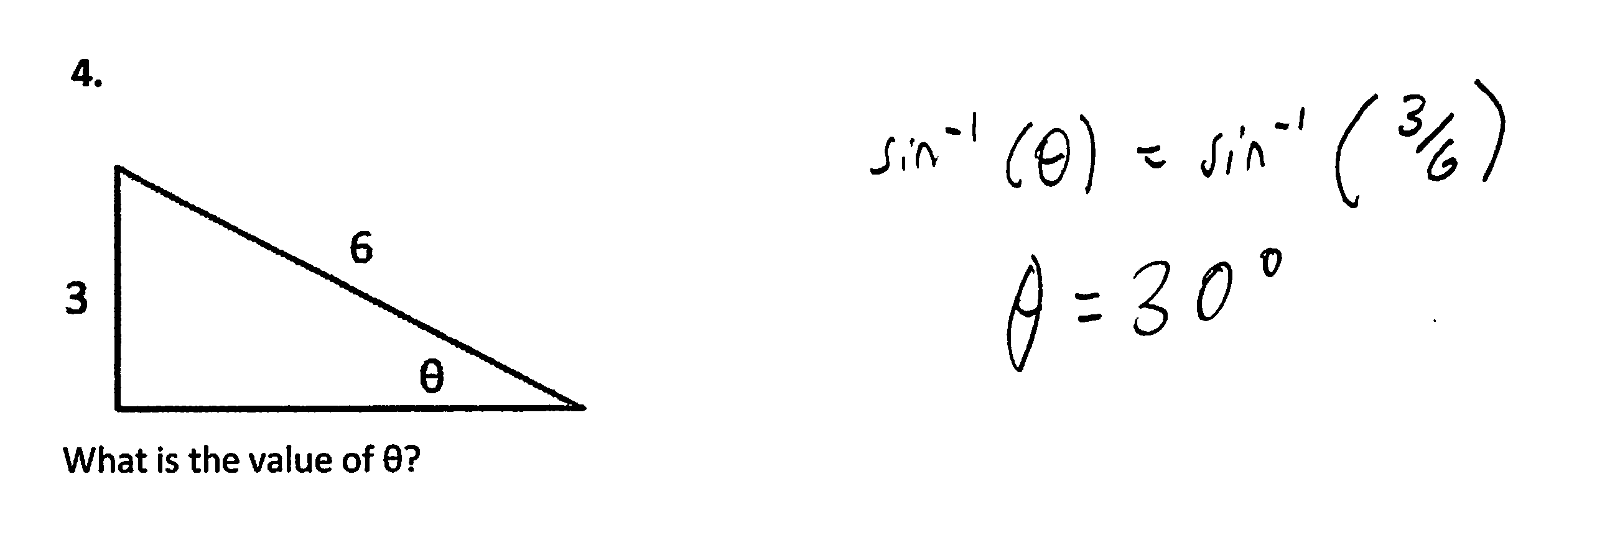
Find Unknown Angle
3.

Slide 7
Find Unknown Angle
3.

Slide 8
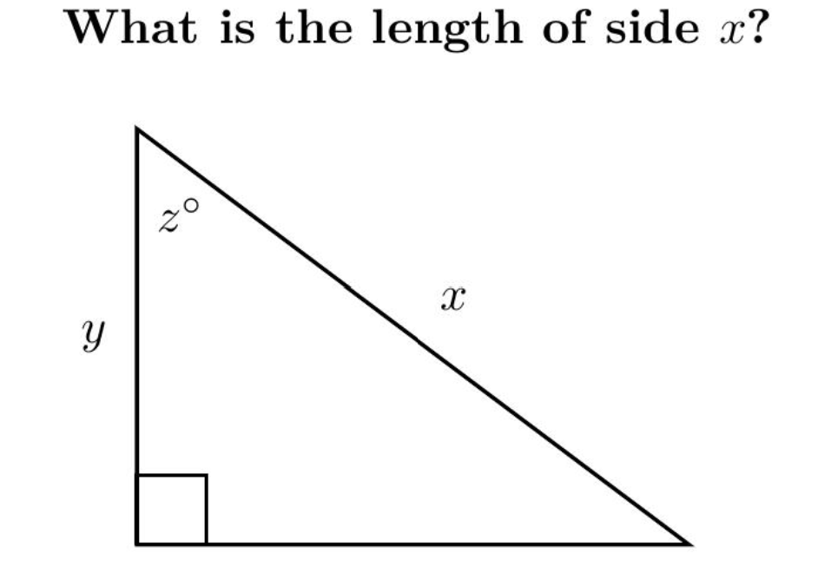
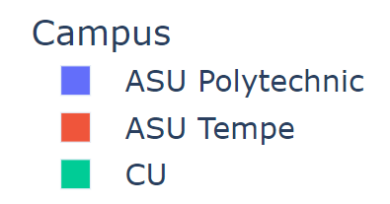
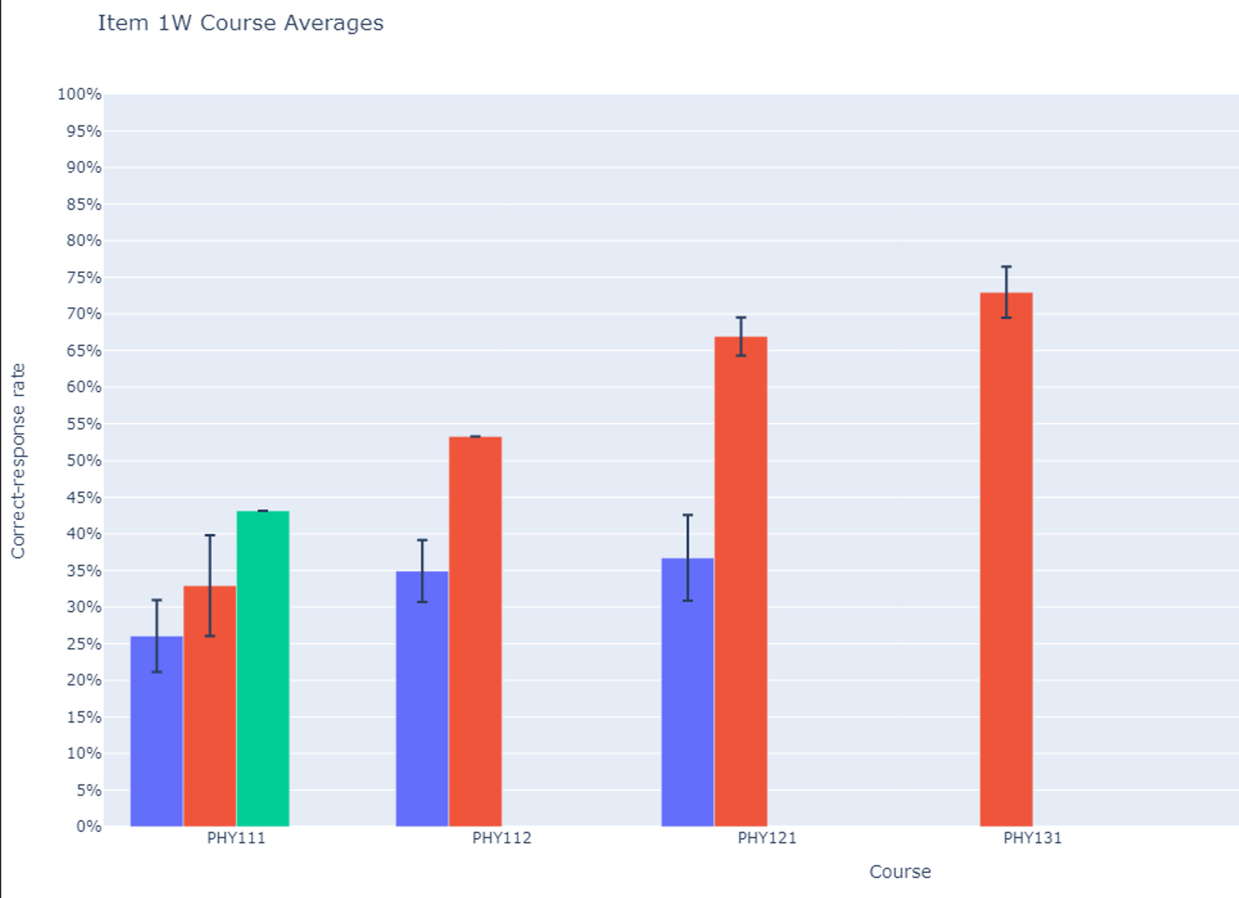
Correct-response rates (written, free-response)
(36 classes; N > 3000)
Alg-1
Alg-2
Calc-1
Calc-2

Slide 9
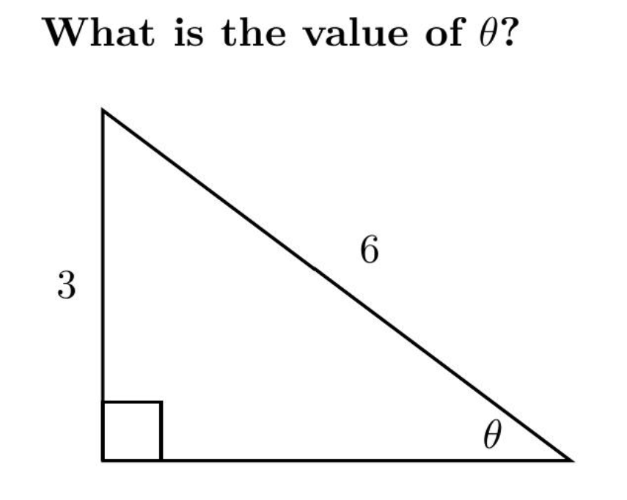
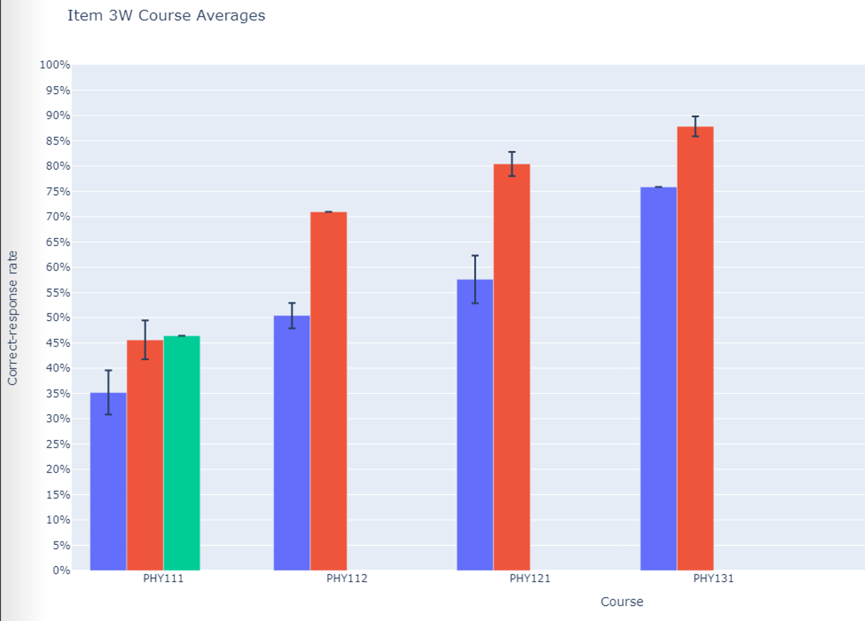
Correct-response rates (written, free-response)
(36 classes; N > 3000)
Most results in the 30-70% range
Alg-1
Alg-2
Calc-1
Calc-2
Alg-1
Alg-2
Calc-1
Calc-2

Slide 10
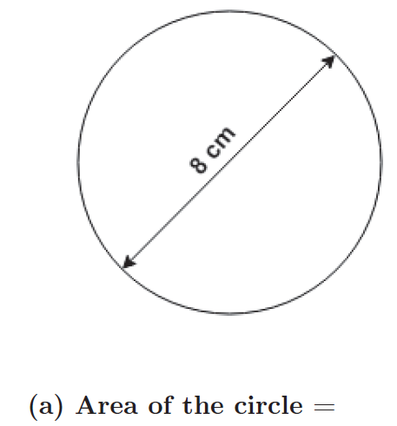
Find Area

Slide 11
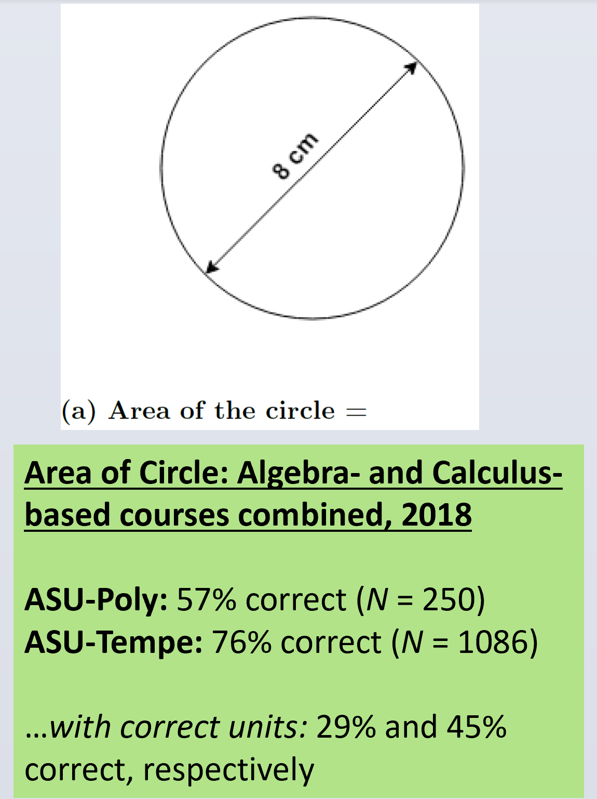
 | N | Numerically correct | Correct with correct units
ASU-Polytechnic | 250 | 57% | 29%
ASU-Tempe | 1086 | 76% | 45%

Slide 12
Find Slope of Graph

Slide 13
Correct-response rate: 30-60% (N > 4000)
(nearly independent of course or campus)
Most common error: Counting grid squares and ignoring numbers on axes

Slide 14
Symbolic notation degrades student performance
Use of symbols to replace numbers in otherwise identical algebraic equations lowered correct-response rates by ≈25%.

Slide 15
Algebra: Simultaneous Equations (Algebra-based course, ASU-T)
0.5y = 2x
78.4 − y = 8x
[Solve for x]
  Numeric Version 61% correct (N = 470)
cy = dx
a − y = bx
[Solve for x]
  Symbolic Version 55% correct (N = 862)

Slide 16
Algebra: Simultaneous Equations (Algebra-based course, ASU-T)
0.5y = 2x
78.4 − y = 8x
[Solve for x]
  Numeric Version 61% correct (N = 470)
cy = dx
a − y = bx
[Solve for x]
  Symbolic Version 31% correct (N = 372)

Slide 17
Algebra: Simultaneous Equations (Calculus-based course, ASU-T)
0.5y = 2x
78.4 − y = 8x
[Solve for x]
  Numeric Version 79% correct (N = 1205)
cy = dx
a − y = bx
[Solve for x]
  Symbolic Version 55% correct (N = 862)

Slide 18
Algebra: Simultaneous Equations (Calculus-based course, ASU-T)
0.5y = 2x
78.4 − y = 8x
[Solve for x]
  Numeric Version 79% correct (N = 1205)
cy = dx
a − y = bx
[Solve for x]
  Symbolic Version 55% correct (N = 1202)

Slide 19
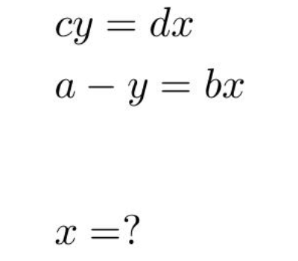
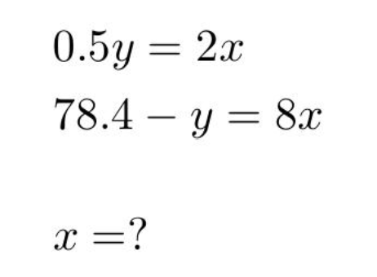
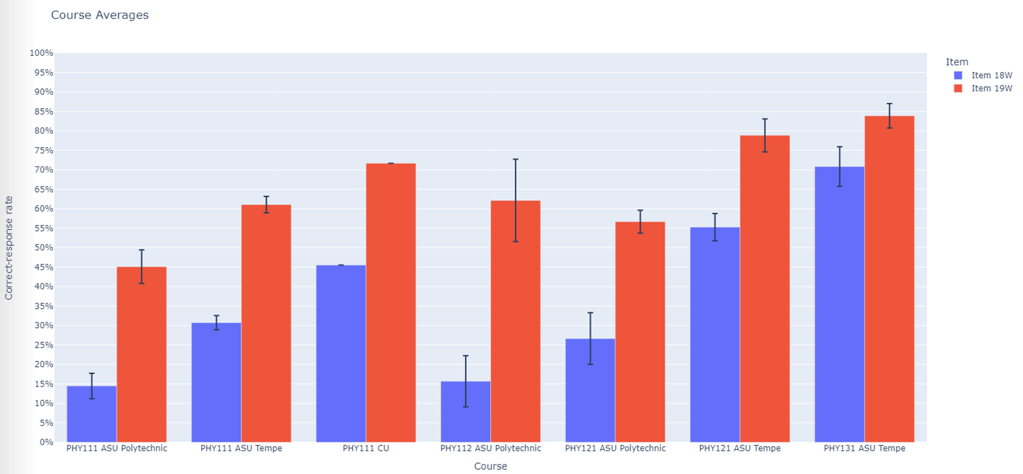
Symbolic
Numeric

Slide 20
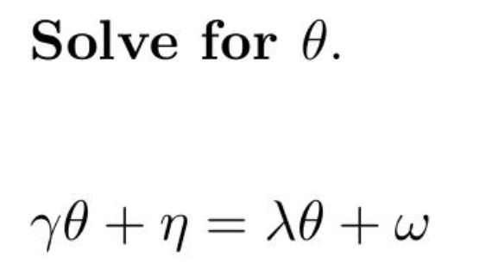
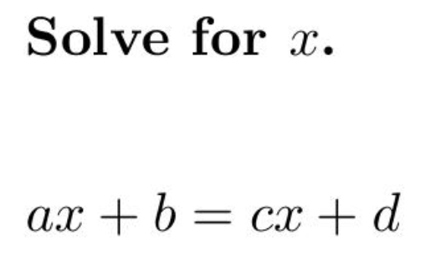
Confusion can result from the nature of the symbols themselves

Slide 21
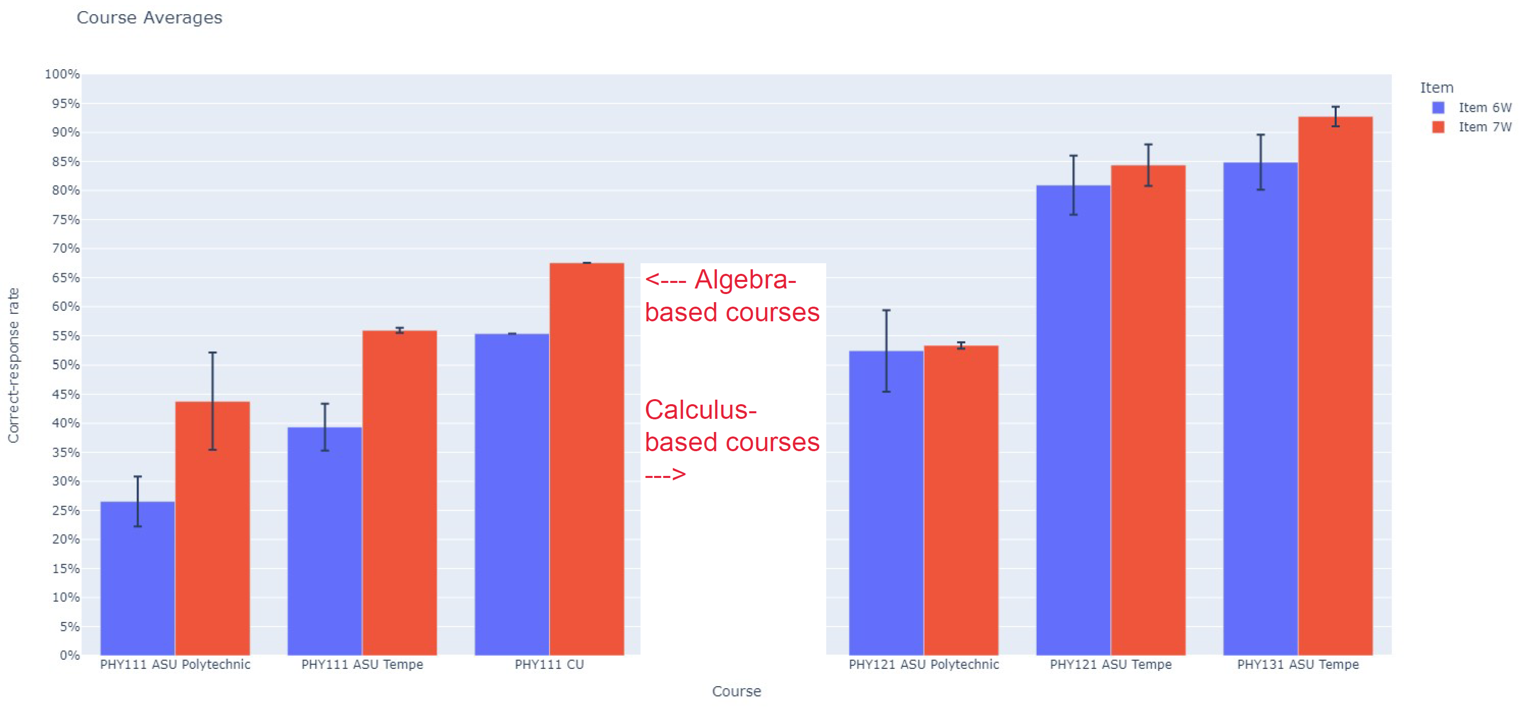
Significantly lower correct-response rates on Greek-letter version in algebra-based courses
(Total N > 1000)

Slide 22
Significantly lower correct-response rates on Greek-letter version in algebra-based courses
(Total N > 1000)

Slide 23
Students favor non-standard solution methods
Introductory physics students favor semi-arithmetic methods for solving solve algebraic equations; they do not “isolate the unknown variable.”

Slide 24
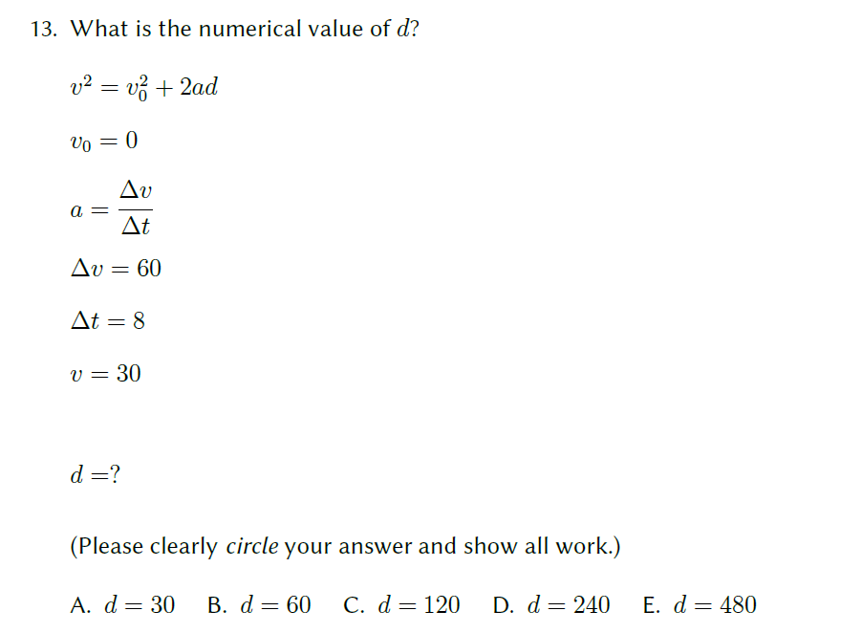
How would you solve this?

Slide 25
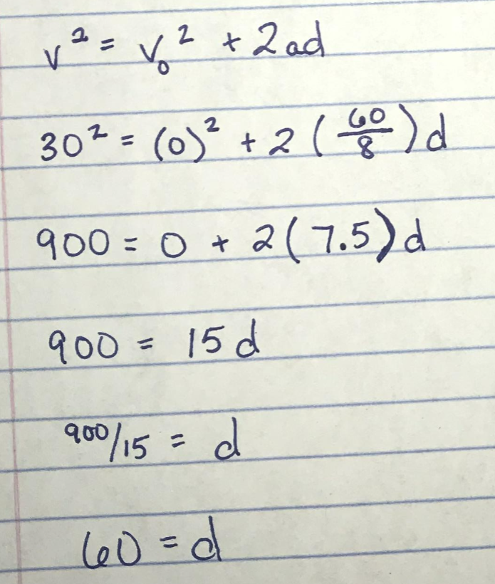
53/53 students solved it this way:
We observed these methods used on thousands of students’ submissions

Slide 26
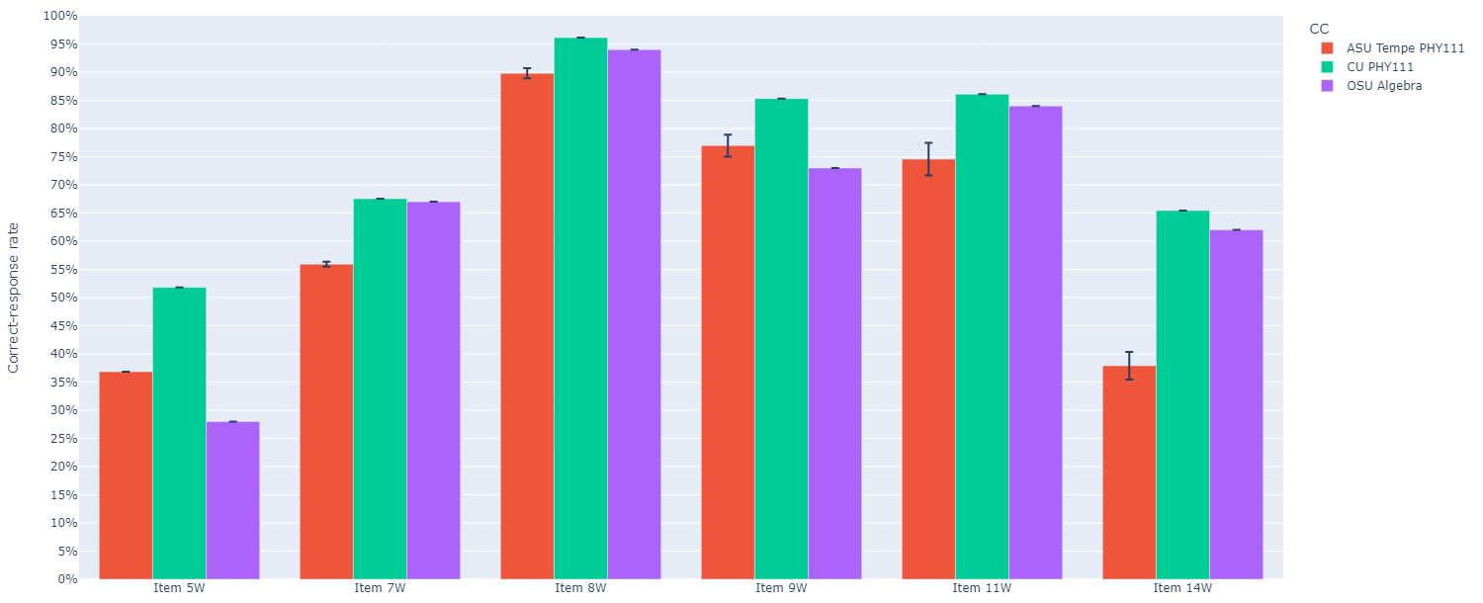
Results consistent among different universities
ASU Tempe (N>500)
CU (N>350)
OSU (N>500)
Correct-response rates: algebra-based course

Slide 27
Caution: Difficulties with one topic implies difficulties with others as well
Students’ scores on different problem types tend to track each other closely: relatively low scores on one type imply relatively low scores on the others
Factor analysis shows only a single factor for entire diagnostic

Slide 28
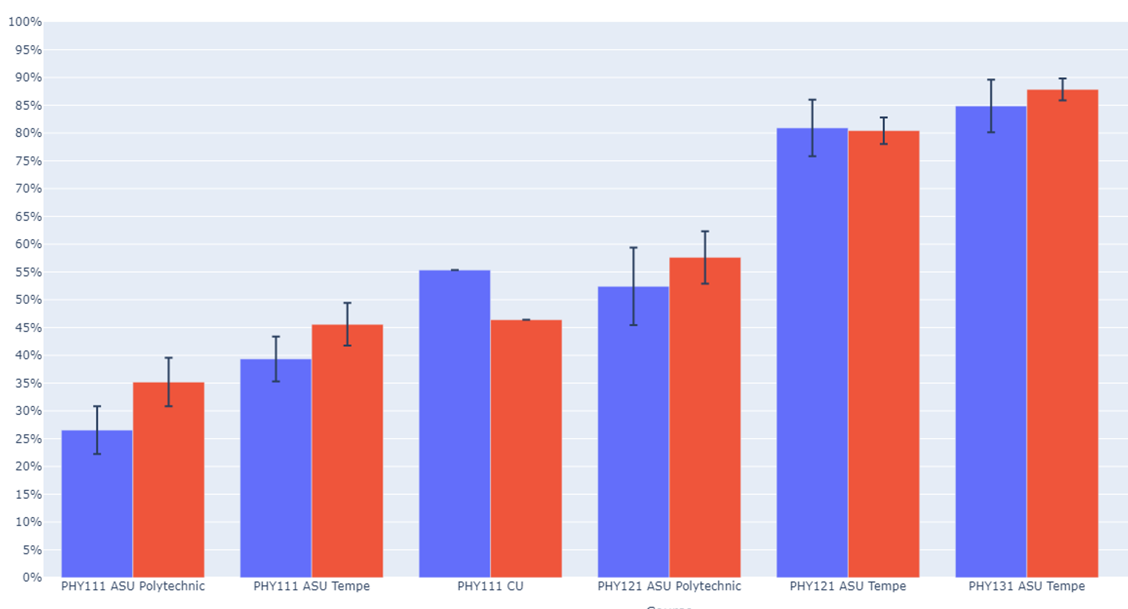
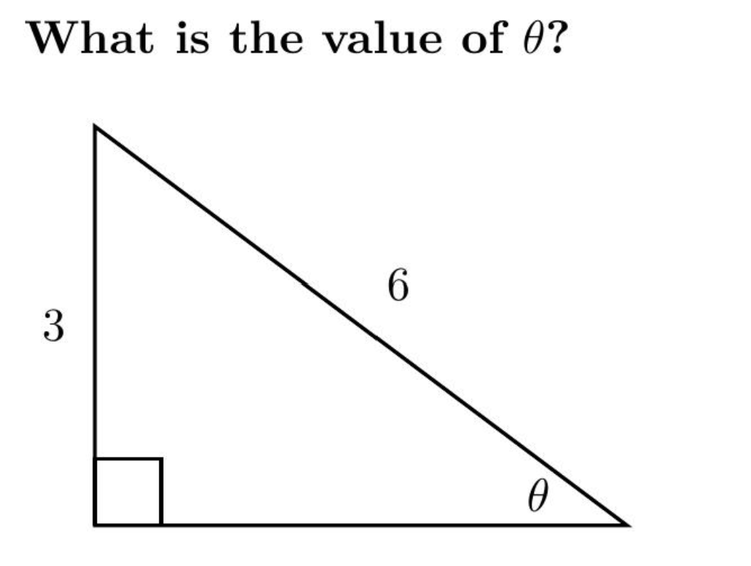
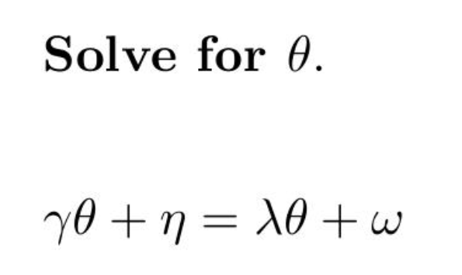
Similar scores on two very different problems
(N > 5000)

Slide 29
On-line Version

Slide 30
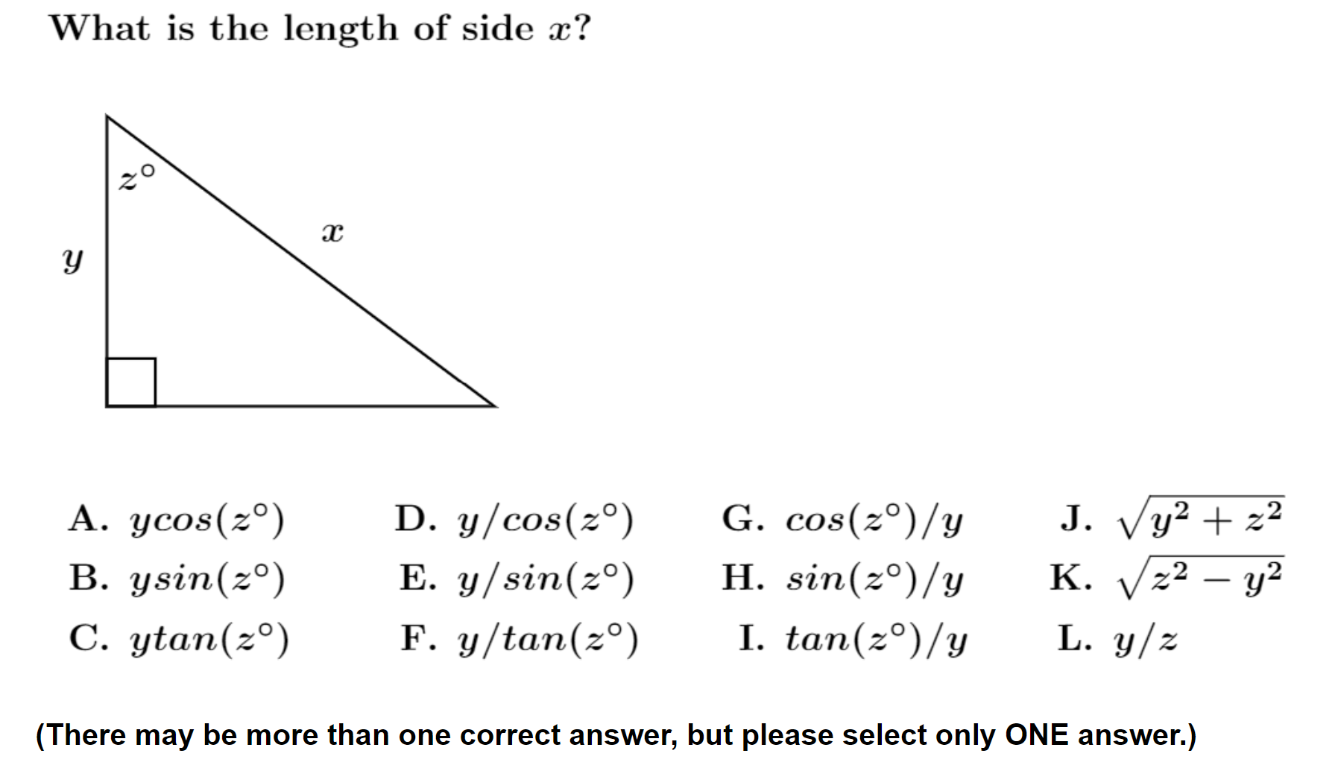
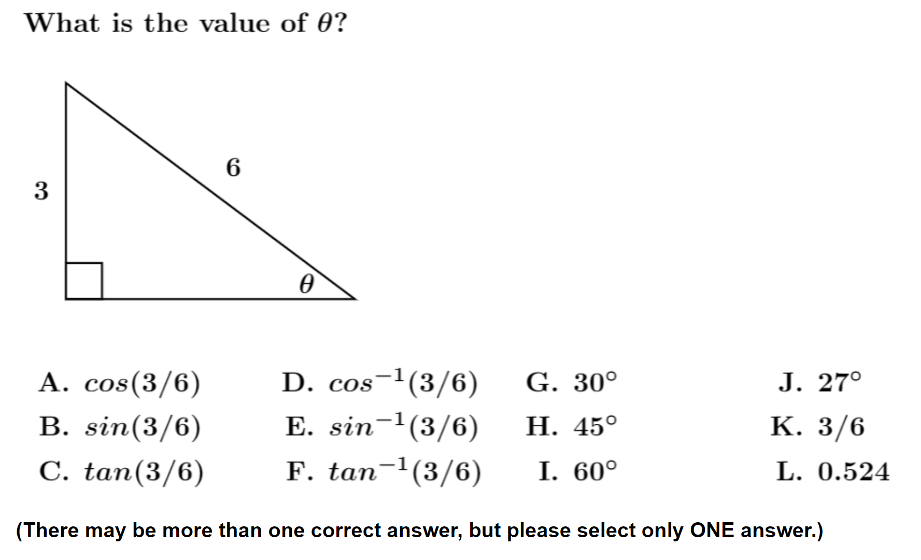
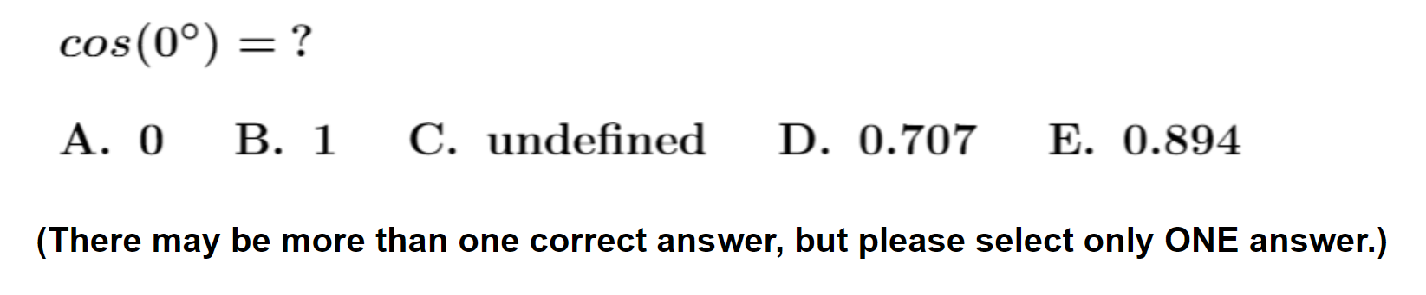
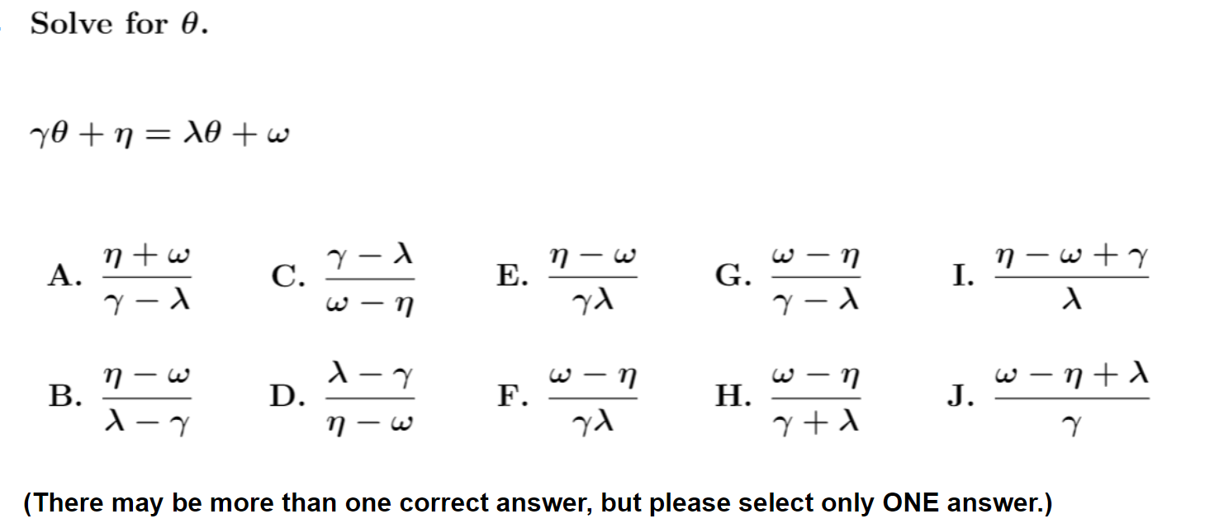
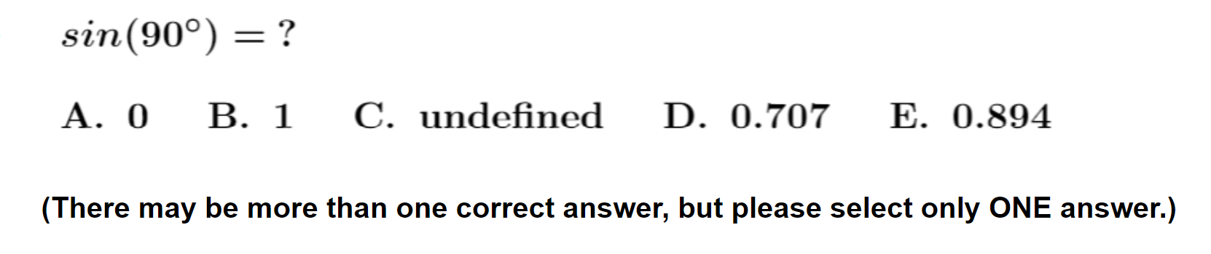
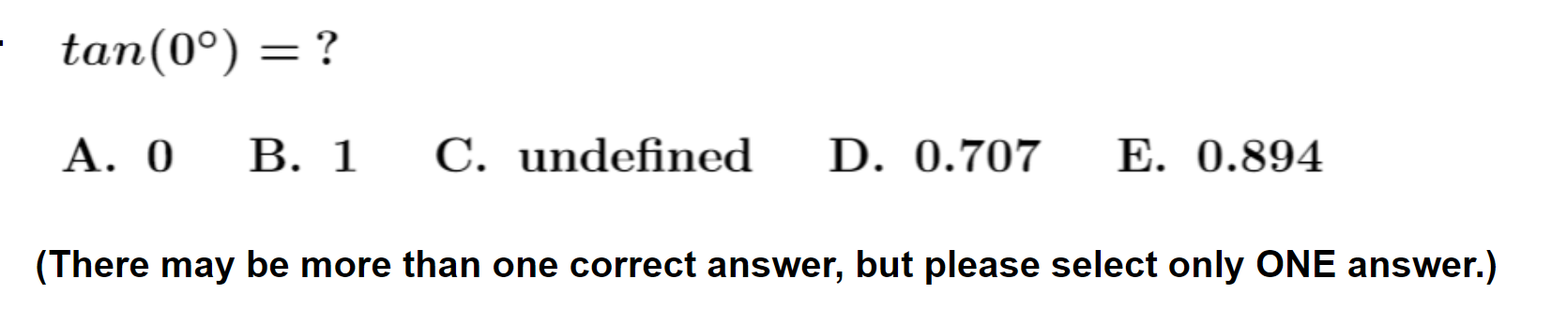

Slide 31
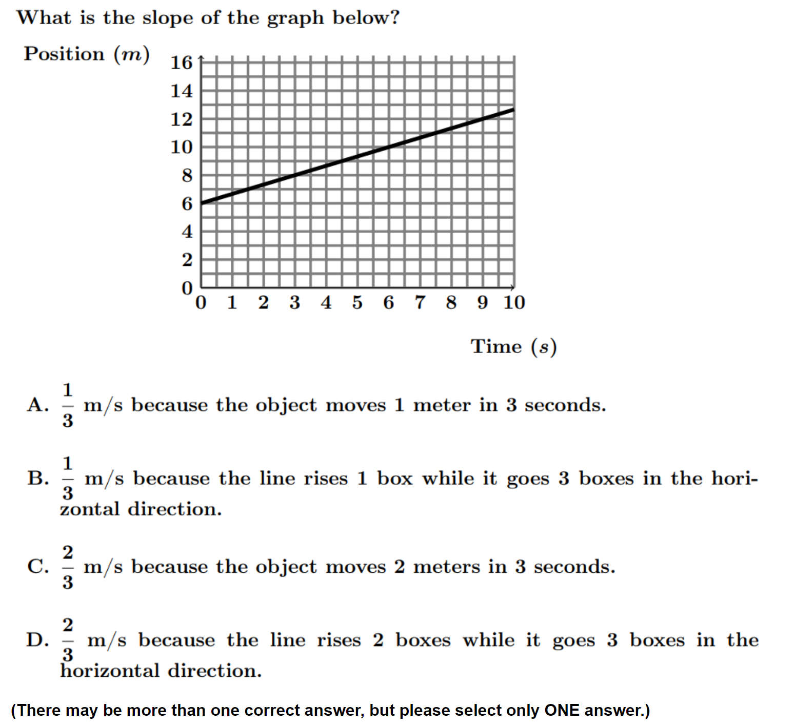
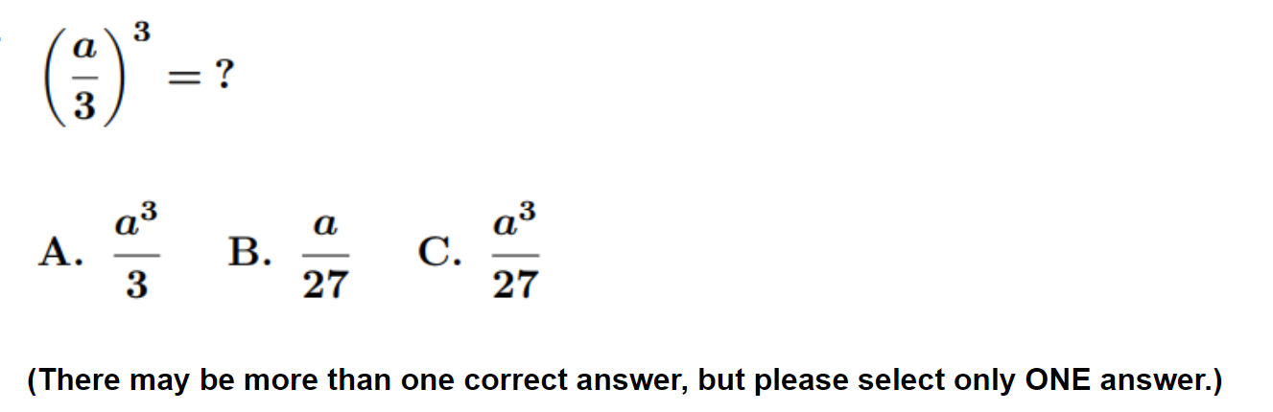
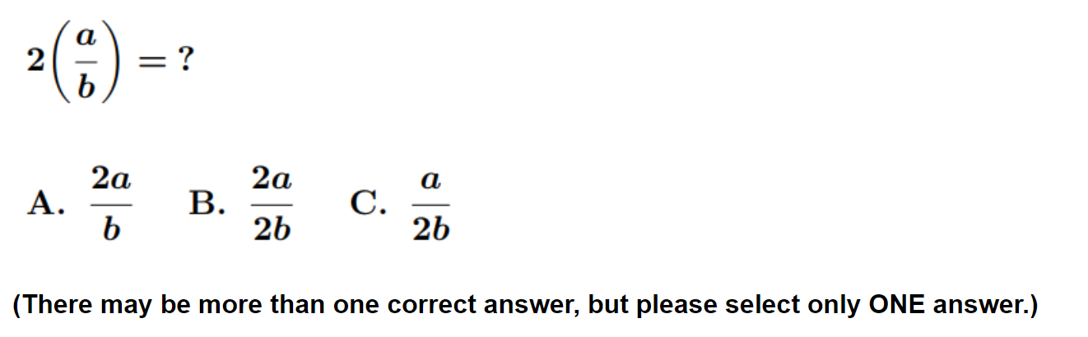
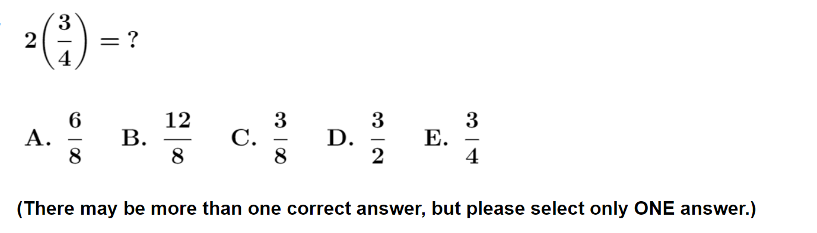
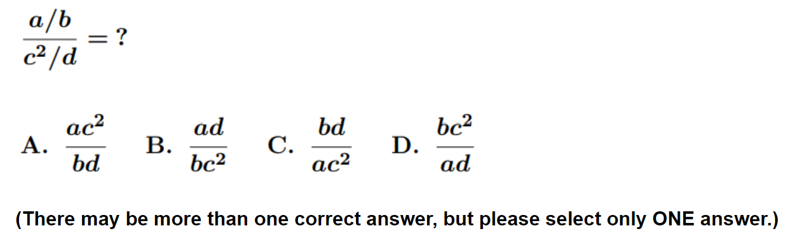

Slide 32
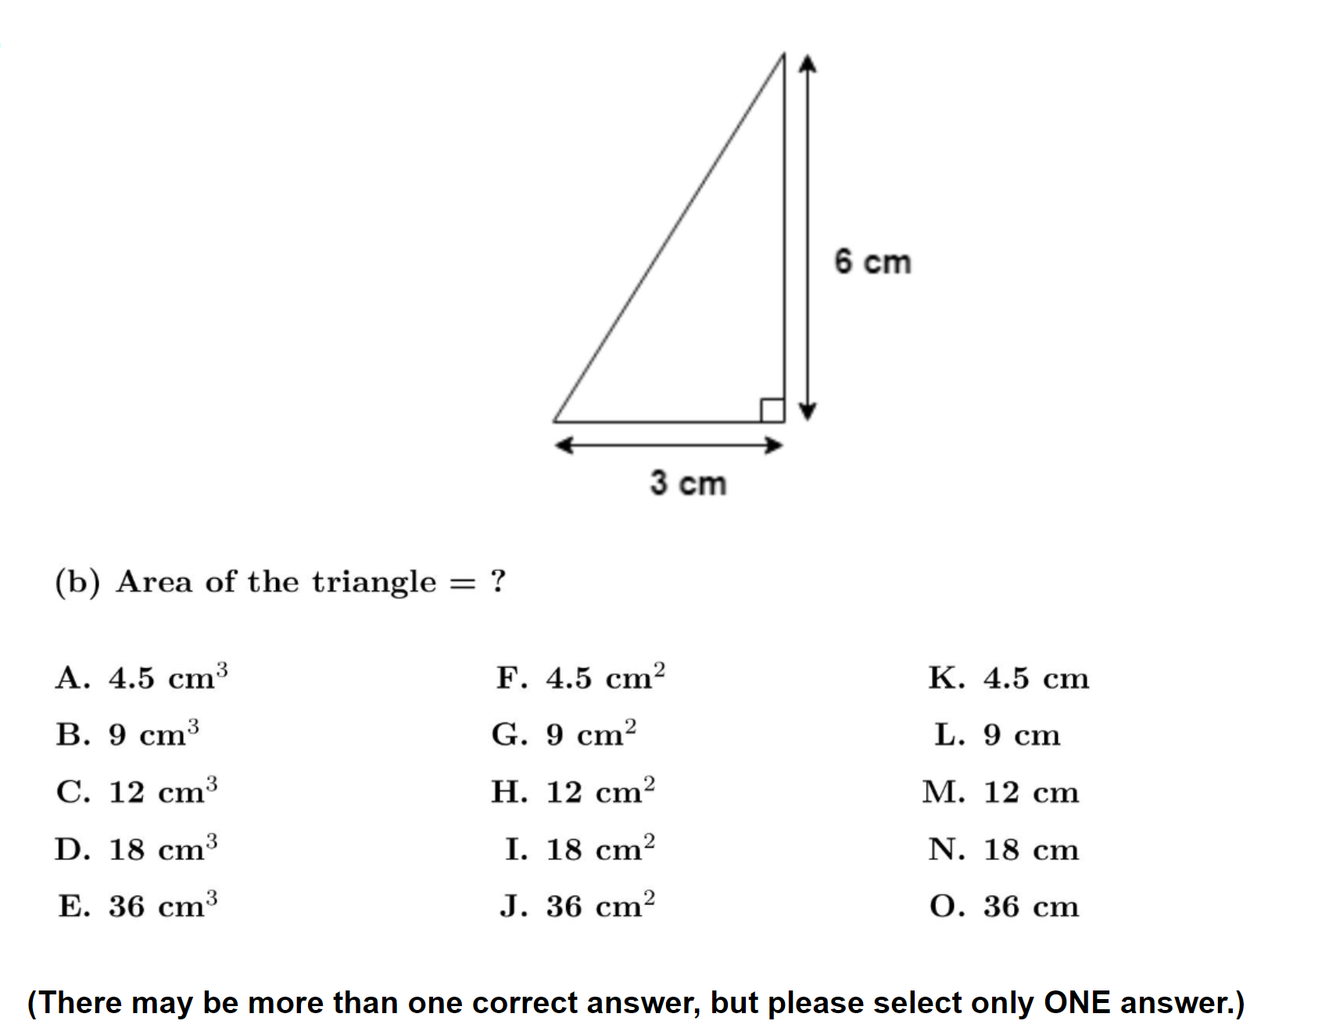
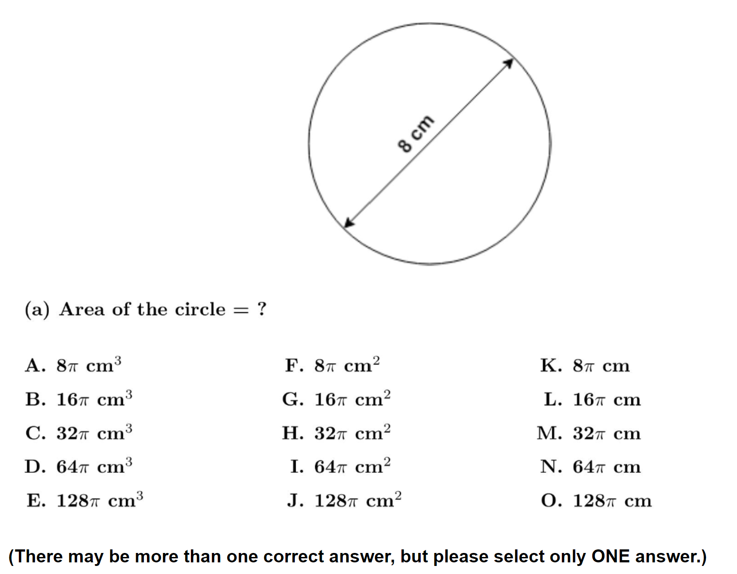
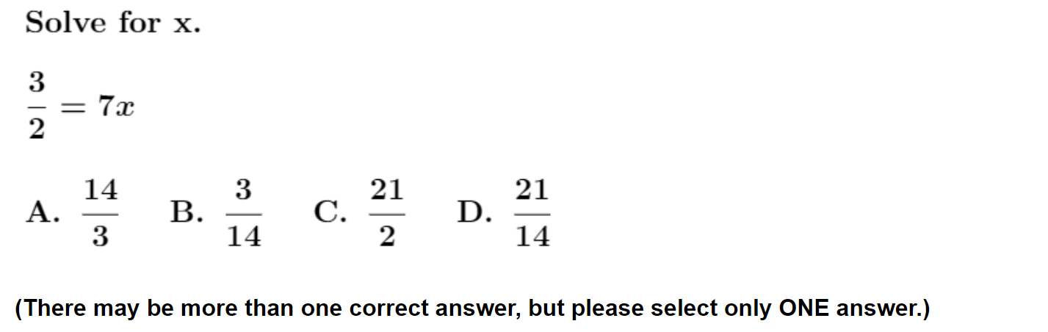
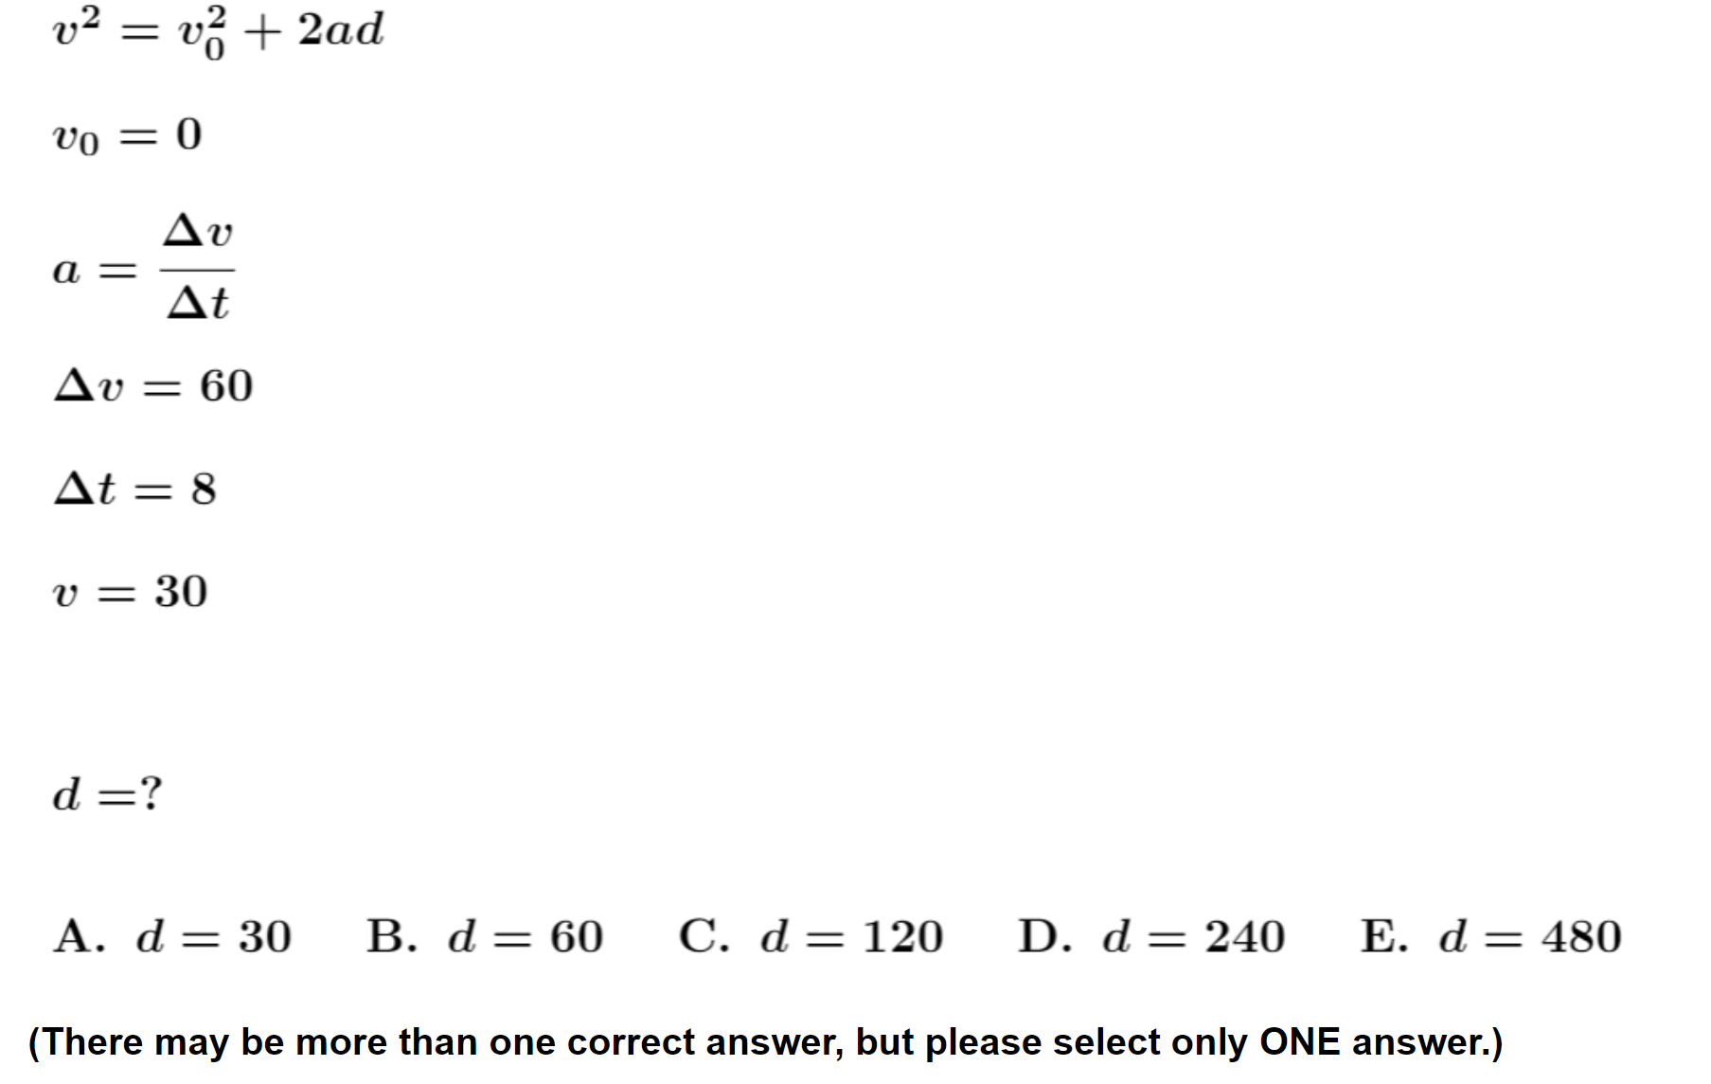
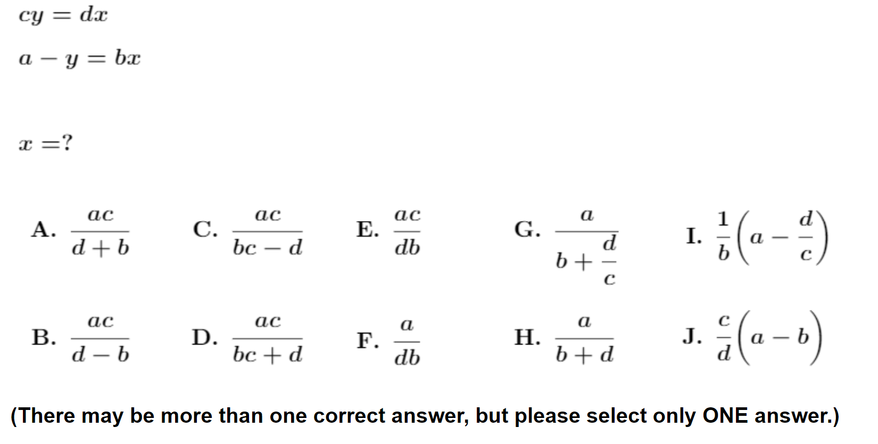

Slide 33

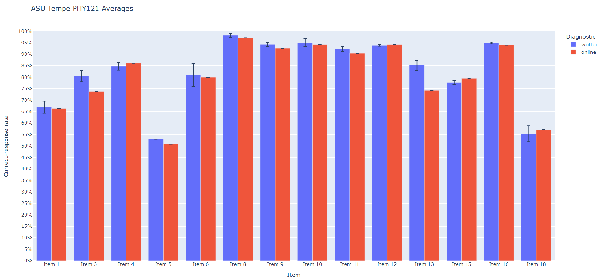
On-line and written versions yield consistent results
written online

Slide 34
Findings from >80 Interviews:
Students make many “careless” errors
During interviews, students tended to self-correct approximately 60% of their initial errors with little or no prompting, suggesting that many errors are “careless.”
These findings suggest that increased focus on improving students’ self-checking behavior might provide significant performance dividends.
  However, studies have shown that making these improvements is quite challenging

Slide 35
Relation Between Scores and Grades
Performance on full online diagnostic can approximately predict final course grade

Slide 36
Low Course Grade vs. Full Diagnostic Score
Course | Campus | N | Overall % grade ≤ C+ | Score ≥ 81% % grade ≤ C+ | Score ≤ 57% % grade ≤ C+ | Low-grade Ratio score ≤ 57% vs. score ≥ 81%

Slide 37
Low Course Grade vs. Full Diagnostic Score
Course | Campus | N | Overall % grade ≤ C+
Alg-1 2021 | ASU-P | 78
Alg-1: Algebra-based course, first semester

Slide 38
Low Course Grade vs. Full Diagnostic Score
Course | Campus | N | Overall % grade ≤ C+
Alg-1 2021 | ASU-P | 78 | 26%
Alg-1: Algebra-based course, first semester

Slide 39
Low Course Grade vs. Full Diagnostic Score
Course | Campus | N | Overall % grade ≤ C+ | Score ≥ 81% % grade ≤ C+ | Score ≤ 57% % grade ≤ C+ | Low-grade Ratio score ≤ 57% vs. score ≥ 81%
Alg-1 2021 | ASU-P | 78 | 26% | 19% | 38% | 2.1
Alg-1: Algebra-based course, first semester
Students who scored low on math diagnostic pretest had more “C” course grades than those who scored high

Slide 40
Low Course Grade vs. Full Diagnostic Score
Course | Campus | N
Alg-1 2021 | ASU-P | 78
Alg-1 2022 | ASU-P | 93
Alg-2 | ASU-P | 72
Calc-1 | UWF | 103
Alg-1: Algebra-based course, first semester
Alg-2: Algebra-based course, second semester
Calc-1: Calculus-based course, first semester
ASU-P: Arizona State University, Polytechnic campus
UWF: University of West Florida

Slide 41
Low Course Grade vs. Full Diagnostic Score
Course | Campus | N | Overall % grade ≤ C+
Alg-1 2021 | ASU-P | 78 | 26%
Alg-1 2022 | ASU-P | 93 | 19%
Alg-2 | ASU-P | 72 | 29%
Calc-1 | UWF | 103 | 39%
Alg-1: Algebra-based course, first semester
Alg-2: Algebra-based course, second semester
Calc-1: Calculus-based course, first semester
ASU-P: Arizona State University, Polytechnic campus
UWF: University of West Florida

Slide 42
Low Course Grade vs. Full Diagnostic Score
Course | Campus | N | Overall % grade ≤ C+ | Score ≥ 81% % grade ≤ C+ | Score ≤ 57% % grade ≤ C+ | Low-grade Ratio score ≤ 57% vs. score ≥ 81%
Alg-1 2021 | ASU-P | 78 | 26%
Alg-1 2022 | ASU-P | 93 | 19%
Alg-2 | ASU-P | 72 | 29%
Calc-1 | UWF | 103 | 39%
Alg-1: Algebra-based course, first semester
Alg-2: Algebra-based course, second semester
Calc-1: Calculus-based course, first semester
ASU-P: Arizona State University, Polytechnic campus
UWF: University of West Florida

Slide 43
Low Course Grade vs. Full Diagnostic Score
Course | Campus | N | Overall % grade ≤ C+ | Score ≥ 81% % grade ≤ C+ | Score ≤ 57% % grade ≤ C+ | Low-grade Ratio score ≤ 57% vs. score ≥ 81%
Alg-1 2021 | ASU-P | 78 | 26% | 19% | 38% | 2.1
Alg-1 2022 | ASU-P | 93 | 19% | 8% | 28% | 3.4
Alg-2 | ASU-P | 72 | 29% | 14% | 35% | 2.6
Calc-1 | UWF | 103 | 39% | 26% | 54% | 2.1
Alg-1: Algebra-based course, first semester
Alg-2: Algebra-based course, second semester
Calc-1: Calculus-based course, first semester
ASU-P: Arizona State University, Polytechnic campus
UWF: University of West Florida
Students who scored low on math diagnostic pretest had consistently more “C” course grades than those who scored high

Slide 44
High Course Grade vs. Full Diagnostic Score
Course | Campus | N | Overall % grade ≥ A- | Score ≥ 81% % grade ≥ A- | Score ≤ 57% % grade ≥ A- | High-grade Ratio score ≥ 81% vs. score ≤ 57%
Alg-1 2021 | ASU-P | 78
Alg-1 2022 | ASU-P | 93
Alg-2 | ASU-P | 72
Alg-2 | ASU-T | 129
Calc-1 | UWF | 103
Calc-2 | UWF | 59
Alg-1: Algebra-based course, first semester
Alg-2: Algebra-based course, second semester
Calc-1: Calculus-based course, first semester
Calc-2: Calculus-based course, second semester
ASU-P: Arizona State University, Polytechnic campus
ASU-T: Arizona State University, Tempe campus
UWF: University of West Florida

Slide 45
High Course Grade vs. Full Diagnostic Score
Course | Campus | N | Overall % grade ≥ A- | Score ≥ 81% % grade ≥ A- | Score ≤ 57% % grade ≥ A- | High-grade Ratio score ≥ 81% vs. score ≤ 57%
Alg-1 2021 | ASU-P | 78 | 35%
Alg-1 2022 | ASU-P | 93 | 45%
Alg-2 | ASU-P | 72 | 39%
Alg-2 | ASU-T | 129 | 60%
Calc-1 | UWF | 103 | 22%
Calc-2 | UWF | 59 | 49%
Alg-1: Algebra-based course, first semester
Alg-2: Algebra-based course, second semester
Calc-1: Calculus-based course, first semester
Calc-2: Calculus-based course, second semester
ASU-P: Arizona State University, Polytechnic campus
ASU-T: Arizona State University, Tempe campus
UWF: University of West Florida

Slide 46
High Course Grade vs. Full Diagnostic Score
Course | Campus | N | Overall % grade ≥ A- | Score ≥ 81% % grade ≥ A- | Score ≤ 57% % grade ≥ A- | High-grade Ratio score ≥ 81% vs. score ≤ 57%
Alg-1 2021 | ASU-P | 78 | 35% | 63% | 15% | 4.2
Alg-1 2022 | ASU-P | 93 | 45% | 67% | 28% | 2.4
Alg-2 | ASU-P | 72 | 39% | 64% | 25% | 2.6
Alg-2 | ASU-T | 129 | 60% | 67% | 55% | 1.2
Calc-1 | UWF | 103 | 22% | 40% | 0% | “∞”
Calc-2 | UWF | 59 | 49% | 61% | 38% | 1.6
Alg-1: Algebra-based course, first semester
Alg-2: Algebra-based course, second semester
Calc-1: Calculus-based course, first semester
Calc-2: Calculus-based course, second semester
ASU-P: Arizona State University, Polytechnic campus
ASU-T: Arizona State University, Tempe campus
UWF: University of West Florida
Students who scored high on math diagnostic pretest had consistently more “A” course grades than those who scored low

Slide 47
Factors other than math preparation may influence course performance
For example:
  Scientific reasoning skills, as measured by the Lawson Test of Scientific Reasoning
  Physics concept knowledge, as measured by the Force Concept Inventory

Slide 48
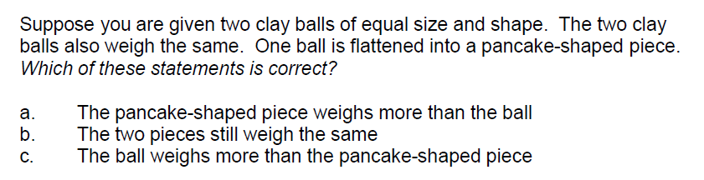
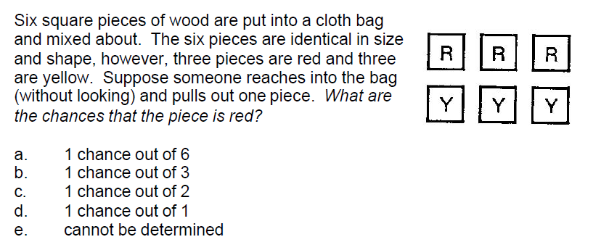
Scientific reasoning skills: The 24-item Lawson test

Slide 49
High Course Grade vs. Lawson Test of Scientific Reasoning Pretest Score
Course | Campus | N | Overall % grade ≥ A- | Top-quartile Lawson % grade ≥ A- | Bottom-quartile Lawson % grade ≥ A- | High-grade Ratio Top quartile vs. Bottom quartile
Alg-1 2021 | ASU-P | 73 | 35% | 65% | 17% | 3.9
Alg-1 2022 | ASU-P | 99 | 45% | 62% | 28% | 2.2
Alg-2 | ASU-P | 73 | 39% | 60% | 15% | 4.0
Alg-1 | CU | 469 | 22% | 43% | 6% | 7.7
Calc-2 | CU | 276 | 25% | 55% | 9% | 6.4
Alg-1 2007 | LMU | 24 | 42% | 83% | 0% | “∞”
Alg-1 2014 | LMU | 33 | 36% | 88% | 0% | “∞”
Alg-1 2018 | LMU | 47 | 38% | 77% | 17% | 4.6
Alg-1 2021 | LMU | 27 | 48% | 63% | 0% | “∞”
Alg-1: Algebra-based course, first semester
Alg-2: Algebra-based course, second semester
Calc-2: Calculus-based course, second semester
ASU-P: Arizona State University, Polytechnic campus
CU: University of Colorado, Boulder
LMU: Loyola Marymount University
Students who scored high on Lawson reasoning pretest had consistently more “A” course grades than those who scored low

Slide 50
Low Course Grade vs. Lawson Test of Scientific Reasoning Pretest Score
Course | Campus | N | Overall % grade ≤ C+ | Top-quartile Lawson % grade ≤ C+ | Bottom-quartile Lawson % grade ≤ C+ | Low-grade Ratio Bottom quartile vs. Top quartile
Alg-1 2021 | ASU-P | 73 | 26% | 5% | 56% | 11.1
Alg-1 2022 | ASU-P | 99 | 19% | 10% | 28% | 2.9
Alg-2 | ASU-P | 73 | 29% | 10% | 35% | 3.5
Alg-1 | CU | 469 | 43% | 21% | 68% | 3.2
Calc-2 | CU | 276 | 34% | 13% | 59% | 4.5
Alg-1 2007 | LMU | 24 | 17% | 0% | 29% | “∞”
Alg-1 2014 | LMU | 33 | 24% | 0% | 67% | “∞”
Alg-1 2018 | LMU | 47 | 19% | 15% | 25% | 1.6
Alg-1 2021 | LMU | 27 | 26% | 13% | 86% | 6.9
Alg-1: Algebra-based course, first semester
Alg-2: Algebra-based course, second semester
Calc-2: Calculus-based course, second semester
ASU-P: Arizona State University, Polytechnic campus
CU: University of Colorado, Boulder
LMU: Loyola Marymount University
Students who scored low on Lawson reasoning pretest had consistently more “C” course grades than those who scored high

Slide 51
What Grade is Predicted by FCI Pretest Score?
Henderson (2002), University of Minnesota (N > 1000)
FCI Pretest score: 0-30% 63-100%
A: 10% A: 47% Ratio: 4.7
C: 46% C: 9% Ratio: 5.1
Students who scored high on FCI pretest had higher course grades than those who scored low

Slide 52
What Grade is Predicted by FCI Pretest Score?
Meltzer (2012/13), Arizona State University (N > 100)
FCI Pretest score: 0-30% 63-100%
A: 12% A: 65% Ratio: 5.4
C: 26% C: 13% Ratio: 2.0
Students who scored high on FCI pretest had higher course grades than those who scored low

Slide 53
What Grade is Predicted by FCI Pretest Score?
Pollock & Dubson (2005), University of Colorado (N =470)
FCI Pretest score: 0-30% 63-100%
A: 13% A: 59% Ratio: 4.7
C: 50% C: 19% Ratio: 2.7
Students who scored high on FCI pretest had higher course grades than those who scored low

Slide 54
Factors are correlated, but not 100%
Outliers using one prediction method can often be explained by high pretest scores on another predictor
Students with uniformly low pretest scores can sometimes perform well with exceptional efforts in class

Slide 55
Summary
Numerous factors influence students’ physics course performance
Previous preparation in calculational and reasoning skills is important, as well as physics concept knowledge, motivation, and effort

