Slide 1
Identifying and Addressing
Students’ Mathematical Difficulties in Introductory Physics Courses
David E. Meltzer
Arizona State University
Supported in part by NSF DUE #1504986

Slide 2
Identifying and Addressing
Students’ Mathematical Difficulties in Introductory Physics Courses
David E. Meltzer
Arizona State University
Supported in part by NSF DUE #1504986
in collaboration with
Matthew I. Jones
and
Dakota H. King

Slide 3
The Problem
Difficulties with very basic math skills impact performance of introductory physics students.
The difficulties are often not resolved by students’ previous mathematical training.
Students can’t effectively grapple with physics ideas when they feel overburdened in dealing with calculational issues.
(Therefore:) Physics instructors need to deal with their students’ mathematical difficulties

Slide 4
Outline
Prevalence and nature of difficulties with trigonometry
Examples of difficulties with vectors, and effective remedies
Difficulties with algebraic symbols and operations
  physics problems posed in symbolic form
  physics students’ algebraic difficulties
Implications for instruction

Slide 5
Work to Date
Administer (and analyze) written diagnostic, given to 1400 students in 18 algebra- and calculus-based physics classes over four semesters at Arizona State University during 2016-2017
Carry out individual interviews with 65 students enrolled in those or similar courses during same period

Slide 6
Difficulties with Trigonometry
  Many students are confused or unaware (or have forgotten) about the relationships between sides and angles in a right triangle.
  Examples: Questions from a diagnostic math test administered at Arizona State University, 2016-2017 (Administered as no-credit quiz during first week labs and/or recitation sections; calculators allowed)

Slide 7
Trigonometry Questions with samples of correct student responses

Slide 8
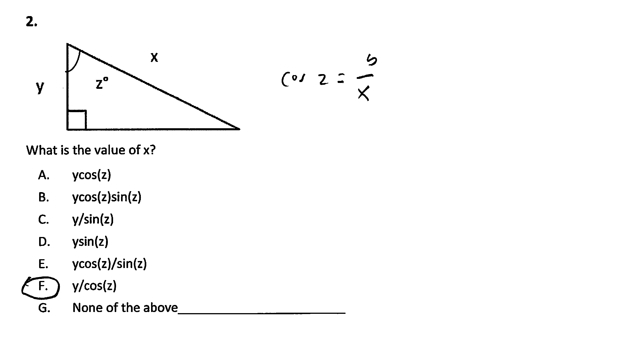

Slide 9
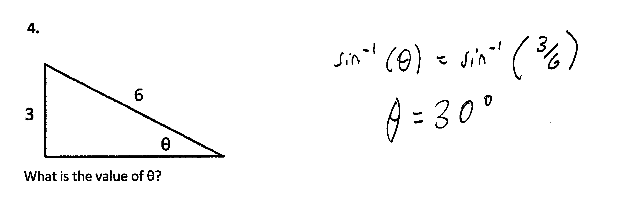
3.

Slide 10
Trigonometry Questions:
Correct Response Rate, #1-3 combined
ASU Polytechnic campus, Spring + Fall average:
  Algebra-based course, 1st semester, (N = 116): 37%
  Algebra-based course, 2nd semester, (N =79): 48%
ASU Polytechnic campus, Spring (2-year average):
  Calculus-based course, 1st semester, (N = 146): 66%
$\frac{1}{3}\text{to} \frac{2}{3}$of students confused on basic trigonometry relations

Slide 11
Results on Trigonometry Questions
Errors observed:
(i) use of incorrect trigonometric function (e.g., cosine instead of sine), or misunderstanding of definition;
(ii) unaware (or forgot) about inverse trigonometric functions, e.g., arctan, arcsin, arccos [tan⁻¹, sin⁻¹, cos⁻¹]
  How to address these problems: It seems that many students require substantial additional practice and repetition with basic trigonometric procedures.

Slide 12
Factors Affecting Results
Differences in results observed between:
  Spring- and fall-semester offerings of same course
  Offerings of same course on different campuses (Polytechnic campus in Mesa, main campus in Tempe)
  Different type of courses (algebra- and calculus-based) and different semesters of same course (first-semester and second-semester)
  Multiple-choice and non-multiple-choice versions of same questions

Slide 13
Trigonometry Questions:
Spring/Fall Semester Difference
Error Rate (% incorrect responses) [*p < 0.05]
Algebra-based course, first semester; #1-3 combined:
  ASU Polytechnic campus, Spring (N = 72): 67%
  ASU Polytechnic campus, Fall (N = 44): 58%
Algebra-based course, second semester; #1-3 combined:
  ASU Polytechnic campus, Spring (N = 52): 59%
  ASU Polytechnic campus, Fall (N = 27): 44%
*Calculus-based course, first semester; #1 only:
  ASU Polytechnic campus, Spring (N = 104): 40%
  ASU Polytechnic campus, Fall (N = 98): 56%

Slide 14

Trigonometry Questions:
Spring/Fall Semester Difference
Error Rate (% incorrect responses) [*p < 0.05]
Algebra-based course, first semester; #1-3 combined:
  ASU Polytechnic campus, Spring (N = 72): 67%
  ASU Polytechnic campus, Fall (N = 44): 58%
Algebra-based course, second semester; #1-3 combined:
  ASU Polytechnic campus, Spring (N = 52): 59%
  ASU Polytechnic campus, Fall (N = 27): 44%
*Calculus-based course, first semester; #1 only:
  ASU Polytechnic campus, Spring (N = 104): 40%
  ASU Polytechnic campus, Fall (N = 98): 56%

Slide 15
Trigonometry Questions:
Spring/Fall Semester Difference
Error Rate (% incorrect responses) [*p < 0.05]
Algebra-based course, first semester; #1-3 combined:
  ASU Polytechnic campus, Spring (N = 72): 67%
  ASU Polytechnic campus, Fall (N = 44): 58%
Algebra-based course, second semester; #1-3 combined:
  ASU Polytechnic campus, Spring (N = 52): 59%
  ASU Polytechnic campus, Fall (N = 27): 44%
*Calculus-based course, first semester; #1 only:
  ASU Polytechnic campus, Spring (N = 104): 40%
  ASU Polytechnic campus, Fall (N = 98): 56%

Slide 16
Trigonometry Questions:
Polytechnic/Tempe Campus Difference
Error Rate (% incorrect responses) [*p = 0.01]
*Algebra-based course, second semester; #1-3 combined:
  ASU Polytechnic campus, Spring (N = 52): 59%
  ASU Tempe campus, Spring (N = 61): 35%

Slide 17
Trigonometry Questions:
Course Difference
Error Rate (% incorrect responses), #1 only [*p < 0.05]
ASU Polytechnic campus, Spring + Fall average:
  Algebra-based course, 1st semester, (N = 166): 59%
  Algebra-based course, 2nd semester, (N = 106): 53%
  Calculus-based course, 1st semester, (N = 202): 48%
*

Slide 18
Trigonometry Questions:
Multiple-Choice vs. Non-Multiple-Choice
(Higher Error Rate on Non-Multiple-Choice [Non-MC])
Error Rate Difference (% incorrect responses), Non-MC−MC
  Course #1, Problem #2: +15
  Course #1, Problem #3: +18
  Course #2, Problem #2: +9
  Course #2, Problem #3: +9
  Course #3, Problem #2: +5
  Course #3, Problem #3: +34
  Course #4, Problem #2: +10
  Course #4, Problem #3: +5

Slide 19
Trigonometry Questions:
Summary
Regardless of course, semester, campus, or question type, between 30% and 70% of introductory physics students at ASU have significant difficulties with basic trigonometric relationships.
Students frequently tended to self-correct errors during interviews, suggesting that many of the errors were “careless” or due to insufficient review or practice.

Slide 20
Difficulties with Vector Concepts
  Vector Concepts: Many students are confused about the fundamental meaning of vector direction, as well as the role of direction in determining the resultant of two or more vectors (Nguyen and Meltzer, 2003; Barniol and Zavala, 2014).

Slide 21
Vector Direction Question

Slide 22
Vector Direction Question
All same direction

Slide 23
Results on Vector Direction
Percent Correct Responses
Calculus-based physics, second semester: 66% (N =29)
Calculus-based physics, first semester: 51% (N = 104)
Algebra-based physics, second semester: 40% (N = 52)
Algebra-based physics, first semester: 40% (N = 72)

Slide 24
Vector Direction, Most Common Error

Slide 25
Vector Direction, Most Common Error
✓
X

Slide 26
Vector Addition (Graphical)
    Students have difficulty interpreting and manipulating vector quantities represented as arrows [Nguyen and Meltzer, 2003; Barniol and Zavala, 2014)
      Example: Add (or subtract) vectors A and B to find the resultant
    A B

Slide 27
Addition of Vectors

Slide 28
Addition of Vectors

Slide 29
Addition of Vectors
Percent Correct Responses
Algebra-based physics, second semester: 36% (N = 61)
Calculus-based physics, first semester: 71% (N = 140)

Slide 30
Common Student Errors With Vector Addition
“Split the Difference” or “Bisector Vector”:
“Tip-to-Tip”:
+
=
=
+

Slide 31
Difficulties with Vector Addition
    How to address these difficulties:
      Practice with a variety of vector orientations; introduce and use the “ijk” coordinate representation for vectors (Heckler and Scaife, 2015)
      Design tutorial worksheet to aid students’ understanding of scalar (“dot”) product of vectors (Barniol and Zavala, 2016)
      Provide extensive on-line practice and homework assignments related to frequently used vector procedures (Mikula and Heckler, 2017)

Slide 32
Physics Students’ Difficulties with Algebraic Symbols and Operations
Extensive investigations by Torigoe and Gladding (2007; 2007; 2011): Probed differences in University of Illinois students’ responses to physics problems posed in numerical and symbolic form.
  In general, students tended to have more difficulties with questions in symbolic form.
Our investigation at Arizona State probed physics students’ responses to mathematical problems stripped of all physics context

Slide 33
Torigoe and Gladding (2011), Findings
Significantly higher proportion of correct responses on some types of numerical questions, not on others
Difference was greater for students in bottom quarter of class
Larger difference linked to difficulties with multiple and simultaneous equations, symbol confusion, and misuse of compound expressions.

Slide 34
Students’ Difficulties with Symbols
    Confusion of symbolic meaning: Students perform worse on solving problems when symbols are used to represent common physical quantities in equations, e.g., “m” instead of “1.5 kg” [Torigoe and Gladding, 2007; 2011)
    Example [University of Illinois]:
Version #1: A car can go from 0 to 60 m/s in 8 s. At what distance d from the start at rest is the car traveling 30 m/s?
Version #2: A car can go from 0 to v₁ in t₁ seconds. At what distance d from the start at rest is the car traveling (v₁/2)?
[93% correct]
[57% correct]
Much worse!

Slide 35
Difficulties with Symbols
(Torigoe and Gladding, 2007; 2011)
Confusion between similar symbols, e.g., using v for v₁ and vice-versa.
Distinguishing between known and unknown information when both are represented by symbols
Misunderstanding compound expressions, e.g., failing to specify m = 3M or v = v₀/2 in the relevant general equation involving m or v.

Slide 36
From Torigoe & Gladding (2011):

Slide 37
From Torigoe & Gladding (2011):
Sample solution for symbolic version:
v² = v₀² +2ad
v₀ = 0
→ v² = 2ad
→ d = v²/2a
a = Δv/Δt = v₁/t
v = v₁ /2
d = v²/2a
= (v₁ /2)²/2a
= (v₁² /4)/2(v₁/t)
= (v₁² /4)/(2v₁/t)
= v₁ t₁ /8

Slide 38

From Torigoe & Gladding (2011):
“Student” solution for numeric version:
(1) a = Δv/Δt = 60/8 = 7.5
(2) v² = v₀² +2ad
v₀ = 0
→ v² = 2ad
→ (30) ² = 2(7.5)d
900 = 15d
900/15 = d
60 m = d
No algebra needed!

Slide 39
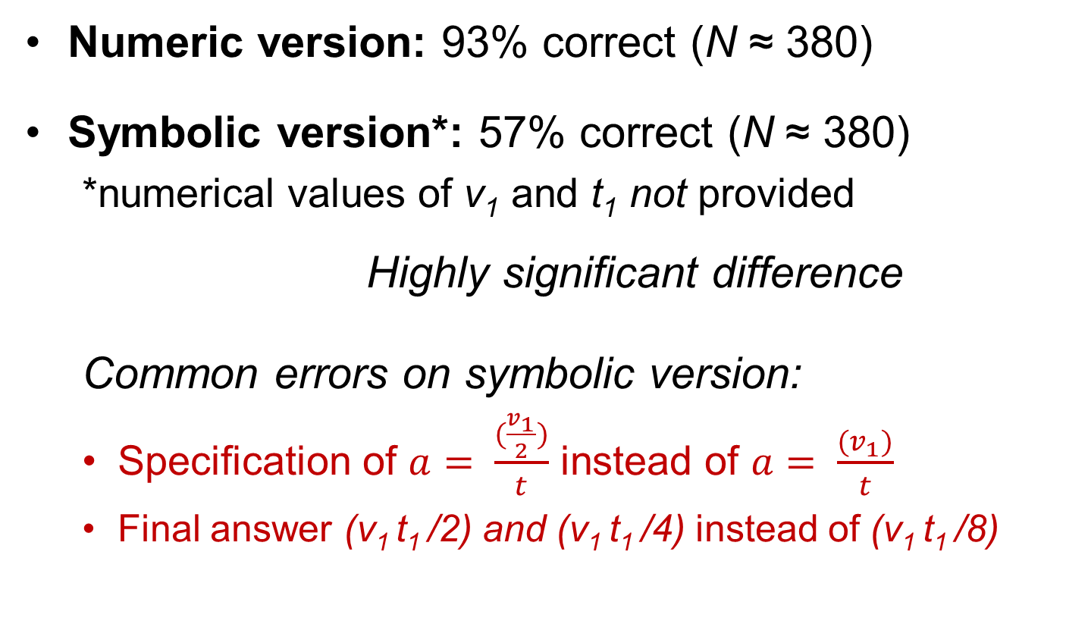
Results on #2
[Torigoe and Gladding, 2007; 2011]
Numeric version: 93% correct (N ≈ 380)
Symbolic version*: 57% correct (N ≈ 380)
  *numerical values of v₁ and t₁ not provided
  Highly significant difference
  Common errors on symbolic version:
  Specification of $a= \frac{(\frac{v_{1}}{2})}{t}$ instead of $a= \frac{(v_{1})}{t}$
  Final answer (v₁ t₁ /2) and (v₁ t₁ /4) instead of (v₁ t₁ /8)

Slide 40
Does complexity of expression play a role?
In symbolic version, have d = (v₁² /4)/(2v₁/t)
→ simplify to d = v₁ t₁ /8
Compared to, in numeric version:
d = 900/15
→ d = 60
^{Not equivalent operations!}

Slide 41
Does complexity of expression play a role?
Probably, but evidence so far is not clear
Torigoe and Gladding noted confusion regarding meaning of symbols, not necessarily with algebraic manipulations

Slide 42
Algebra: Simultaneous Equations

Slide 43
Algebra: Simultaneous Equations
Do differences in students’ success rate between numerical and symbolic versions of same problem persist when simultaneous equations are involved? (E.g., two equations, two unknowns)

Slide 44
From Torigoe and Gladding (2011):
Mg − T = Ma
TR = Iα
[I = ½ MR²; α = a/R]
…→
Mg − T = Ma
TR = [½ MR²][a/R]
a = ?
F_{net} = ma
τ_{net} = I α

Slide 45
From Torigoe and Gladding (2011):
Mg − T = Ma
TR = Iα
[I = ½ MR²; α = a/R]
…→
Mg − T = Ma
TR = [½ MR²][a/R]
a = ?

Slide 46
From Torigoe and Gladding (2011):
Mg − T = Ma
TR = Iα
[I = ½ MR²; α = a/R]
…→
Mg − T = Ma
TR = [½ MR²][a/R]
a = ?
a – y = bx
cy = dx
x =?
Symbolic version

Slide 47
From Torigoe and Gladding (2011):
Mg − T = Ma
TR = Iα
[I = ½ MR²; α = a/R]
…→
Mg − T = Ma
TR = [½ MR²][a/R]
a = ?
78.4 – y = 8x
0.5y = 2x
x =?
Numeric version

Slide 48
Results on #10
(Two equations, two unknowns)
[Torigoe and Gladding, 2011]
Numeric version: 49% correct (N ≈ 380)
Symbolic version*: 53% correct (N ≈ 380)
  *values of M and R not provided
  No significant difference
  (“…because students are forced to use the same procedure to solve both the numeric and symbolic versions.” Torigoe and Gladding, 2011)

Slide 49
Our Findings: Significant Differences between Numerical and Symbolic Versions of Simultaneous-Equations Problem
Summary of the Data
Algebra-based course: 70% correct on numerical version, 20% on symbolic version;
Calculus-based course: 70% correct on numerical version, 43% correct on symbolic version.

Slide 50
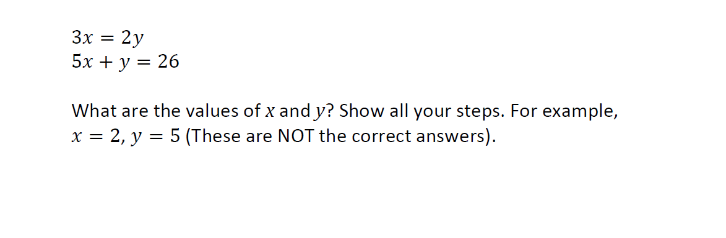
Algebra: Simultaneous Equations
Correct Response Rate, ASU (% correct responses)
Algebra-based course, second semester (N = 123): 70%
[This is the “numerical” problem]

Slide 51
Algebra: Simultaneous Equations
x cos (20°) = y cos (70°)
x cos (70°) + y cos (20°) = 10
What are the values of x and y? Show all your steps. Note: The value for x should NOT include y, and the value for y should NOT include x.
Correct Response Rate, ASU (% correct responses)
Algebra-based course, second semester (N =150): 20-30%
(different campuses, slightly different versions)

Slide 52
Algebra: Simultaneous Equations
ax = by
bx + ay = c
a, b, and c are constants.
What are the values of x and y in terms of a, b, and c? Show all your steps. Note: The value for x should NOT include y, and the value for y should NOT include x.
Correct Response Rate, ASU (% correct responses)
Algebra-based course, second semester (N =150): 10-20%
(different campuses, slightly different versions)
Only 10-20% correct responses!

Slide 53
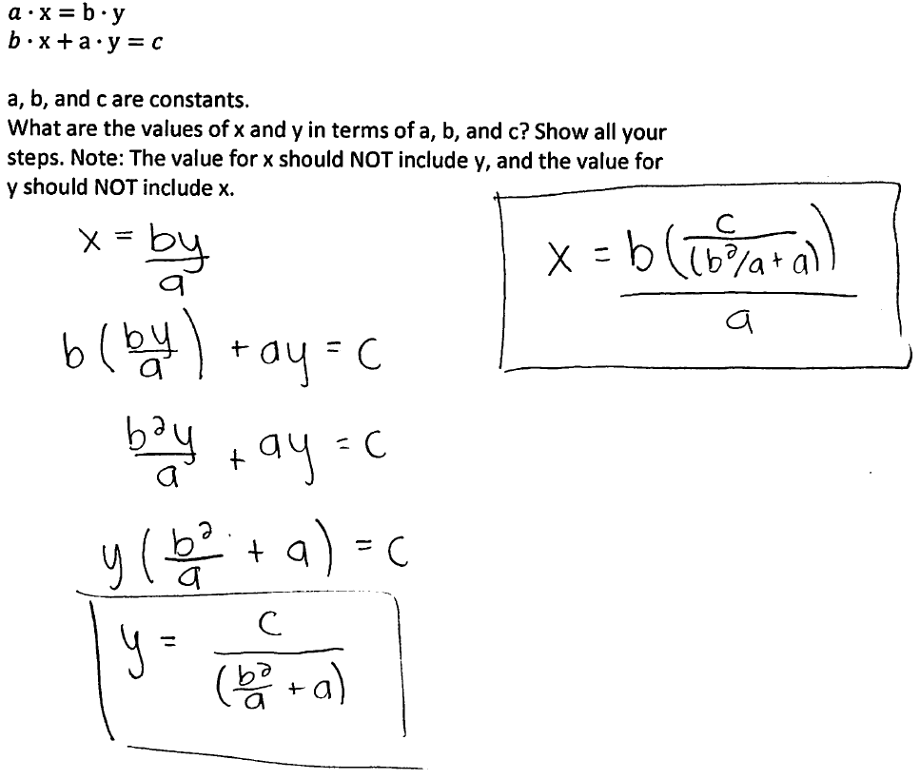
Algebra: Simultaneous Equations
Sample of Correct Student Response

Slide 54
Difficulties with Equations
Interviews indicate that students who missed the first (numerical) problem had fundamental difficulties with arithmetic and/or algebra (e.g., failing to isolate variables, failing to substitute expression from first equation into the second equation).
Many students who could solve the first (numerical) problem failed on one or both of the other two.

Slide 55
Simultaneous Equations Questions in Calculus-based course, first semester (Polytechnic campus) [N = 91]
3x = 2y
5x + y = 26
What is the numerical value of x?
70% correct
In the two equations below, a, b, c, and d represent (unknown) numbers, e.g., 3, 8, 9, 14.
ax = by
cx + y = d
x = ?
(Your answer for x should have a, b, c, and d in it, but not y.)
43% correct

Slide 56
Numerical vs. Algebraic
Providing numerical versions of problems allows students to side-step difficulties with symbolic representation and algebraic operation
  Problems can often be solved with purely arithmetic, non-algebraic operations
However, certain types of problems (“equation-priority”: Torigoe and Gladding, 2011) require algebraic operations for solution, for example:
  simultaneous equations;
  problems posed in purely symbolic form;
  problems of form Ax + B = Cx + D

Slide 57
Other Difficulties with Symbols
Possible confusion due merely to replacing numbers by symbols
Is this a real difficulty for physics students?

Slide 58


Confusion due to replacing numbers by symbols
$$3= \frac{5}{x}$$
$$x= ?$$
$$\cos{60°}= \frac{10}{x}$$
$$x= ?$$
$$a= \frac{b}{x}$$
$$x= ?$$
$$\cos{z°}= \frac{y}{x}$$
$$x= ?$$

Slide 59
“Level 0”: Confusion due to replacing numbers by symbols
What is the value of x?
49% correct
41% correct
[First-semester (Fall 2017), calculus-based; N = 91]
McNemar Test for Correlated Proportions: p = 0.10

Slide 60
Difficulties with Mathematical Operations (Booth et al., 2014)
Negative Sign, e.g., moving a term without changing its sign; deleting or adding a negative sign;
Equality, e.g., performing operations without maintaining balance on both sides of an equals sign;
Mathematical Property, e.g., inappropriately applying the distributive property;
Fraction, e.g., moving a term from the numerator to the denominator or vice versa
All of these observed in our investigation

Slide 61
Why the Difficulties with Symbols?
Some Suggestions Arising from the Interviews
In elementary math courses, “simplified forms” of equations are emphasized (i.e., few messy symbols and functions)
Students get “overloaded” by seeing all the variables, and are unable to carry out procedures (e.g., multiplying each term in an expression by a constant [symbol]) that they do successfully with numbers (e.g., multiply through by a number)
Other procedural failures that occur more often with symbols: cancellation, factoring out a constant, retaining coefficients from one line to the next

Slide 62
Sources of Difficulties
Carelessness
  Students very frequently self-correct errors during interviews
  Evidence of carelessness on written diagnostic
Skill practice deficit: Insufficient repetitive practice with learned skills
  E.g., applying definitions of sine and cosine; factoring out variables in algebraic expressions
Inability to efficiently access previous learning

Slide 63
Implications for Instruction
Vectors
  Essential for study of physics, and arguably not covered in a suitable manner during high school, or in college math courses
  Consist of a relatively small and well-defined area of knowledge insofar as related to introductory physics
  Difficulties addressed effectively by short-term, carefully targeted in- and out-of-class tutorials and assignments in physics courses (e.g., Barniol and Zavala (2016), Mikula and Heckler (2017)

Slide 64
Implications for Instruction
Trigonometry
  Essential, to some extent, for study of physics, and presumably covered thoroughly during students’ previous preparation
  Consists of a relatively small and well-defined area of knowledge insofar as related to introductory physics
  Difficulties might be addressed effectively by short-term, carefully targeted in- and out-of-class tutorials and assignments in physics courses, designed to refresh students’ previously learned knowledge and skills

Slide 65
Implications for Instruction
Algebra
  Essential, to some extent, for study of physics, and covered very extensively during students’ previous preparation
  Consists of a relatively large and poorly defined area of knowledge insofar as related to introductory physics
  Difficulties might best be addressed by guiding students to (1) explicitly identify known and unknown variables; (2) carefully check and re-check key steps in calculation, to minimize careless errors; (3) slow down, review, and re-solve when possible (through alternative solution path) lengthy and/or complex calculations

Slide 66
Summary
Some mathematical difficulties relate to relatively narrow, well-defined procedures and may be subject to significant improvement by short-term, targeted instruction (e.g., vectors, trigonometry)
Other difficulties are likely more long-standing, resistant to quick improvement, and not easily addressable within physics courses themselves
  Examples: algebraic operations
Guidance to strengthen physics students’ self-checking, “care-taking” skills offers greater hope for short-term improvements

