Slide 1
Consistency of students' mathematical difficulties may allow reliable performance predictability
David E. Meltzer and Dakota H. King
Arizona State University
Supported in part by NSF DUE #1504986 and #1914712

Slide 2
Acknowledgments
Student data and very useful discussions have been provided by (among others):
Darya Dolenko (Arizona State University)
Andrew Heckler (Ohio State University)
Beatriz Burrola Gabilondo (Ohio State University)
Steven Pollock (University of Colorado, Boulder)
Colin West (University of Colorado, Boulder)
Christopher Varney (University of West Florida)

Slide 3
Overview
We have given pre-college-math diagnostic tests to over 6000 physics students in introductory courses at four universities. We find:
Error rates are consistently in the 30-60% range, suggesting that difficulties with basic operations might have significant impact on course performance.
Class-average performance on individual test items is highly predictive of performance on the overall 13-item test
Individual student performance on test items from any one topic (algebra, trigonometry, graphing, and geometry) is highly correlated with performance on items from the other topics
Performance on conceptual physics items is correlated with math performance

Slide 4
Examples of Test Items

Slide 5
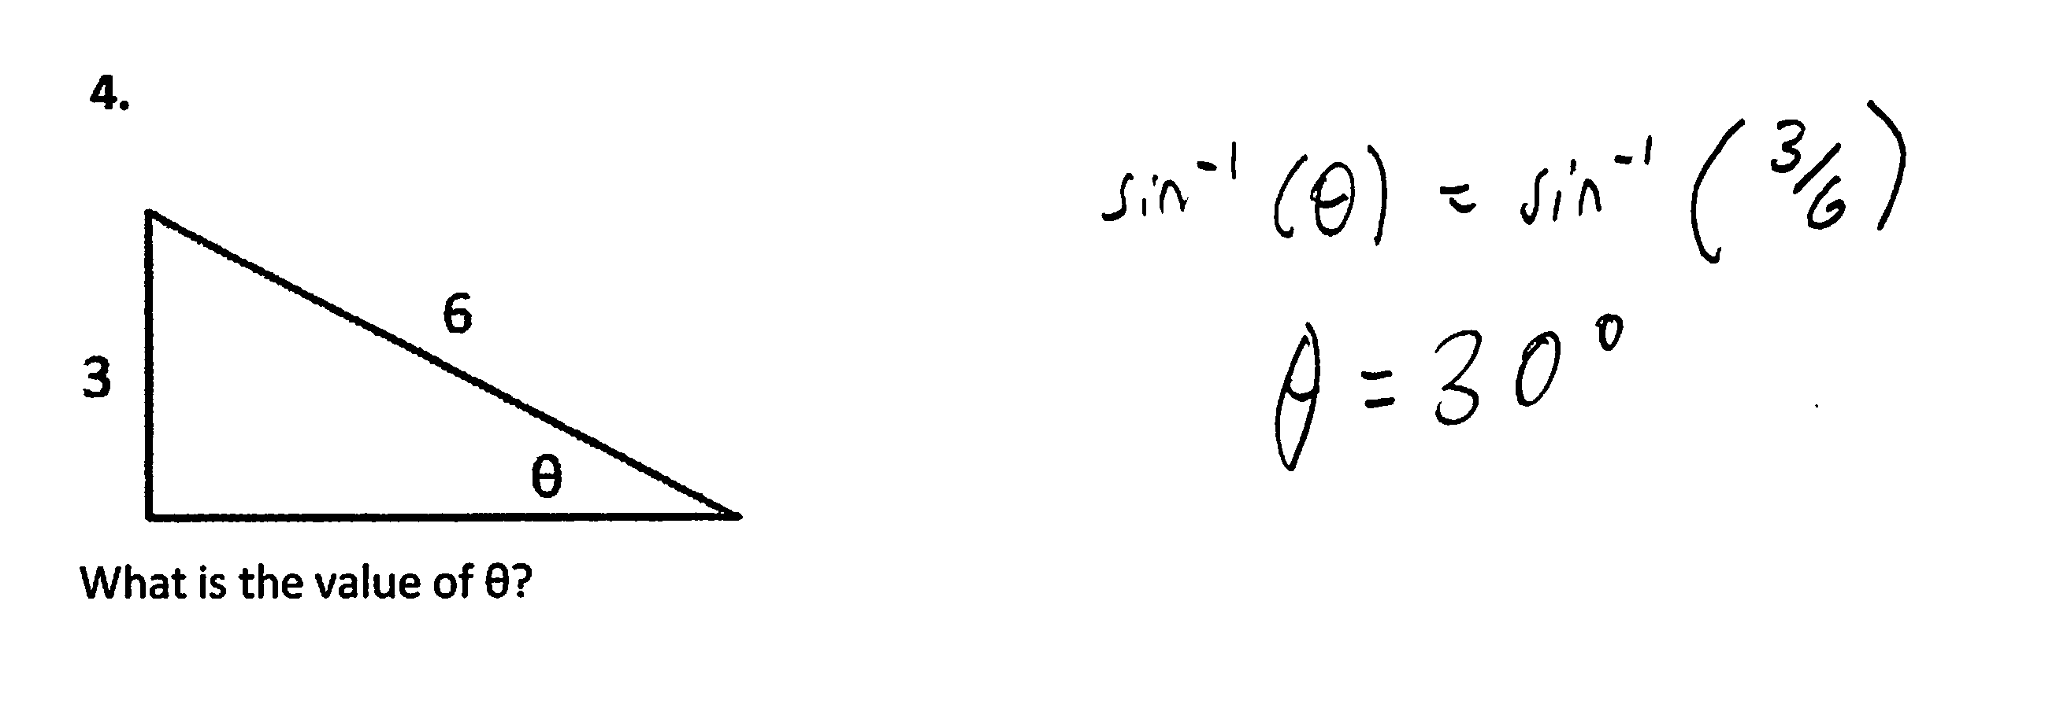
Find Unknown Angle
3.

Slide 6
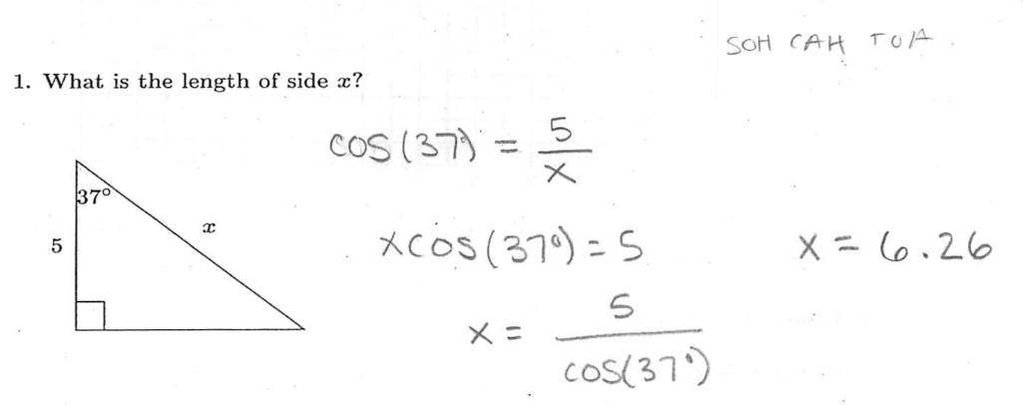
Find Unknown Side

Slide 7
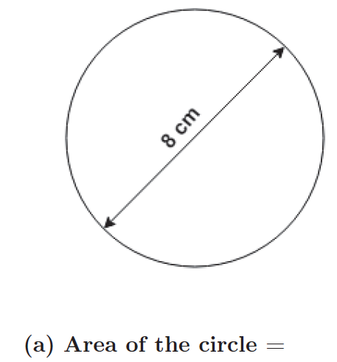
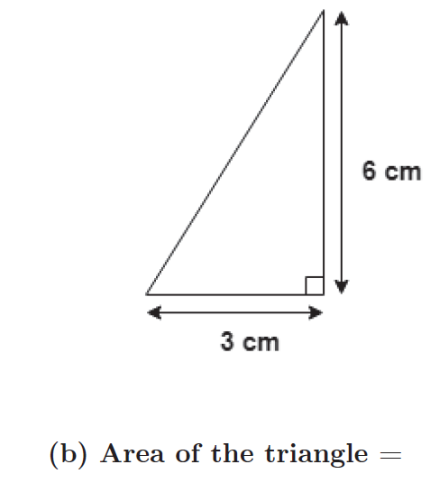
Find Area

Slide 8
Find Slope of Graph

Slide 9
Simultaneous Equations, Numeric Coefficients

Slide 10
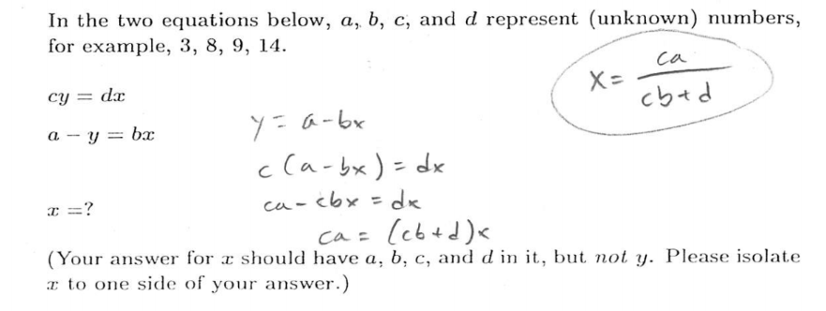
Simultaneous Equations, Symbolic Coefficients

Slide 11
(Some) Other Items

Slide 12
Our Primary Sample Populations
(Arizona State University)
PHY 111: Algebra-based; 1st semester
PHY 112: Algebra-based; 2nd semester
PHY 121: Calculus-based; 1st semester
PHY 131: Calculus-based; 2nd semester

Slide 13
Our Primary Sample Populations
(Arizona State University)
PHY 111: Algebra-based; 1st semester
PHY 112: Algebra-based; 2nd semester
PHY 121: Calculus-based; 1st semester
PHY 131: Calculus-based; 2nd semester
Tempe
Poly
Tempe
Poly
Tempe
Poly
Tempe
Poly

Slide 14
Primary Findings
Difficulties with pre-college mathematical operations are widespread among students in both algebra- and calculus-based physics courses.
  Results were highly consistent among five different campuses at four different state universities: Arizona State University (ASU), Tempe and Poly campuses; University of Colorado (CU); Ohio State University (OSU); University of West Florida (UWF)
Despite the great diversity of diagnostic item types, students’ item responses were highly correlated with each other, and with total score.

Slide 15
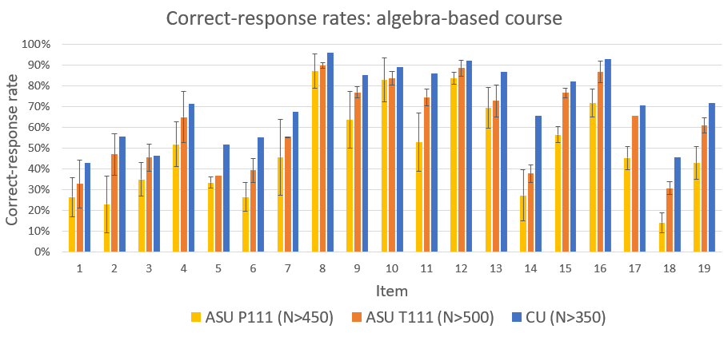

Slide 16
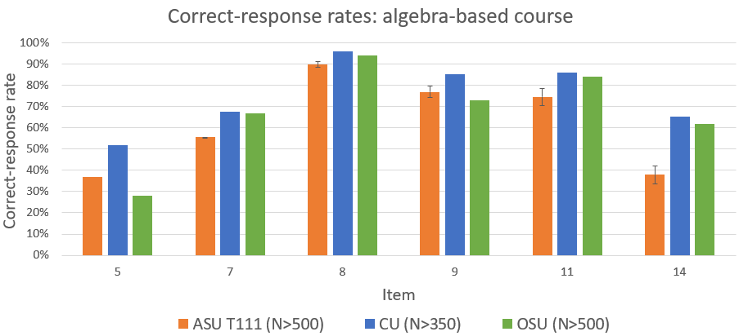

Slide 18
Primary Findings
Difficulties with pre-college mathematical operations are widespread among students in both algebra- and calculus-based physics courses.
  Results were highly consistent among five different campuses at four different state universities.
Despite the great diversity of diagnostic item types, students’ item responses were highly correlated with each other, and with total score.
  Example: Items #3 and #18

Slide 20
Predictability at Individual-Student Level
Performance on a single test item can predict probable correct-response rate on remaining 13 items
Examples:
  Item #3
  Item #7

Slide 21
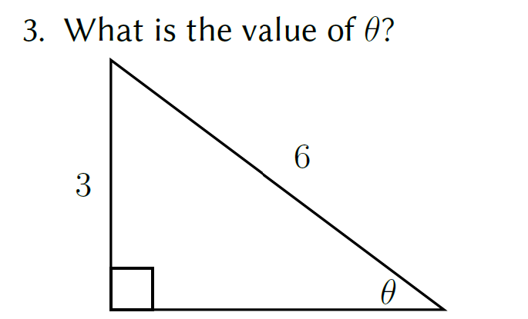

Slide 23
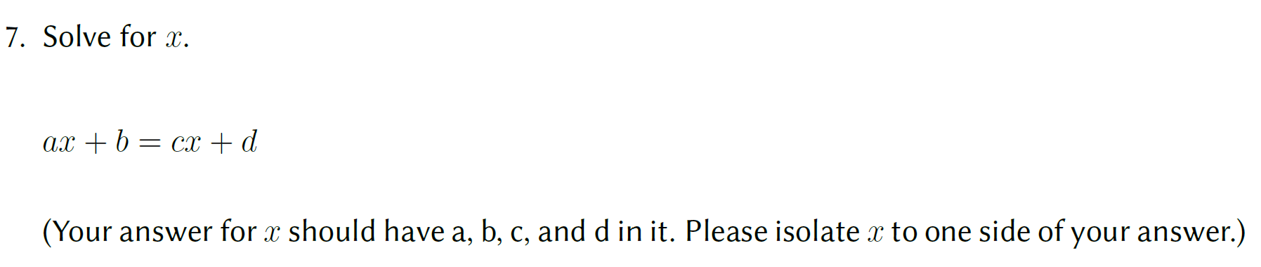

Slide 25
Predictability at Individual-Student Level
Performance on 3-item subset can accurately predict correct-response rate on remaining 11 items
Examples:
  [#9, #14, #16]
  [#3, #9, #15]

Slide 26
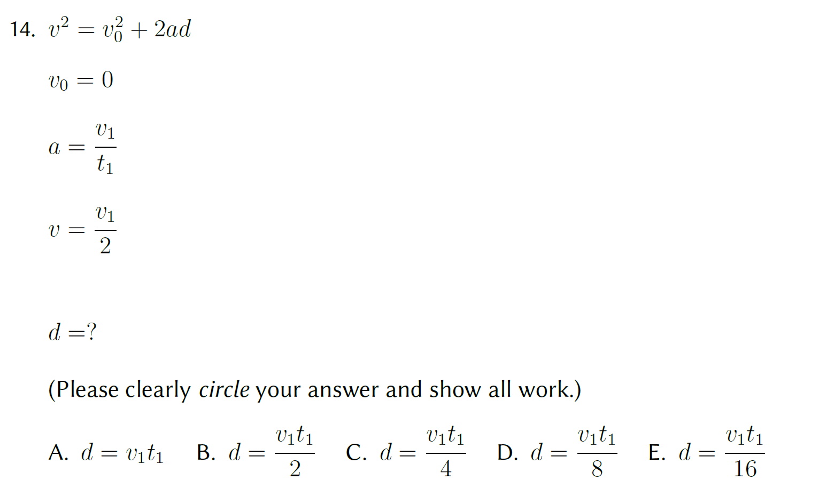
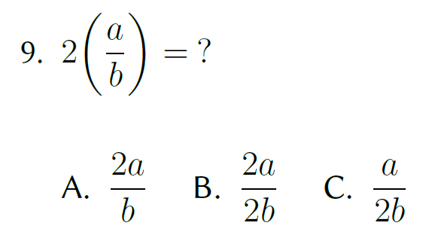
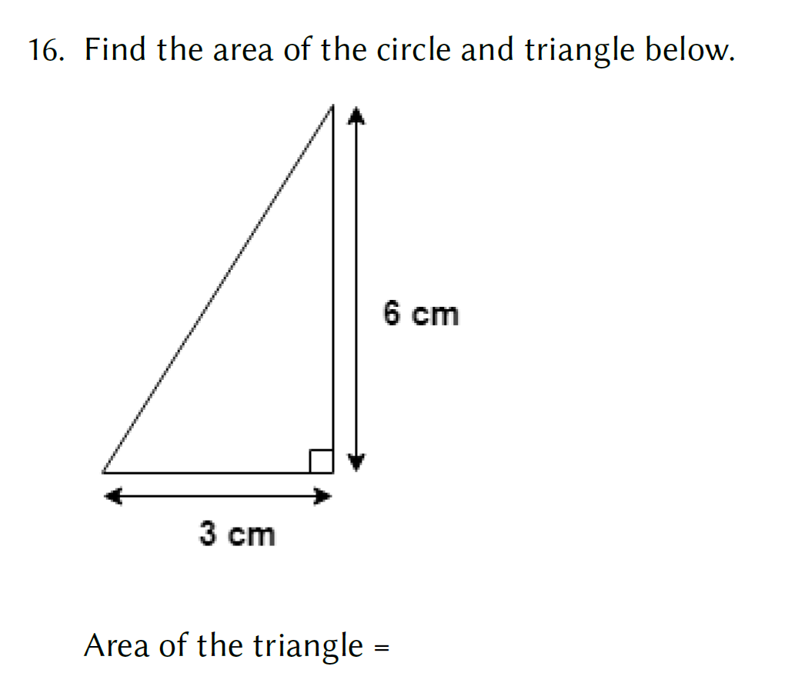

Slide 28
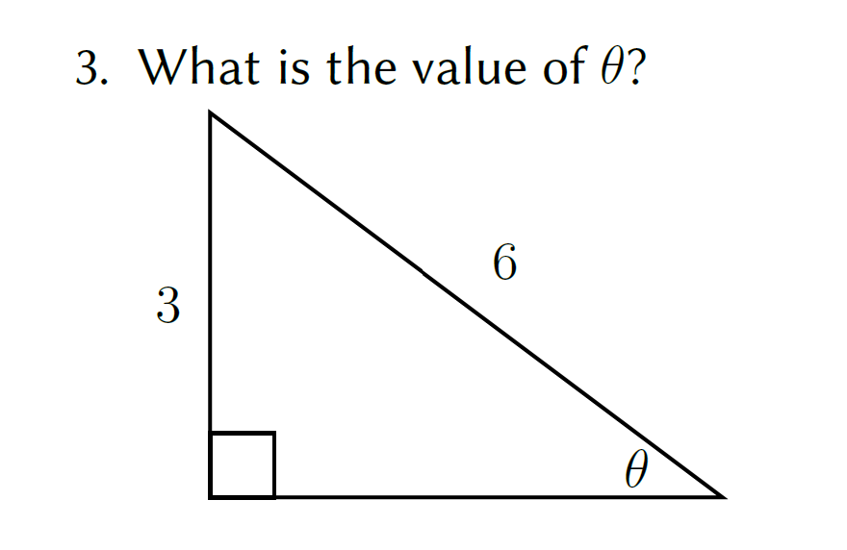
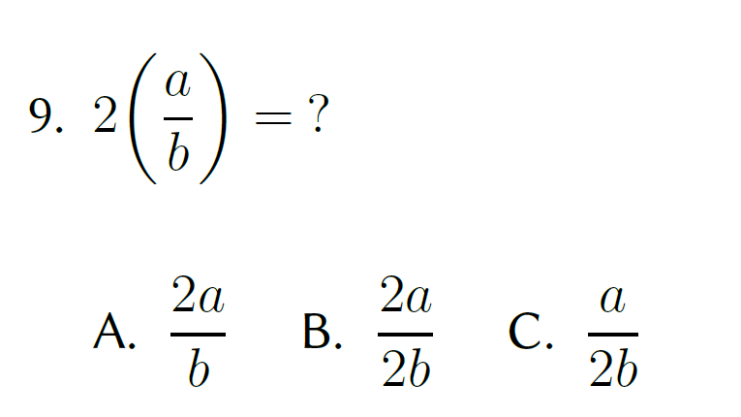
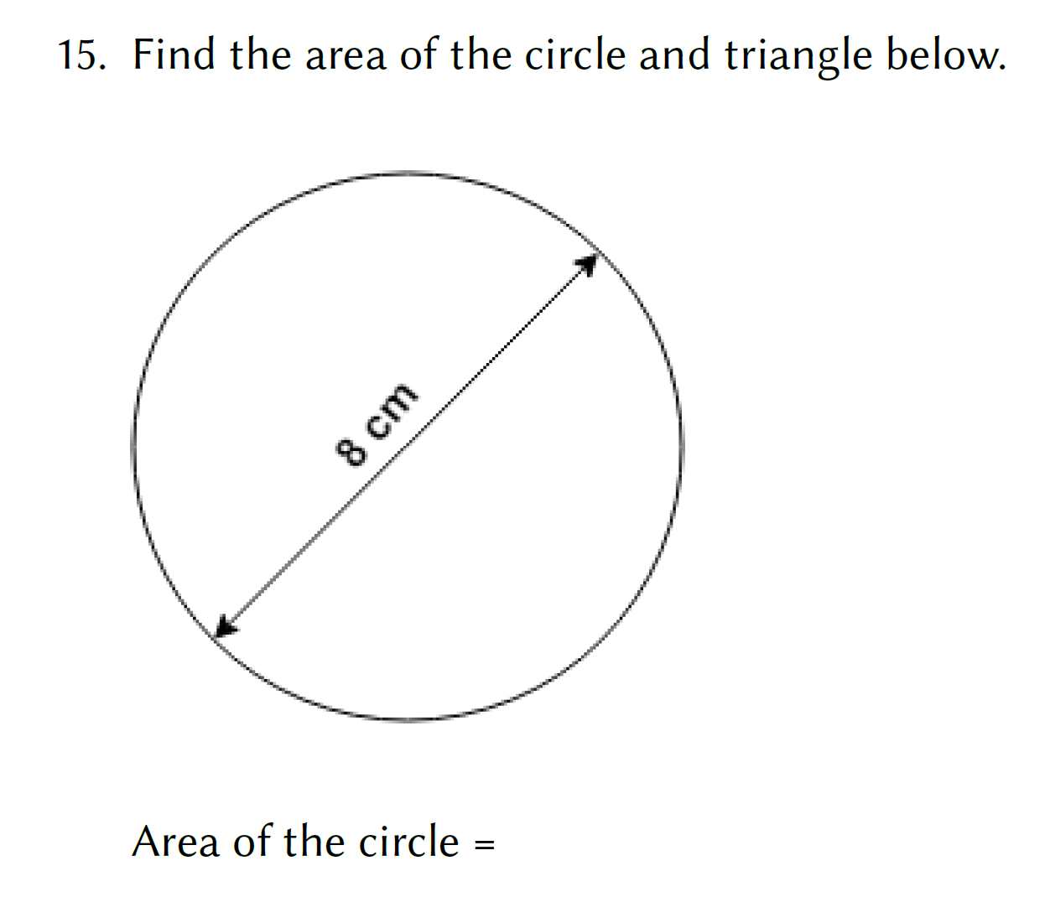

Slide 30
Predictability at Individual-Student Level
Individual student pretest score on online version is moderately predictive of post-test score

Slide 32
Predictability at Whole-Class Level
Class-average performance on single test item can accurately predict class-average correct-response rate on remaining 13 items

Slide 33
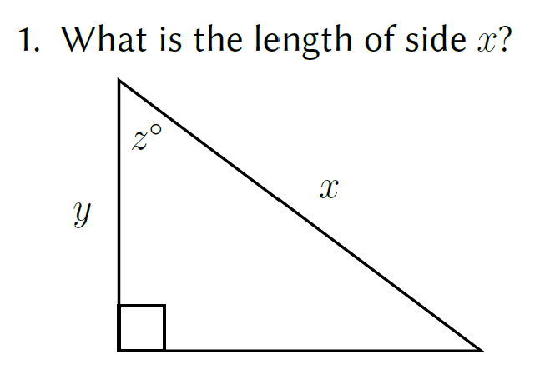

Slide 37
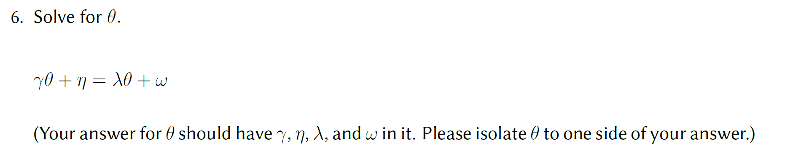

Slide 40
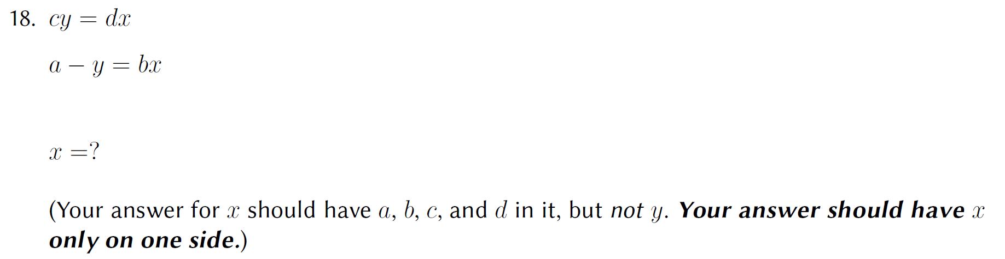

Slide 43
Relationship between physics and math performance
For online version, student performance on conceptual physics questions is positively correlated with performance on math diagnostic
[4-item physics cluster vs 14-item math diagnostic}

Slide 44
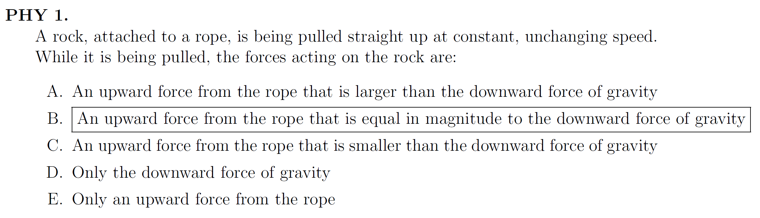
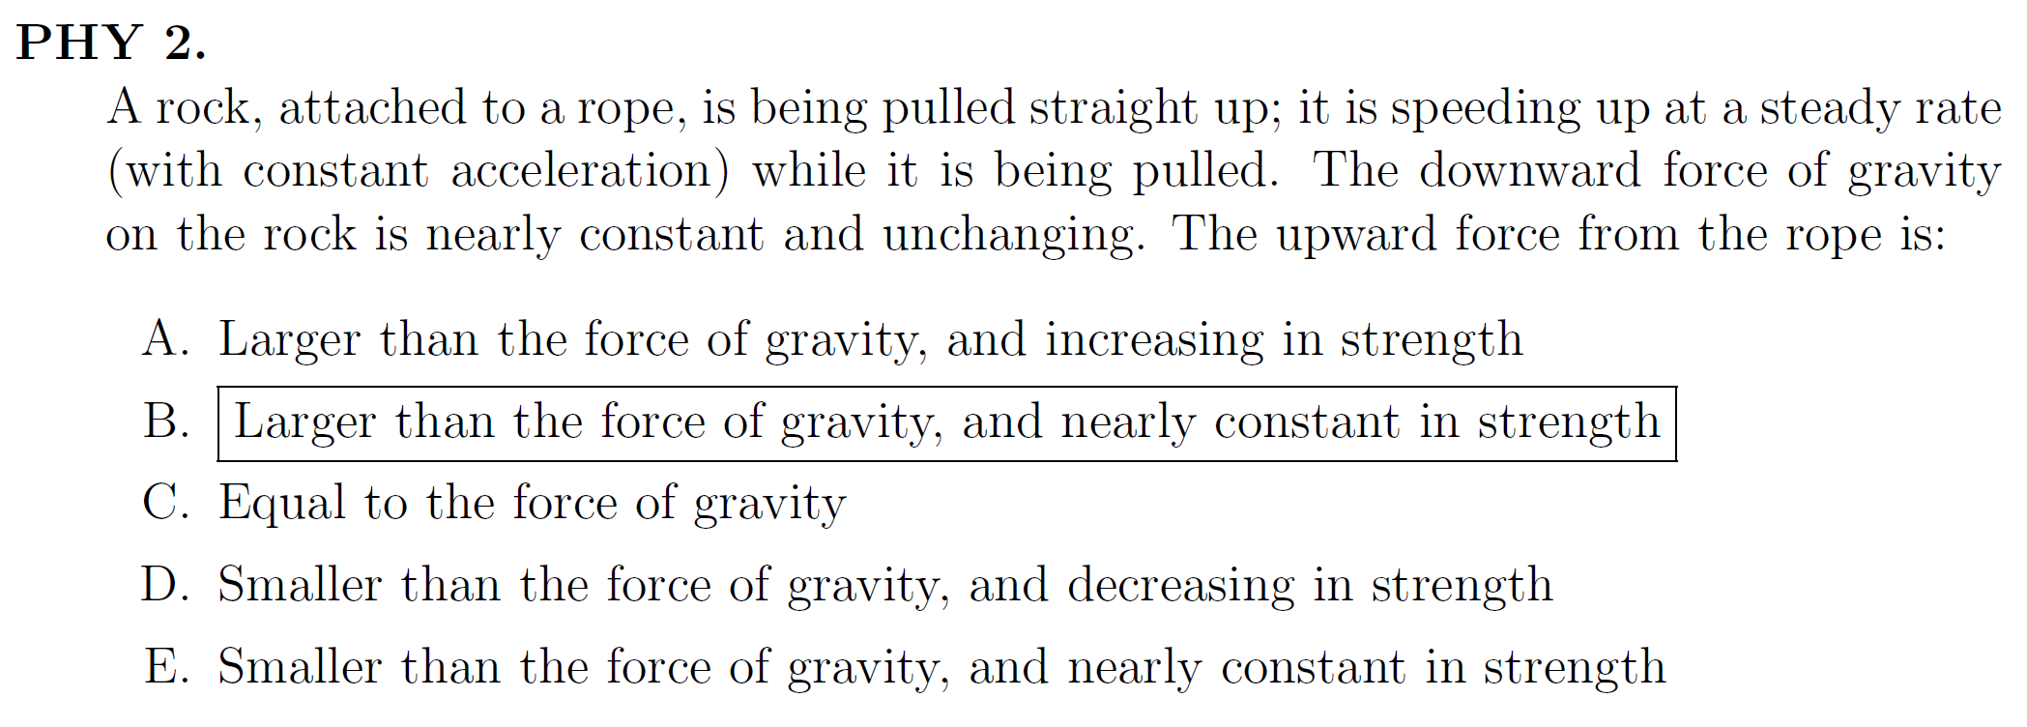

Slide 45
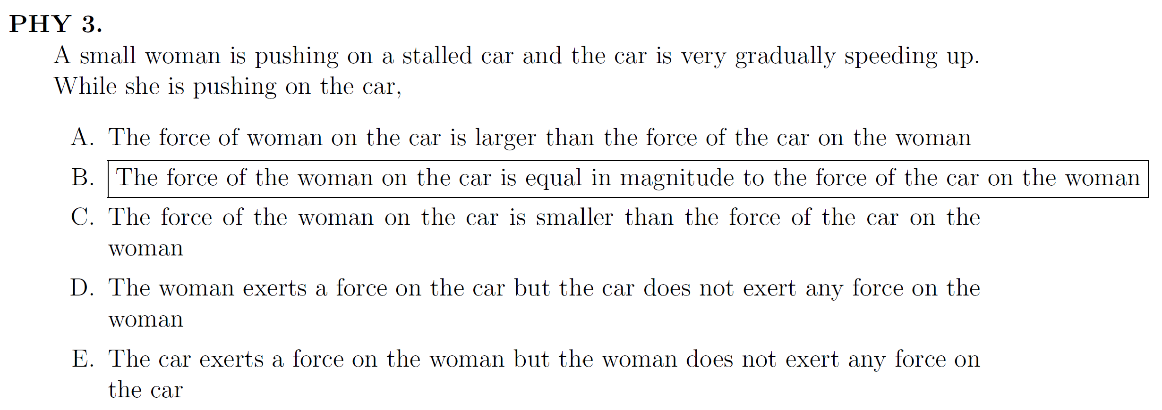

Slide 46
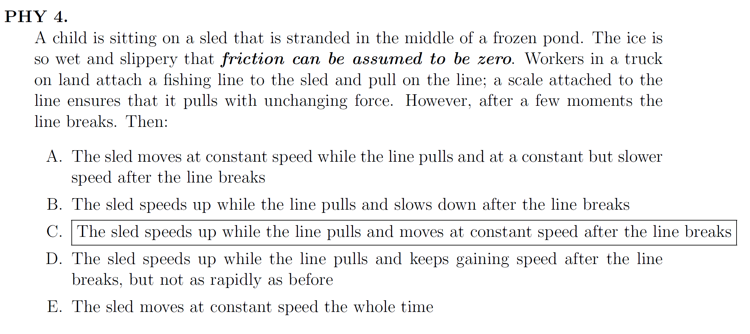

Slide 48
Summary
Physics students’ difficulties with basic mathematical operations are not confined to one particular topic (e.g., trigonometry, algebra, graphing); rather, difficulties on one topic are highly correlated with difficulties on other topics
Performance on single math test items, or on small item subsets, is predictive of overall individual-student math performance, and highly predictive at the class-average level

