Slide 1
Pre-instruction Math Quiz May Predict Students’ Physics Course Performance
David E. Meltzer,¹ Dakota H. King,² and John D. Byrd¹
¹ Arizona State University
² National Heart, Lung, and Blood Institute, National Institutes of Health
Supported in part by NSF DUE #1504986 and #1914712

Slide 2
Acknowledgments
Student data and very useful discussions have been provided by (among others):
Darya Dolenko (Arizona State University)
Andrew Heckler (Ohio State University)
Beatriz Burrola Gabilondo (Ohio State University)
Steven Pollock (University of Colorado, Boulder)
Colin West (University of Colorado, Boulder)
Christopher Varney (University of West Florida)

Slide 3
Overview
We have given diagnostic tests covering pre-college mathematics to over 7000 introductory physics students:
Error rates were large enough to suggest that math difficulties can interfere with course performance;
Results from five campuses at four different state universities were consistent with each other;
Most data are from written free-response diagnostic; new online multiple-choice diagnostic has yielded results extremely similar to those of written version;
Preliminary findings suggest that very high or low math pre-test scores may provide indications of ultimate physics course performance

Slide 4
All test items, multiple-choice version (Calculators are allowed)

Slide 5
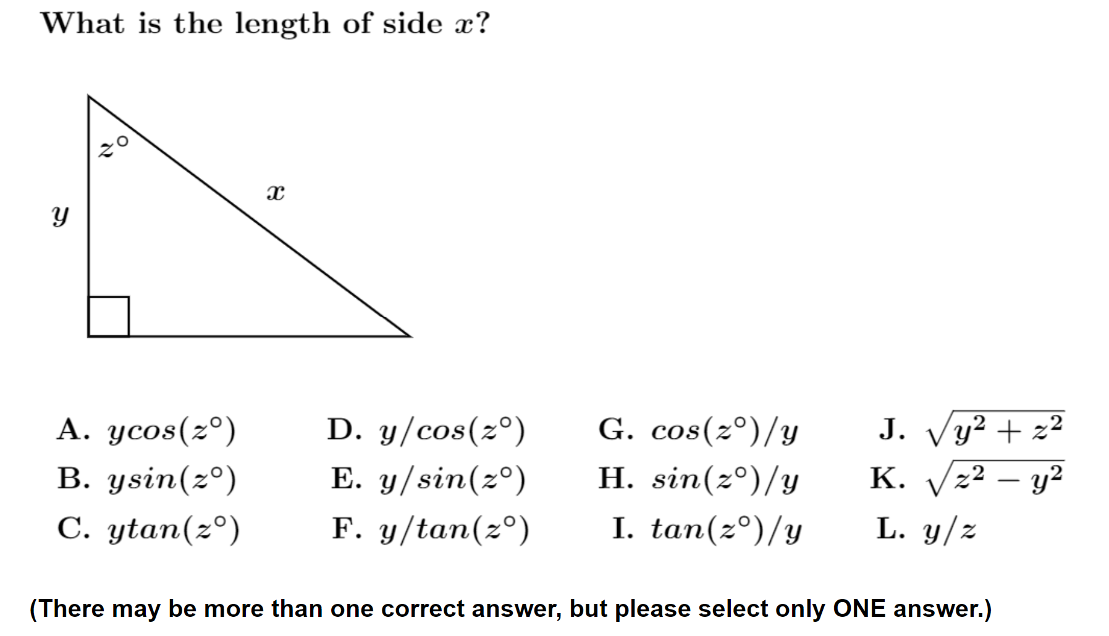
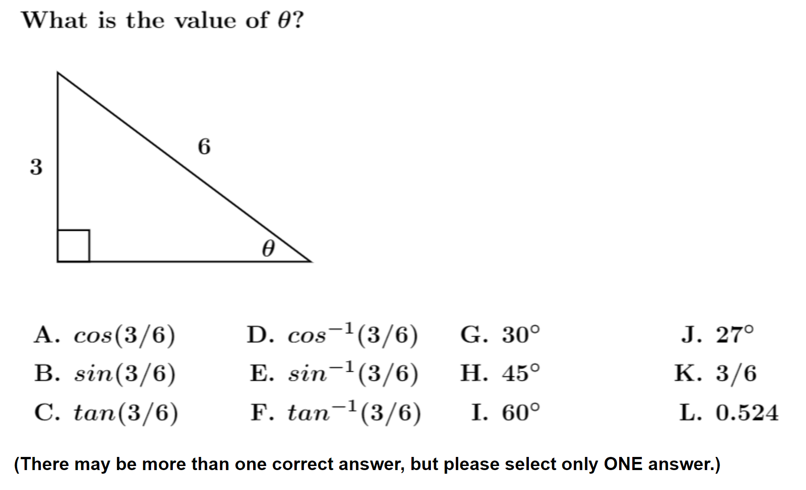

Slide 6
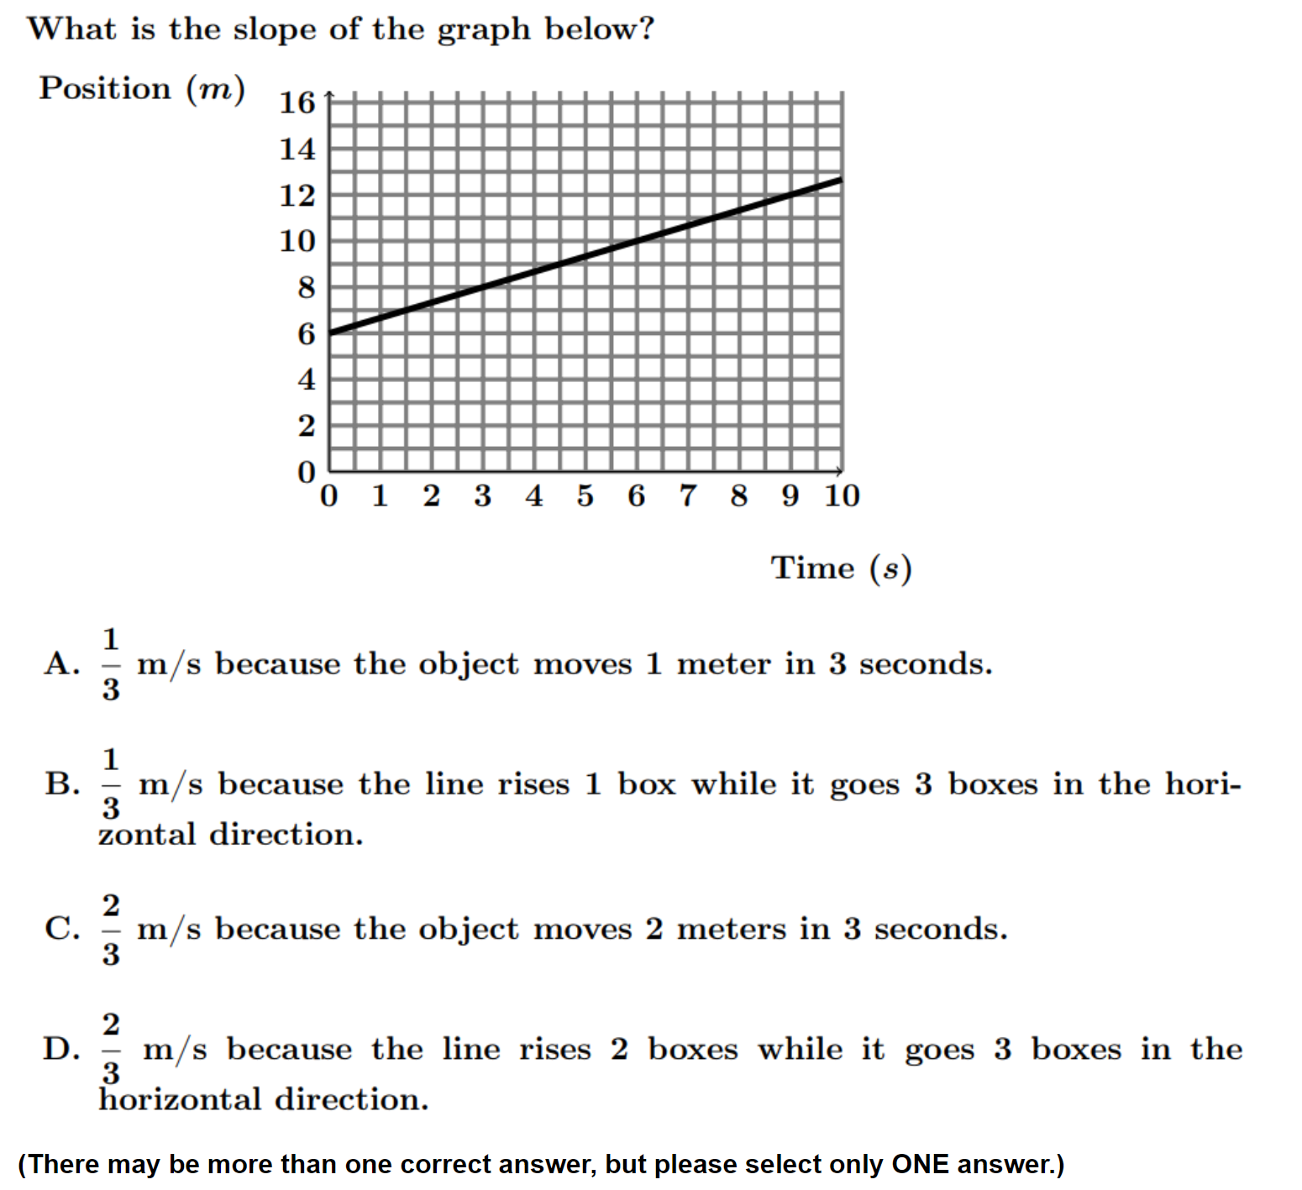

Slide 7
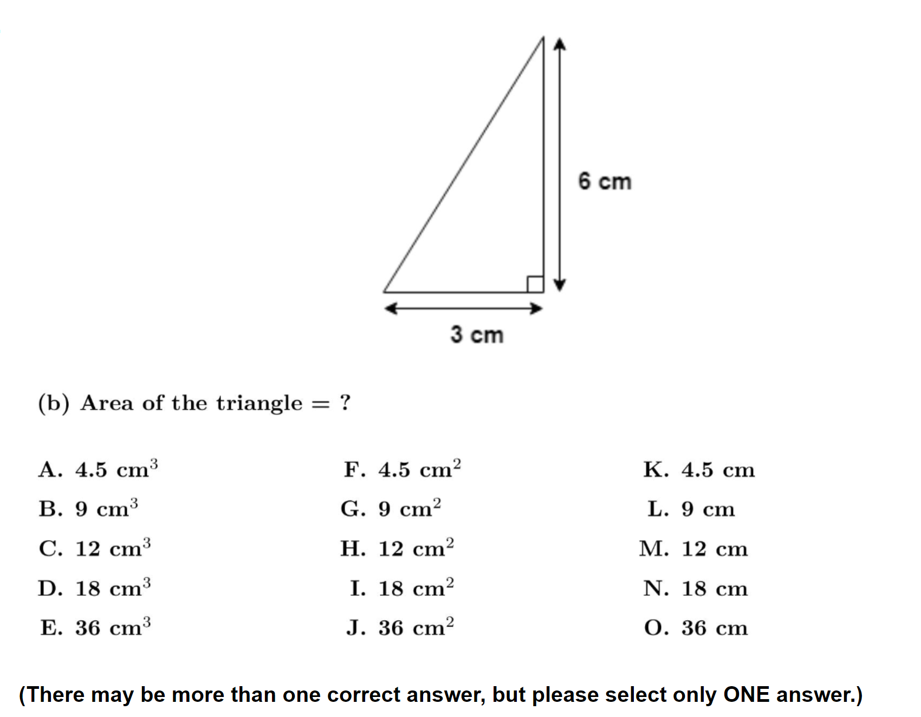
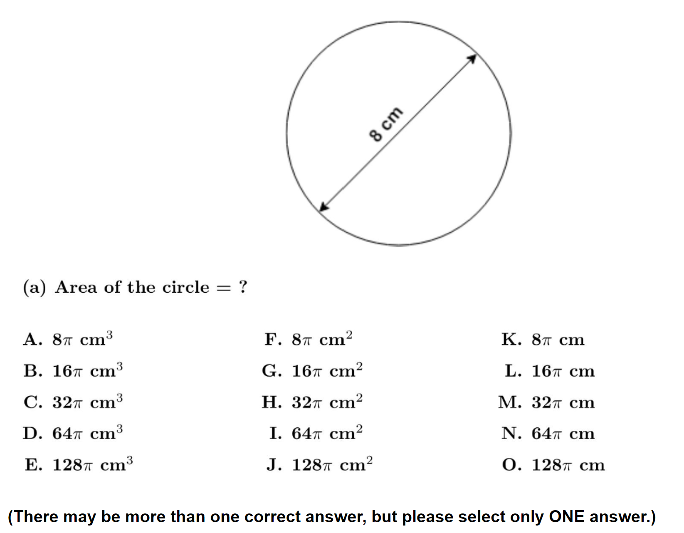
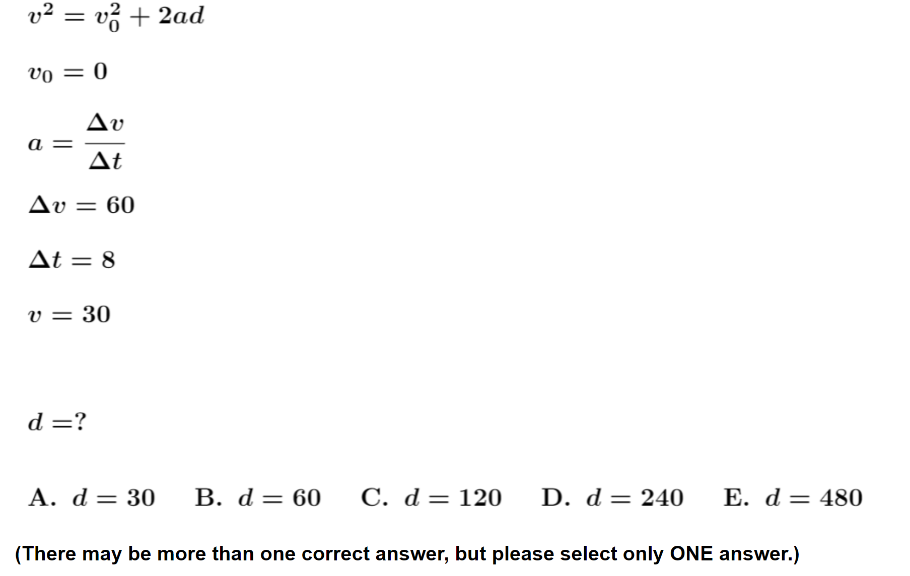
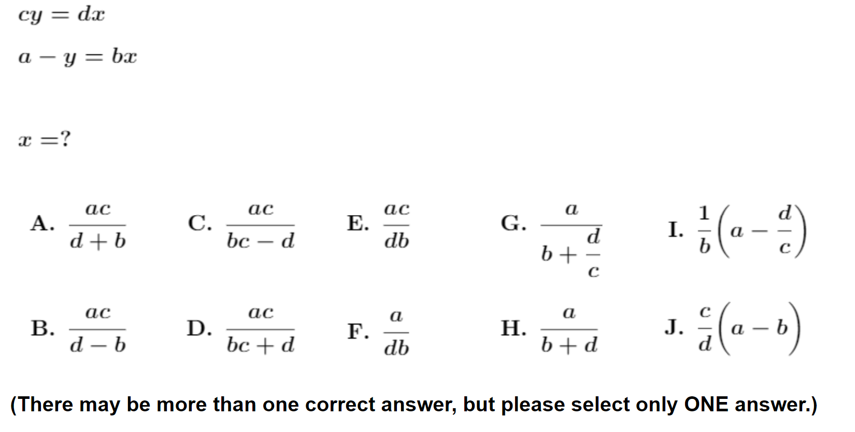

Slide 8
Key Finding: High error rates on many items
Error rates of 30-60% appear consistently among diverse test items in all student populations.
Implication: Instructors may need to adjust expectations of students’ operational abilities with trigonometry, graphing, algebra, etc.

Slide 9
Key Finding: Even single test items are highly predictive
Class-average scores on even a single diagnostic test item—regardless of which item was chosen—were highly predictive of average scores on all other diagnostic items covering varied topics.
Implication: It may be possible to diagnose the level of students’ difficulties with only one or very few mathematics pretest items.

Slide 10
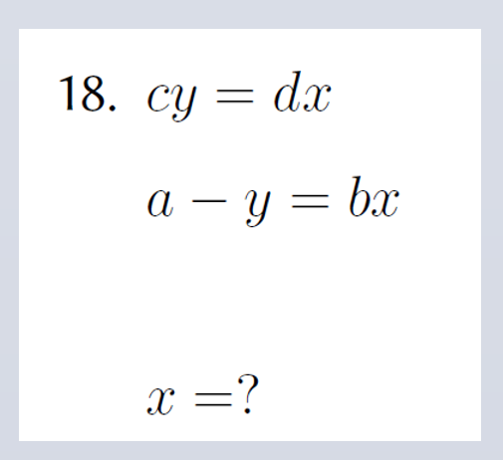
Predictability at Whole-Class Level
Performance on one single diagnostic item can accurately predict class-average score on full diagnostic
Example:
[“#18”]

Slide 11
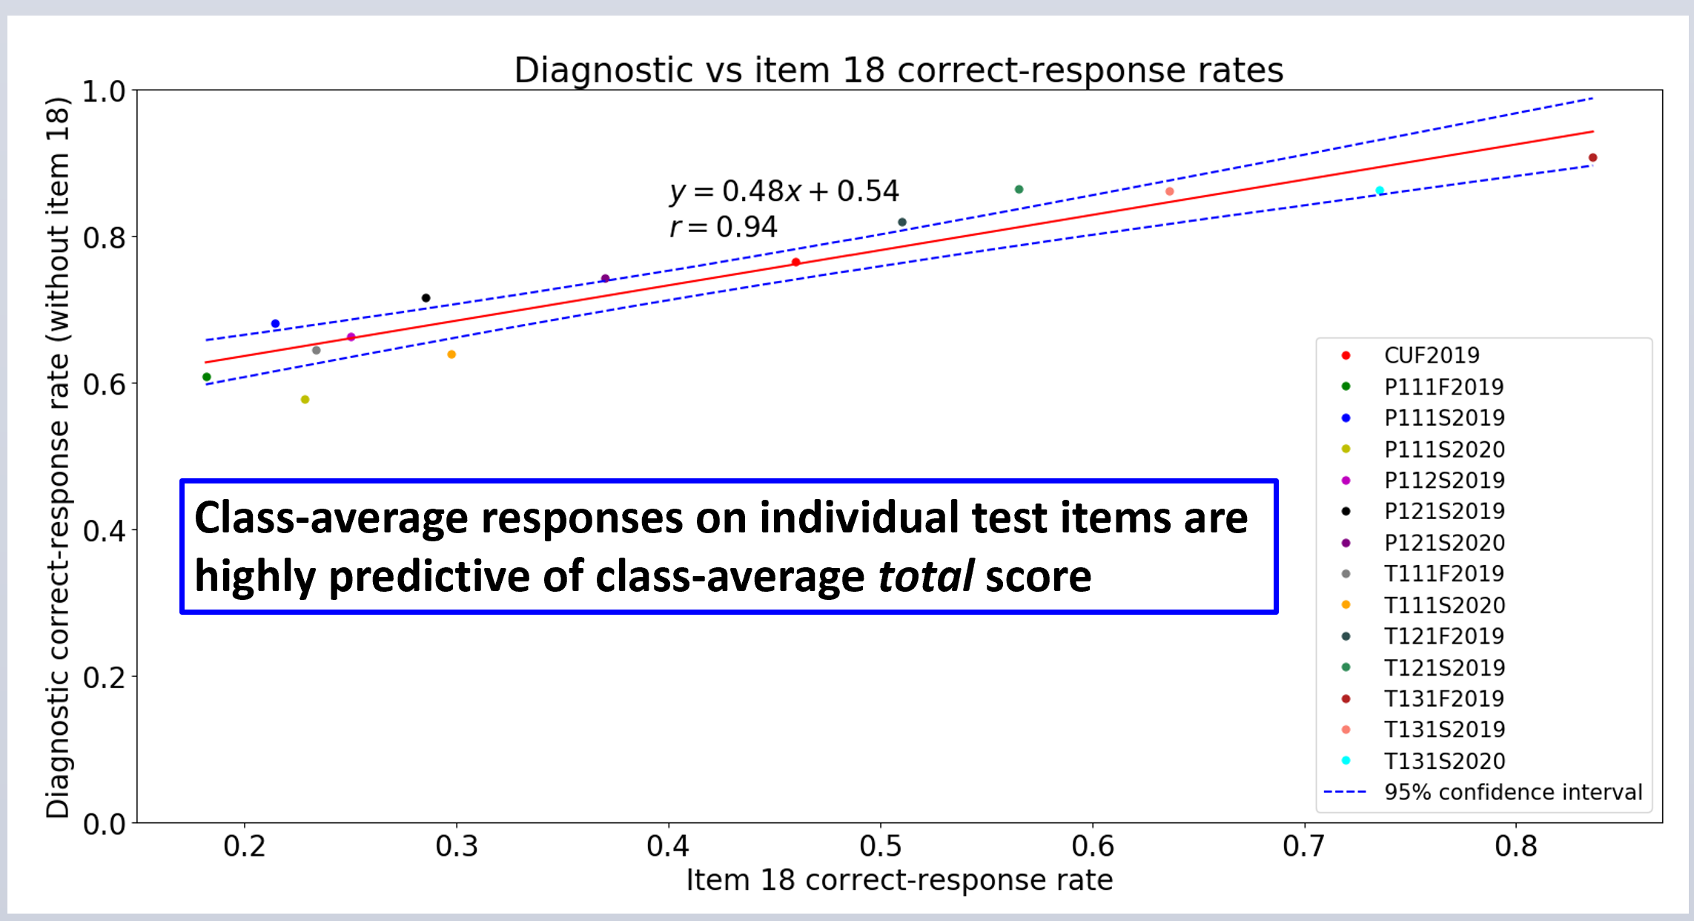

Slide 12
Tentative Finding: Math performance somewhat predictive of final grade
Limited data: three class samples
Clear pattern, but pattern type depends on student population
No evidence of causal relationship

Slide 13
Predictability at Individual-Student Level
Performance on 3-item subset may approximately predict final course grade
Example:
[#3, #11, #12]
[We found this to be the most predictive three-item set for the UWF student sample]

Slide 14
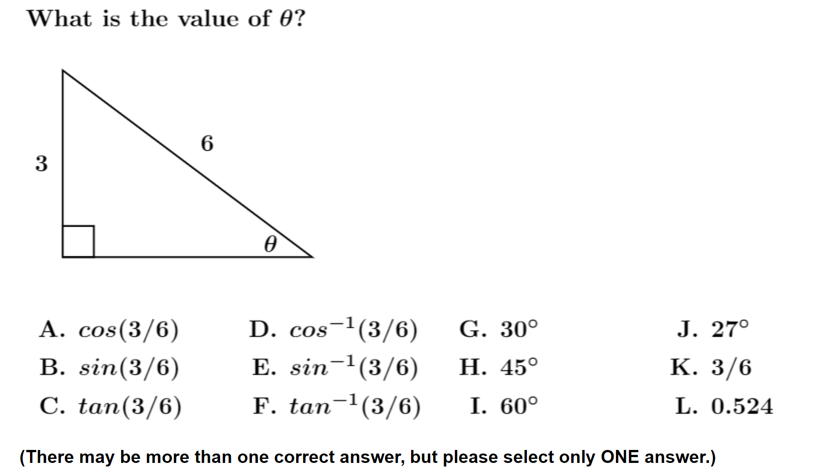
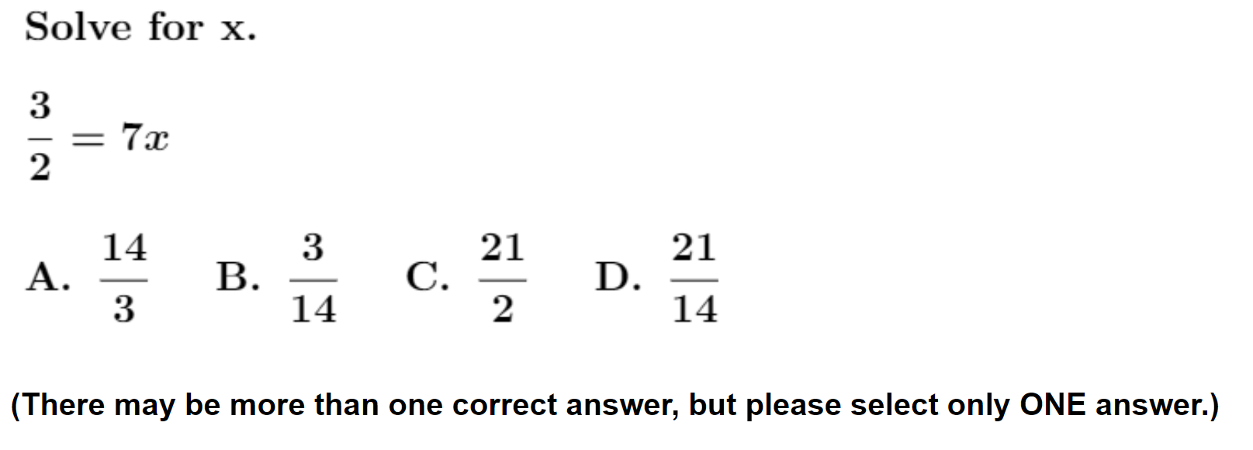
#3
#12
#11

Slide 15
Calculus-based Physics, 1st semester (UWF) N = 95, 32% with final grade B+/A-/A
0 or 1 correct on [#3, #11, #12]
(N = 21)
5% with final grade B+/A-/A
3/3 correct on [#3, #11, #12]
(N = 44)
52% with final grade B+/A-/A
Three-item subset appears to be predictive of final grades…

Slide 16
#3
#11
#12
We found this set to be predictive of course grades for the UWF Spring 2021 sample (calculus-based course).
How would it perform in Fall 2021 in an algebra-based course at ASU Polytechic?

Slide 17
Algebra-based Physics, 1st semester (ASU Poly) N = 82, 49% with final grade B+/A-/A
0 or 1 correct on [#3, #11, #12]
(N = 20)
35% with final grade B+/A-/A
3/3 correct on [#3, #11, #12]
(N = 20)
65% with final grade B+/A-/A
[We found that the very same three-item set was also predictive for the new ASU Poly sample]

Slide 18
Predictability at Individual-Student Level
Performance on full online diagnostic can approximately predict final course grade
Previous data:
Calculus-based physics, 1st semester (UWF)
Algebra-based physics, 2nd semester (ASU Tempe)
New data:
Algebra-based physics, 1st semester (ASU Polytechnic)

Slide 19
Calculus-based Physics, 1st semester (UWF) N = 95, 32% with final grade B+/A-/A
<70% correct responses (full diagnostic)
(N = 35)
6% with final grade B+/A-/A
>92% correct responses (full diagnostic)
(N = 21)
62% with final grade B+/A-/A

Slide 20
Algebra-based Physics, 2nd semester (ASU Tempe) N = 118, 59% with final grade A-/A/A+
<86% correct responses (full diagnostic)
(N = 101)
53% with final grade A-/A/A+
>92% correct responses (full diagnostic)
(N = 17)
94% with final grade A-/A/A+

Slide 21
New Data: Fall 2021, ASU Polytechnic
Algebra-based course, 1st semester (mechanics)
Very light use of mathematics: little trigonometry, single-variable equations only; limited use of symbols; almost all graphing was qualitative (no numbers or units)
Taught by DEM; two sections taught back-to-back; samples combined

Slide 23
This class

Slide 24
Algebra-based Physics, 1st semester (ASU Poly) N = 82, 34% with final grade A-/A/A+
<57% correct responses (full diagnostic)
(N = 29)
14% with final grade A-/A/A+
>81% correct responses (full diagnostic)
(N = 16)
63% with final grade A-/A/A+
But here, we can examine individual data points [students] in more detail…

Slide 25
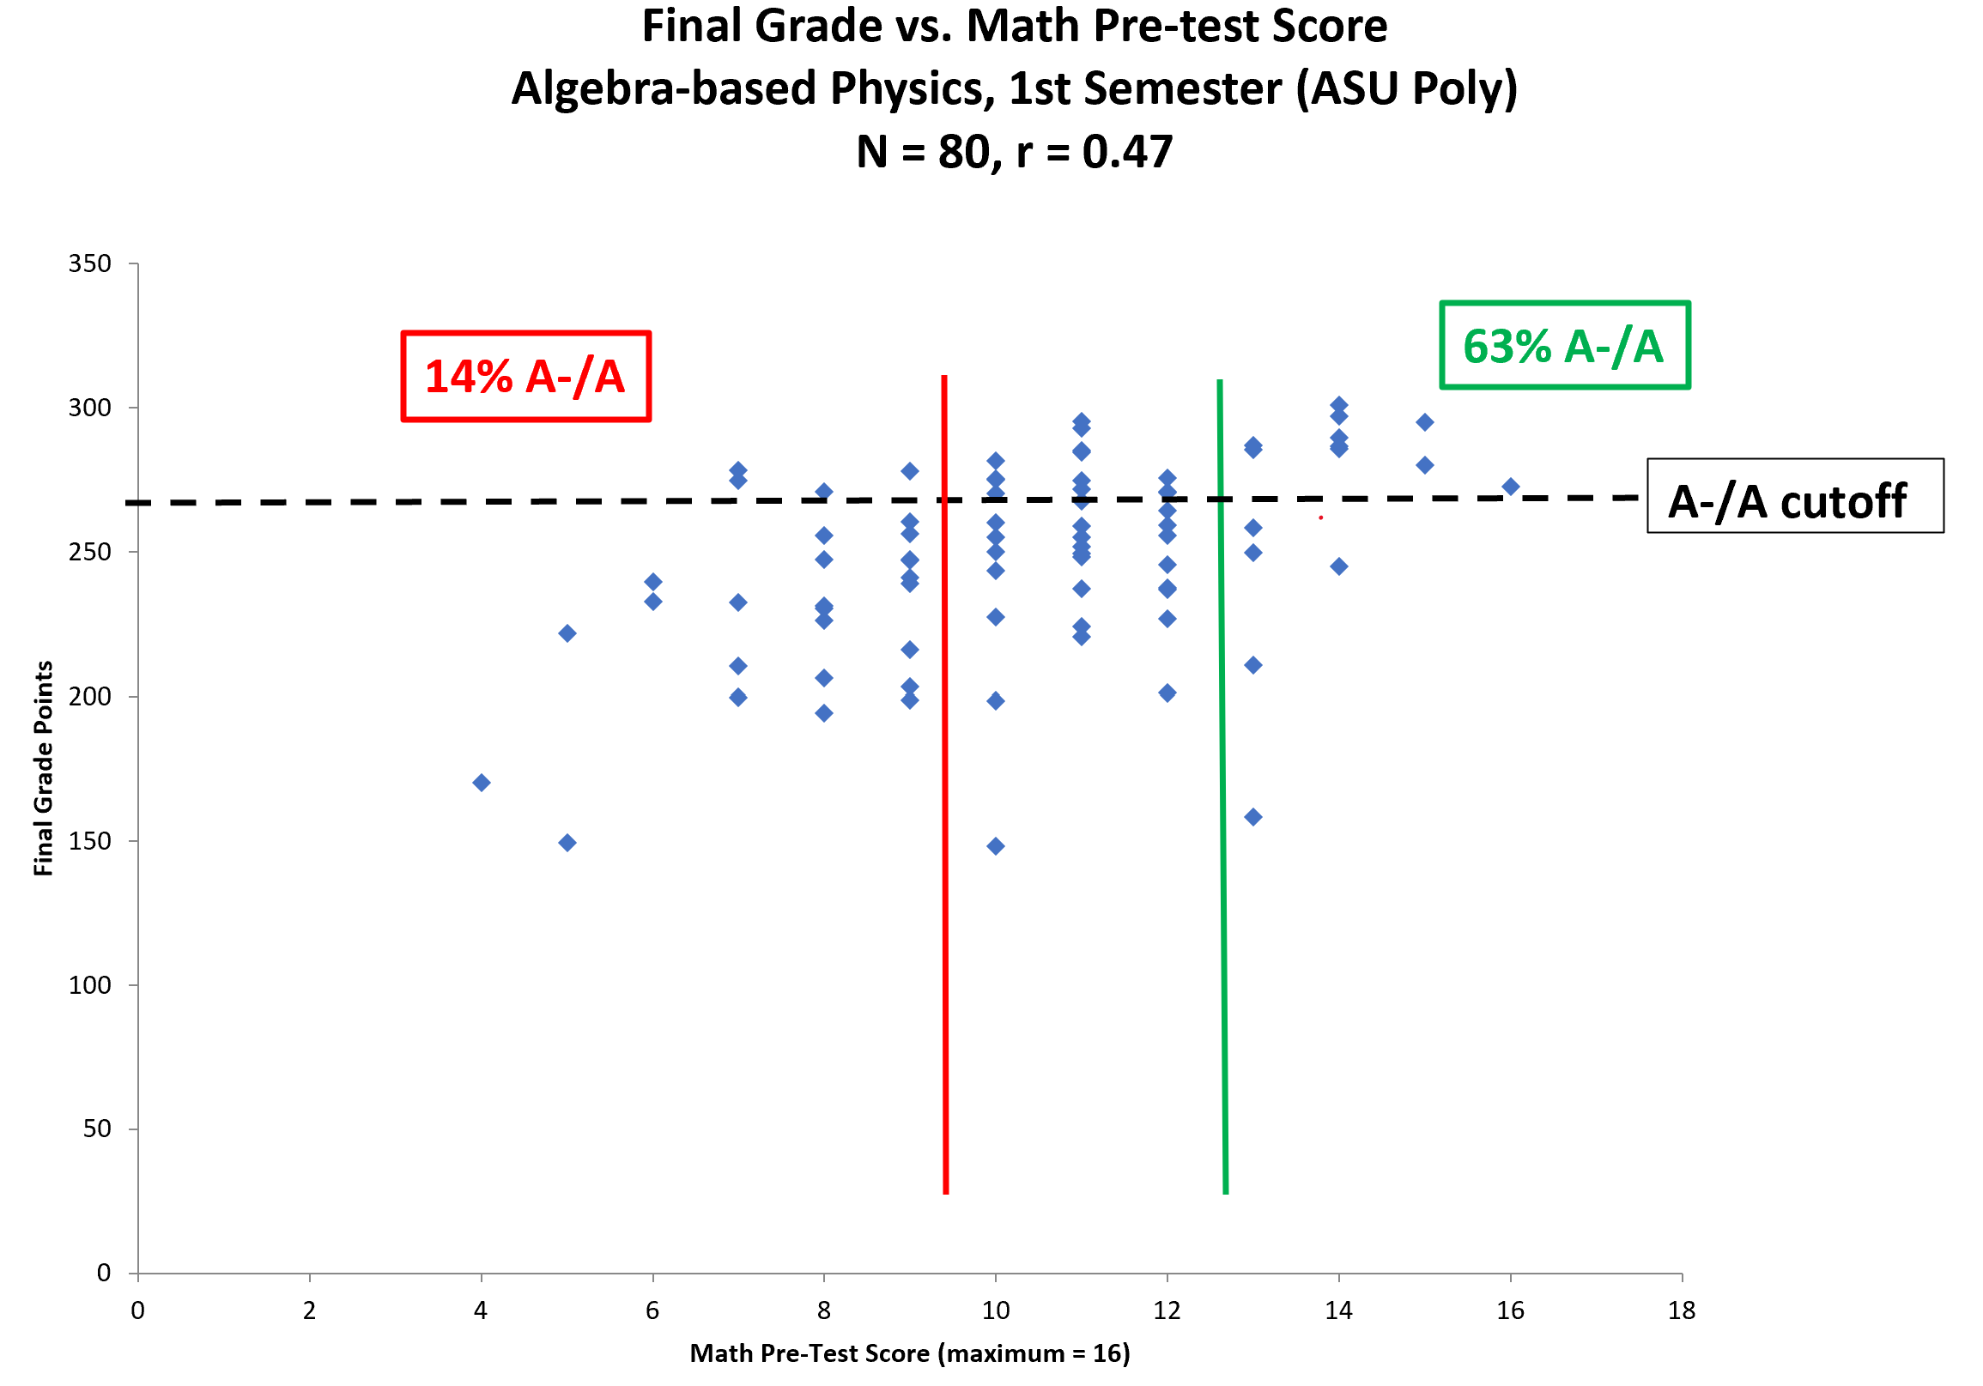

Slide 26
9/16 or worse on math pre-test
13/16 or better on math pre-test

Slide 27
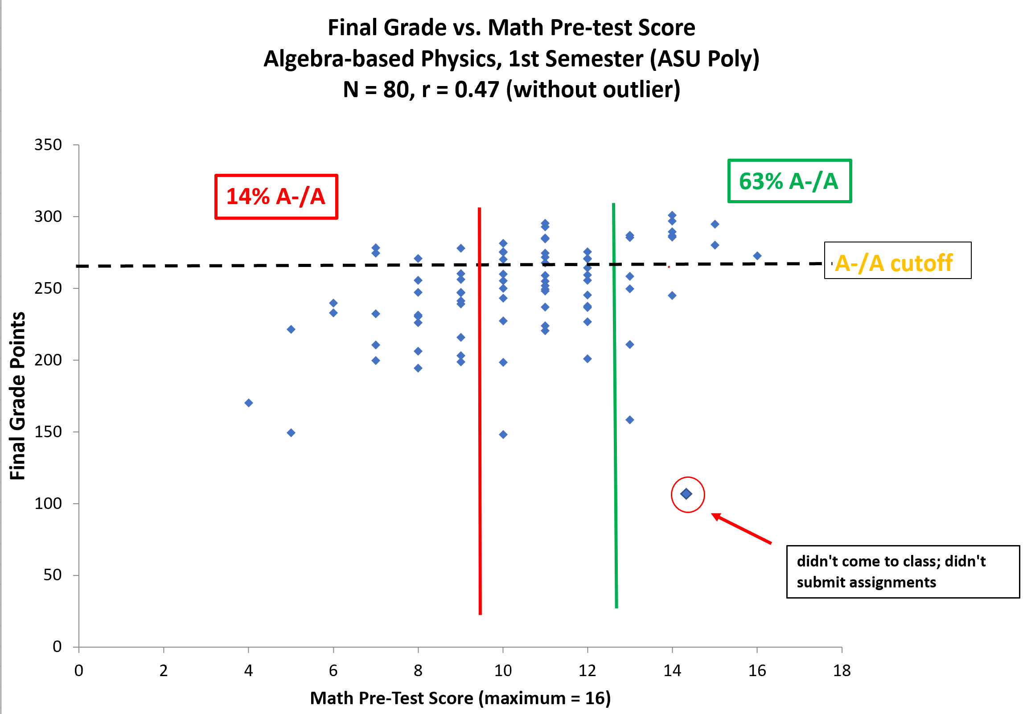

Slide 28
Frequently e-mailed instructor to get suggestions for quiz-study topics

Slide 29
always came to class
sat near front
actively participated in all class activities

Slide 30
always came to class
sat near front
actively participated in all class activities
stopped coming to class
stopped taking quizzes

Slide 31
always came to class
sat near front
actively participated in all class activities
didn’t hand in any homework assignments
stopped coming to class
stopped taking quizzes

Slide 32
always came to class
sat near front
actively participated in all class activities
missed many classes
didn’t hand in any homework assignments
stopped coming to class
stopped taking quizzes

Slide 33
always came to class
sat near front
actively participated in all class activities
missed many classes
missed many classes
didn’t hand in any homework assignments
stopped coming to class
stopped taking quizzes

Slide 34
always came to class
sat near front
actively participated in all class activities
missed many classes
missed many classes
didn’t hand in any homework assignments
stopped coming to class
stopped taking quizzes
Scored 17th percentile on Lawson test of scientific reasoning

Slide 35
always came to class
sat near front
actively participated in all class activities
missed many classes
Scored 17th percentile on Lawson test of scientific reasoning
didn’t hand in any homework assignments
stopped coming to class
stopped taking quizzes
Scored 17th percentile on Lawson test of scientific reasoning

Slide 36
always came to class
sat near front
actively participated in all class activities
missed many classes
missed many classes
didn’t hand in any homework assignments
stopped coming to class
stopped taking quizzes
Scored 80th percentile on Lawson test of scientific reasoning

Slide 37
always came to class
sat near front
actively participated in all class activities
missed many classes
missed many classes
didn’t hand in any homework assignments
Scored 10th percentile on FCI Pre-test
Scored 80th percentile on Lawson test of scientific reasoning

Slide 38
always came to class
sat near front
actively participated in all class activities
Scored 81th percentile on FCI Pre-test
missed many classes
missed many classes
didn’t hand in any homework assignments
Scored 10th percentile on FCI Pre-test
Scored 80th percentile on Lawson test of scientific reasoning

Slide 39
Scored 77th percentile on FCI Pre-test
Scored 81th percentile on FCI Pre-test
missed many classes
missed many classes
didn’t hand in any homework assignments
Scored 10th percentile on FCI Pre-test
Scored 80th percentile on Lawson test of scientific reasoning

Slide 40
Summary
Performance on individual mathematics test items is predictive of overall diagnostic performance, and performance on the full diagnostic is somewhat predictive of final course grades
Preliminary evidence suggests that “exceptions to the rule” regarding predictability of course performance may be explainable by motivational factors

