Slide 1
Instructional implications of findings on students' mathematical difficulties
David E. Meltzer and Dakota H. King
Arizona State University
Supported in part by NSF DUE #1504986 and #1914712

Slide 2
Acknowledgments
Student data and very useful discussions have been provided by (among others):
Darya Dolenko (Arizona State University)
Andrew Heckler (Ohio State University)
Beatriz Burrola Gabilondo (Ohio State University)
Steven Pollock (University of Colorado, Boulder)
Colin West (University of Colorado, Boulder)
Christopher Varney (University of West Florida)

Slide 3
Overview
We have given diagnostic tests covering pre-college mathematics to over 7000 introductory physics students:
Error rates were large enough to suggest that math difficulties can interfere with course performance;
Results from five campuses at four different state universities were consistent with each other;
We have adjusted our own instruction based on the findings, and offer some suggestions for other physics instructors.

Slide 4
Examples of Test Items

Slide 5
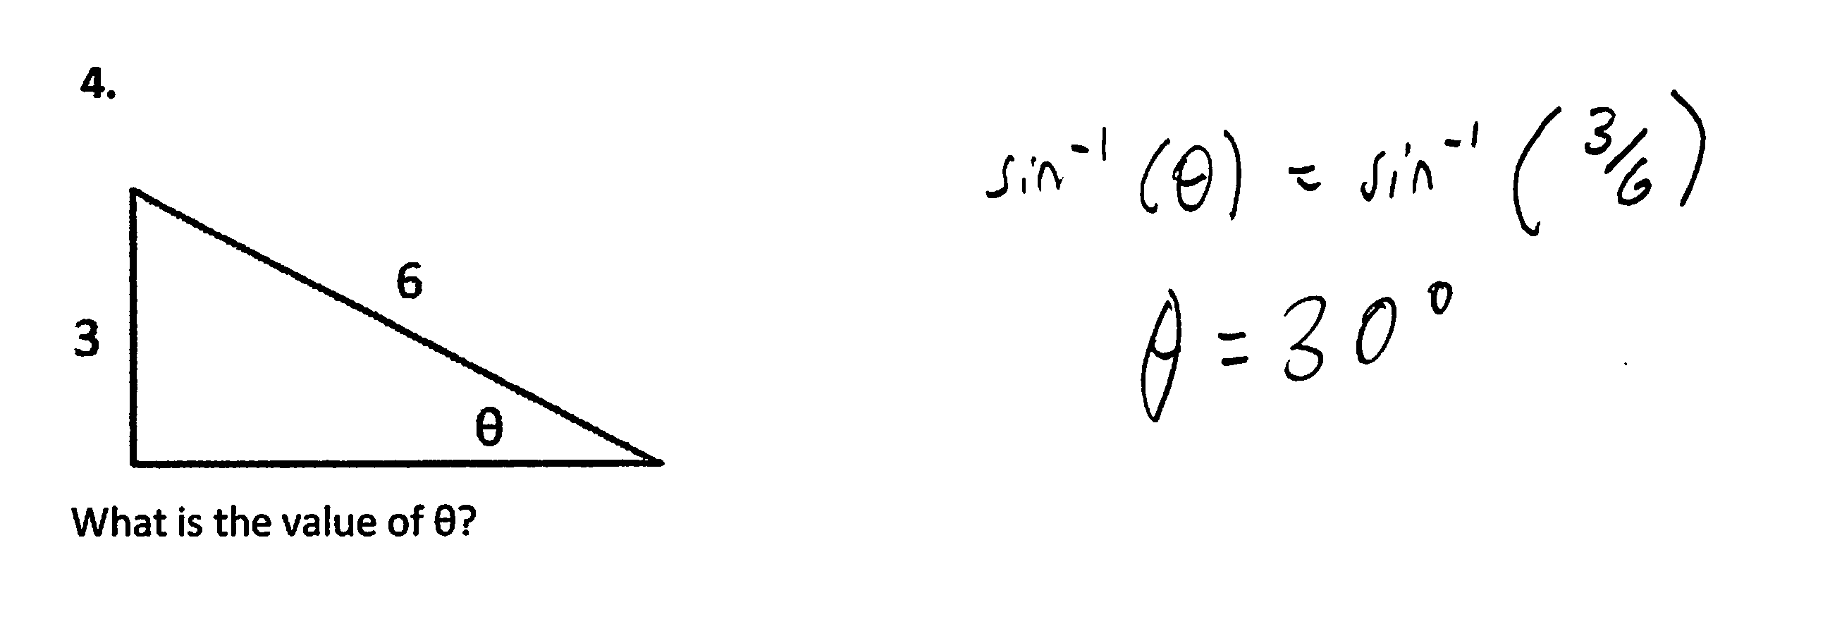
Find Unknown Angle
3.

Slide 6
Find Slope of Graph

Slide 7
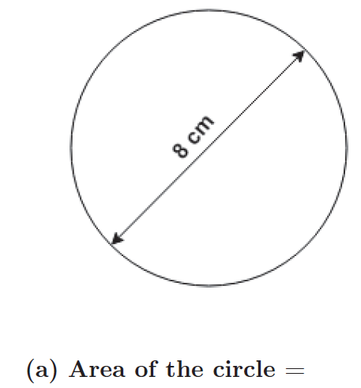
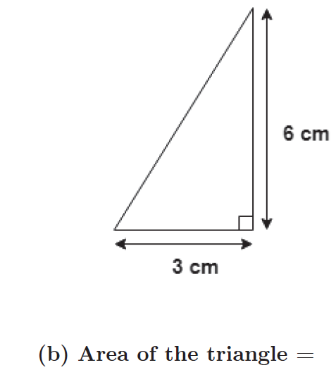
Find Area

Slide 8
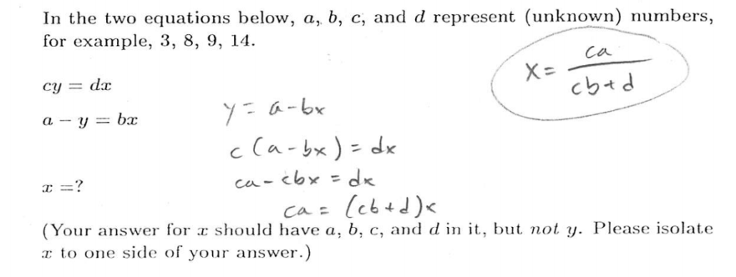
Simultaneous Equations, Symbolic Coefficients

Slide 9
1. High error rates on many items
Error rates of 30-60% appear consistently among diverse test items in all student populations.
  Implication: Instructors may need to adjust expectations of students’ operational abilities with trigonometry, graphing, algebra, etc.

Slide 10
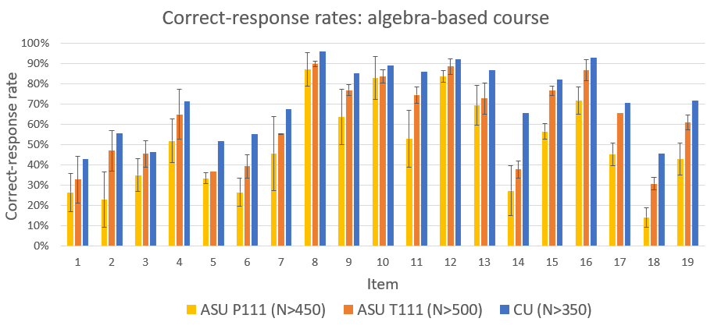
High consistency of results among five campuses at four different universities (three campuses shown below) suggests findings are generalizable

Slide 11
2. Symbolic notation degrades student performance
Use of symbols to replace numbers in otherwise identical algebraic equations significantly lowered students’ correct-response rate.

Slide 12
Correct-response rates are ≈ 25% lower on “symbolic” versions
Algebra: Simultaneous Equations (calculus-based course)
0.5y = 2x
78.4 − y = 8x
[Solve for x]
  Numeric Version 79% correct (N = 1043)
cy = dx
a − y = bx
[Solve for x]
  Symbolic Version 55% correct (N = 862)

Slide 13
Correct-response rates are ≈ 25% lower on “symbolic” versions
Algebra: Simultaneous Equations (calculus-based course)
0.5y = 2x
78.4 − y = 8x
[Solve for x]
  Numeric Version 79% correct (N = 1043)
cy = dx
a − y = bx
[Solve for x]
  Symbolic Version 55% correct (N = 862)

Slide 14
2. Symbolic notation degrades student performance
Use of symbols to replace numbers in otherwise identical algebraic equations significantly lowered students’ correct-response rate.
  Implication: Instructors may choose to be much more cautious in using symbolic manipulation to explain or demonstrate concepts.

Slide 15
3. Students favor non-standard solution methods
Introductory physics students favor semi-arithmetic methods for solving solve algebraic equations; they do not “isolate the unknown variable.”
  Implication: Physics instructors’ habitual approach to algebraic manipulation may be confusing to their introductory students.

Slide 16
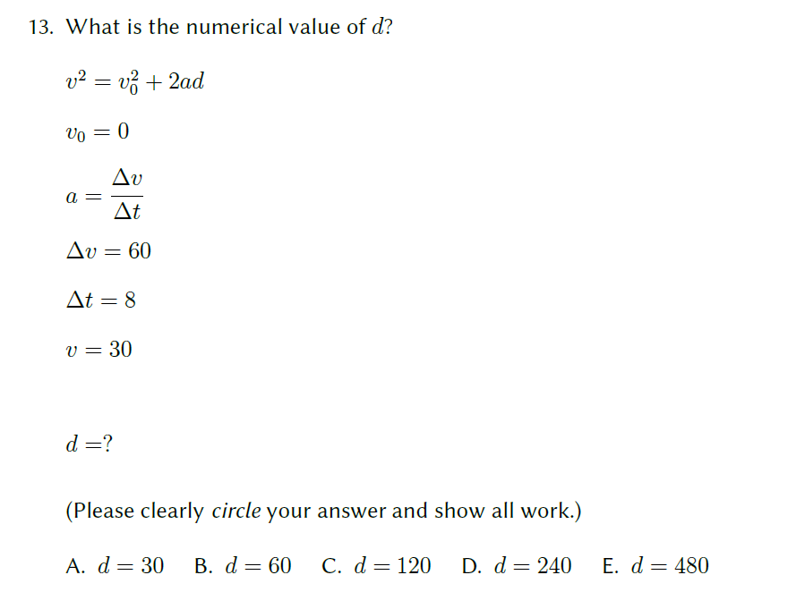
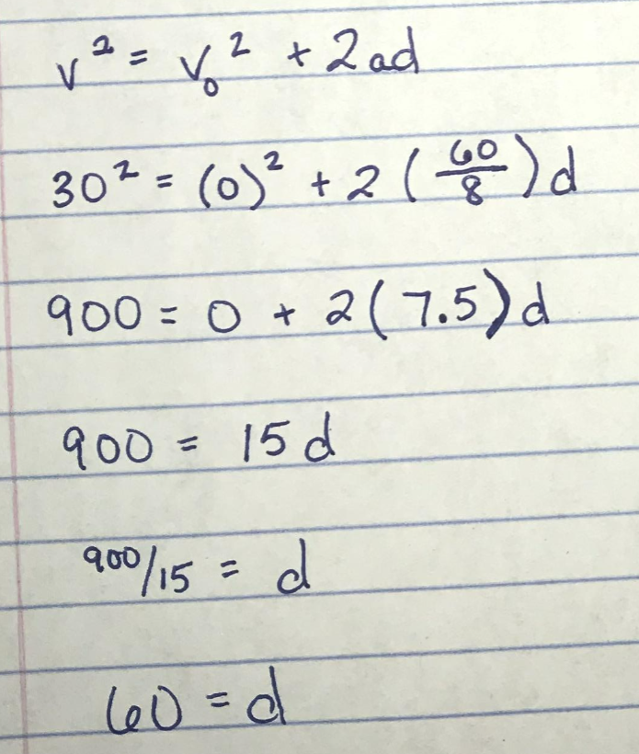
53/53 students solved it this way:
How would you solve this?

Slide 17
4. Similar error rates on different topics
Students’ errors on specific topics were highly correlated with errors on other, disparate topics (e.g., trigonometry, geometry, graphing, algebra).
  Implication: If instructors are aware that their students have difficulties with a specific type of mathematical operation, they may be confident that the students will have analogous difficulties with other types of operations.

Slide 18
5. Students show weakness with units and graphing
Many students in both algebra- and calculus-based physics courses are extremely weak in handling units and/or graphs: they ignored graph-axis labels, and provided no or incorrect units for area and velocity.
  Implication: Instructors may not fully appreciate the degree to which many students are challenged in using units and graphs.

Slide 19
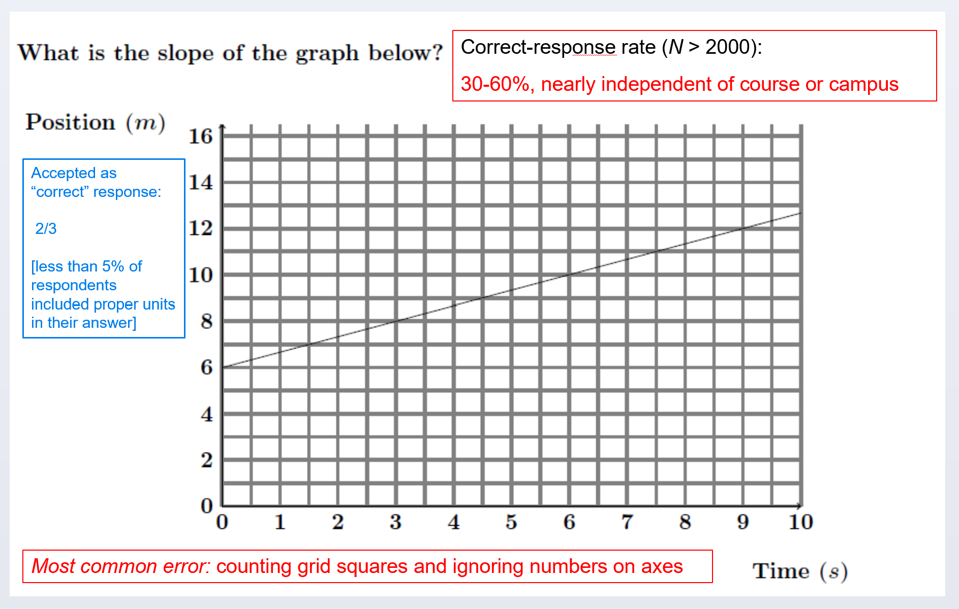

Slide 22
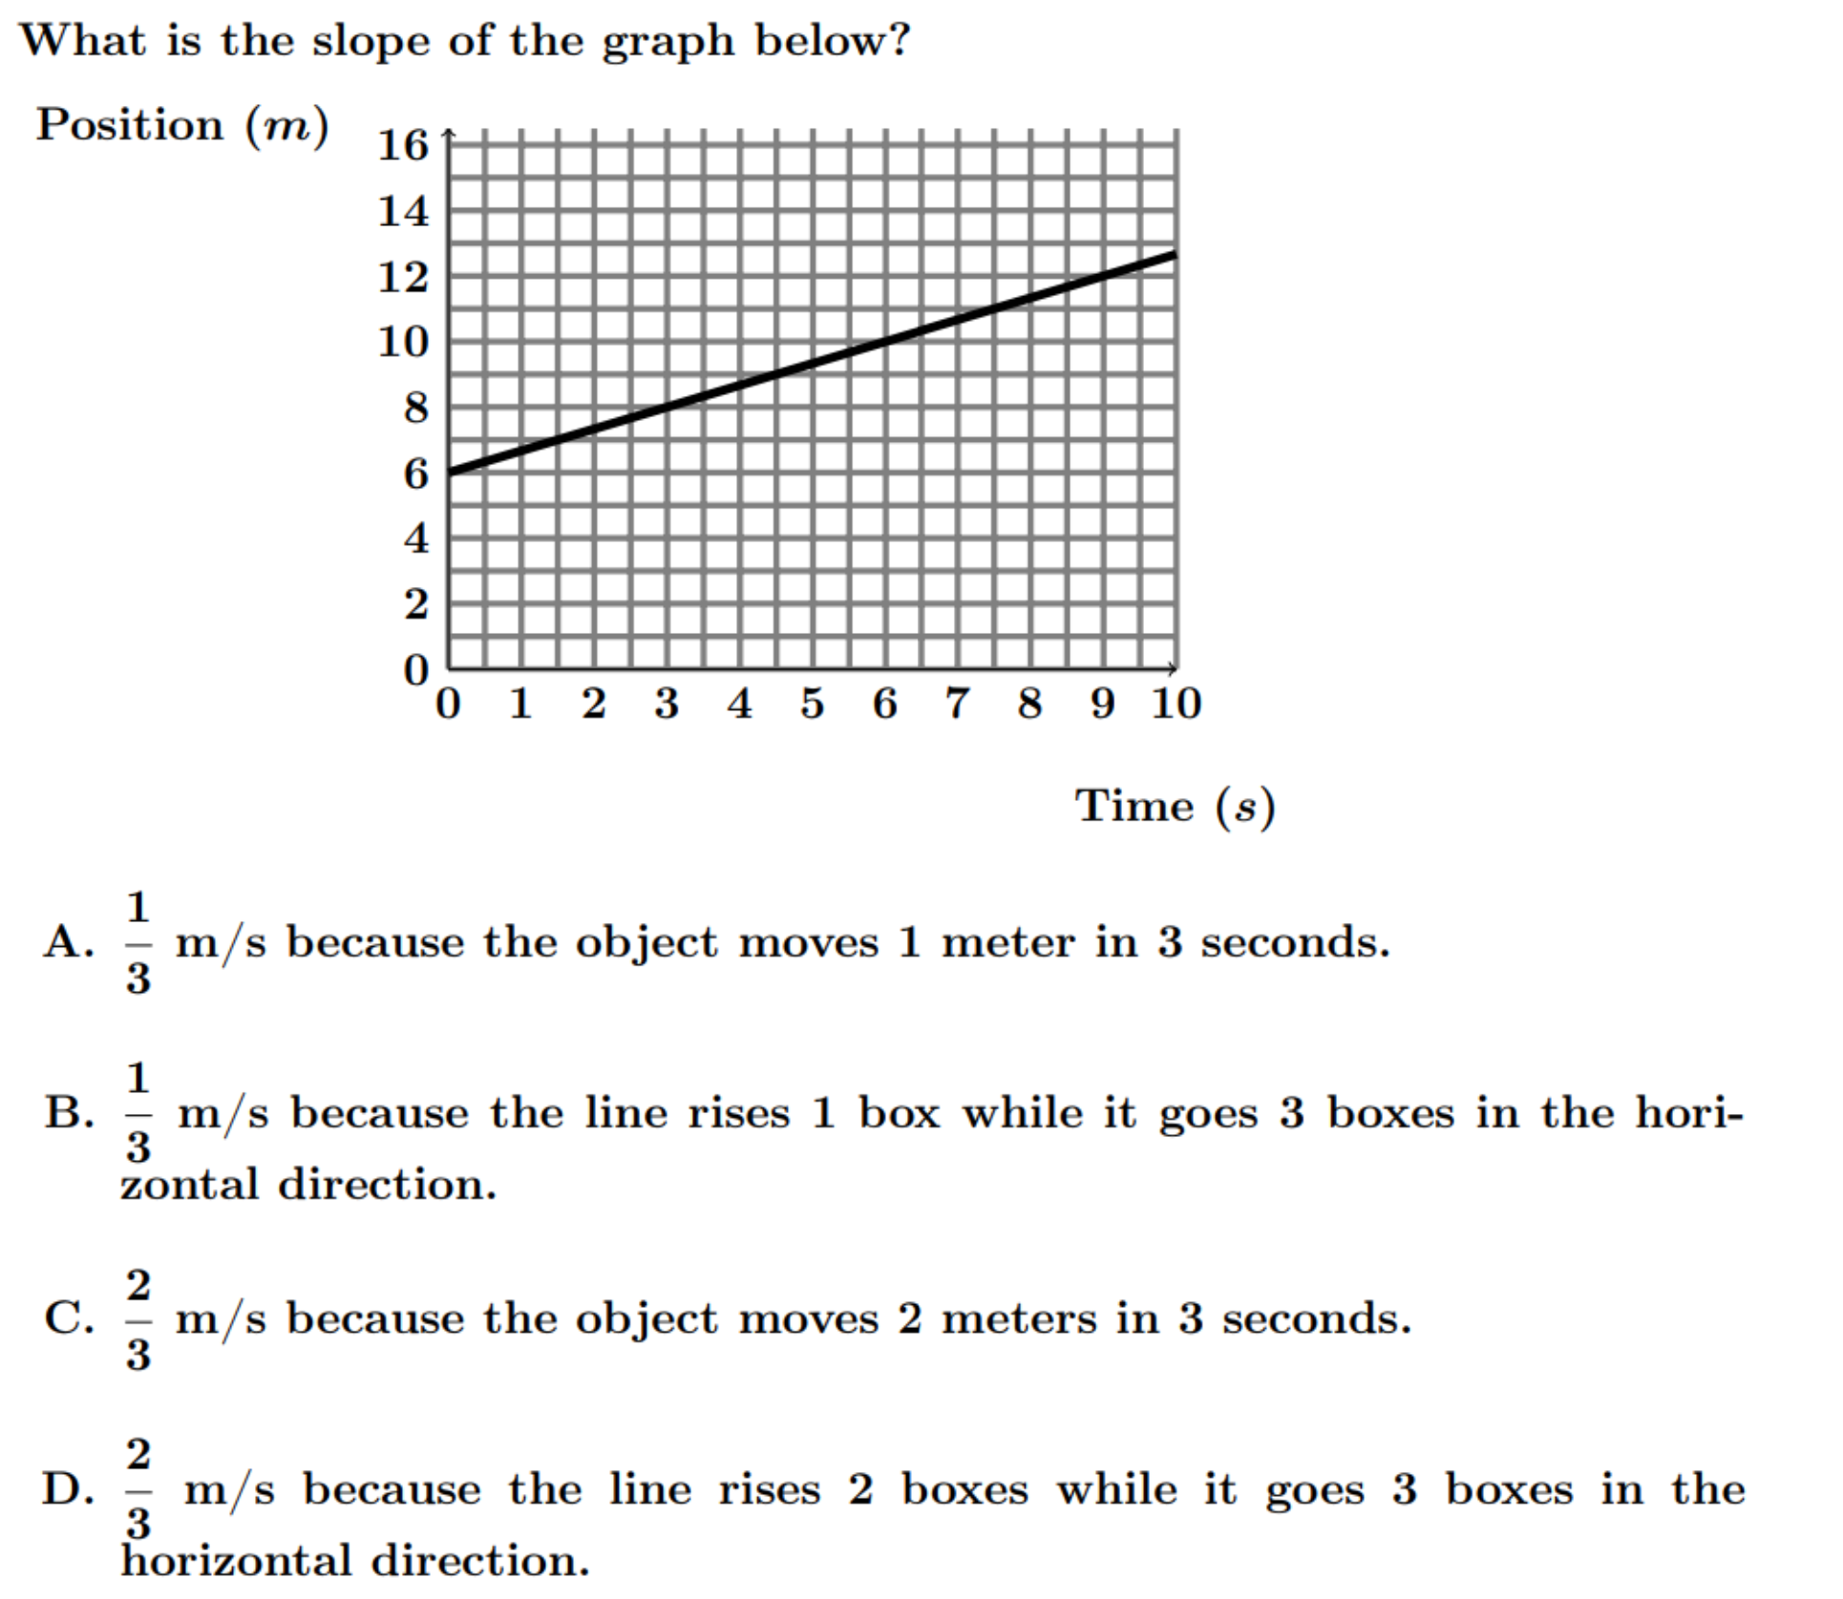
N = 2556
Numerically correct (C or D): 59%
Actually correct (C): 48%
Consistent with results on written version
Most common error: Counting grid squares and ignoring numbers on axes

Slide 23
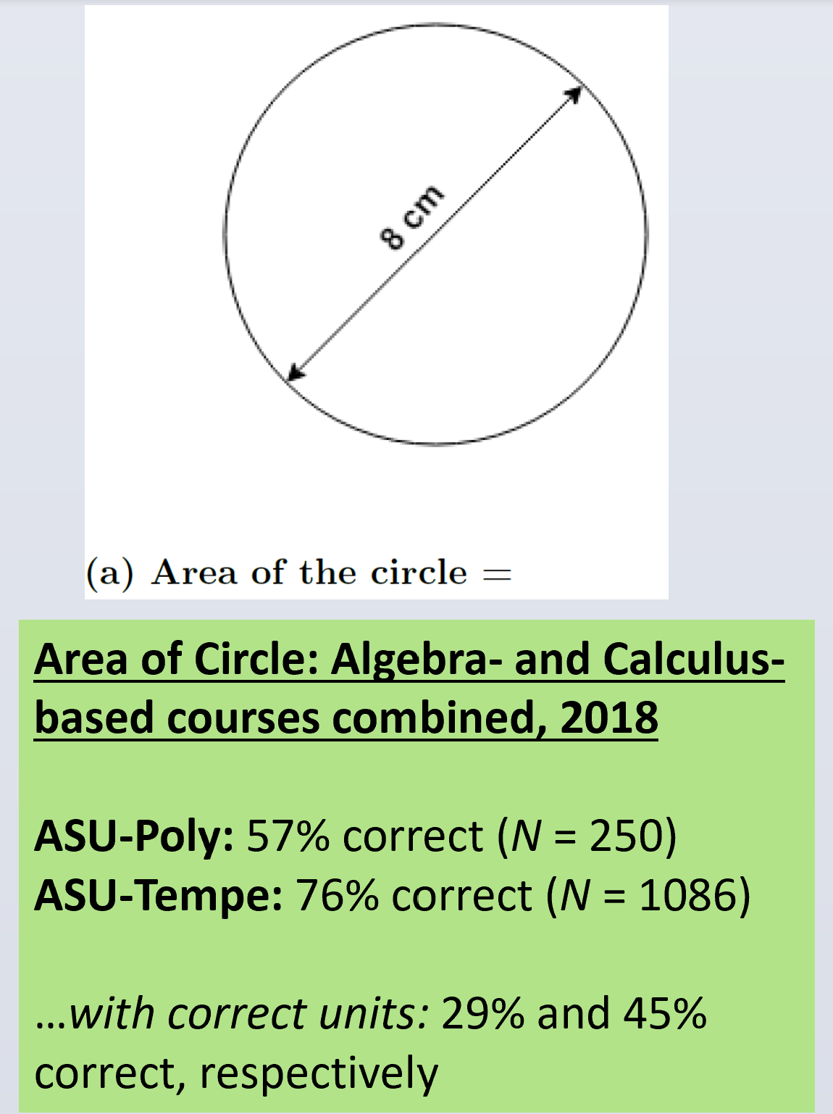

Slide 27
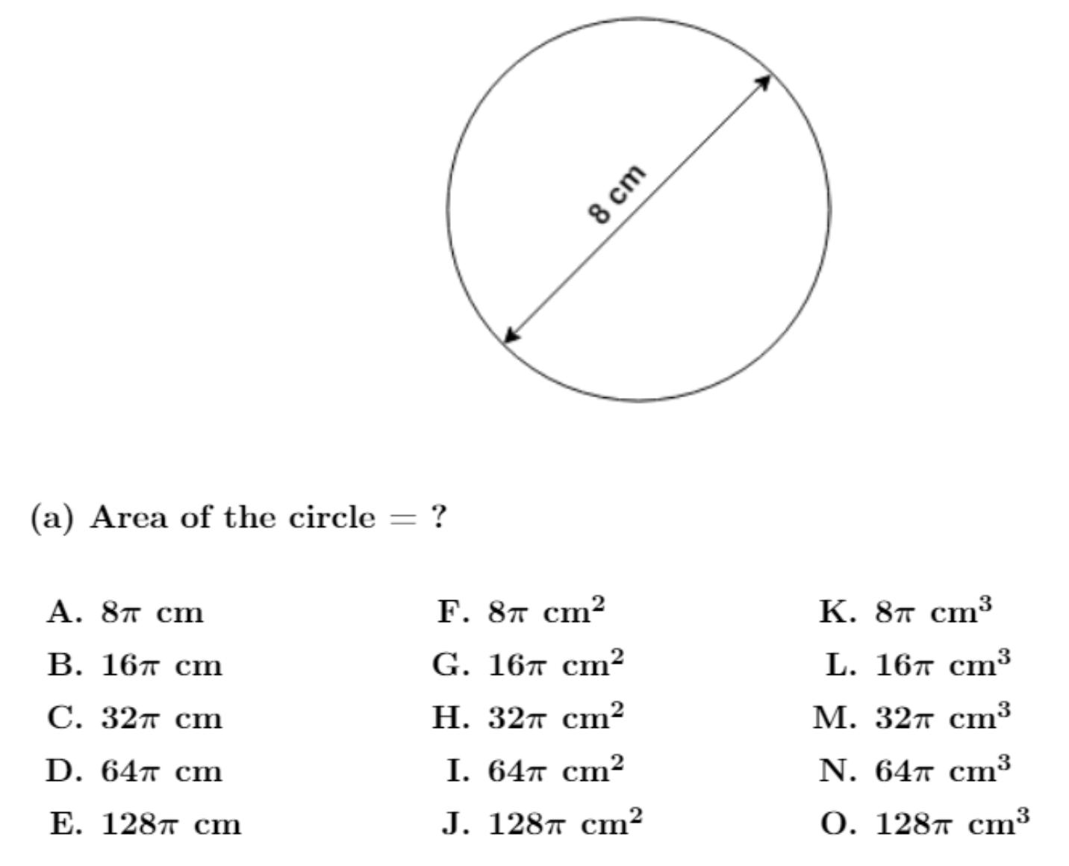
On-line Version:
20% did not choose cm²
(N = 1252)

Slide 28
6. Students make many “careless” errors
During interviews, students tended to self-correct approximately 60% of their initial errors, suggesting many errors are “careless.”
  Implication: Instruction on error-detecting, checking, and self-correcting strategies may offer disproportionately high returns in helping students address their mathematical difficulties.

Slide 29
7. Even single test items are highly predictive
Class-average scores on even a single diagnostic test item—regardless of which item was chosen—were highly predictive of average scores on 13 other diagnostic items covering varied topics.
  Implication: It may be possible to diagnose the level of students’ difficulties with only one or very few mathematics pretest items.

Slide 30
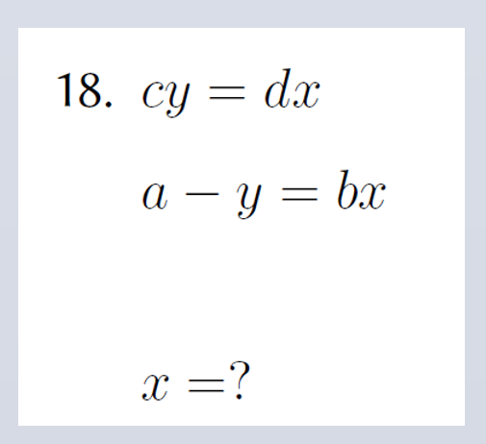
Predictability at Whole-Class Level
Performance on one single diagnostic item can accurately predict class-average score on full 13-item diagnostic
Example:
  [#18]

Slide 31
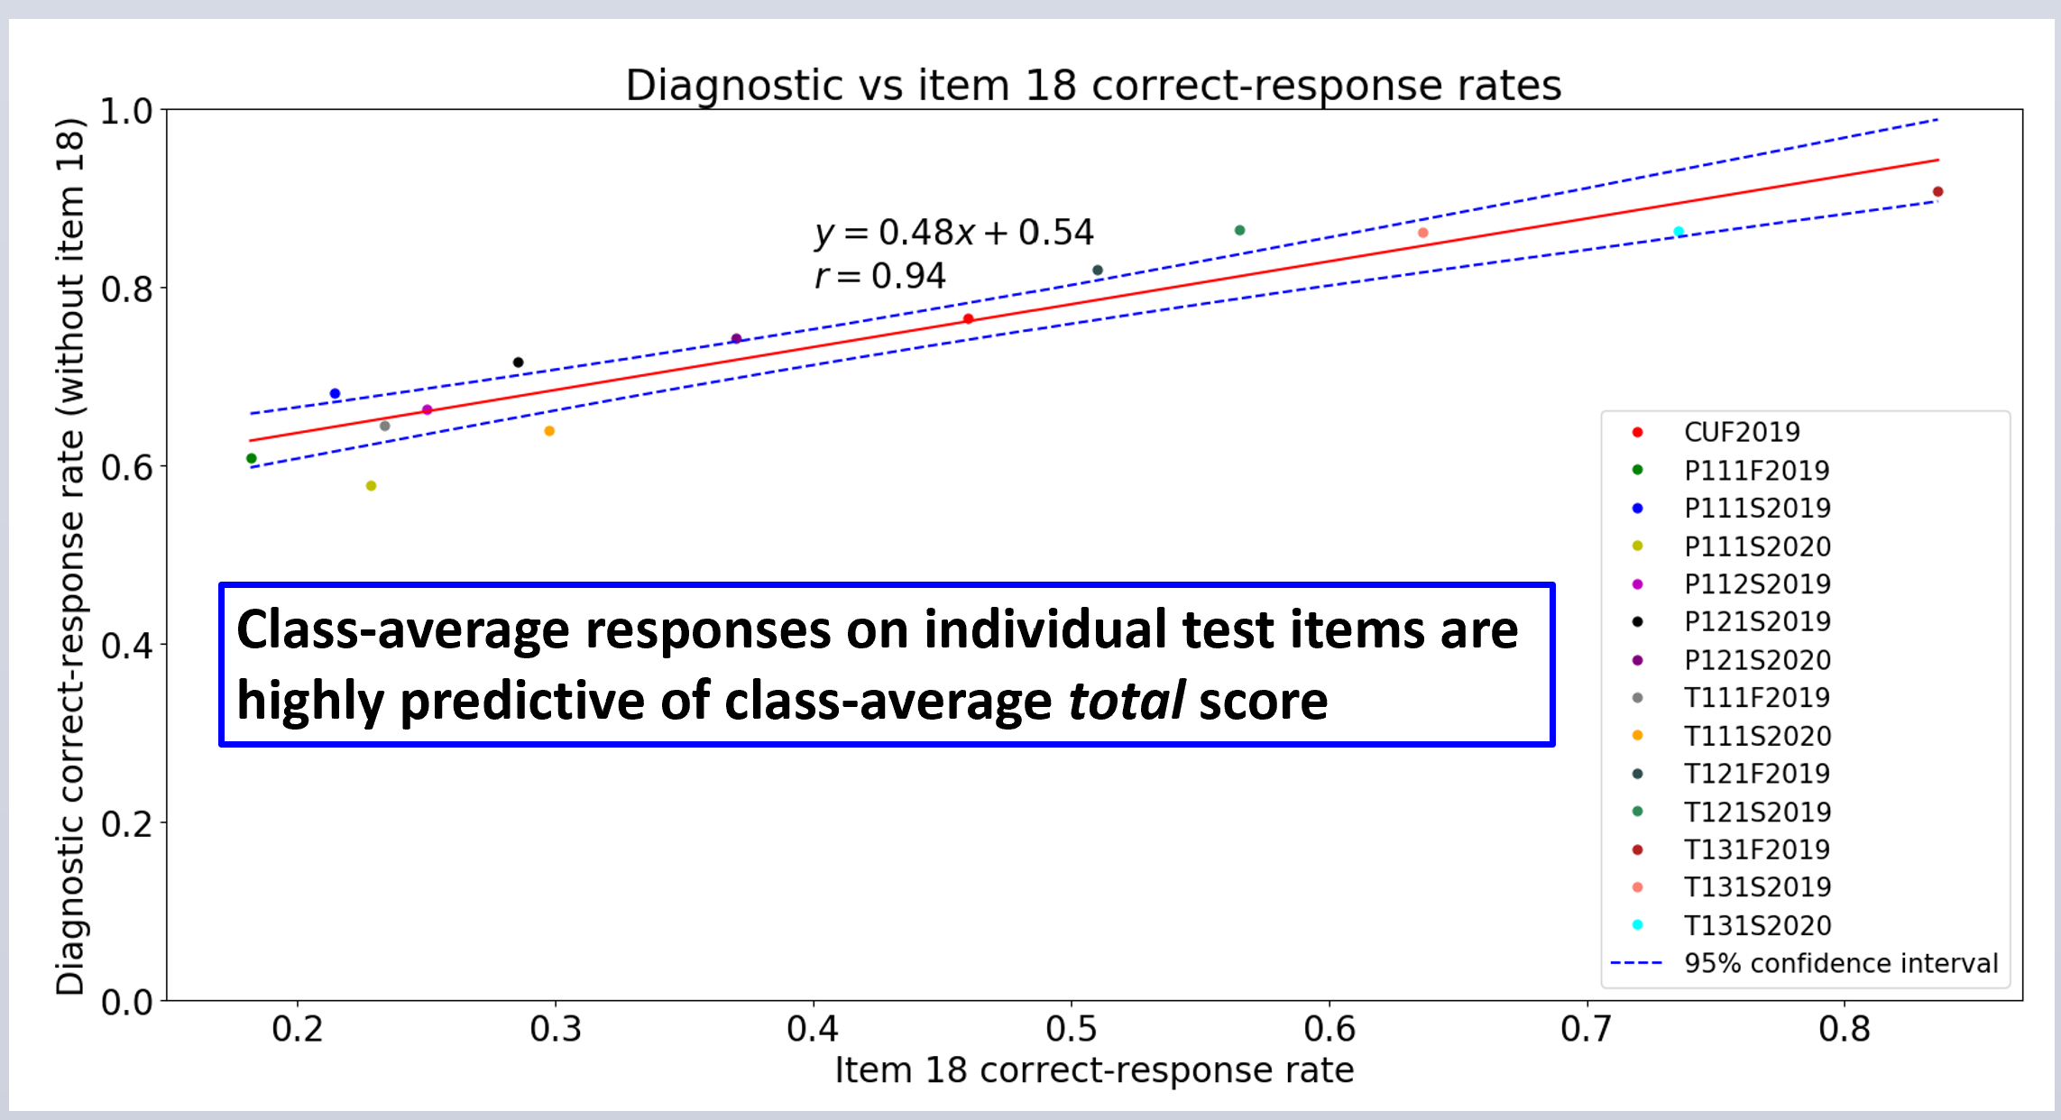

Slide 32
8. Math performance somewhat predictive of final grade
Limited data: two class samples
Clear pattern, but pattern type depends on student population
No evidence of causal relationship

Slide 33
Predictability at Individual-Student Level
Performance on 3-item subset can approximately predict final course grade
Example:
  [#3, #11, #12]

Slide 34
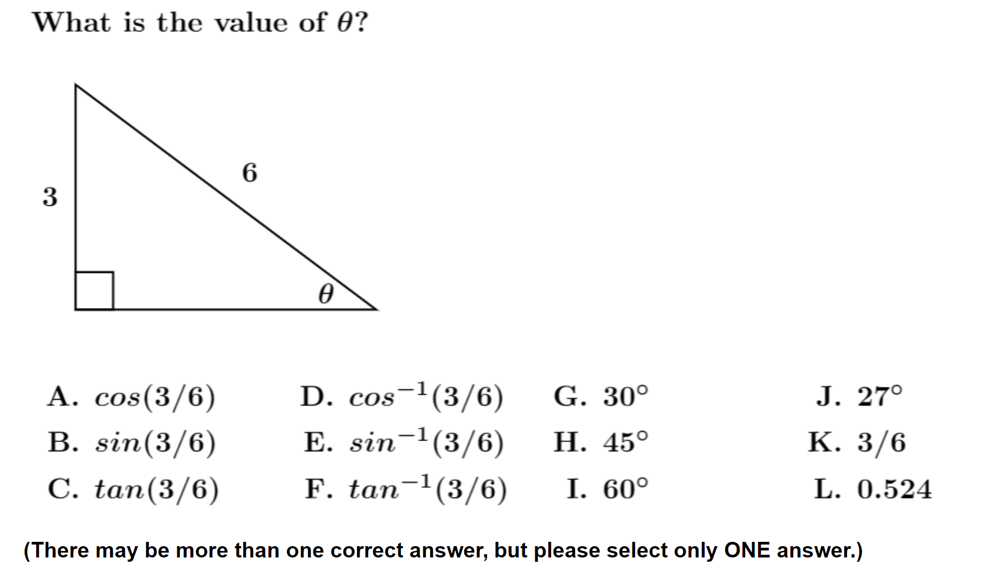
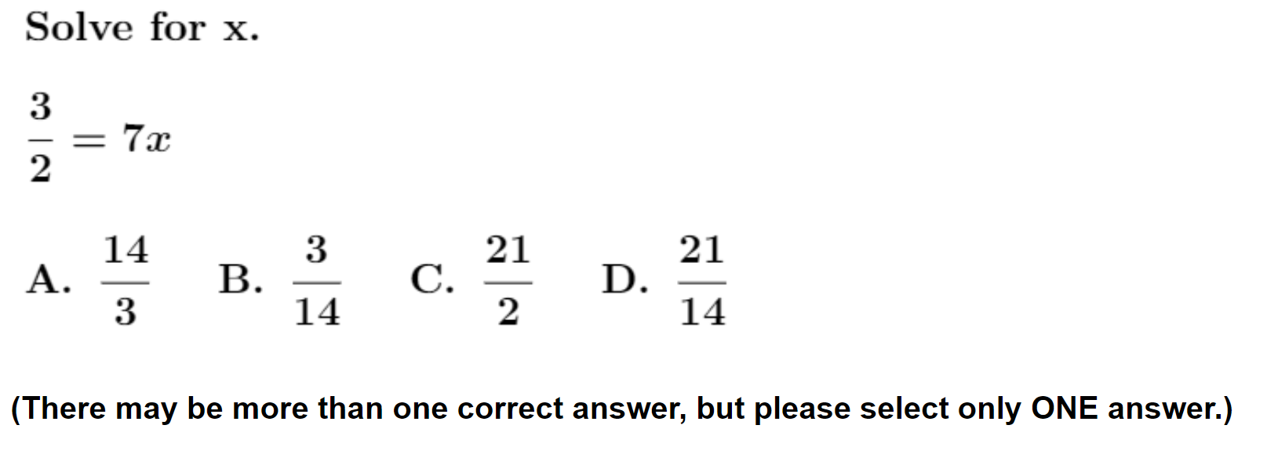
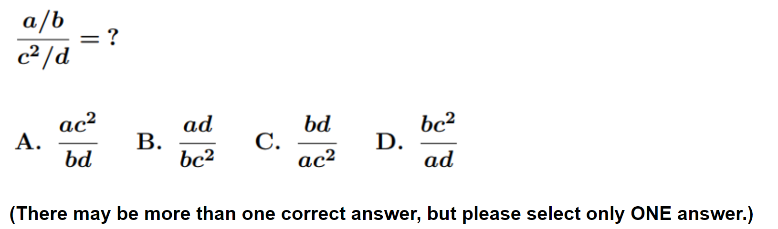
#3
#12
#11

Slide 35
Calculus-based Physics, 1st semester (UWF)
N = 95, 32% with final grade B+/A-/A
0 or 1 correct on [#3, #11, #12]
(N = 21)
5% with final grade B+/A-/A
3/3 correct on [#3, #11, #12]
(N = 44)
52% with final grade B+/A-/A

Slide 36
Predictability at Individual-Student Level
Performance on full online diagnostic can approximately predict final course grade
Examples:
  Calculus-based physics, 1st semester (UWF)
  Algebra-based physics, 2nd semester (ASU Tempe)

Slide 37
Calculus-based Physics, 1st semester (UWF)
N = 101, 30% with final grade B+/A-/A
<70% correct responses (full diagnostic)
(N = 35)
6% with final grade B+/A-/A
>92% correct responses (full diagnostic)
(N = 21)
62% with final grade B+/A-/A

Slide 38
Algebra-based Physics, 2nd semester (ASU Tempe)
N = 118, 59% with final grade A-/A/A+
<86% correct responses (full diagnostic)
(N = 101)
53% with final grade A-/A/A+
>92% correct responses (full diagnostic)
(N = 17)
94% with final grade A-/A/A+

Slide 39
Summary
The scale of physics students’ difficulties with basic mathematical operations may warrant adjustment of instructors’ expectations and instructional approach
Performance on individual mathematics test items is predictive of overall diagnostic performance, and somewhat predictive of final course grades

