Slide 1
Historical Sketch of Research on Mathematization in Physics Education
David E. Meltzer
Arizona State University
http://www.physicseducation.net/
Supported in part by NSF DUE #1504986

Slide 2
Development of Students’ Mathematical Thinking
Most college physics students receive their initial mathematical preparation in middle school and high school
The “mathematical landscape” of physics students’ thinking must be traced back to these formative years…

Slide 3
The High School-College Connection
Until the 1870s, high school physics instruction was largely qualitative, light on math
As high schools spread and enrollment increased, they became increasingly important sources for college admissions
High school physics instruction began to resemble college more closely: emphasis on quantitative measurement and mathematical problem solving

Slide 4
The Teacher Preparation Dilemma
Very weak high school physics teacher education in the early 1900s contributed to ineffective preparation of students for college physics
College entrance exam scores were low, and high school instructors began to rebel at the heavy influence of the colleges
A “new movement” of physics teachers attempted to re-focus high school instruction on inductive, lab-centered learning

Slide 5
“De-Mathematization” and Backlash
Some suggested “de-mathematization” of high school physics:
Prof. A. A. Michelson (1909)
A backlash developed as some investigators tried to show that “de-mathematization” was leading to poor learning.

Slide 6
Studies of Physics Students’ Math Skills
Beginning in 1918 and continuing today, investigators have probed physics students’ mathematics preparation and asked whether it’s adequate for college physics.
Many mathematics diagnostic tests have been administered to high school and college physics students.
Almost always, students’ mathematics preparation has been found wanting.

Slide 7
Representative Results from Diagnostic Tests
Randall, Chapman, and Sutton (1918) claimed poor performance showed that “de-mathematization” was damaging physics students’ ability to have “thorough understanding” and “exact thinking.”
Hughes (1924) argued to the contrary, that poor math performance by university students showed that it was not possible to “mathematize” high school physics to any great extent and still get satisfactory achievement.
Lohr (1925) concluded that it was necessary for university physics teachers to “re-teach until [they are] sure of assimilation of the mathematics involved before attempting to give the physics using these principles.”
Kilzer (1929) concluded that there was a need for “maintenance drills” covering the math needed in high school physics courses.
Breitenberger (1992) found that new physics graduate students were deficient in math skills and mathematical thinking!

Slide 8
Probes of Math’s Impact on Physics Performance…
Bless (1932) found a very high correlation between university students’ physics grades and their scores on an arithmetic/algebra diagnostic test.
Carter (1932) found a similarly high correlation among high school students.
However, he noted that the correlation was sharply reduced when student’s “intelligence” (determined by an IQ test) was held constant
Kruglak and Keller (1950) found a high correlation between math course grades and physics course grades of university students.

Slide 9
Additional Analogous Results Based on Grades or Diagnostic Test Scores, by:
Blumenthal (1961)
Bolte (1966)
Larkin and Brackett (1974)
Hudson and McIntire (1977)
Cohen, Hillman, and Agne (1978)
Champagne, Klopfer, and Anderson (1980)
Hudson and Rottmann (1981)
Champagne and Klopfer (1982)
Hudson and Liberman (1982)
Wollman and Lawrenz (1984)
Griffith (1985)
Halloun and Hestenes (1985)
Hudson (1986)
McCammon, Golden, and Wuensch (1988)
Linder and Hudson (1989)
Hart and Cottle (1993)
Alters (1995)
Sadler and Tai (2001)

Slide 10
But the Problem is More Complicated…
Weak calculational skills are only part of the problem.
Many early studies were flawed by conflating difficulties with physics concepts together with weak mathematical skills, and presuming the combination was “problems with math.”
Undeveloped technology limited the tools available for visualization of functional relationships, as well as real-time interaction with the outcomes of calculations.
(Those of us who went to college in the late 1960s-early 1970s did most of our calculations for course exams on a slide rule!)
Up until the 1970s, there was virtually no research on which to base efforts to improve the situation.

Slide 11
Glimpses of the Future…
Lapp (1940) showed that university students who were taught to give a qualitative analysis of a physics problem—that is, describing in words exactly how they could go about solving it—had substantially higher scores on a standard physics diagnostic test compared to students who were taught merely to find quantitative solutions to the same problems.
Black (1931) carried out a rare investigation of physics students’ thinking in a physics context, using written diagnostics and one-on-one student interviews…

Slide 12
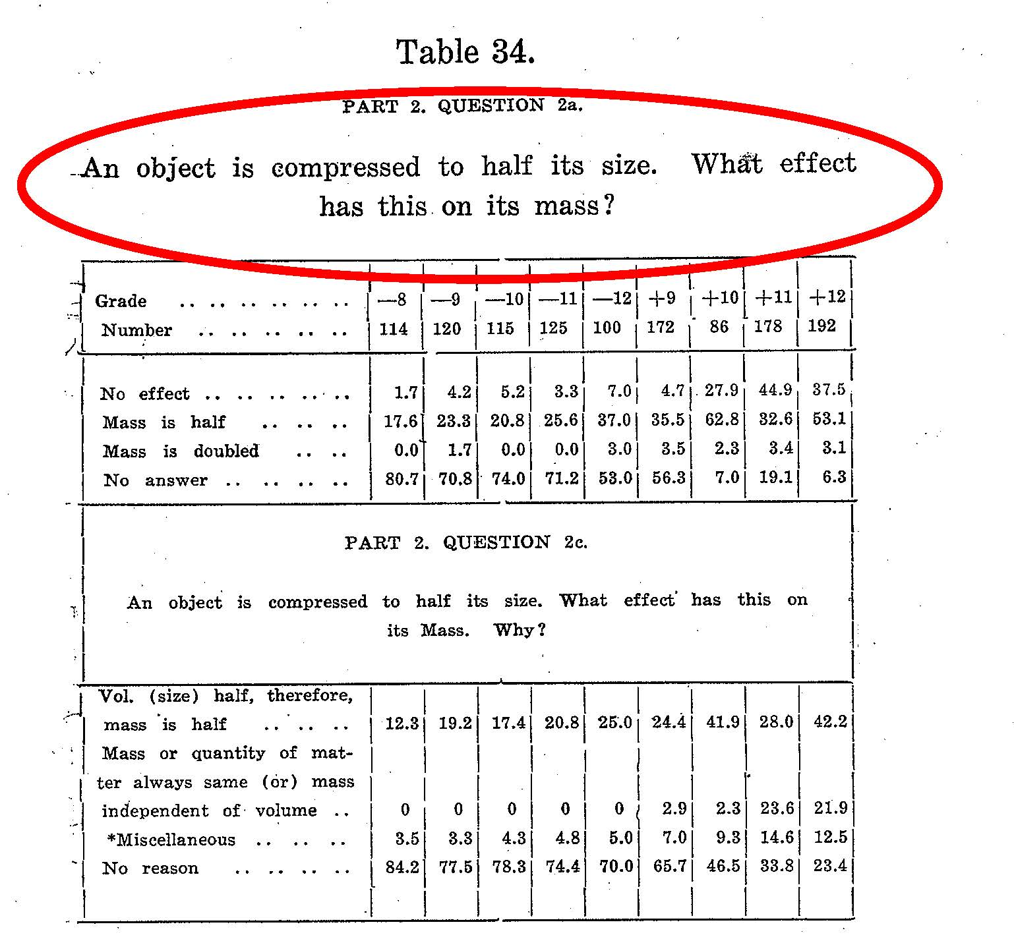
From Black (1931):

Slide 13
Interlude
Lots of research by physicists during the 1960s and 1970s on students’ mathematical and scientific reasoning processes (Robert Karplus et al.)
However, not directly in the context of physics
Research on general problem solving, carried out in a physics context (Fred Reif et al.)
Not directly linked to studies of mathematization
Direct precursor to future investigations by many PER workers focused on methods of physics problem solving
“Workshop on Physics Teaching and the Development of Reasoning” by Karplus et al. (1975), and “The Various Language” by Arons (1977) both contributed greatly to future advances in research-based curriculum development

Slide 14
McDermott and the PEG
Lillian McDermott and the University of Washington Physics Education Group (PEG) demonstrated that physics students’ mathematical skills, physics ideas, and reasoning abilities are not easily disentangled, and must often be studied together, in the context of authentic physical systems.
The PEG investigated students’ abilities to work with multiple representations of physics ideas, including graphs and diagrams.

Slide 15
Some Examples
Probing students’ thinking regarding ratios of differences, e.g. Δv/Δt
Trowbridge and McDermott, 1981
Investigating students’ ideas about graphical representations of motion
McDermott, Rosenquist, and Van Zee, 1987
Examining the utility of computer simulations to probe student thinking
McDermott, 1990; Grayson and McDermott, 1996

Slide 16
Further Work
In the mid-1980s, David Trowbridge developed some of the very first physics simulation software (“Graphs and Tracks”) based on his Ph.D. research directed by McDermott.
Beginning in 1986, Thornton, Sokoloff, and Laws utilized the PEG’s research to help develop curriculum based on real-time data acquisition and visualization using “probeware” and computers (computer graphing– the “microcomputer-based labs,” or “MBL”)
Thornton (1987); Laws (1989); Thornton and Sokoloff (1990)
Beichner (1994) made use of PEG work in developing his diagnostic test on kinematics graphs.

Slide 17
Redish and the Maryland PER Group
From early on, Joe Redish emphasized that efficient accessing of ideas could be as important as forming them in the first place:
-- Redish (1994)

Slide 18
Mental Models for Mathematization
The further work of the Maryland group explored the mental models that influence students’ learning and use of mathematics for physics:
-- Redish (1994)

Slide 19
Later Work by the Maryland Group
Students often fail to make use of specific mathematical tools that they do know how to use, because they don’t recognize their applicability to a physics problem
Bing and Redish, 2009; Gupta and Elby, 2011

Slide 20
Summary
Despite nearly a century of efforts, research on mathematization in physics education tended to circle around and repeat similar studies with few new insights through the 1950s
Work by physicists Arons, Karplus, and Reif during the 1960s and 1970s had an enormous impact and helped set the stage for modern PER
McDermott, Redish, and their students and collaborators, helped catalyze critical breakthroughs that continue to guide much of the work done today.

