Slide 1
Physics Students’ Mathematical Difficulties with Operations and Algebra
Dakota H. King and David E. Meltzer
Arizona State University
Supported in part by NSF DUE #1504986 and #1914712

Slide 2
Students’ difficulties with symbols Torigoe and Gladding (2011)
Numeric version:
Symbolic version:
A car can go from 0 to 60 m/s in 8 s. At what distance d from the start at rest is the car traveling 30 m/s?
A car can go from 0 to v₁ in t₁ seconds. At what distance d from the start at rest is the car traveling (v₁/2)?
Our version (pure math)
Our version (pure math)

Slide 3
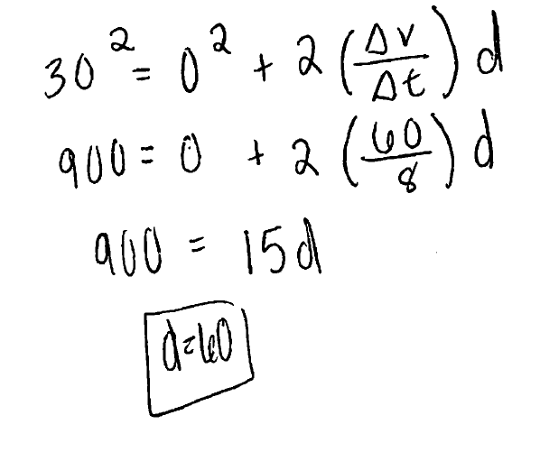
Difference in Procedure Examples of student work
Numeric:
Symbolic:
Skills required: Arithmetic
Skills required:
Squaring, multiplying, and dividing symbolic fractions; handling of “complex” symbolic expressions

Slide 4
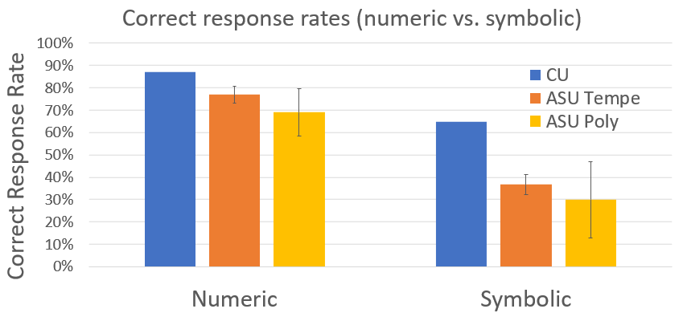
Correct response rate difference: symbolic vs. numeric
CU: N=196, 191
ASU Tempe: N=471, 461 (average from 3 semesters)
ASU Poly: N =147, 136 (average from 3 semesters)
Error bars are ±σ
Significant differences between numeric and symbolic version; ≈20-40% difference in correct response rates

Slide 5
Errors observed on the symbolic version
Incorrectly squaring and multiplying/dividing fractions
High frequency of these errors motivated us to investigate students’ difficulties at the level of operations
Squaring error
Multiplication error
Division error

Slide 6
Types of difficulty with symbols
Operations
Multi-step
Physics
A car can go from 0 to v₁ in t₁ seconds. At what distance d from the start at rest is the car traveling (v₁/2)?
“Operations”
“Multi-step”

Slide 7
Types of difficulty with symbols
Operations
Multi-step
Physics
A car can go from 0 to v₁ in t₁ seconds. At what distance d from the start at rest is the car traveling (v₁/2)?
Mastery of “operations” in “multi-step” problems is required to correctly answer the physics problem

Slide 8
“Correct” students
Students who respond correctly to this problem will be referred to as “Correct” students

Slide 9
“Incorrect” students
Students who respond incorrectly to this problem will be referred to as “Incorrect” students

Slide 10
Grouping “Correct” students on kinematics problem
Student A
Students A & B
Student B
Correct response
All correct
“Operational”
error

Slide 11
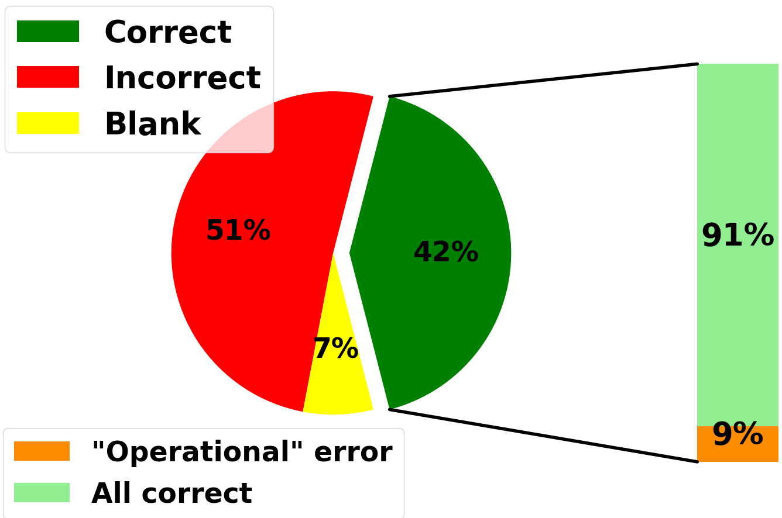
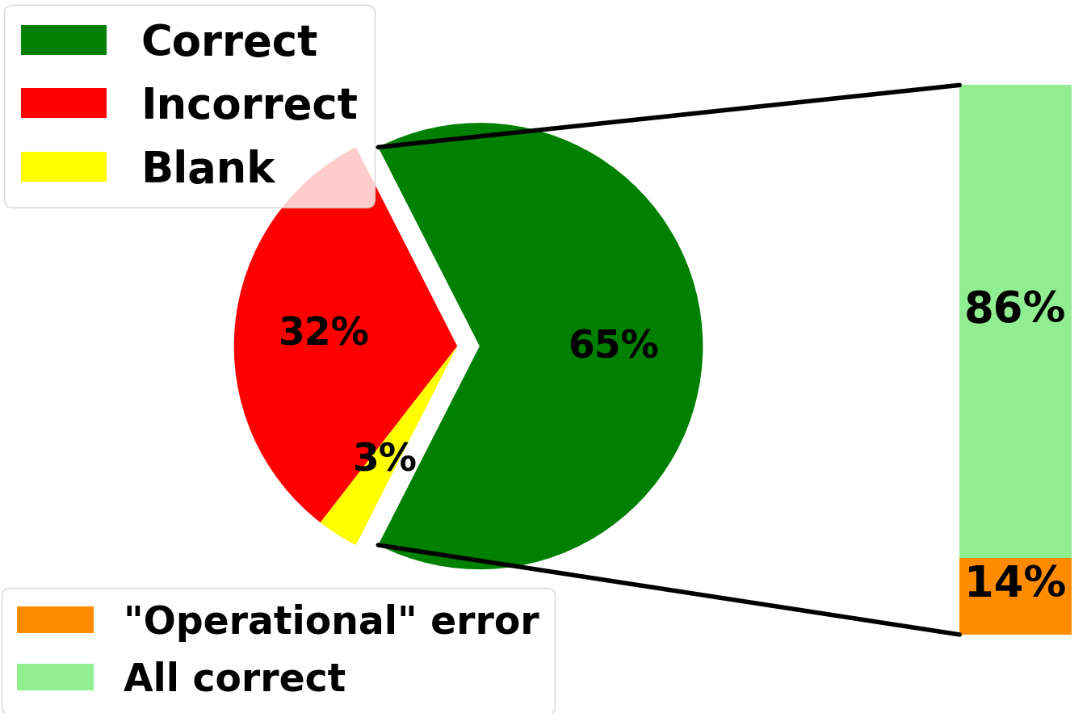
Quantifying the “Correct” groups (All correct and “Operational” error)
PHY 111 Tempe Fall 2019 (N=106)
CU Fall 2019 (N=191)
Most students who solve the symbolic kinematics problem correctly, solve all “operation” problems correctly.

Slide 12
“Operational” and “non-operational” errors
We now examine the “incorrect” students and group them into two groups: “operational” errors and “non-operational” errors
Define errors on any of the three fraction problems as “operational” errors
Define “non-operational errors” as errors that occur when the student answers all fraction problems correctly while also answering the kinematic problem incorrectly

Slide 13
Grouping “Incorrect” students on kinematics problem
Student A
Students A & B
Student B
Incorrect response
“Operational”
error
“non-
operational”
error

Slide 14
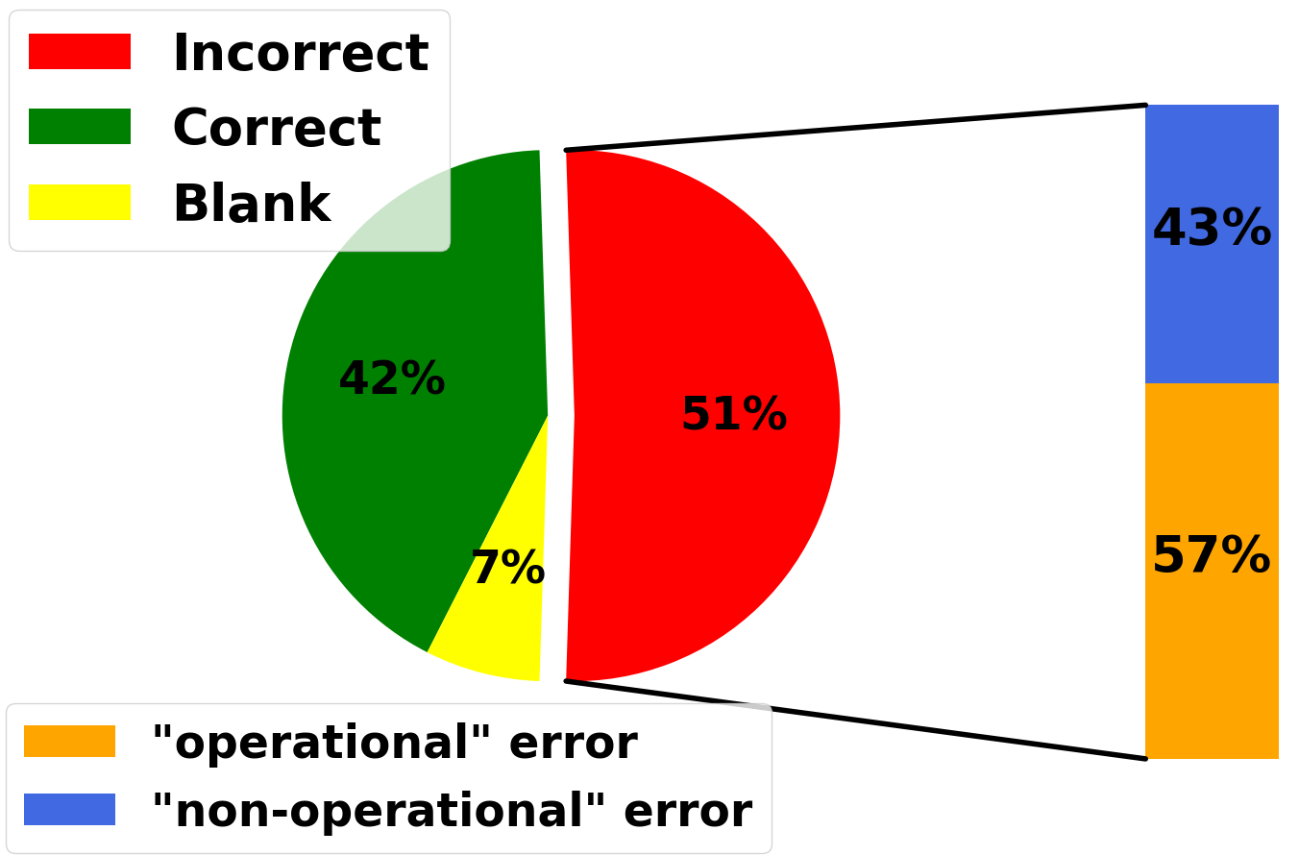
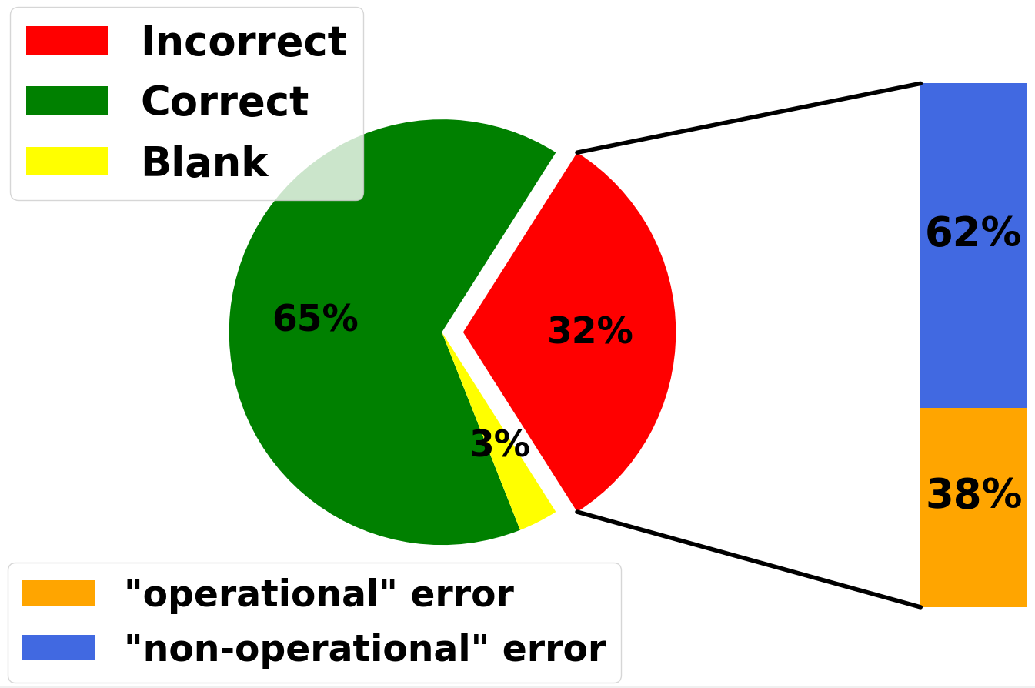
Quantifying the “Incorrect” groups (“operational” and “non-operational”)
PHY 111 Tempe Fall 2019 (N=106)
CU Fall 2019 (N=191)
Courses with lower operational error rates achieve higher correct response rates

Slide 15
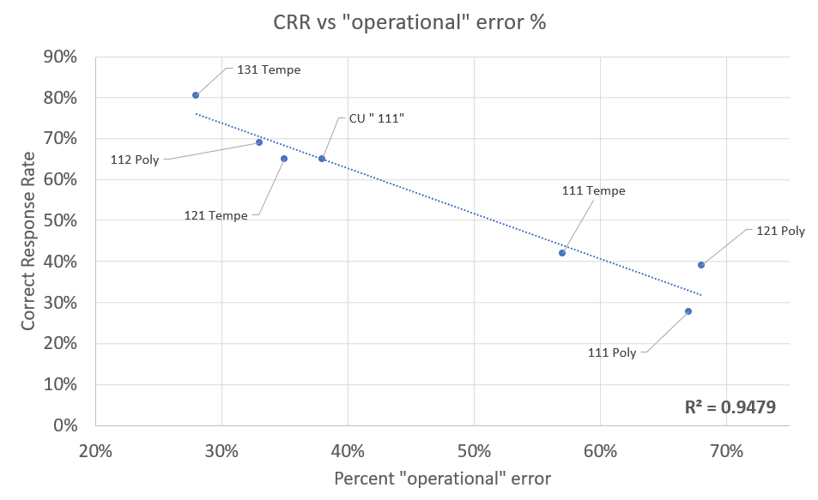

Slide 16
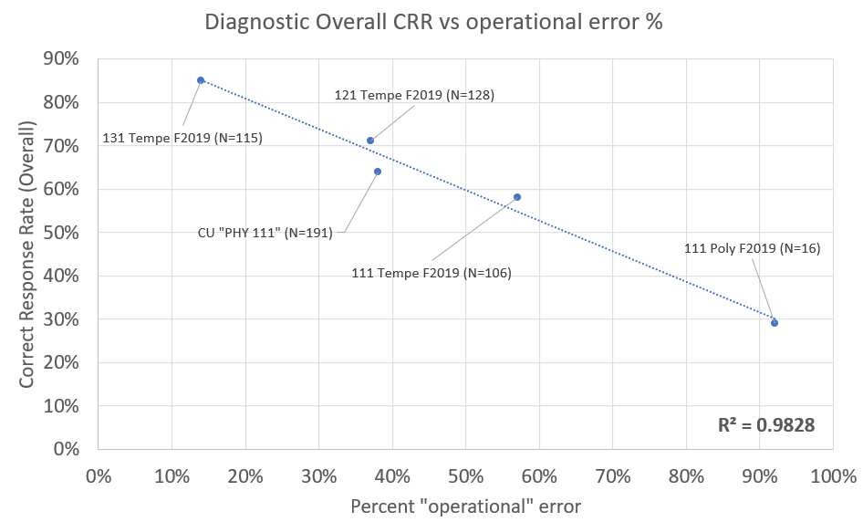

Slide 17
Interpretation of results
Students often apparently possess the operational tools necessary to solve a problem, but make non-operational mistakes
These non-operational mistakes may be due to carelessness, such as the lack of checking over work
Some students’ difficulties are at the level of operations
Possibility of significant improvement by way of:
Operational skill practice
Work-checking strategies

Slide 18
Future research
Develop and implement practice assignments (called Math Practice) in collaboration with researchers at Ohio State University
Goal: improve students’ success in introductory physics through improvement of math fluency
Test and practice relevant math skills, with and without physics context
Analyze impact from student performance data (grade and retention)
Evaluate impact of “operational” and “non-operational” errors on performance

