Slide 1
Exploring Physics Students’ Difficulties in Solving Symbolic Algebra Problems
Dakota H. King and David E. Meltzer
Arizona State University
Supported in part by NSF DUE #1504986

Slide 2
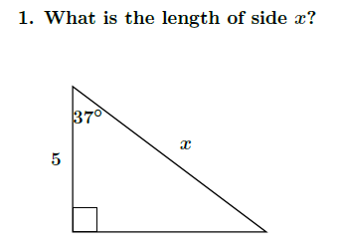
Trigonometry Questions
Three basic trigonometry questions were administered on our diagnostic math quiz to a total of 1,318 students in beginning of the Spring 2018 semester.
“Numeric” hypotenuse problem
“Symbolic” hypotenuse problem
Solving for an angle problem

Slide 3
Trigonometry Correct Response Rate #1-3 Combined Spring 2018
ASU Tempe campus averages:
PHY 121, 1st semester calculus-based course, (N=906): 81%
PHY 111, 1st semester algebra-based course, (N=225): 54%
ASU Polytechnic campus averages:
PHY 111, 1st semester algebra-based course, (N=88): 41%
PHY 112, 2nd semester algebra-based course, (N=99): 40%
About 20%-60% of students confused on basic high school level trigonometry problems.

Slide 4
Trigonometry Errors Observed
Use of the wrong trig function, e.g., using cosine or tangent instead of sine.
Not understanding the definition or proper relationship for trig functions.
Not showing all work when arriving at incorrect answer, e.g., x=ycos($z^{o}$).
Many students seem not to be fluent with basic trigonometric functions and need additional practice.

Slide 5
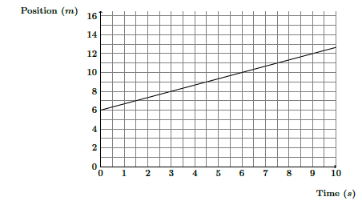
Finding the slope of a graph.
On our diagnostic, students were asked to find the slope of a graph:
Answer: $\frac{2}{3}$ m/s

Slide 6
Slope Question Correct Response Rate
ASU Tempe campus averages:
PHY 121, 1st semester calculus-based course, (N=902): 61%
PHY 111, 1st semester algebra-based course, (N=225): 53%
ASU Polytechnic campus averages:
PHY 111, 1st semester algebra-based course, (N=88): 30%
PHY 112, 2nd semester algebra-based course, (N=99): 39%
About 40%-70% of students did not give a correct slope.

Slide 7
Slope Question Errors Observed
60%-76% of all incorrect responses were slope = 1/3.
Students assume scaling on the x-axis is equal to that of the y-axis.
Students are counting boxes to find the slope of the graph, which was also found to be true from the interviews.
Almost no responses included correct units (including responses we counted as correct).

Slide 8
Numeric vs Symbolic Questions
Torigoe and Gladding (2007; 2011) investigated differences in students’ responses to physics problems in both numeric and symbolic form.
“Numeric” and “symbolic” refer to the nature of the constant coefficients.
They found that students (most of the time) had more difficulties with symbolic questions.
We asked paired problems in both symbolic and numeric form.
Questions were stripped of all physics context and asked as pure mathematical problems.
We included paired numeric vs symbolic problems from Torigoe and Gladding’s (2011) study (stripped of physics context), as well as a pair of trigonometry problems.

Slide 9


Trigonometry: Numeric vs Symbolic
$$x=\frac{5}{cos⁡({37}^{o})}$$
$$x=\frac{y}{cos⁡(z^{o})}$$
Correct answer:
Correct answer:

Slide 10
Trigonometry Symbolic vs Numeric Correct Response Rates Compared Spring 2018 (Tempe)
ASU Tempe campus averages:
PHY 121, 1st semester calculus-based course, (N=903): 80% (numeric)
PHY 121, 1st semester calculus-based course, (N=903): 77% (symbolic)
PHY 111, 1st semester algebra-based course, (N=225): 56% (numeric)
PHY 111, 1st semester algebra-based course, (N=225): 52% (symbolic)
Students at Tempe did 3%-4% worse on the symbolic version of the hypotenuse problem.

Slide 11
Trigonometry Symbolic vs Numeric Results
For the Tempe calculus-based course, the error-rate increase in the symbolic version was found to be significant:
McNemar Test for Correlated Proportions Two-Tail: p = 0.03
Results at Polytechnic for PHY 111/112 were similar but not significant due to the smaller sample size.

Slide 12

Basic Algebra Problem Symbolic vs Numeric
Numeric
$$x=\frac{2}{3}$$
Correct answer:
Symbolic
$$x=\frac{d−b}{a−c}$$
Correct answer:

Slide 13
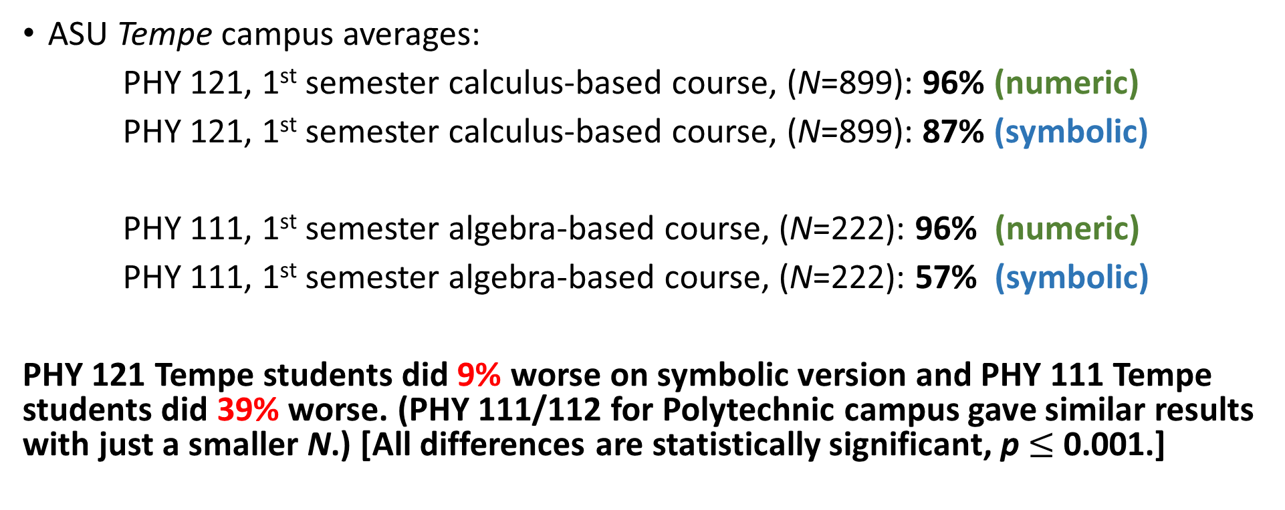
Basic Algebra Problem Symbolic vs Numeric Correct Response Rates Compared Spring 2018 (Tempe)
ASU Tempe campus averages:
PHY 121, 1st semester calculus-based course, (N=899): 96% (numeric)
PHY 121, 1st semester calculus-based course, (N=899): 87% (symbolic)
PHY 111, 1st semester algebra-based course, (N=222): 96% (numeric)
PHY 111, 1st semester algebra-based course, (N=222): 57% (symbolic)
PHY 121 Tempe students did 9% worse on symbolic version and PHY 111 Tempe students did 39% worse. (PHY 111/112 for Polytechnic campus gave similar results with just a smaller N.) [All differences are statistically significant, p $≤$ 0.001.]

Slide 14
Example of not isolating x.
Student’s final answer

Slide 15

Simultaneous Equations Symbolic vs Numeric
Numeric:
$$x=\frac{78.4}{12}≈6.5$$
Correct answer:
Symbolic:
Correct answer:
$$x= \frac{ac}{d+bc}$$

Slide 16
Simultaneous Equations Problem Symbolic vs Numeric Correct Response Rates Compared Spring 2018 (Tempe)
ASU Tempe campus averages:
PHY 121, 1st semester calculus-based course, (N=733): 87% (numeric)
PHY 121, 1st semester calculus-based course, (N=733): 63% (symbolic)
PHY 111, 1st semester algebra-based course, (N=140): 72% (numeric)
PHY 111, 1st semester algebra-based course, (N=140): 36% (symbolic)
PHY 121 Tempe students did 24% worse on symbolic version and PHY 111 Tempe students did 36% worse. (PHY 111/112 at the Polytechnic campus gave similar results with a smaller N.)

Slide 17
Simultaneous Equations Errors Observed
Numeric version: sign errors; not eliminating y.
Symbolic version: not eliminating y; factoring errors; not isolating x.
The complexity of the symbolic expressions led to many new errors that were not observed in the numeric version.

Slide 18
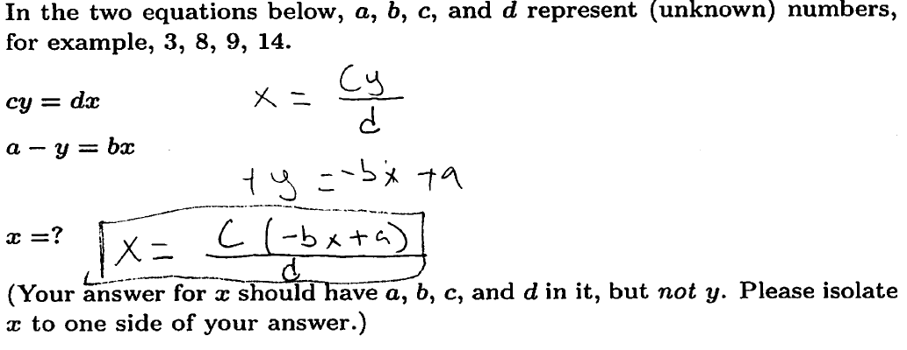
Example of not isolating x in simultaneous equations
Leaving x in terms of x
Failure to isolate x was responsible for > 40% of all errors in PHY 121

Slide 19
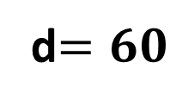
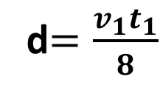
Kinematic Equation Problem Numeric vs Symbolic
Numeric:
Symbolic:
Correct answer:
d$=60$
Correct answer:
d$=\frac{v_{1}t_{1}}{8}$

Slide 20
Kinematics Equation Problem Symbolic vs Numeric Correct Response Rates Compared Spring 2018 (Tempe)
ASU Tempe campus averages:
PHY 121, 1st semester calculus-based course, (N=889): 89% (numeric)
PHY 121, 1st semester calculus-based course, (N=889): 72% (symbolic)
PHY 111, 1st semester algebra-based course, (N=215): 81% (numeric)
PHY 111, 1st semester algebra-based course, (N=215): 37% (symbolic)
PHY 121 Tempe students did 17% worse on symbolic version and PHY 111 Tempe students did 44% worse. (PHY 111/112 at Polytechnic gave similar results with a smaller N.)

Slide 21
Kinematic Equation Problem Errors Observed
Numeric version: substituting the wrong value into original equation, e.g., $∆v$for v.
Symbolic version: incorrectly squaring and multiplying/dividing fractions.
Students seem to struggle with the additional steps and complexity in the symbolic version.

Slide 22
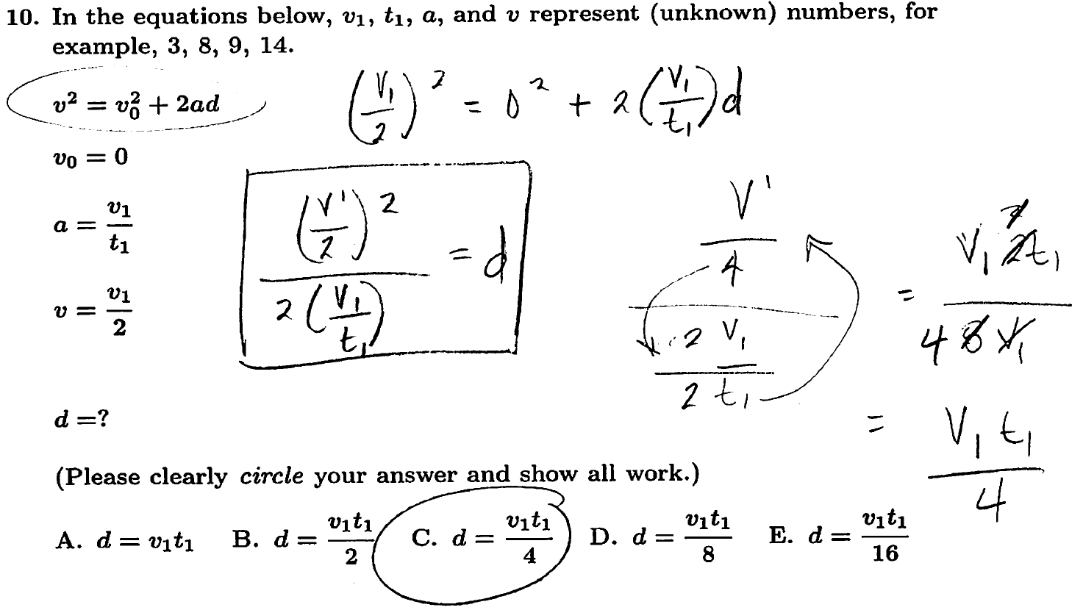
Example of common error with fractions
Error
Correct expression

Slide 23
Summary of Difficulties with Symbols
We find that students have significant difficulties with most of the symbolic problems.
Students seem not to be confused with the meaning of symbols themselves, but instead struggle with manipulations.
Changing numbers to symbols in a simple problem (e.g., the hypotenuse problem) only produces very small differences in correct response rates.
More complicated algebra problems result in much larger differences in response rates.
With symbols, students are forced to deal with more obstacles which are not encountered in numeric problems.

