Slide 1
Measuring and predicting the mathematical preparedness of introductory physics students
Dakota H. King and David E. Meltzer
Arizona State University
Supported in part by NSF DUE #1504986 and #1914712

Slide 2
Predicting mathematical preparedness
Our diagnostic was administered to over 1,900 students at three large university campuses over the course of three semesters
From these data, we have found interesting relationships between diagnostic items and overall diagnostic performance
Performance at the course, and individual student level

Slide 3
Predicting course correct response rate on entire diagnostic
Single item correct-response rate (CRR)
Single item correct-response rate (CRR)
7 random courses
7 random courses
F(CRR)
Total score on diagnostic
Total score on diagnostic

Slide 4
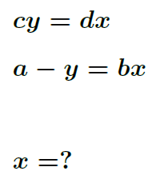
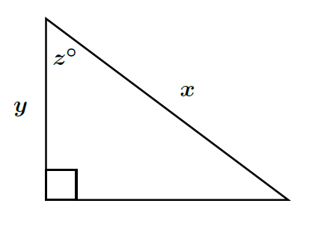
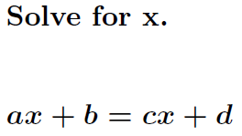
Good predictor items
Item 18
Item 1
Item 7

Slide 5
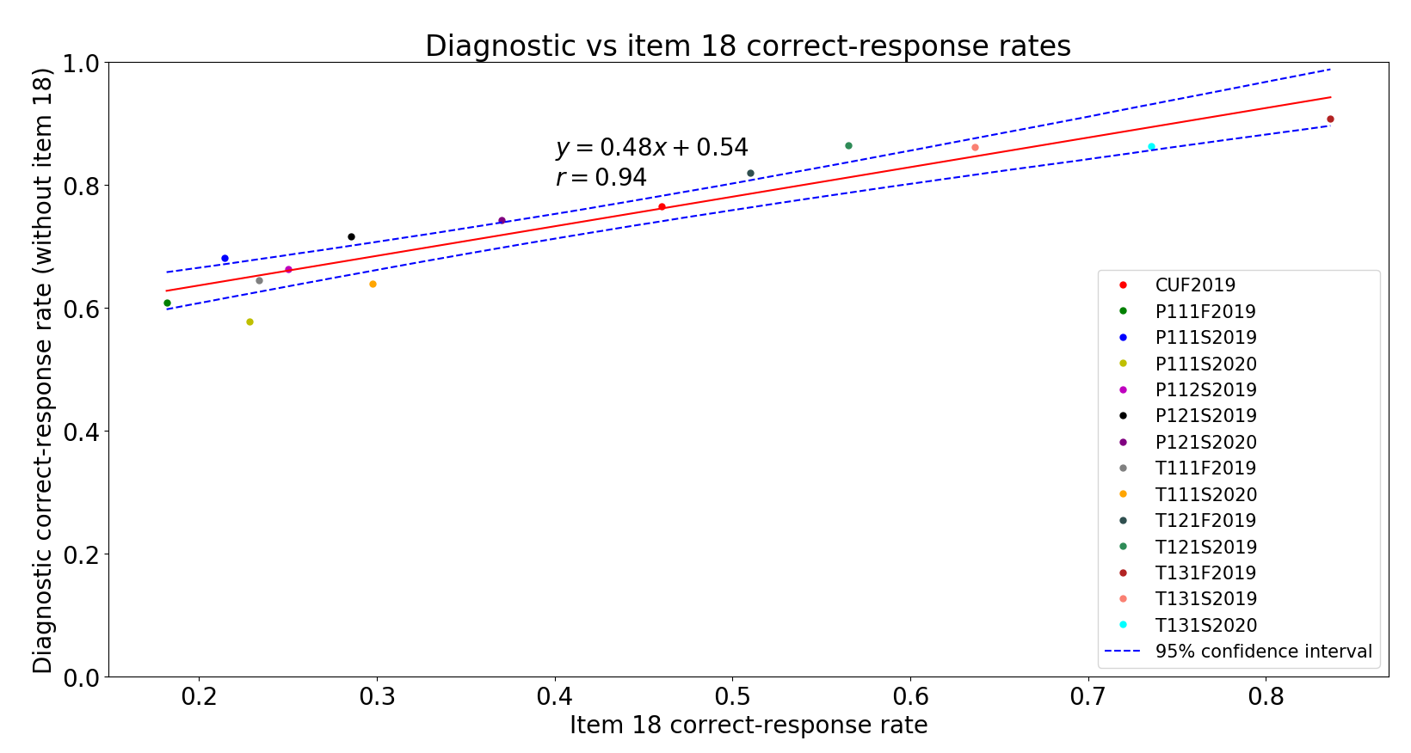
Item 18 as a predictor
R-squared: 0.88

Slide 6
Predicting course correct response rate on entire diagnostic (method 2)
Type of error on single item
Type of error on single item
7 random courses
7 random courses
F(E)
Total score on diagnostic
Total score on diagnostic

Slide 7
Method 2: items involved
Item 9
Item 8
Item 14
Item 11

Slide 8
Error “type”
Student A
Students A & B
Student B
Incorrect response
“Operational”
error
“non-
operational”
error

Slide 9
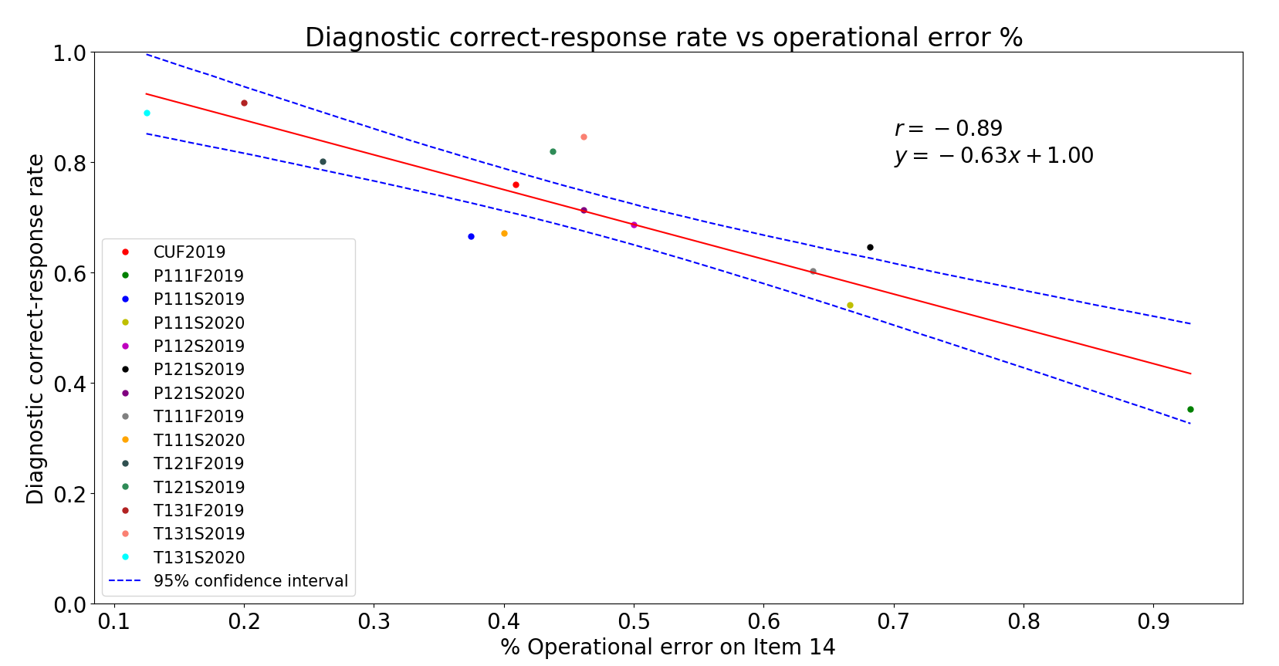
% Operational error as a predictor

Slide 10
Predicting course performance summary
We find that course correct-response rates on the entire diagnostic are highly predictable
We can predict diagnostic correct-response rate by simply examining the course correct-response rate on a single item
The best predictor items are generally “symbolic” type problems
Recall, this is true for courses varying in academic term, course level, university, and campus

Slide 11
Individual student correlations
Student diagnostic score
Individual student
Single item CRR

Slide 12
Student correlations on the same items
Item 18
Item 1
Item 7

Slide 13
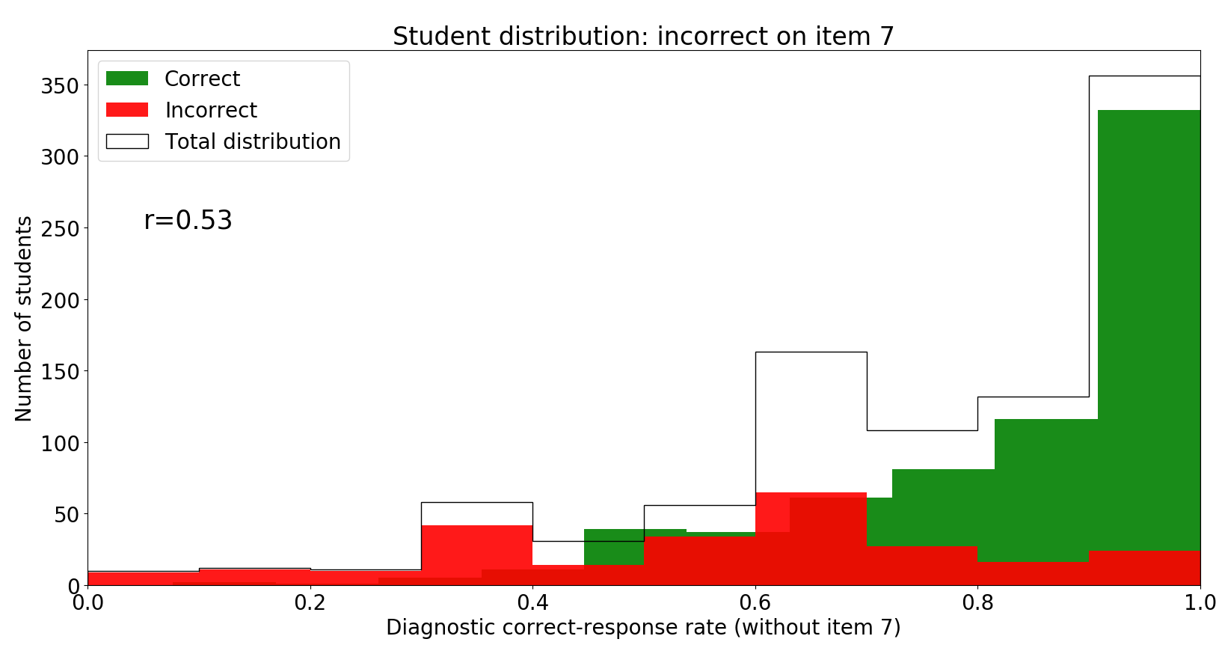
Student distribution on item 7

Slide 14
Student correlations with error type
Student diagnostic score
Individual student
Single item error type

Slide 15
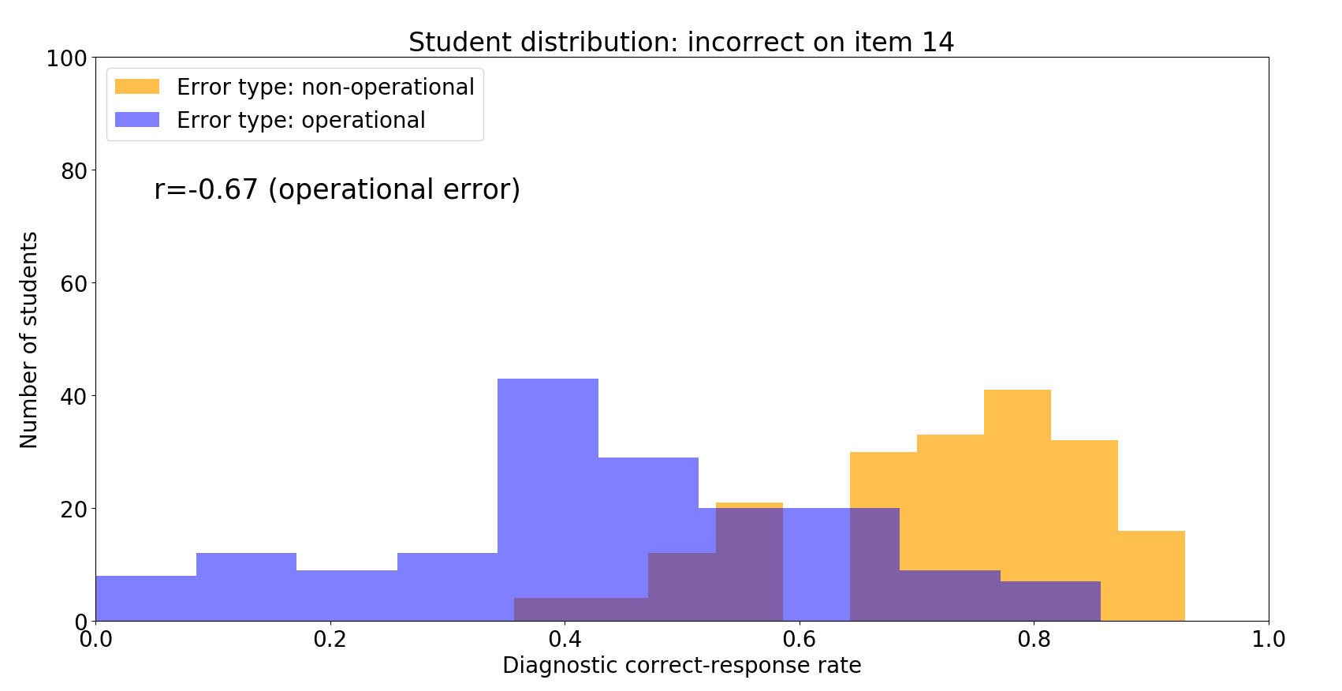

Slide 16
Summary
Course diagnostic performance can be accurately predicted independent of course level, campus, and academic term
Student diagnostic performance is less predictable, but high correlations are observed
This strong predictability and correlation amongst diverse student samples, along with high correlations between items, shows that students’ lack of understanding in math seems to represent itself in various mathematics topics to a similar degree

