Slide 1
Introductory Physics Students’ Mathematical Preparedness and Conceptual Understanding of Force
Dakota H. King and David E. Meltzer
Arizona State University
Supported in part by NSF DUE #1504986 and #1914712

Slide 2
Our newest mathematics diagnostic
Online
Identical math items found on our previous hand-written version
Trigonometry, geometry, graphing, and algebra
100% multiple choice
Free-response items were reformatted to multiple-choice by analyzing student responses from four years of data
4 physics items testing conceptual understanding of force
Newton’s second and third laws

Slide 3
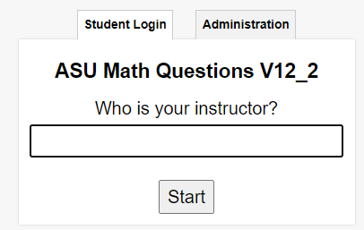
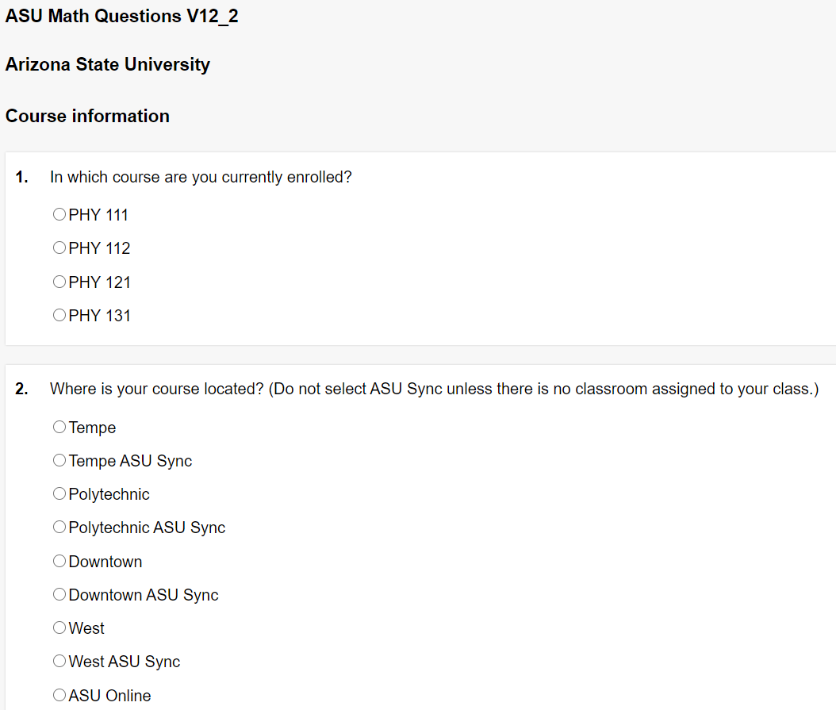
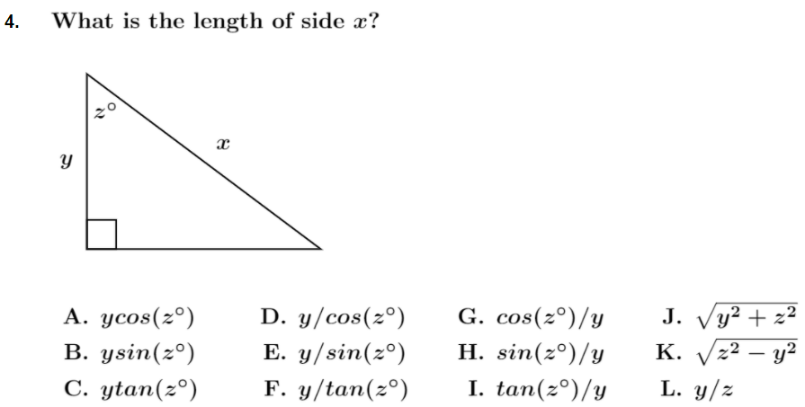
Our newest mathematics diagnostic
Identifying information
Multiple-choice items
(15 math, 4 physics)

Slide 4
Online vs hand-written diagnostic Correct-response rate comparison Trigonometry, algebra, geometry, and graphing

Slide 5
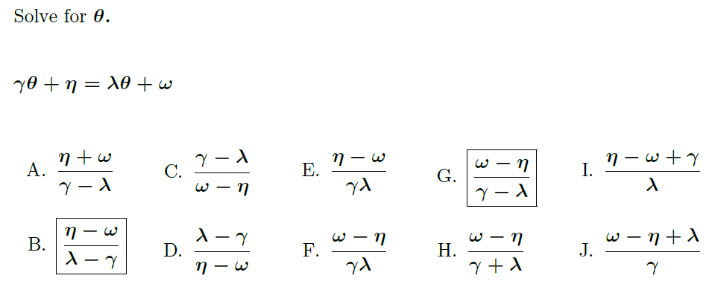
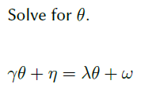
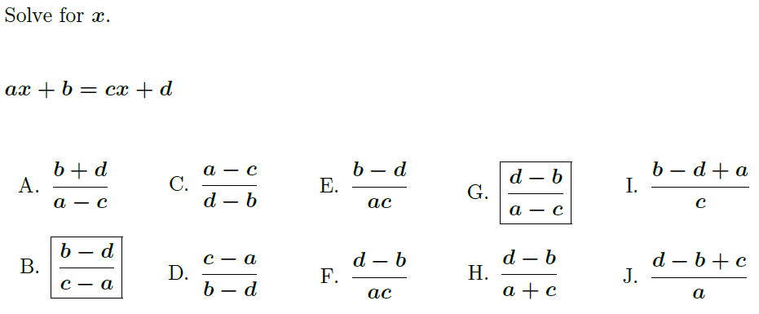
Item comparison: “Greek vs ABC” Hand-written vs online
Hand-written
Online
Greek letter coefficients
English alphabet coefficients

Slide 6
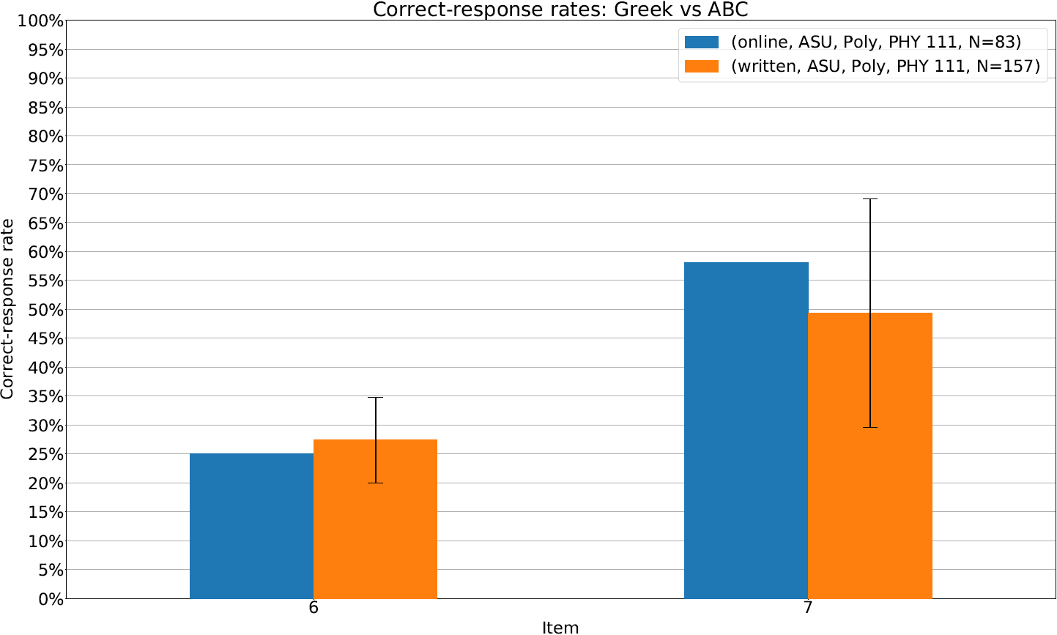
Item comparison: “Greek vs ABC” Hand-written vs online
[S2019, F2019, S2020]

Slide 7
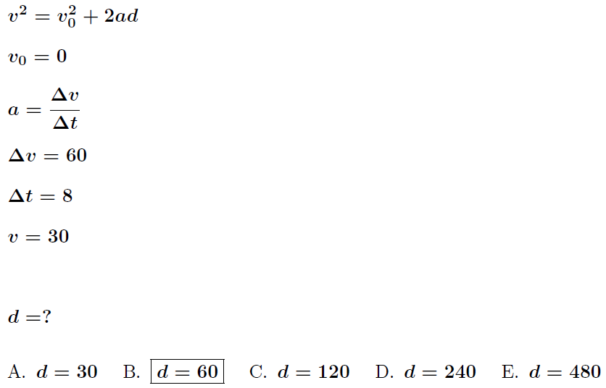
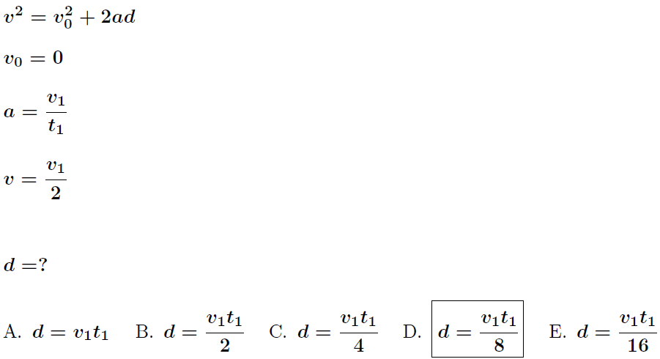
Item comparison: “Kinematics multiple-choice” Hand-written vs online
Hand-written & online
Symbolic coefficients
Numeric coefficients

Slide 8
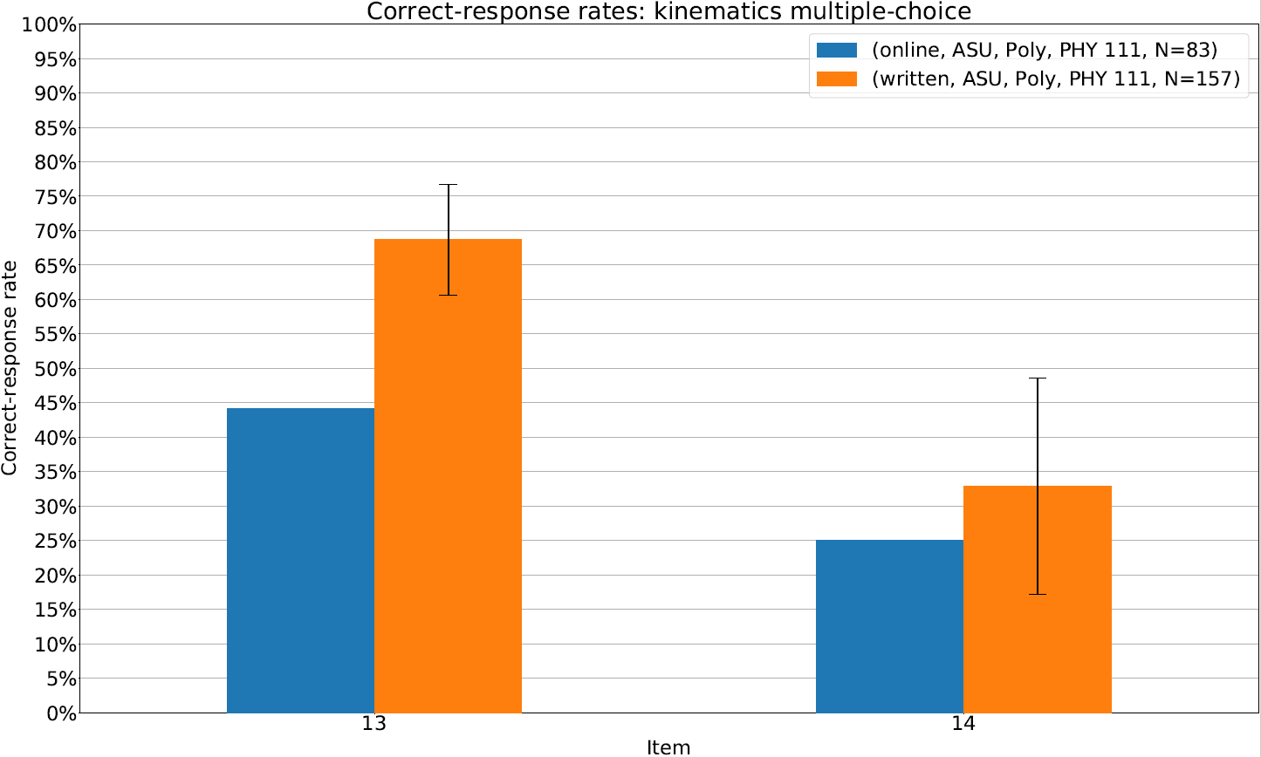
Item comparison: “Kinematics multiple-choice” Hand-written vs online
[S2019, F2019, S2020]

Slide 9
Item comparison: Area of a triangle and circle Hand-written vs online
Hand-written
Online

Slide 10
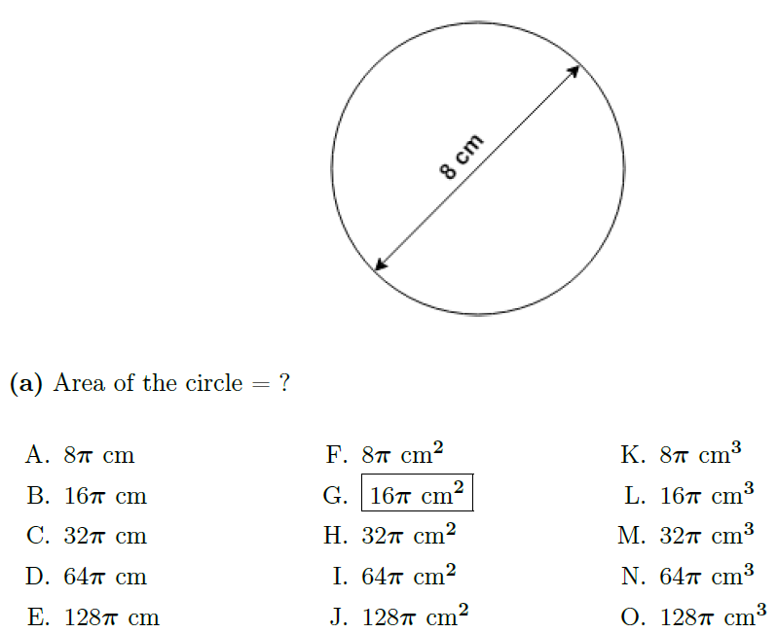
Item comparison: Area of a triangle and circle Hand-written vs online
Hand-written
Online

Slide 11
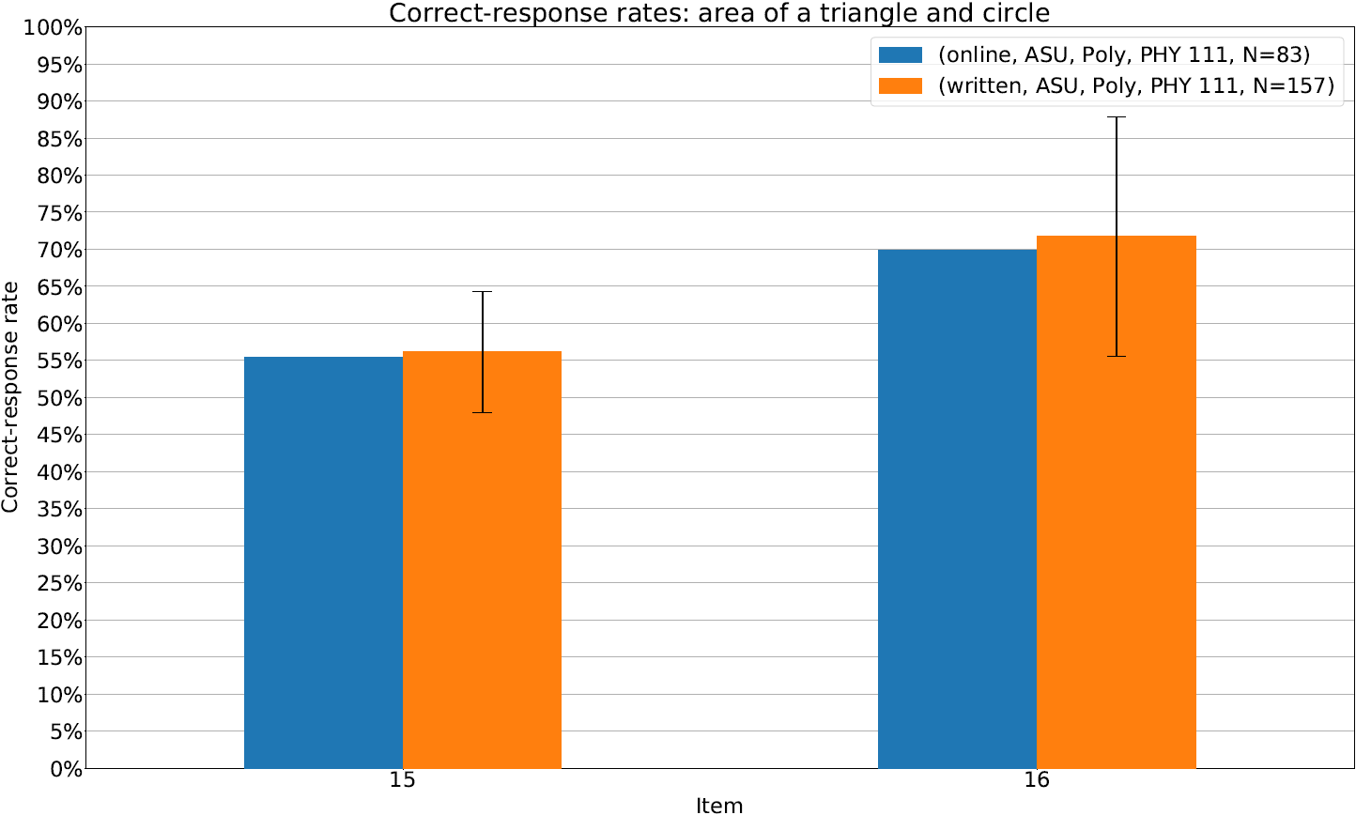
Item comparison: area of a triangle and circle Hand-written vs online
[S2019, F2019, S2020]

Slide 12
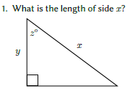
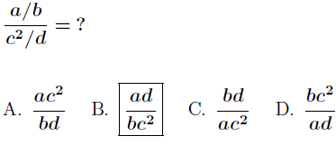
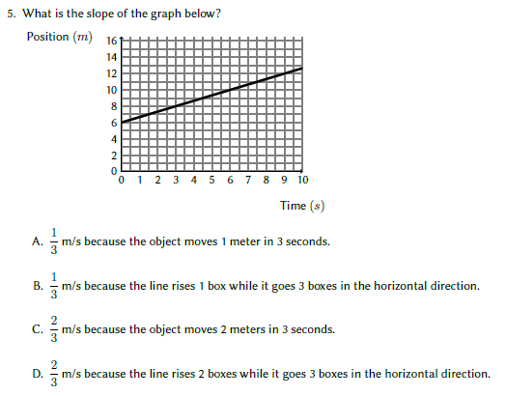
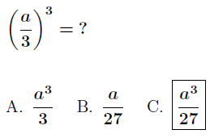
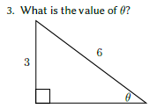
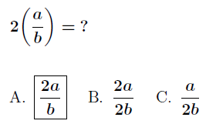
Other items Hand-written vs online

Slide 13
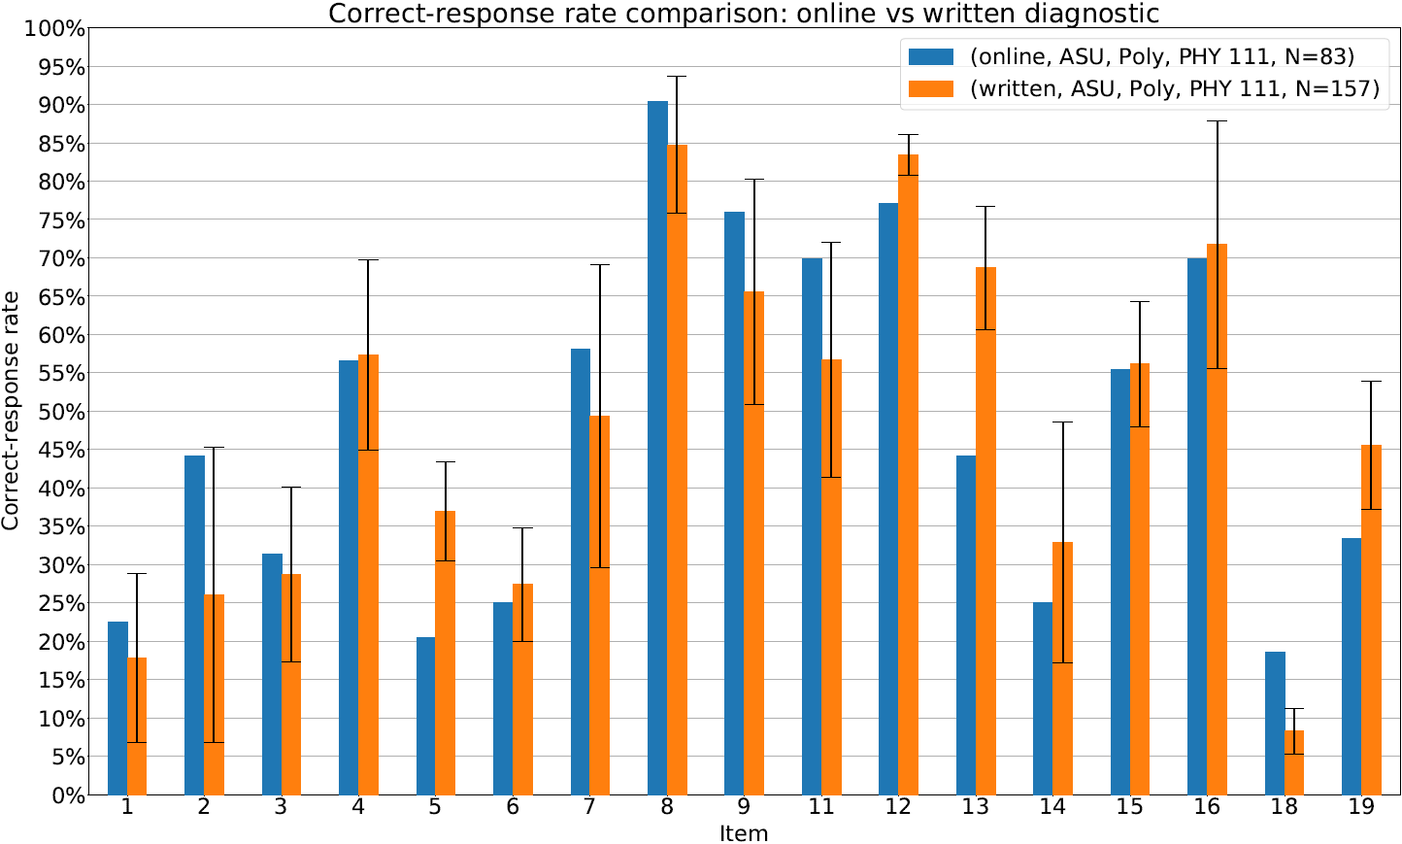
Comparing the hand-written diagnostic to the online version Correct-response rates (math items only)
[S2019, F2019, S2020]

Slide 14
Online vs hand-written diagnostic Comparing correlations and performance prediction Trigonometry, algebra, geometry, and graphing

Slide 15
Comparing the hand-written diagnostic to the online version Predicting course diagnostic performance
Taking the course score on a single item and predicting the overall course score on the remaining items
2 Trigonometry problems
1 graphing problem
2 geometry problems
4 algebra problems
?

Slide 16
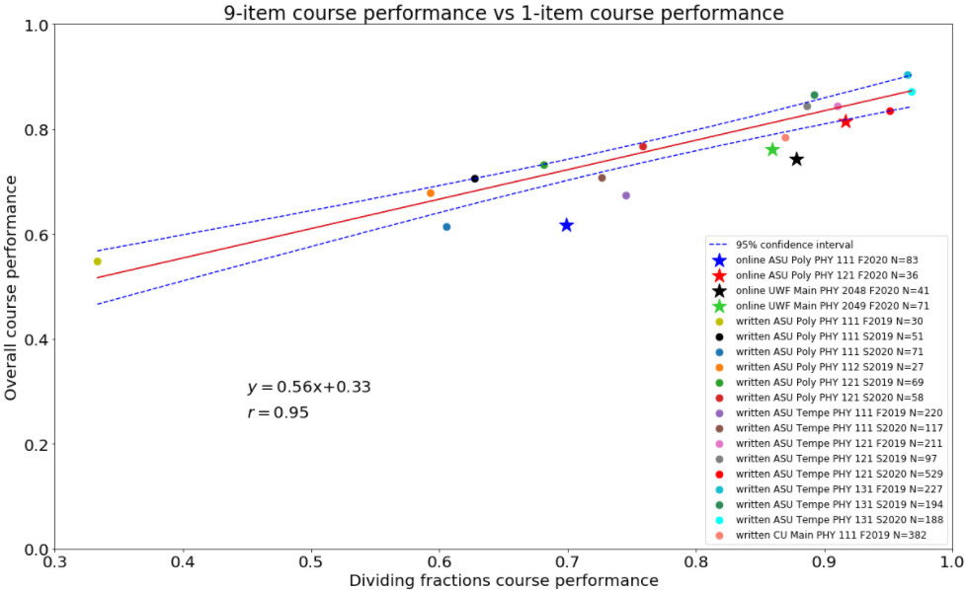
Comparing the hand-written diagnostic to the online version Predicting course diagnostic performance
Course performance on entire diagnostic (without the predictor item)
Course performance on the predictor item

Slide 17
Comparing the hand-written diagnostic to the online version Predicting course diagnostic performance
Taking a student’s response on a single item (incorrect or correct) and predicting the student’s overall score on the remaining items
2 Trigonometry problems
1 graphing problem
2 geometry problems
4 algebra problems
?

Slide 18
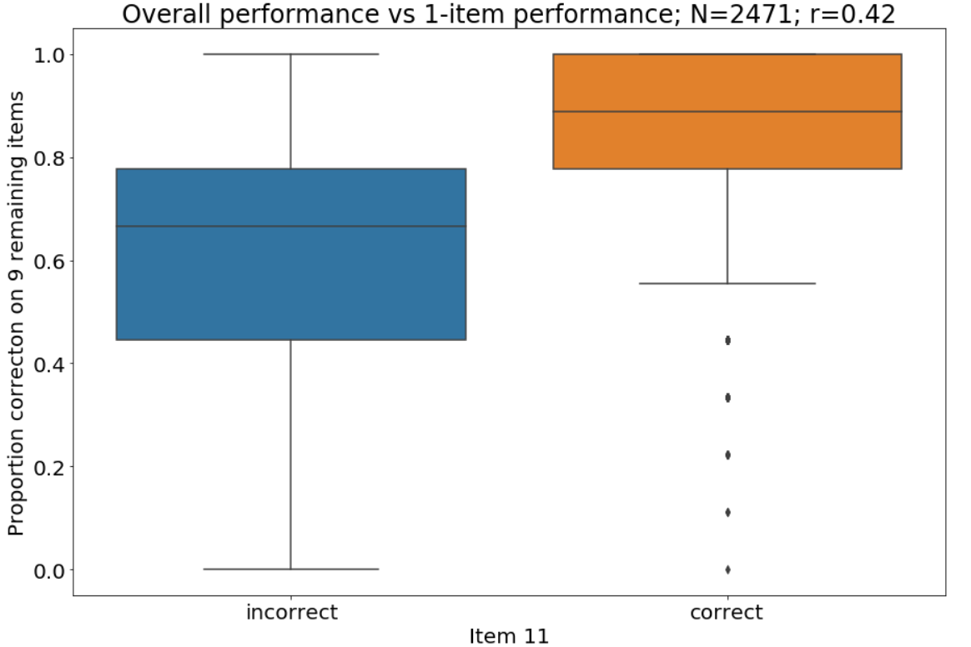
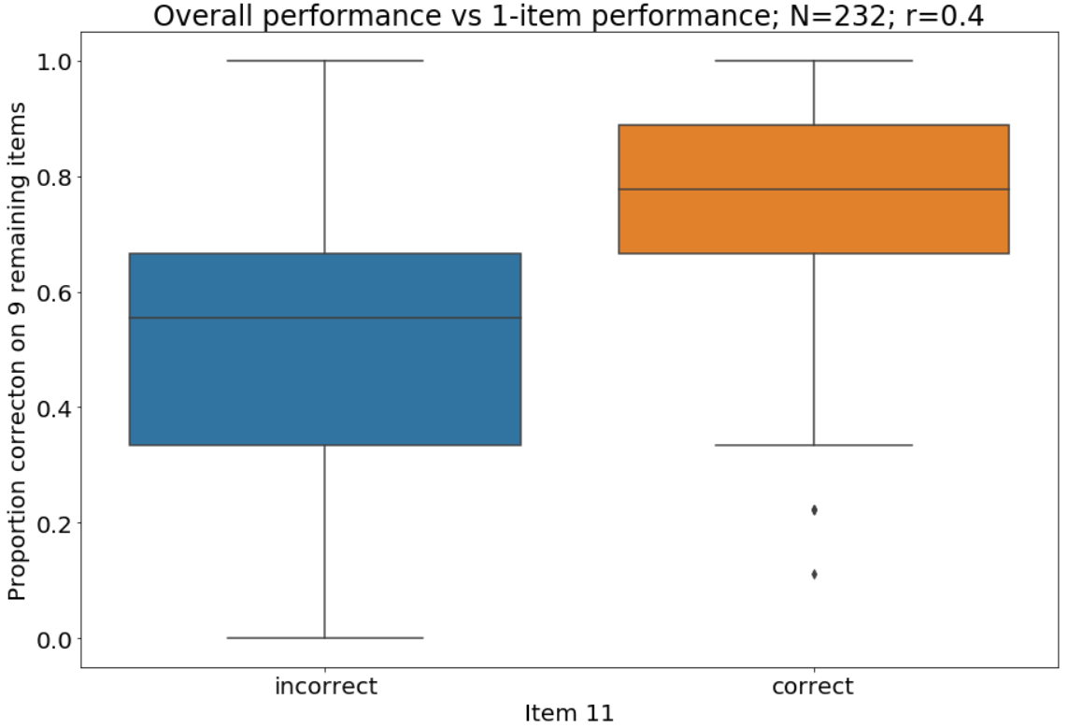
Comparing the hand-written diagnostic to the online version Student performance correlations (math items only)
Hand-written diagnostic
Online diagnostic
Student performance on entire diagnostic (without the predictor item)
Student performance on the predictor item

Slide 19
Physics portion of the online diagnostic Four problems on Newton’s 2nd and 3rd laws

Slide 20
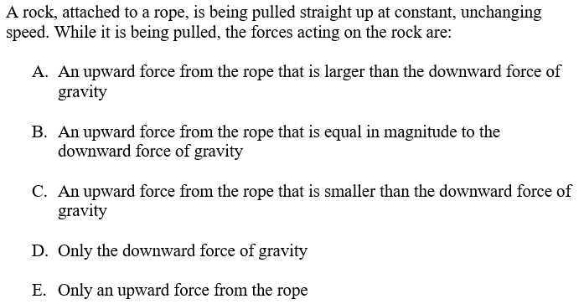
Online diagnostic physics problems Newton’s second law (PHY1)
University | Campus | Course | Term | N | CRR
ASU | Poly | PHY 111 | F2020 | 83 | 14%
ASU | Poly | PHY 121 | F2020 | 36 | 39%
UWF | Main | PHY 2048 | F2020 | 41 | 24%
UWF | Main | PHY 2049 | F2020 | 71 | 32%
Correct-response rates: 14% - 39%

Slide 21
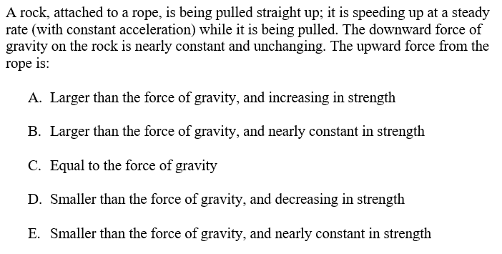
Online diagnostic physics problems Newton’s second law (PHY2)
University | Campus | Course | Term | N | CRR
ASU | Poly | PHY 111 | F2020 | 83 | 24%
ASU | Poly | PHY 121 | F2020 | 36 | 47%
UWF | Main | PHY 2048 | F2020 | 41 | 41%
UWF | Main | PHY 2049 | F2020 | 71 | 32%
Correct-response rates: 24% - 47%

Slide 22
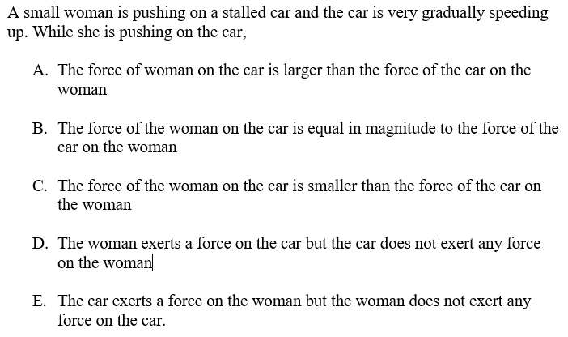
Online diagnostic physics problems Newton’s third law (PHY3)
University | Campus | Course | Term | N | CRR
ASU | Poly | PHY 111 | F2020 | 83 | 13%
ASU | Poly | PHY 121 | F2020 | 36 | 50%
UWF | Main | PHY 2048 | F2020 | 41 | 39%
UWF | Main | PHY 2049 | F2020 | 71 | 41%
Correct-response rates: 13% - 50%

Slide 23
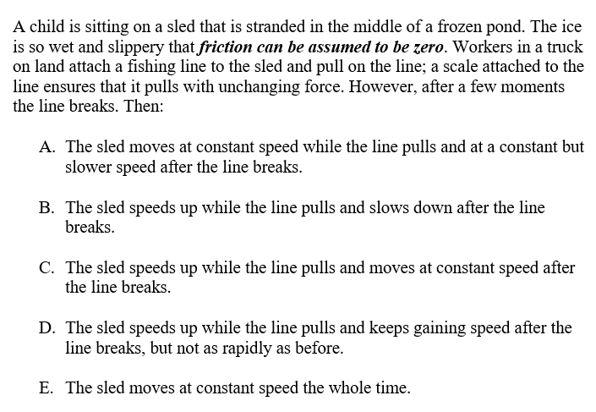
Online diagnostic physics problems Newton’s second law (PHY4)
University | Campus | Course | Term | N | CRR
ASU | Poly | PHY 111 | F2020 | 83 | 17%
ASU | Poly | PHY 121 | F2020 | 36 | 50%
UWF | Main | PHY 2048 | F2020 | 41 | 49%
UWF | Main | PHY 2049 | F2020 | 71 | 41%
Correct-response rates: 17% - 50%

Slide 24
Comparing student performance on the physics and math portion of the online diagnostic

Slide 25
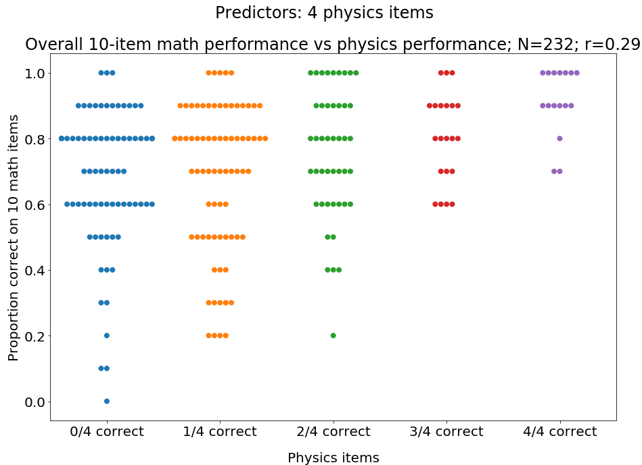
Online diagnostic physics problems Math vs physics performance

Slide 26
Summary
Our new online diagnostic appears comparable to our hand-written diagnostic in measuring and predicting students’ mathematical preparedness
Performance on the physics items is correlated (r≈0.3) with performance on the mathematics items
Larger sample sizes and further analysis are needed to characterize these measures with more confidence and detail
If you would like this diagnostic administered in your university physics course, please email me or David Meltzer at:
dhking1@asu.edu
David.Meltzer@asu.edu

Slide 29
Summary
Our new online diagnostic seems to measure and predict the mathematical preparedness of students to a similar degree as our hand-written diagnostic
A larger sample size is desired to fully characterize the capability of making these measurements and predictions using the online diagnostic
Performance on our conceptual physics problems (Newton’s 2nd and 3rd laws) is significantly correlated with mathematics performance

Slide 30
Comparing the hand-written diagnostic to the online version Internal consistency (math items only)
Version | Hand-written (N, KR-20) | Online (N, KR-20)
A (14 items) | (1224, 0.76) | (16, 0.85)
B (14 items) | (1108, 0.74) | (17, 0.85)
C (10 items; subset of mutual items between A & B) | (2370, 0.70) | (232, 0.68)

Slide 31
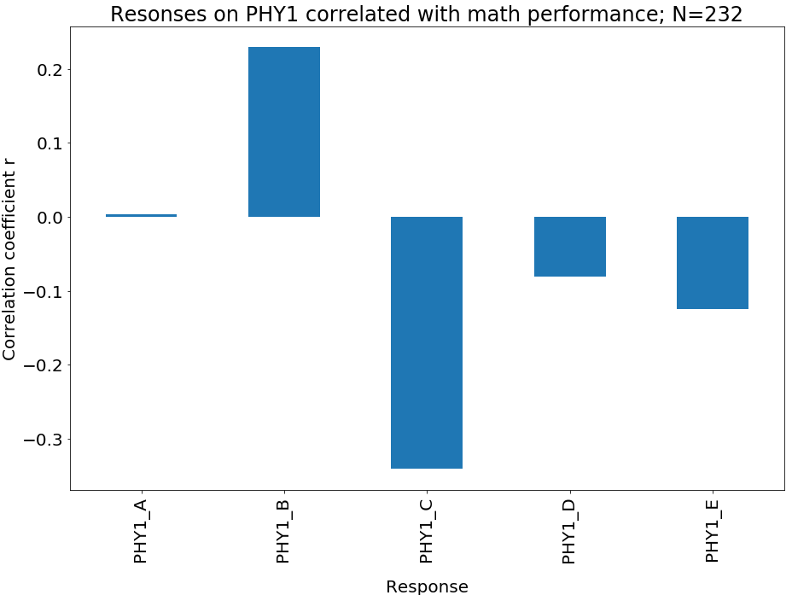
Online diagnostic physics problems Newton’s second law (PHY1)

Slide 32
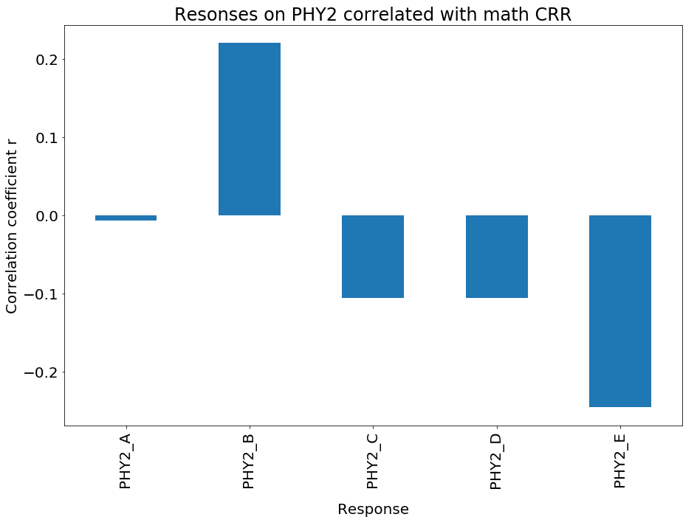
Online diagnostic physics problems Newton’s second law (PHY2)

Slide 33
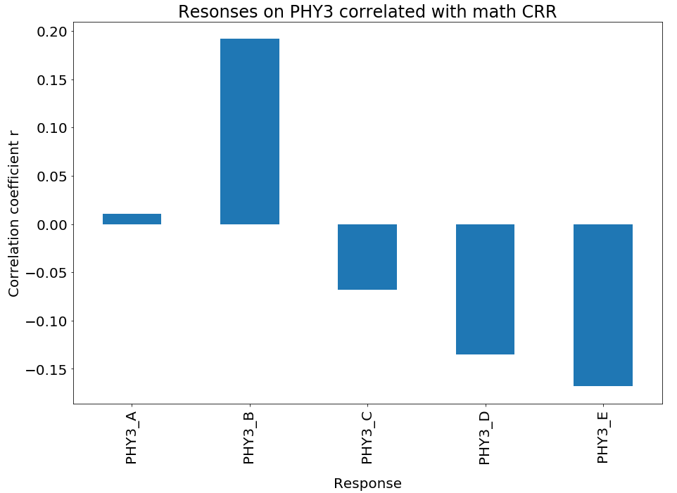
Online diagnostic physics problems Newton’s third law (PHY3)

Slide 34
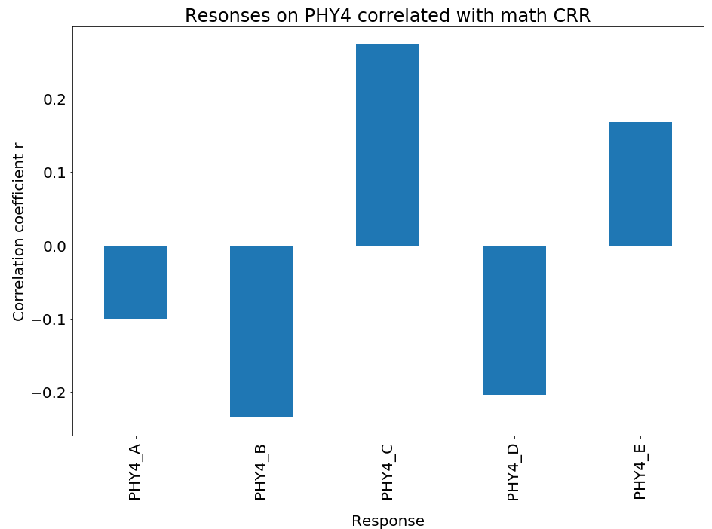
Online diagnostic physics problems Newton’s second law (PHY4)

Slide 36
Online diagnostic physics problems Math vs physics performance

Slide 37
Online diagnostic physics problems Math vs physics performance

Slide 38
Online diagnostic physics problems Newton’s second law (PHY1)
Key concept:
The $∑\vec{F}=0$when an object is moving at a constant unchanging speed
Steps:
Assess the object’s motion
Reason what combination of forces are causing the motion

Slide 39
Online diagnostic physics problems Newton’s second law (PHY2)
Key concept:
The $∑\vec{F}=constant$when an object is moving with a constant acceleration
Steps:
Assess the object’s motion
Reason what combination of forces are causing the motion

Slide 40
Online diagnostic physics problems Newton’s third law (PHY3)
Key concept:
Newton’s third law
Steps:
Assess the objects’ motion
Use Newton’s third law to understand what forces are acting on each object

Slide 41
Online diagnostic physics problems Newton’s second law (PHY4)
Key concepts:
When $∑\vec{F}=constant$the object is accelerating
When $∑\vec{F}=0$the object moves at a constant speed
Steps:
Assess the forces
Reason what motion would be caused by the forces

