Slide 1
Investigating Student Difficulties in Solving Basic Mathematics Problems
Dakota H. King and David E. Meltzer
Arizona State University
Supported in part by NSF DUE #1504986

Slide 2
Overview
We’ve administered approximately 4000 math diagnostics to introductory algebra- and calculus-based physics courses since 2016
We asked students high school level mathematics problems stripped of physics context
Our most recent diagnostic included new questions including basic geometry
We continue to focus on analyzing student difficulties with symbolic problems

Slide 3
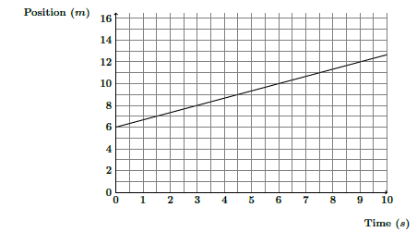
Finding the Slope of a Line
Answer: $\frac{2}{3}$ m/s
Scaling on the time and position axes differ

Slide 4
Slope Correct Response Rates
ASU Tempe campus averages:
PHY 131, 2nd semester calculus-based course, (N=214): 53%
PHY 121, 1st semester calculus-based course, (N=329): 56%
PHY 111, 1st semester algebra-based course, (N=305): 43%
About 40%-60% of students could not find the slope

Slide 5
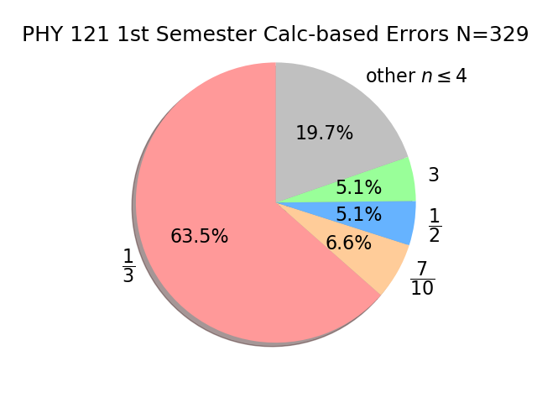
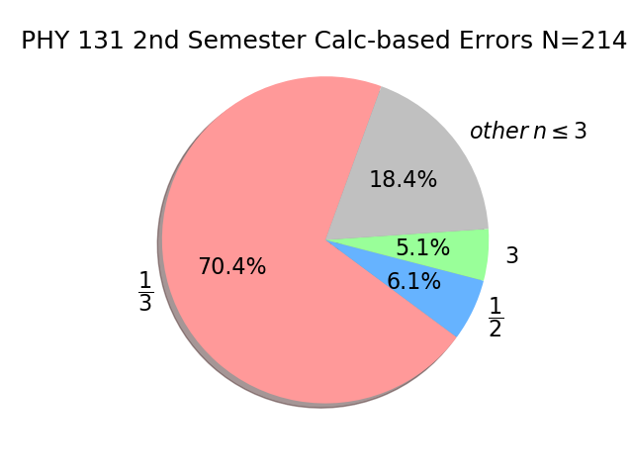
Slope Question Errors Observed
About 50%-70% of incorrect responses were $"\frac{1}{3}"$

Slide 6
Slope Question Carelessness
Students seem to assume scaling on the x-axis is equal to that of the y-axis
Students count boxes rather than checking the numeric scaling of the axes
Only ≈5% of all students included units in their answer
Correct response rates increase 25-55% when scaling of axes is equal

Slide 7
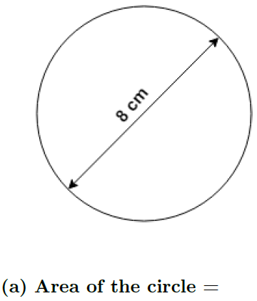
Basic Geometry – Area of Circle
Answer: $16π{ cm}^{2}$

Slide 8
Area of Circle Correct Response Rates
ASU Tempe campus averages:
PHY 131, 2nd semester calculus-based course, (N=207): 76%
PHY 121, 1st semester calculus-based course, (N=313): 75%
PHY 111, 1st semester algebra-based course, (N=277): 77%
About 25% of students were not able to find the area of a circle

Slide 9
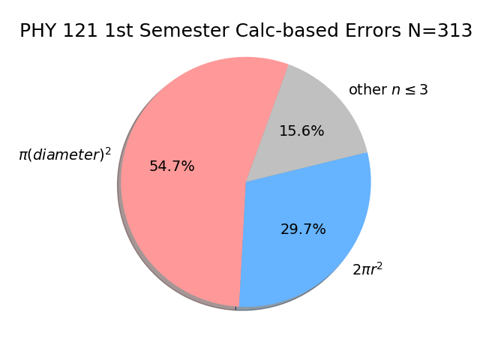
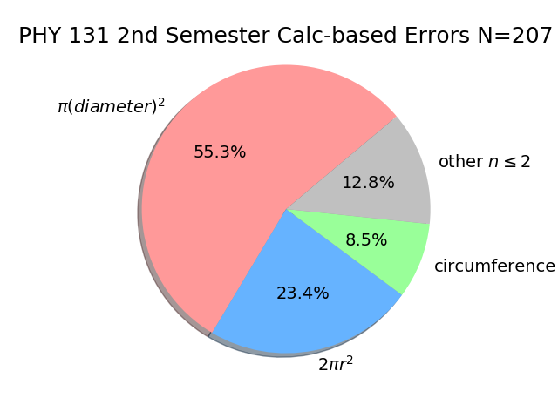
Area of Circle Errors Observed

Slide 10
Numeric vs Symbolic Questions
Torigoe and Gladding (2007; 2011) investigated differences in students’ responses to physics problems in both numeric and symbolic form.
“Numeric” and “symbolic” refer to the nature of the constant coefficients.
They found that students (most of the time) had more difficulties with symbolic questions.
We administered numeric-symbolic problem pairs to 1,318 students in Spring 2018 and 967 students in Fall 2018.

Slide 11

Simultaneous Equations: Symbolic vs Numeric
Numeric:
$$x=\frac{78.4}{12}≈6.5$$
Correct answer:
Symbolic:
Correct answer:
$$x= \frac{ac}{d+bc}$$

Slide 12
Numeric vs Symbolic: Simultaneous Equations
Spring 2018 1st semester calculus-based:
PHY 121, (N=733): 87% (numeric)
PHY 121, (N=733): 63% (symbolic)
Fall 2018 1st semester calculus-based:
PHY 121, (N=146): 75% (numeric)
PHY 121, (N=129): 47% (symbolic)
Spring 2018 1st semester algebra-based:
PHY 111, (N=140): 72% (numeric)
PHY 111, (N=140): 36% (symbolic)
Fall 2018 1st semester algebra-based:
PHY 111, (N=114): 56% (numeric)
PHY 111, (N=101): 28% (symbolic)
24% difference
28% difference
36% difference
28% difference

Slide 13
Simultaneous Equations Errors Observed
Numeric version: sign errors; not eliminating y.
Symbolic version: not eliminating y; factoring errors; not isolating x.
The complexity of the symbolic expressions led to many new errors that were not observed in the numeric version.

Slide 14
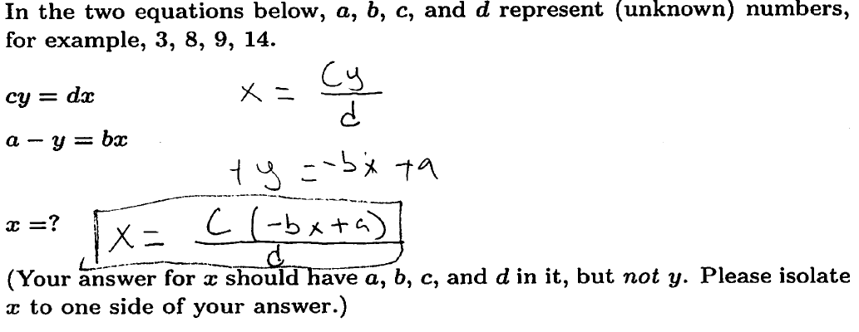
Example of not isolating x in simultaneous equations
Leaving x in terms of x
Failure to isolate x was responsible for ≈50% of all errors in PHY 111/121

Slide 15
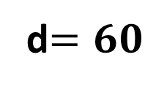
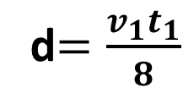
Kinematic Equation Problem Numeric vs Symbolic
Numeric:
Symbolic:
Correct answer:
d$=60$
Correct answer:
d$=\frac{v_{1}t_{1}}{8}$

Slide 16
Numeric vs Symbolic: Kinematic Equation
Spring 2018 1st semester calculus-based:
PHY 121, (N=889): 89% (numeric)
PHY 121, (N=889): 72% (symbolic)
Fall 2018 1st semester calculus-based:
PHY 121, (N=157): 85% (numeric)
PHY 121, (N=165): 65% (symbolic)
Spring 2018 1st semester algebra-based:
PHY 111, (N=215): 81% (numeric)
PHY 111, (N=215): 37% (symbolic)
Fall 2018 1st semester algebra-based:
PHY 111, (N=145): 78% (numeric)
PHY 111, (N=140): 31% (symbolic)
17% difference
20% difference
44% difference
47% difference

Slide 17
Kinematic Equation Problem Errors Observed
Numeric version: substituting the wrong value into original equation, e.g., $∆v$for v.
Symbolic version: incorrectly squaring and multiplying/dividing fractions.
Students seem to struggle with the additional steps and complexity in the symbolic version.

Slide 18
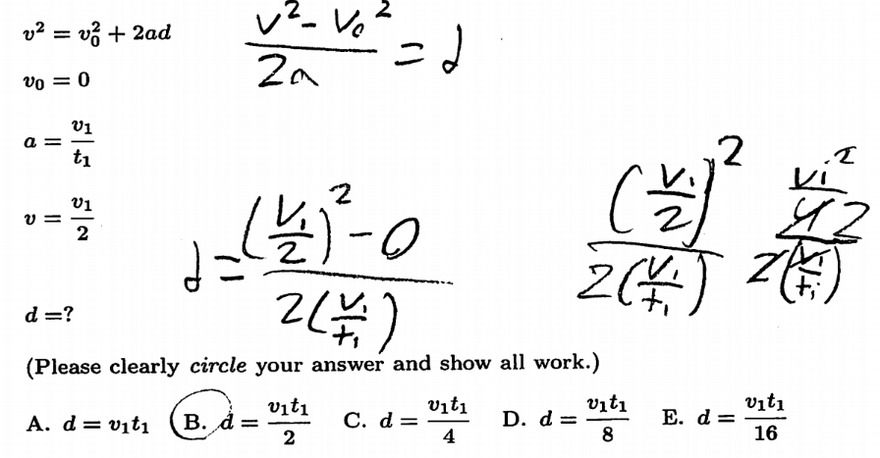
Example of common error with fractions
Fraction division error
Correct expression

Slide 19
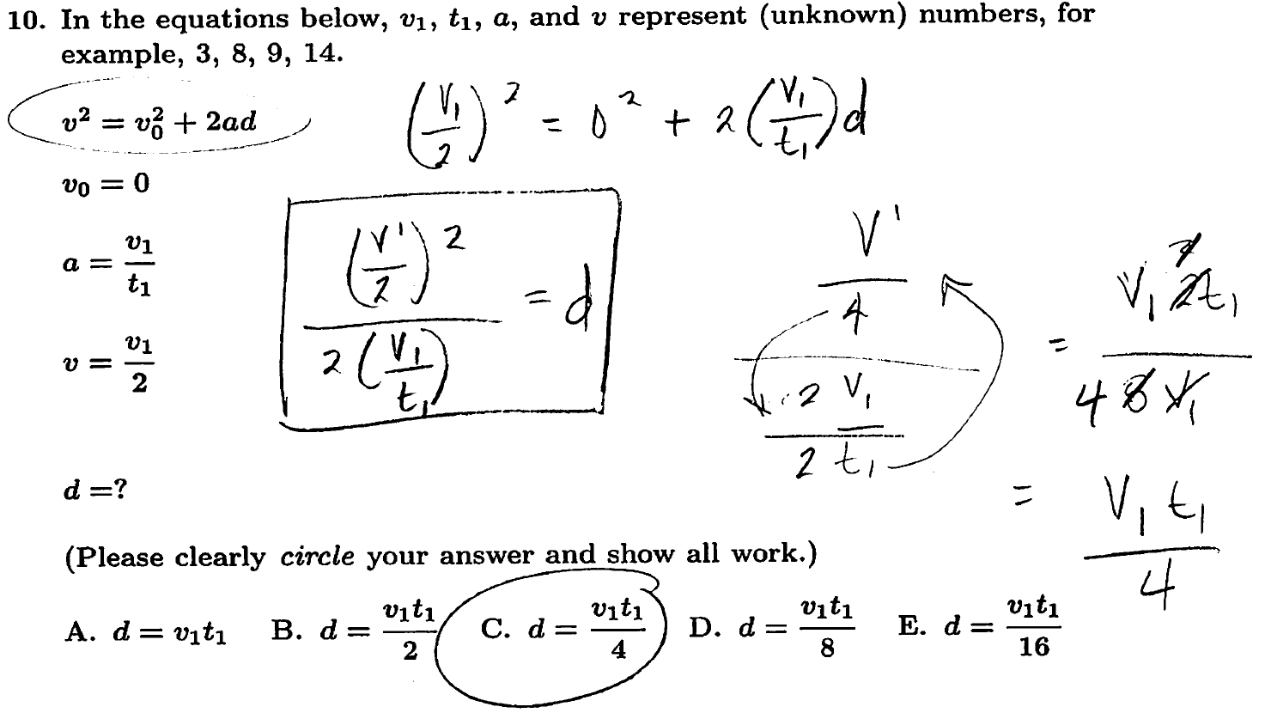
Example of common error with fractions
Error
Correct expression

Slide 20
Summary
We find that students have significant difficulties with basic mathematics problems
Students struggle with symbolic manipulation resulting in significantly higher error rates on the symbolic problems
About half of the students did not respond correctly to finding the slope of a line when scaling is different among the axes
A quarter of all students (regardless of calculus- or algebra- based) could not find the area of a circle

Slide 22
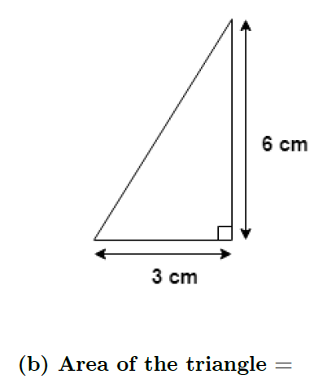
Basic Geometry – Finding Areas
Answer: $16π{ cm}^{2}$
Answer: $9{ cm}^{2}$

Slide 23
Area of Triangle Correct Response Rates
ASU Tempe campus averages:
PHY 131, 2nd semester calculus-based course, (N=207): 95%
PHY 121, 1st semester calculus-based course, (N=311): 96%
PHY 111, 1st semester algebra-based course, (N=272): 84%

