Slide 1
Exploring Student Difficulties in Mathematics Used in Introductory Physics
Dakota H. King and David E. Meltzer
Arizona State University
Supported in part by NSF DUE #1504986

Slide 2
Overview
We’ve administered approximately 4000 math diagnostics to introductory algebra- and calculus-based physics courses since 2016
We asked students high school level mathematics problems stripped of physics context
Our most recent diagnostic included new questions including basic fractions
We continue to focus on analyzing student difficulties with symbolic problems

Slide 3
“Symbolic” Versus “Numeric”
Torigoe and Gladding (2007; 2011) investigated differences in students’ responses to physics problems in both numeric and symbolic form
“Numeric” and “symbolic” refer to the nature of the constant coefficients
Starting in 2018, we asked paired problems in both symbolic and numeric form
Our problems were stripped of physics context and asked as pure math problems
Focused on trigonometry and algebra

Slide 4
Students’ Difficulties with Symbols
Torigoe and Gladding (2011):
A car can go from 0 to 60 m/s in 8 s. At what distance d from the start at rest is the car traveling 30 m/s?
A car can go from 0 to v₁ in t₁ seconds. At what distance d from the start at rest is the car traveling (v₁/2)?
Numeric version:
Symbolic version:

Slide 5
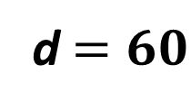
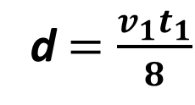
Kinematic Equation Problem
Numeric:
Symbolic:
(Multiple Choice)
(Multiple Choice)
Correct answer:
d$=\frac{v_{1}t_{1}}{8}$
Correct answer:
d$=60$

Slide 6
Correct-Response-Rate Differences
First Semester algebra-based (PHY 111) Tempe Campus:
First Semester calculus-based (PHY 121) Tempe Campus:

Slide 7
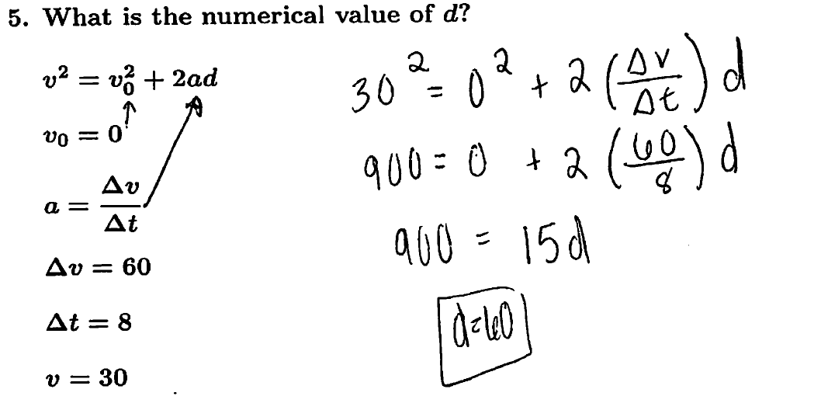
Differences in Procedure
Numeric:
Example of student work
Arithmetic used on both sides of equation

Slide 8
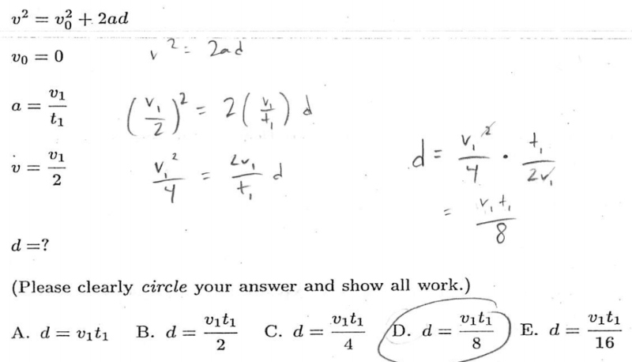
Differences in Procedure
Symbolic:
Dividing Fraction
Squaring Fraction

Slide 9
Errors Observed
Numeric version: substituting the wrong value into original equation, e.g., $∆v$for v.
Symbolic version: incorrectly squaring and multiplying/dividing fractions.
Students seem to struggle with the additional steps and complexity in the symbolic version.

Slide 10
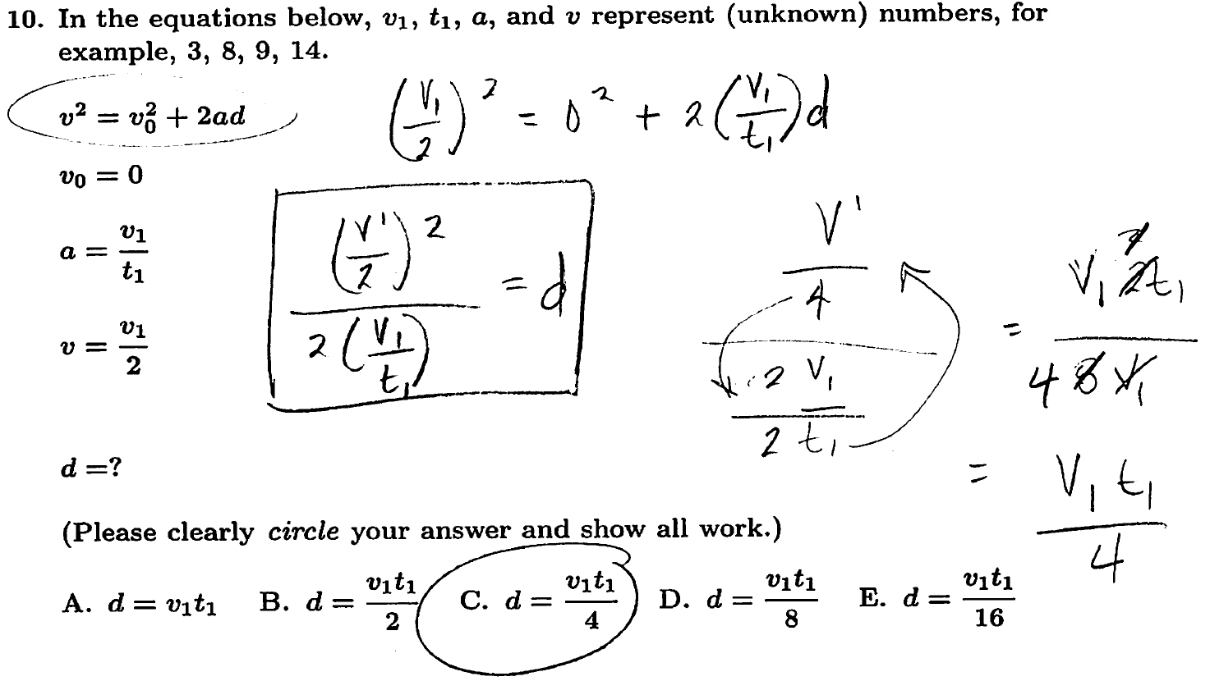
Example of Multiplication Error
Error
Correct expression

Slide 11
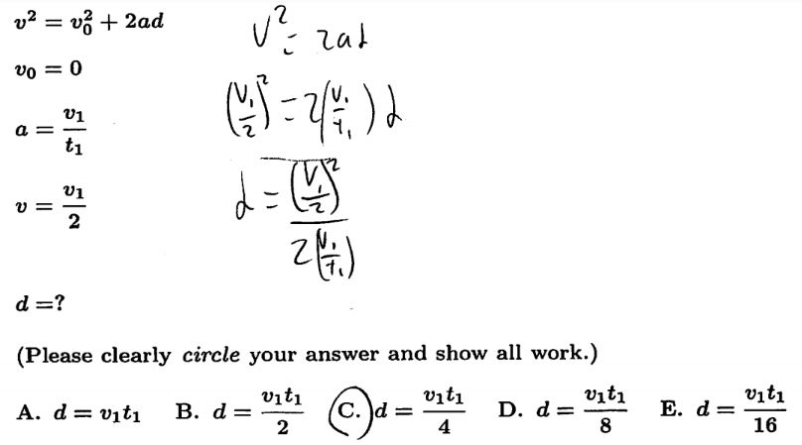
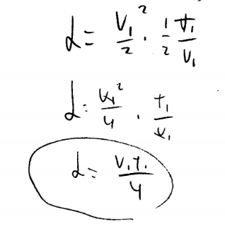
Example of Squaring Error
Not squaring the denominator

Slide 12
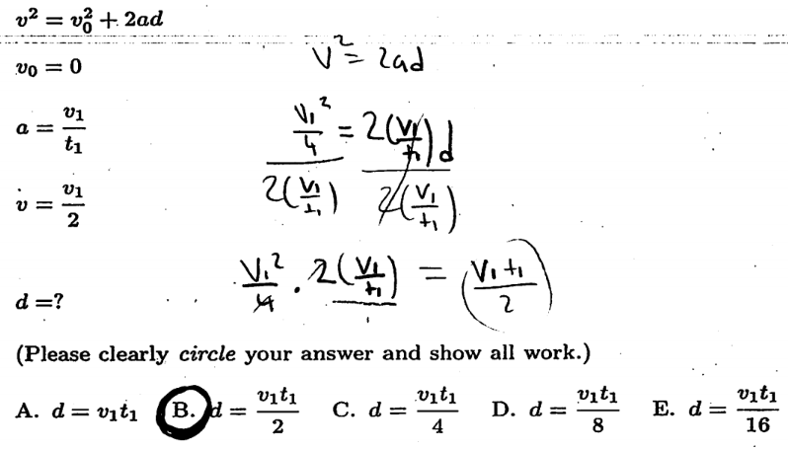
Example of Division Error
Division of fractions error

Slide 13
Testing Operational Skills
To help better understand the errors occurring on the symbolic problem, we asked basic questions to test math skills at the middle-school level
We wanted to reduce the complexity of the problem in order to isolate errors
“Complexity” implies, among other things, the number of steps involved in the problem
We administered three problems on the manipulation of fractions which were directly related to the kinematic equation algebra problem

Slide 14
Fractions – 3 Problems
Symbolic Multiplication
Symbolic Division
(1)
(2)
Exponent
(3)

Slide 15
(1) Correct Response Rates (multiplication)
ASU Tempe campus averages:
1st semester calculus-based course, (N=95): 96%
ASU Polytechnic campus averages:
1st semester calculus-based course, (N=69): 75%

Slide 16
(2) Correct Response Rates (division)
ASU Tempe campus averages:
1st semester calculus-based course, (N=95): 92%
ASU Polytechnic campus averages:
1st semester calculus-based course, (N=69): 68%

Slide 17
(3) Correct Response Rates (exponent)
ASU Tempe campus averages:
1st semester calculus-based course, (N=95): 100%
ASU Polytechnic campus averages:
1st semester calculus-based course, (N=69): 91%

Slide 18
Weak Operational Skills, or Carelessness?
We define “non-operational errors” as all errors that occur when the student has knowledge of the mathematical operations needed to solve steps of a problem but fails to do so correctly, e.g. , from not checking their work, not accessing previously learned skills, or not exercising sufficient care.
Knowledge of how to solve each fraction problem is essential to work the kinematic equation problem correctly
With certain assumptions, we can then estimate the percentage of students that solved the kinematic equation problem incorrectly because of “non-operational errors”

Slide 19
Measuring “Non-Operational Errors”
We hypothesize, based on analysis of thousands of written diagnostics, that the majority of errors on the symbolic version were due to errors on one or more of the three “fraction” operations
Therefore, we assume that, if a student responds incorrectly to any of the three fraction problems, they would probably give an incorrect response to the kinematics problem; we call this an “operational” error
We define any other error as a “non-operational” error

Slide 20

Calculation Example
$$40\%+X=60\% ⇒X=20\%$$
Percentage of errors that are “operational” errors
Percentage of errors that are
“non-operational” errors
Total incorrect response rate (kinematics problem)

Slide 21
Calculation Example
$$\frac{X}{60\%} \sim 35\%$$
Percentage of errors that are
“non-operational” errors
Proportion of errors that are “non-operational” errors
Total incorrect response rate (kinematics problem)

Slide 22
Table of Results: “Non-Operational Errors”
1st semester algebra-based course:
1st semester calculus-based course:
2nd semester calculus-based course:

Slide 23
Summary and Relation to Interviews
Students’ tend to self-correct their errors during problem-solving interviews approximately 50% of the time, consistent with findings on the written diagnostics
Therefore, we conclude that students often posses the operational tools necessary to solve a problem, but make non-operational mistakes due to “carelessness”, inability to access relevant knowledge, etc.
We see the possibility of significant improvement through implementation and improvement of work-checking strategies

