Slide 1
Investigating Student Difficulties Solving Systems of Equations
Matthew Jones, David Meltzer
Arizona state university
Supported in part by NSF DUE #1504986

Slide 2
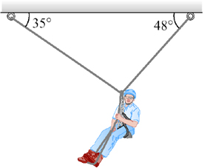
Necessity
Students are frequently asked to solve systems of equations in introductory physics courses
Rope tension problems, such as the figure to the left, are very popular
These types of problems require solving systems of equations

Slide 3
Importance of mathematical understanding
It is well established that many students are ill prepared for the math aspect of introductory physics courses
When students do not follow the math, the physics can be lost as well
It is important to ensure that students understand the mathematics that is going on behind the physics to gain a complete understanding

Slide 4
Three types of problems
Numeric
Symbolic
Trigonometric
$$3x=2y$$
$$5x+y=26$$
Easiest to solve for students
Not very likely to appear in a physics course
$$a∙x=b∙y$$
$$c∙x−a∙y=b$$
Very adaptable, values can be inserted later
Much more difficult for students to solve
$$x∙\cos\left(20°\right)=y∙cos(70°)$$
$$x∙\cos\left(70°\right)+y∙\cos\left(20°\right)=10$$
Actual problem that could arise from a rope tension problem
Also difficult for students to solve

Slide 5
Student success rates
All three of these questions were asked in a preinstruction diagnostic on the first recitation day of an algebra based, second semester physics course
123 students
Numeric
66-75% correct
Symbolic
21-23% correct
Trigonometric
30-35% correct

Slide 6
Interviews
To see in depth how students solved these problems, I interviewed 44 students
Primarily students from a second semester, calculus based physics course
Additional interviews are planned for students in algebra based courses

Slide 7
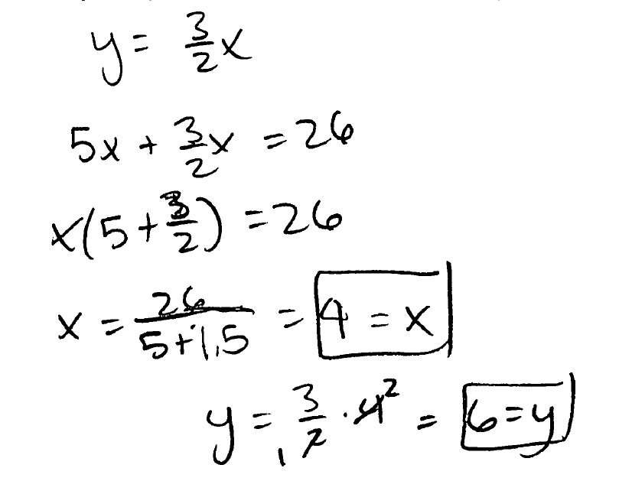
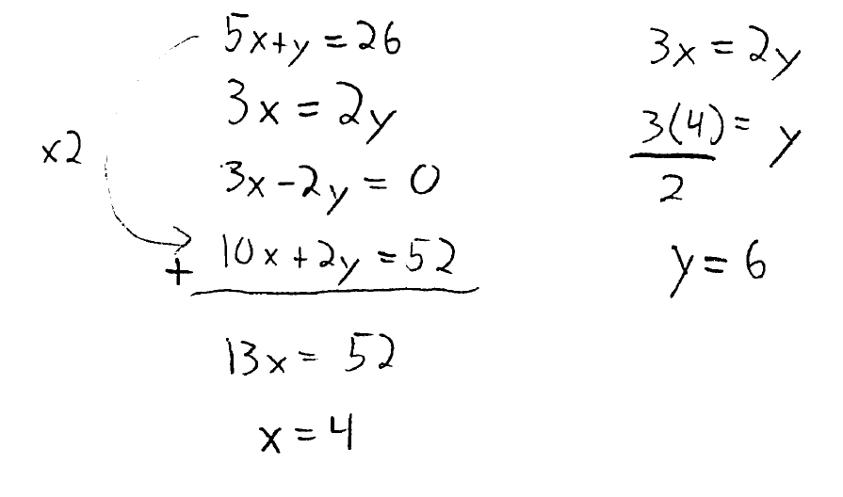
The main methods for solving systems of equations
Substitution
Elimination

Slide 8
Basic steps of each method
Substitution
Isolate
Substitute
Factor
Divide
Insert first value into initial equation to solve for second value

Slide 9
Basic steps of each method
Elimination
Arrange/multiply equations
Add equation/eliminate variable
Divide
Insert first value into initial equation to solve for second value

Slide 10
Student use rates in interviews (N=44)
Substitution
Elimination
79% overall
If students used substitution for the numeric problem, they always used substitution for the symbolic and trigonometric problems
17% overall
27% on numeric
13% on symbolic/trigonometric

Slide 11
Pros of both methods
Substitution
Elimination
Very adaptable
The exact same method can be used for any type of coefficients
Slightly, but not statistically significant, higher correct percentage in interviews
Works very well with numeric problems
Good for math class

Slide 12
Cons of both methods
Substitution
Elimination
Vulnerable to careless algebra errors
~20% of errors occurred during the factor step
Some preliminary evidence suggests that students sometimes become stuck at the factor step, and don’t think to pull out the variable
Vulnerable to careless algebra errors
~60% of errors occurred during the multiply equations step
Becomes much more difficult with symbolic, trigonometric problems
It is not always immediately clear how to multiply the equations to cancel a variable

Slide 13
Conclusions
For students struggling to understand problems that involve systems of equations, it may be that math that is getting in the way
Substitution seems to be the superior method
Useful with any coefficients
The basic steps can be followed easily, without any additional complications
A quick fix to help struggling students:
Four basic steps of substitution (isolate, substitute, factor, divide)
Careless algebra errors: go slow and check work

