Slide 1
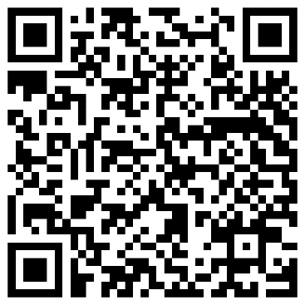
Realistic Assessment of Students’ Mathematical Preparation in Introductory Physics Courses
David E. Meltzer,¹ Dakota H. King,² and John D. Byrd^{1,3}
¹Arizona State University
²Arizona State University (present address) and
National Heart, Lung, and Blood Institute, National Institutes of Health
³Michigan State University (present address)
Supported in part by NSF DUE #1504986 and #1914712

Slide 2
Overview
We have given diagnostic pretests covering pre-college mathematics to over 7000 introductory physics students:
Results from five campuses at four different state universities were consistent
Results on an online version are consistent with those on the written version
High and low scores on the diagnostic are somewhat predictive of course grades

Slide 3
Examples of Test Items

Slide 4
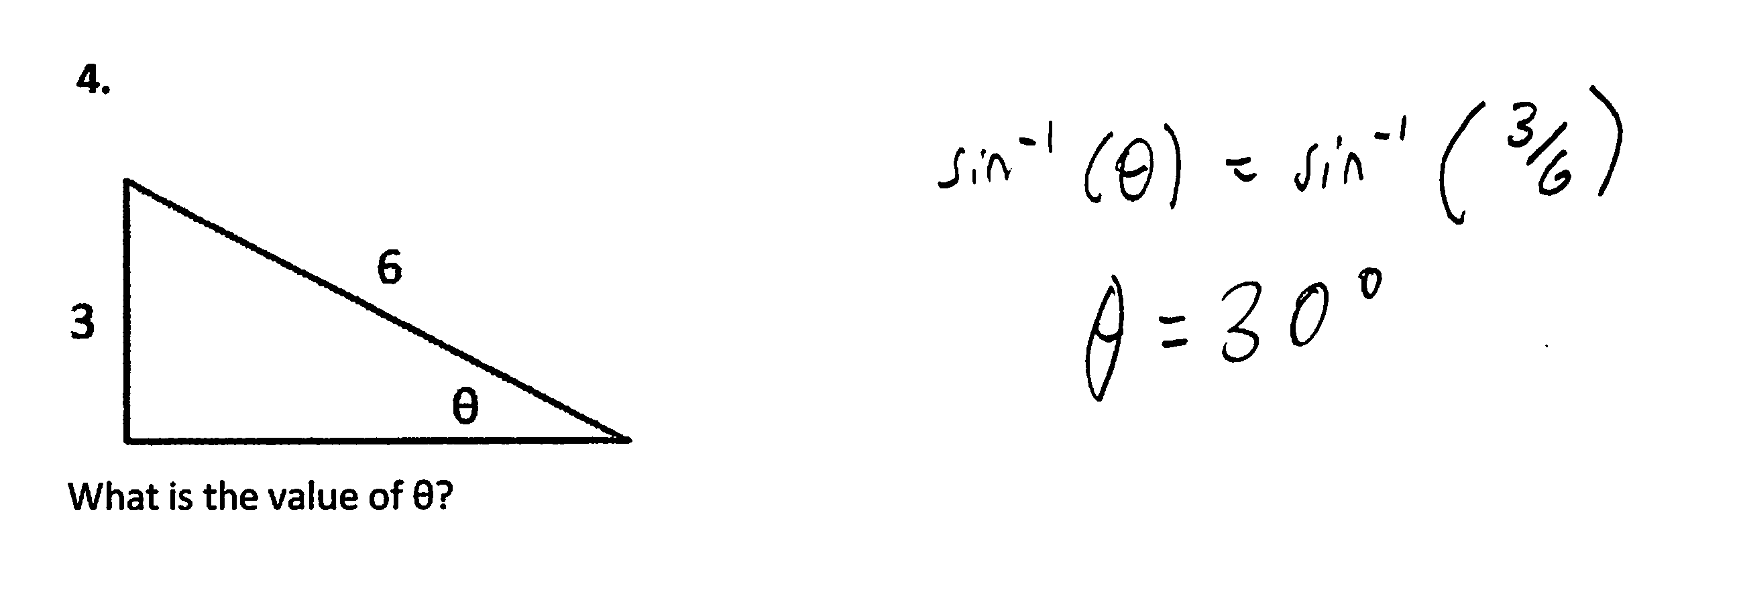
Find Unknown Angle
3.

Slide 5
Find Slope of Graph

Slide 6
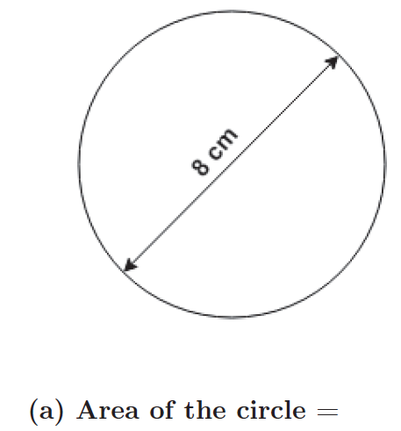
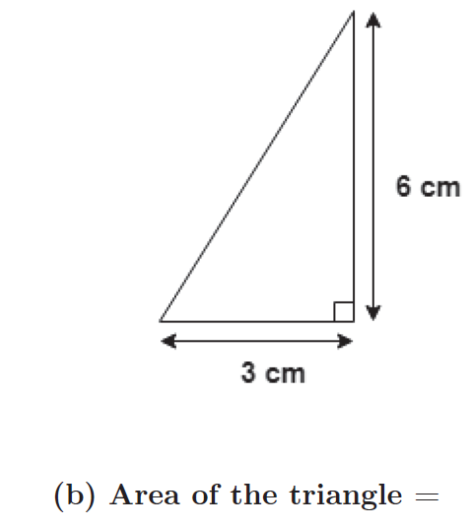
Find Area

Slide 7
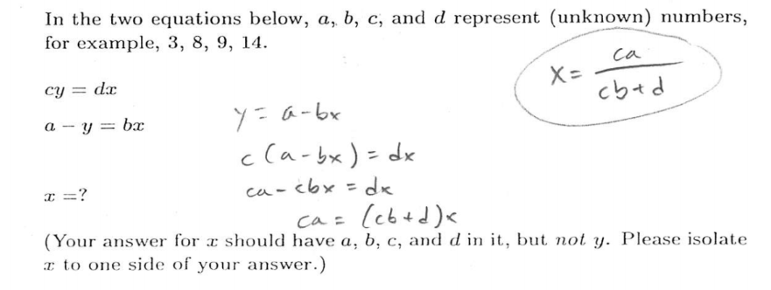
Simultaneous Equations, Symbolic Coefficients

Slide 8
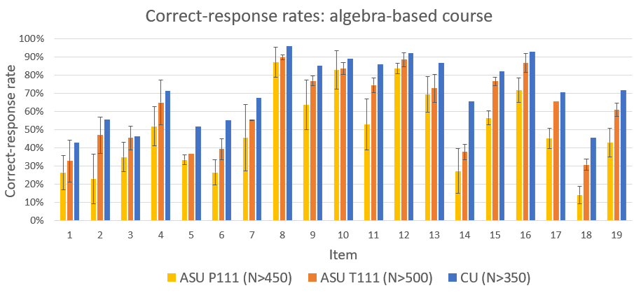
High consistency of results among five campuses at four different universities (three campuses shown below) suggests findings are generalizable

Slide 9
Students show weakness with units and graphing
Many students ignored graph-axis labels, and provided no or incorrect units for area and velocity.

Slide 10
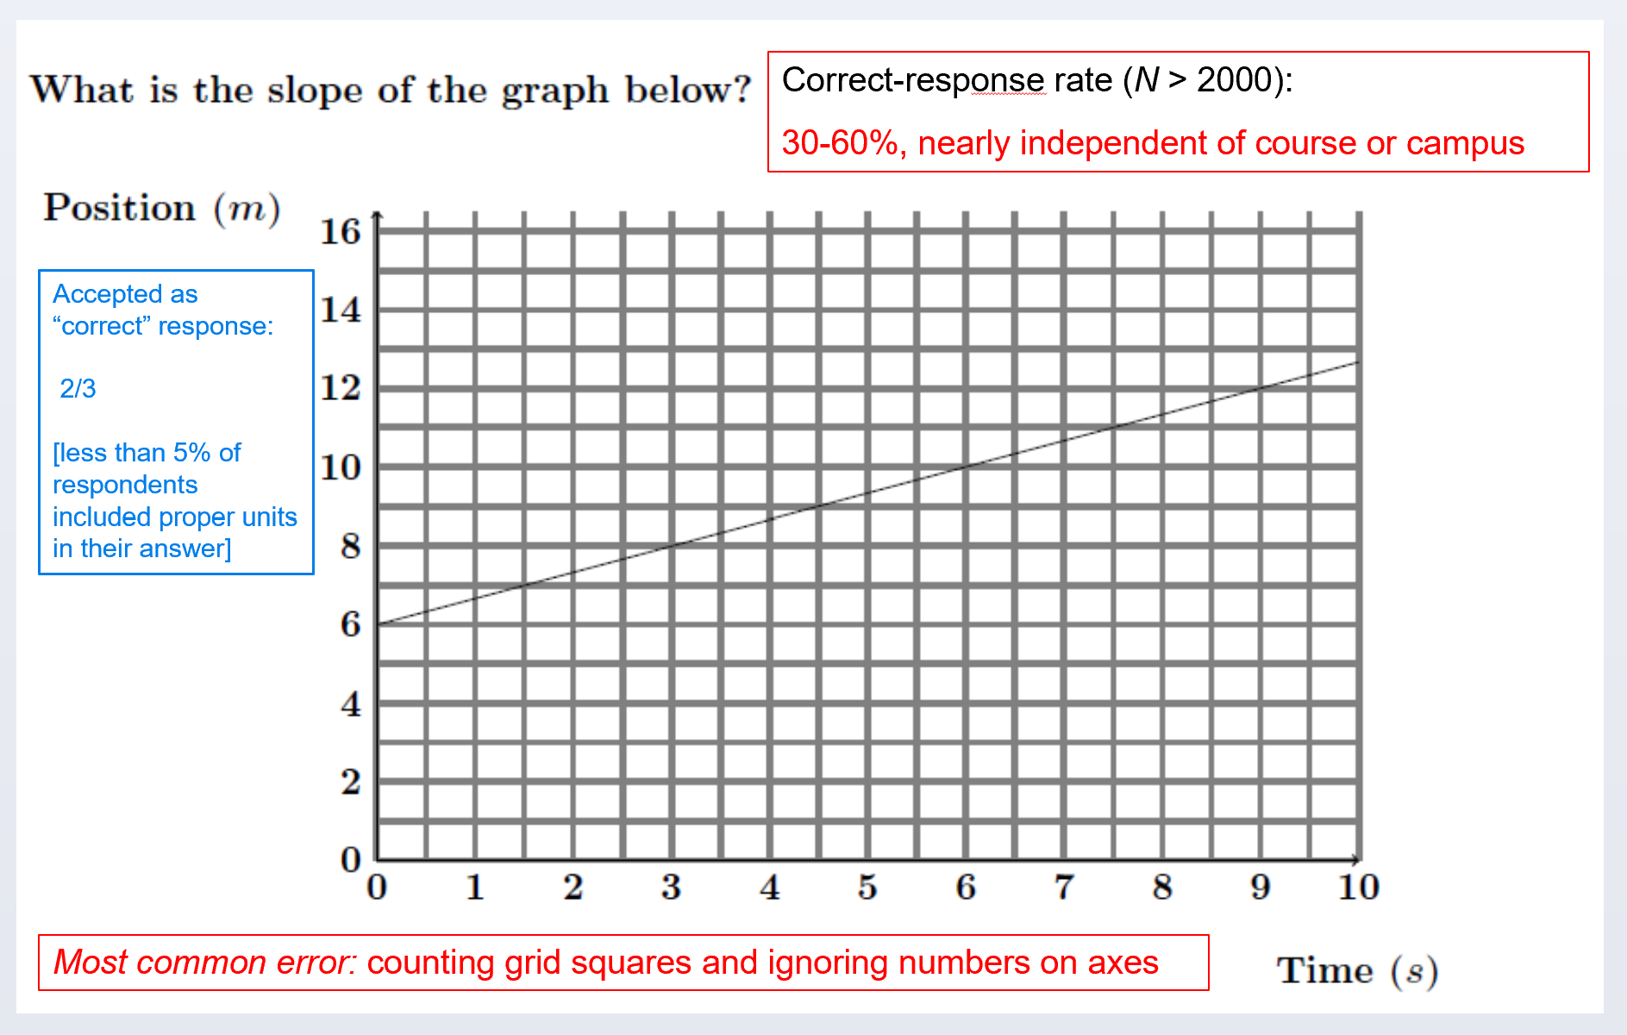

Slide 12
Most common error: Counting grid squares and ignoring numbers on axes

Slide 13
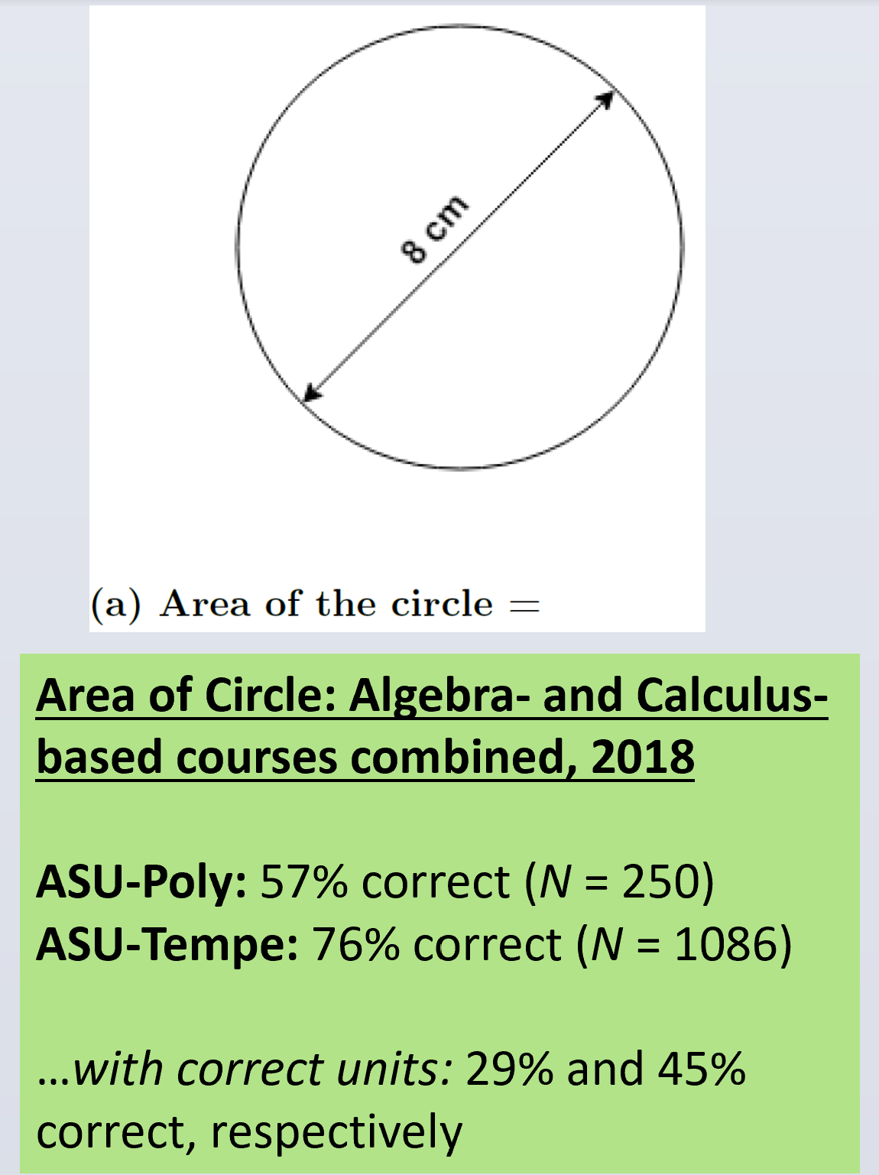

Slide 15
 | N | Numerically correct | Correct with correct units
ASU-Polytechnic | 250 | 57% | 29%
ASU-Tempe | 1086 | 76% | 45%

Slide 16
 | N | Numerically correct | Correct with correct units
ASU-Polytechnic | 250 | 57% | 29%
ASU-Tempe | 1086 | 76% | 45%

Slide 17
On-line Version

Slide 18
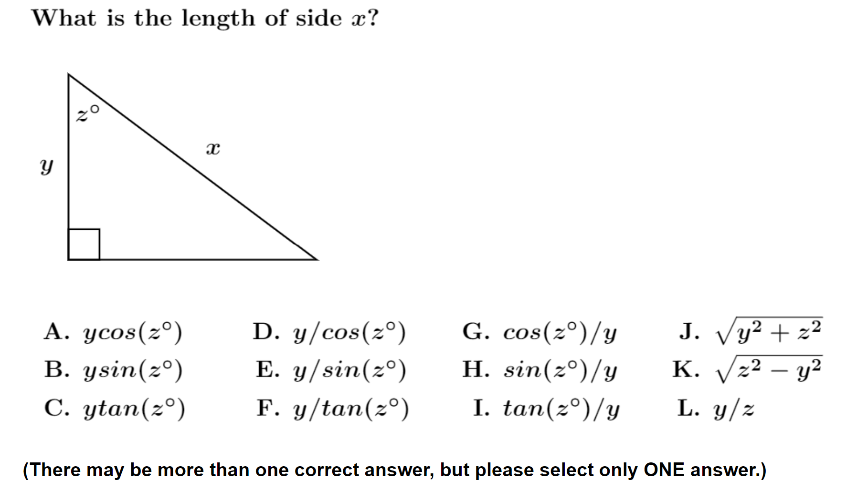
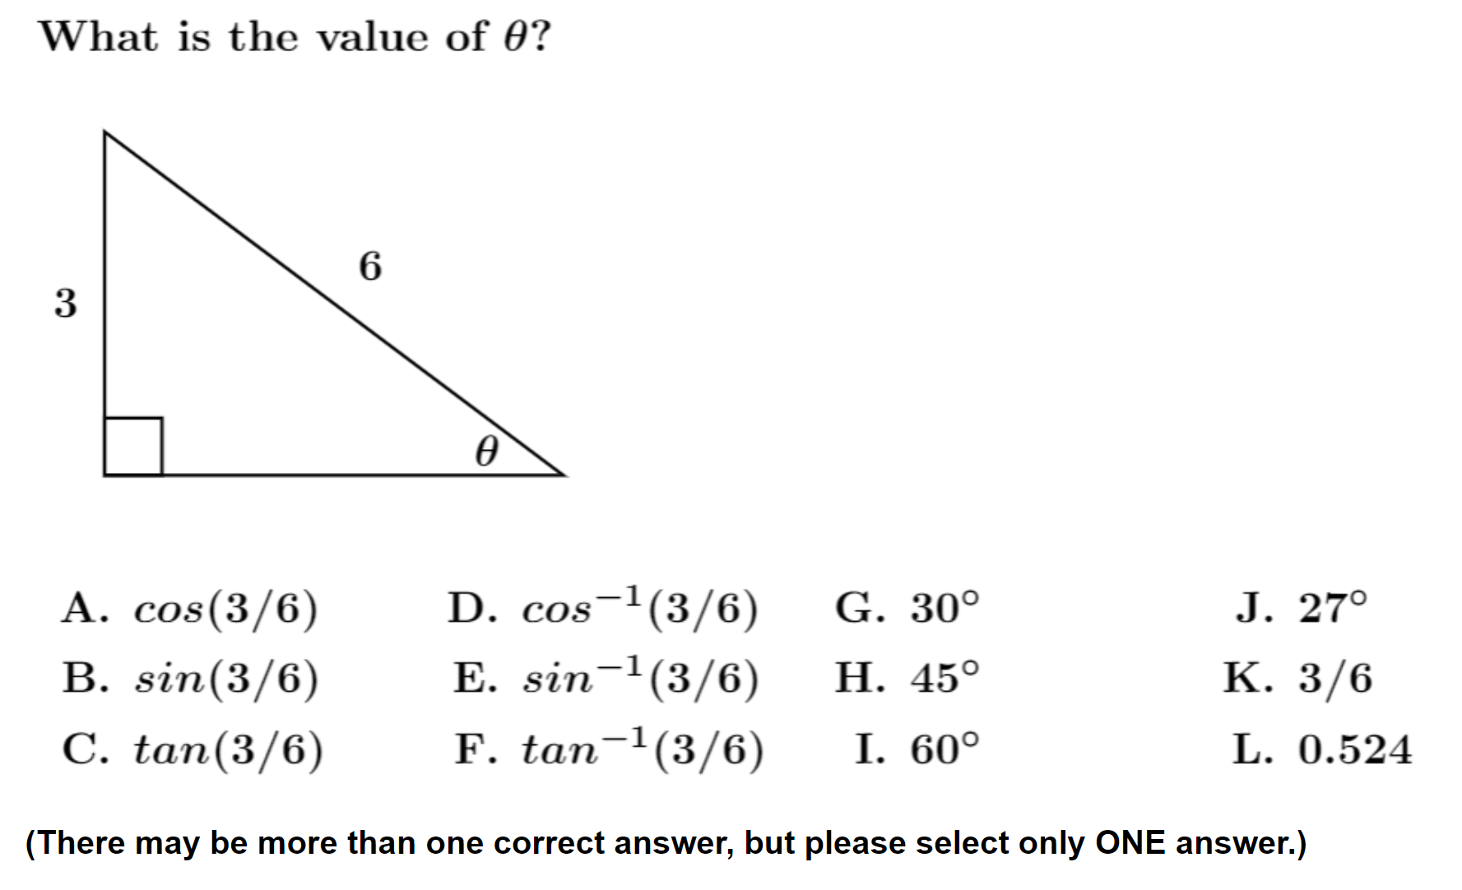
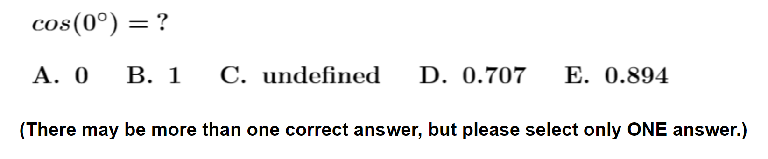
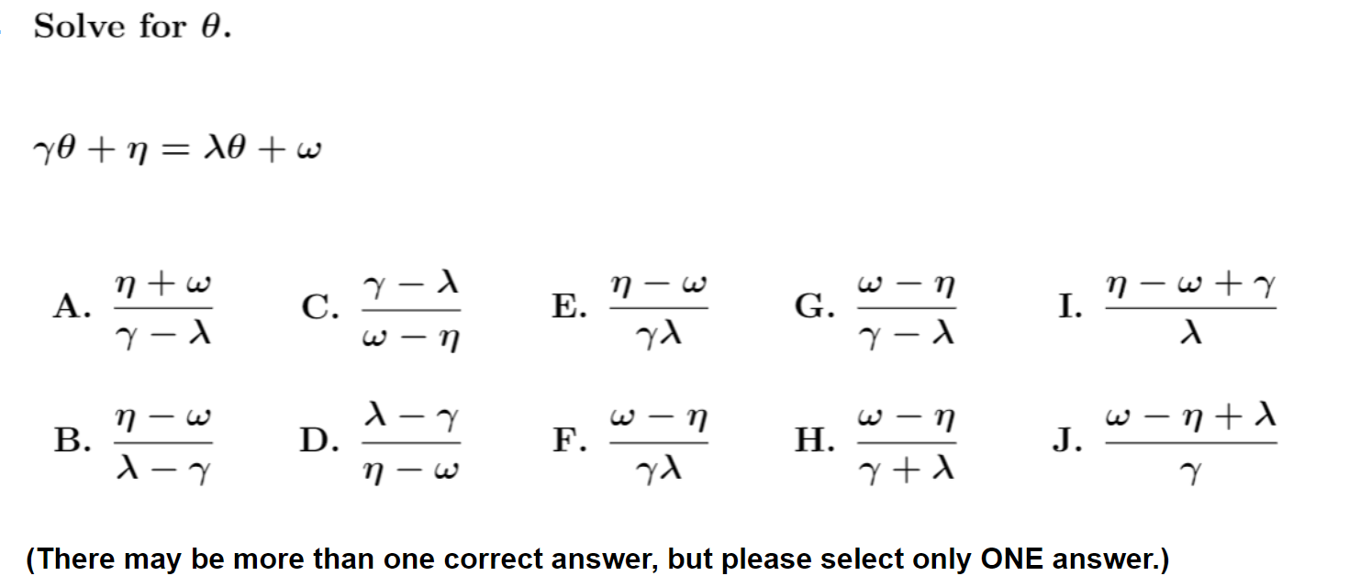
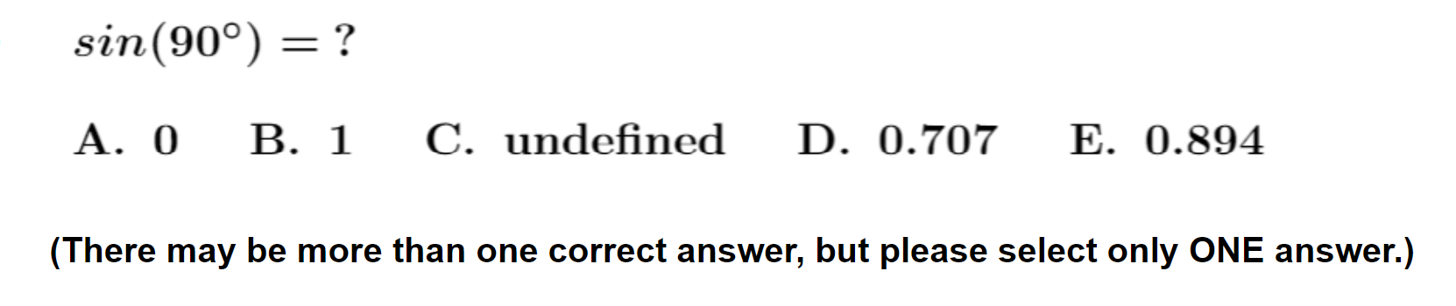
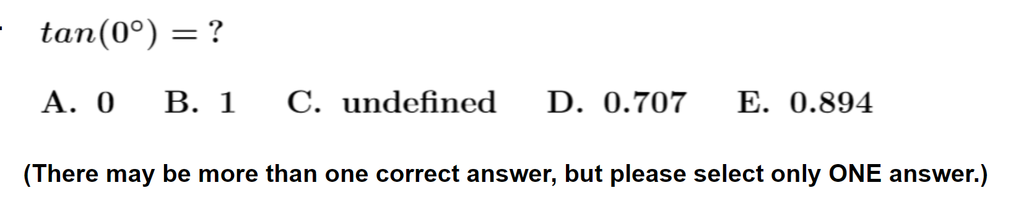

Slide 19
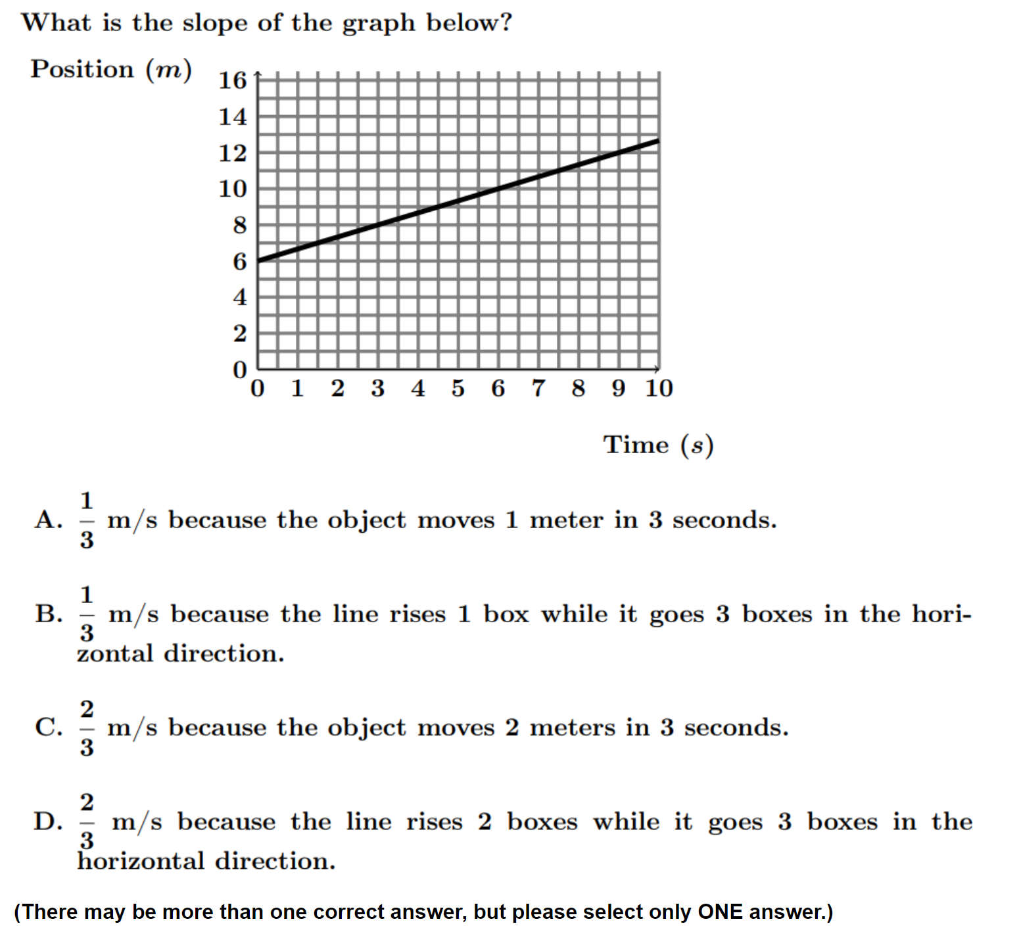
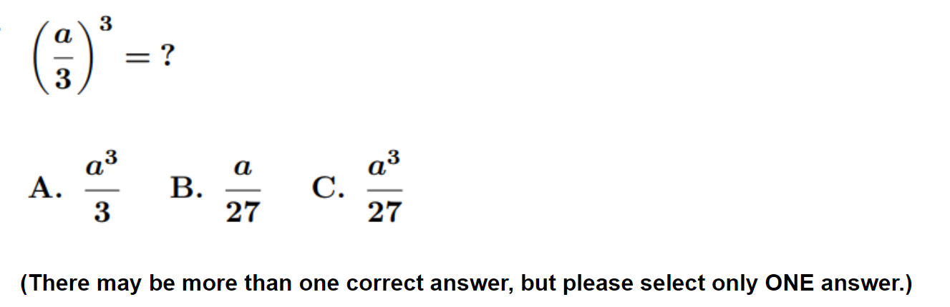
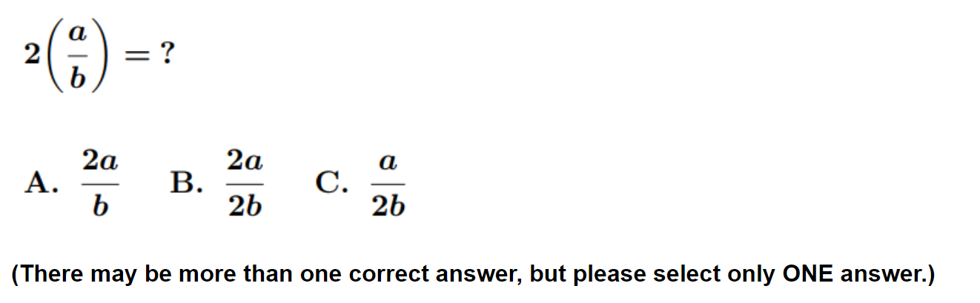
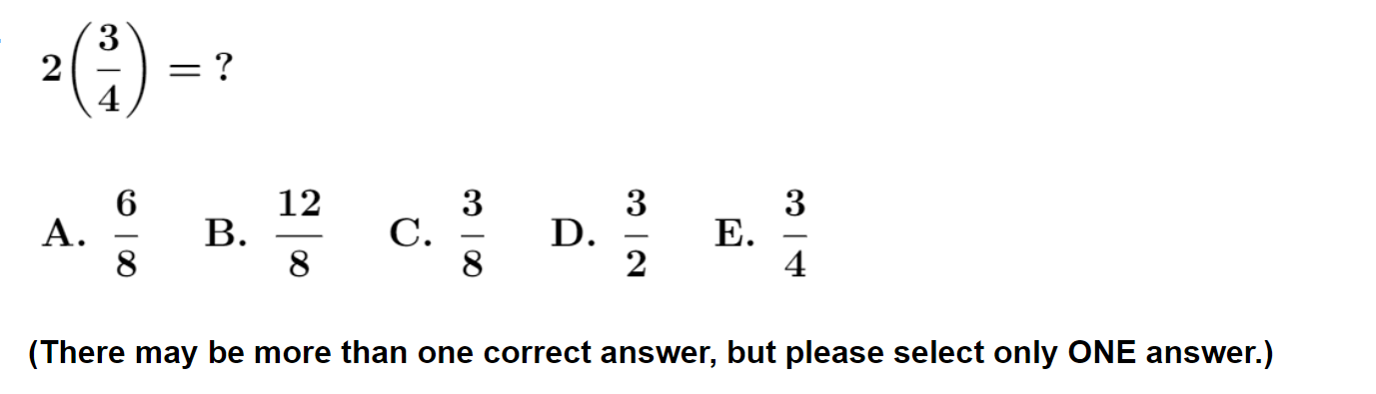
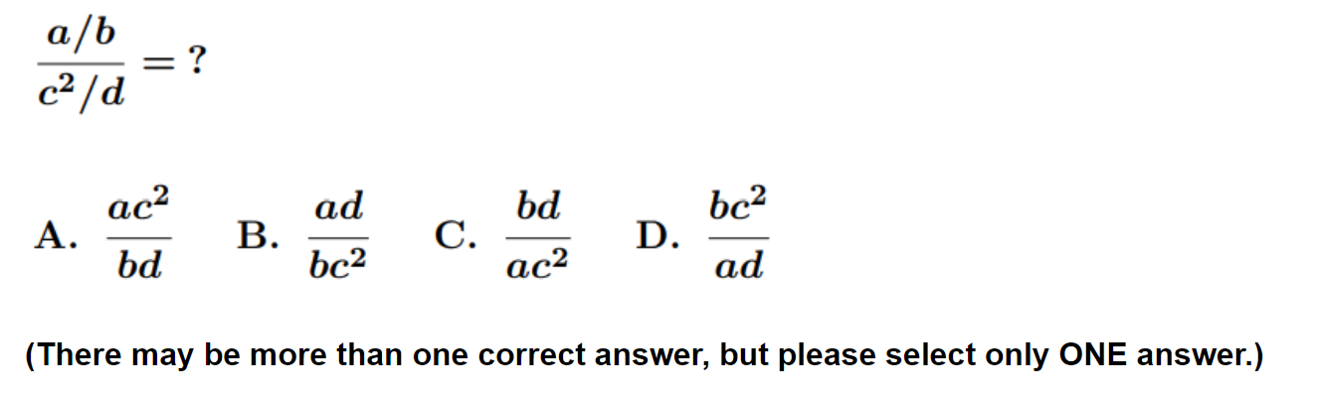

Slide 20
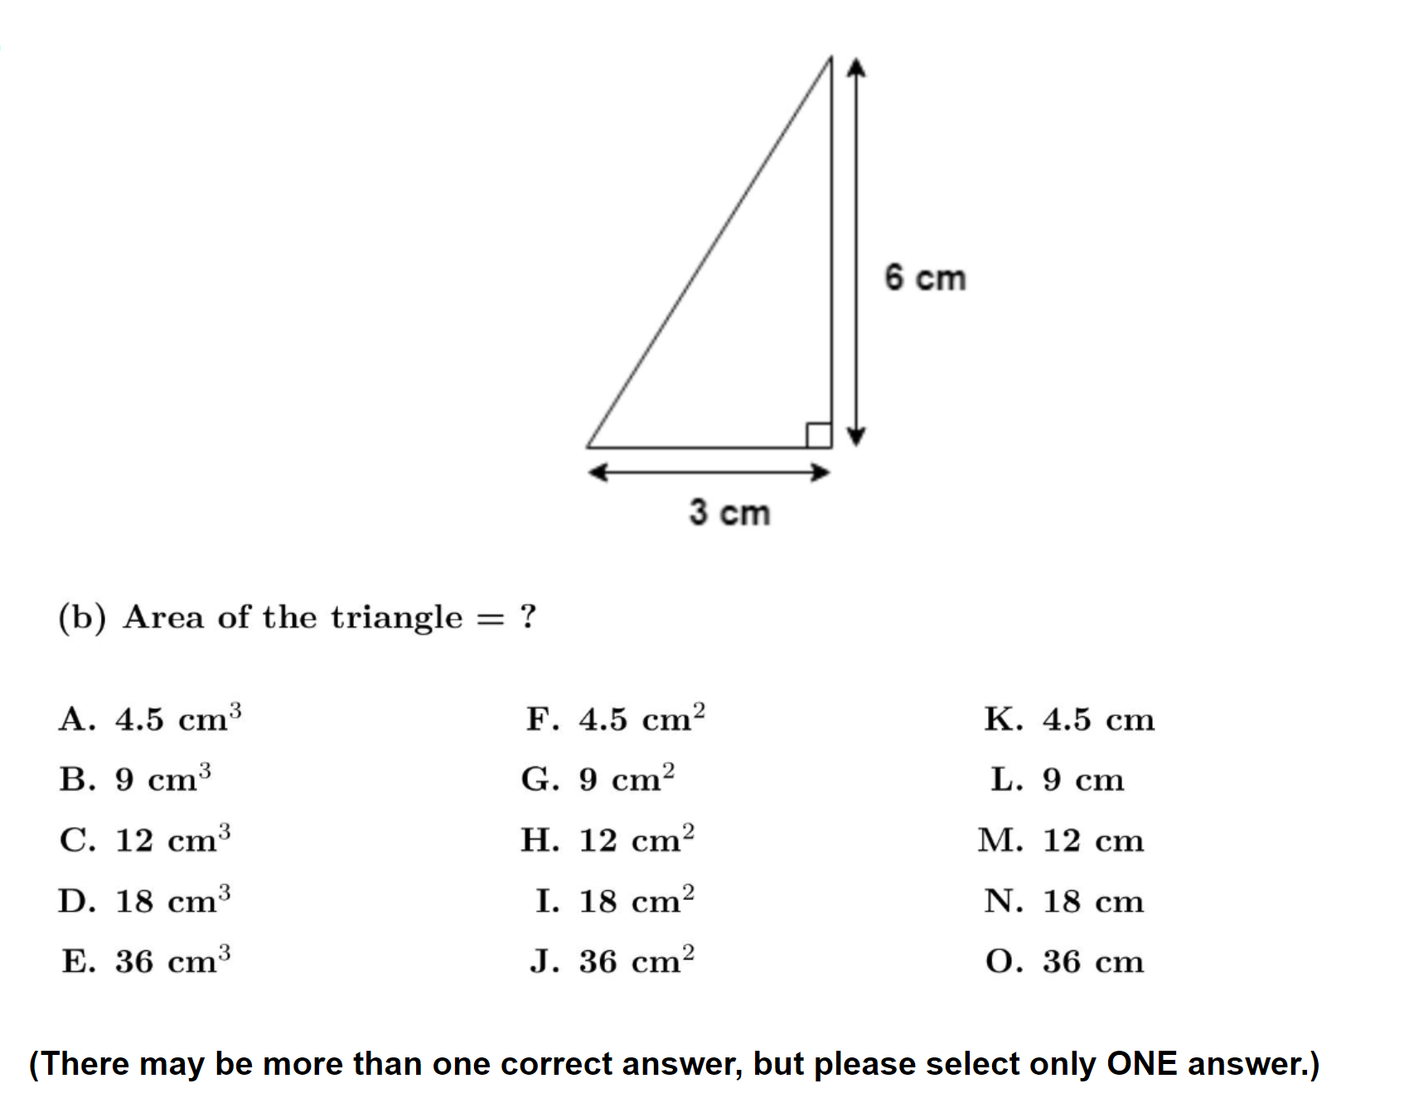
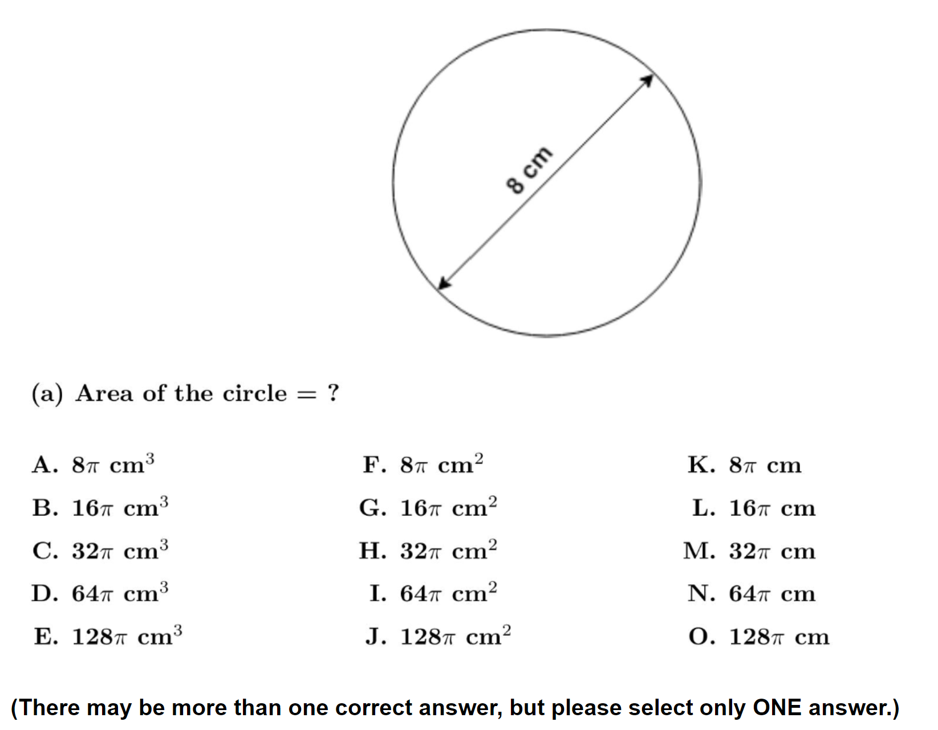
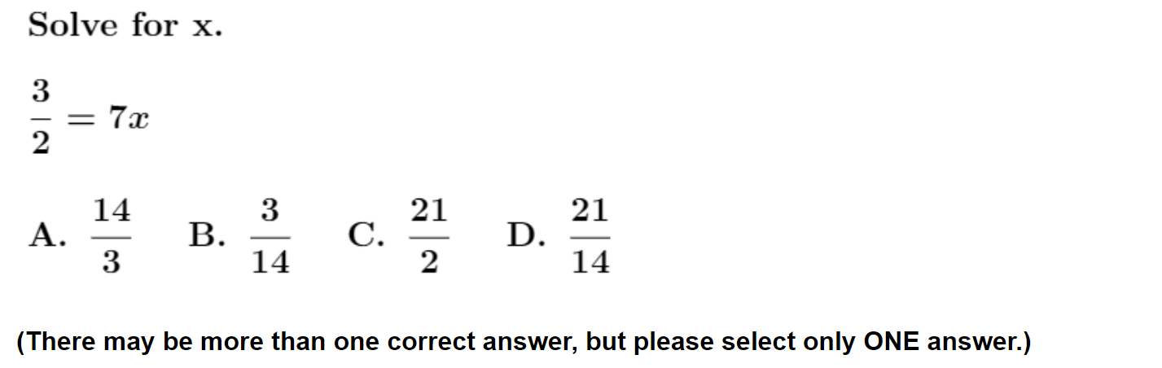
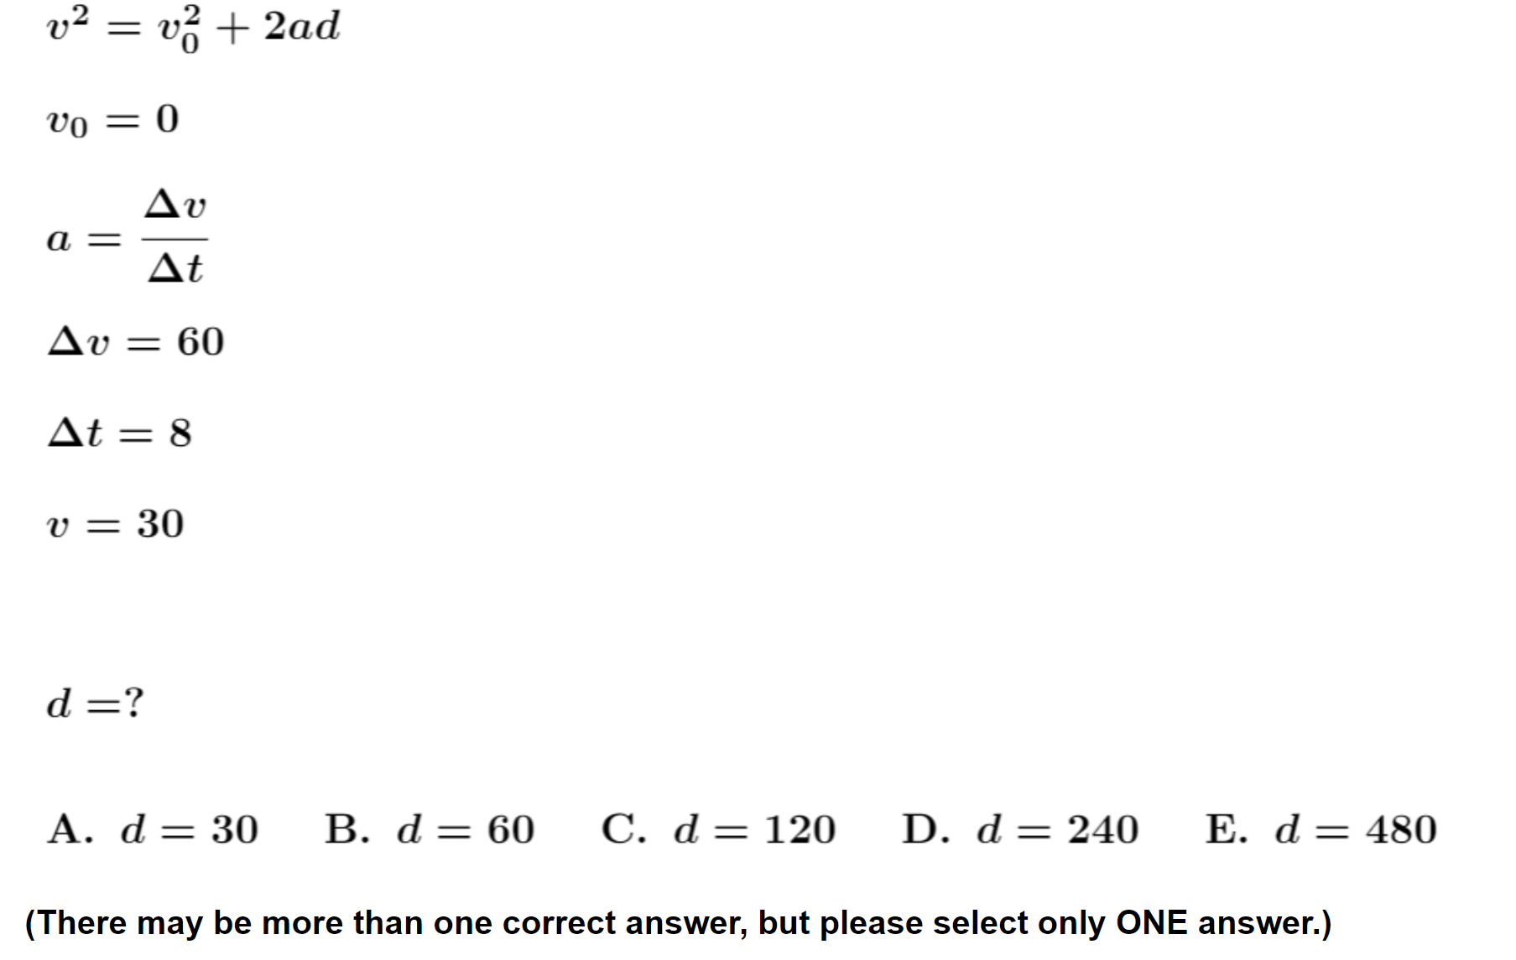
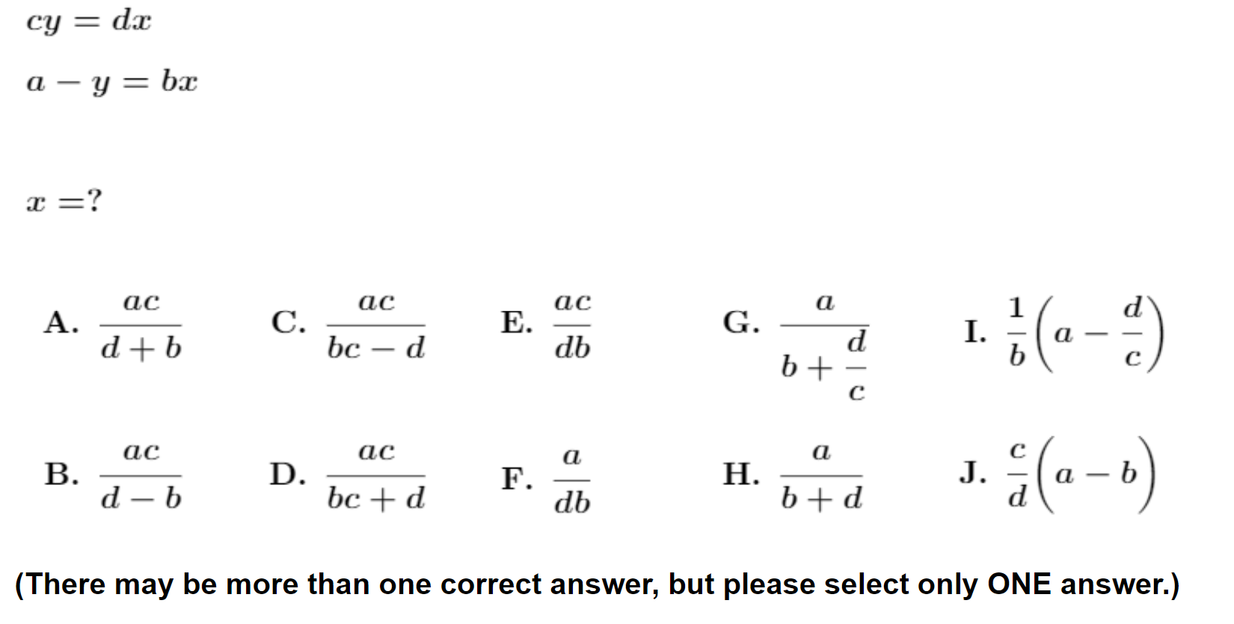

Slide 21

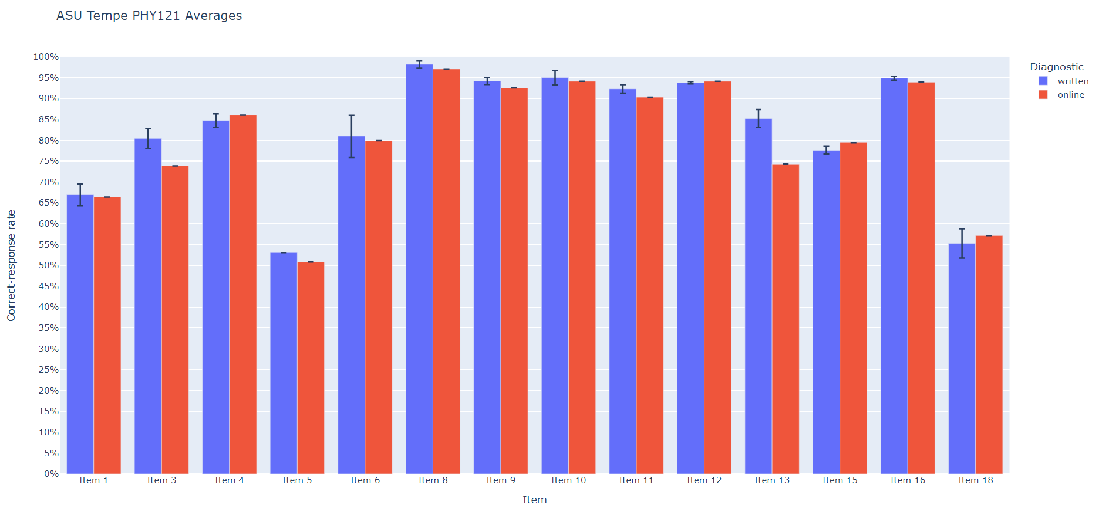
On-line and written versions yield consistent results
written online

Slide 22
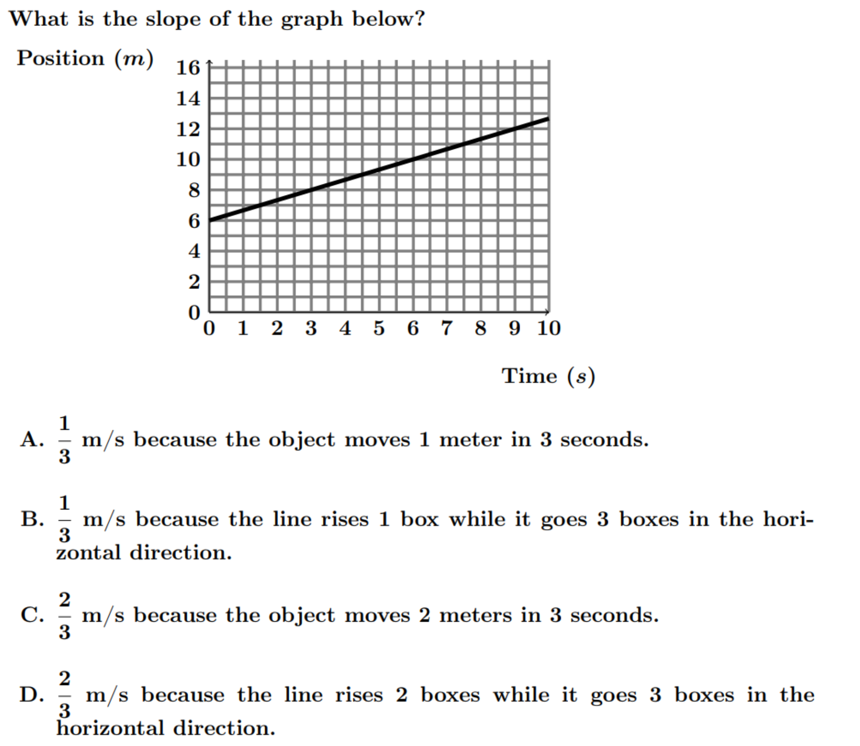
N = 2556
Numerically correct (C or D): 59%
Actually correct (C): 48%
Consistent with results on written version
Most common error: Counting grid squares and ignoring numbers on axes

Slide 23
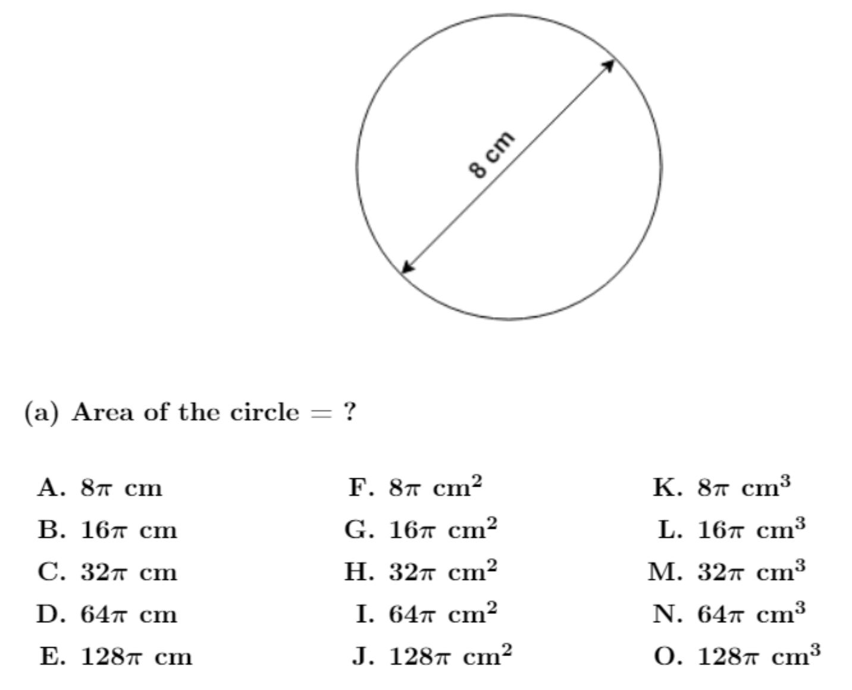
On-line Version:
20% did not choose cm²
(N = 1252)

Slide 24
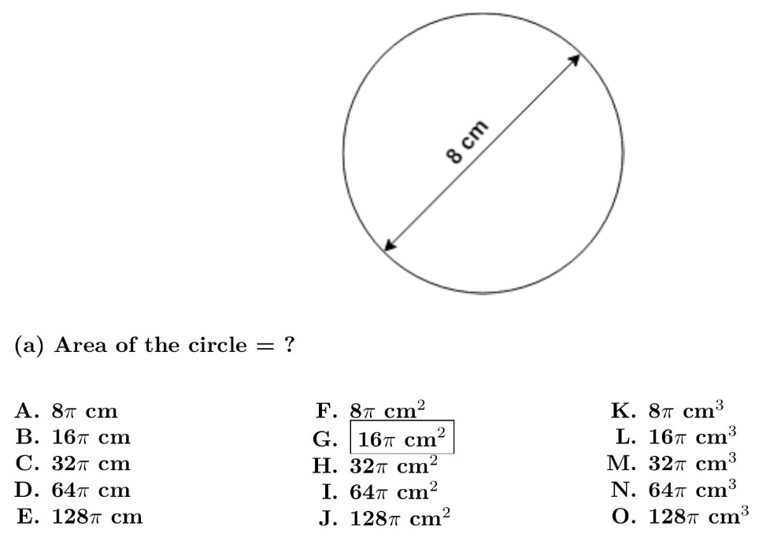
Calculus-based Course, ASU-Tempe (N = 430)
G: 68%
B: 10%
L: 2%
Other: 20%

Slide 25
Symbolic notation degrades student performance
Use of symbols to replace numbers in otherwise identical algebraic equations lowered correct-response rates by ≈25%.

Slide 26
Algebra: Simultaneous Equations (calculus-based course)
0.5y = 2x
78.4 − y = 8x
[Solve for x]
  Numeric Version 79% correct (N = 1043)
cy = dx
a − y = bx
[Solve for x]
  Symbolic Version 55% correct (N = 862)

Slide 27
Algebra: Simultaneous Equations (calculus-based course)
0.5y = 2x
78.4 − y = 8x
[Solve for x]
  Numeric Version 79% correct (N = 1043)
cy = dx
a − y = bx
[Solve for x]
  Symbolic Version 55% correct (N = 862)

Slide 28
Findings from >70 Interviews:
Students make many “careless” errors
During interviews, students tended to self-correct approximately 60% of their initial errors, suggesting many errors are “careless.”

Slide 29
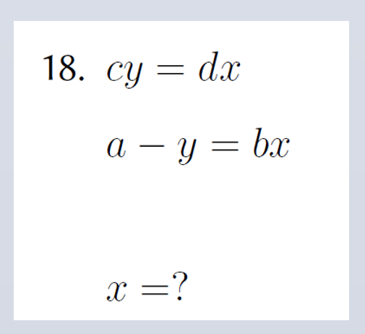
Even single test items are highly predictive
Performance on one single diagnostic item can accurately predict class-average score on full 13-item diagnostic
Example:
  [#18]

Slide 30
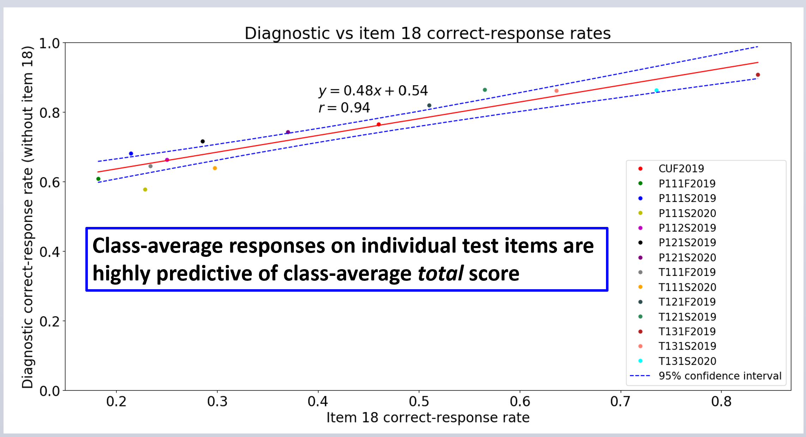

Slide 31
New data, 2021

Slide 32
  Implication: It may be possible to diagnose the level of students’ difficulties with only one or very few mathematics pretest items.

Slide 33
Scores on 3-item Subset:
Relation to High Course Grades
Can performance on a 3-item subset predict final course grade?
Example:
  [#3, #11, #12]

Slide 34
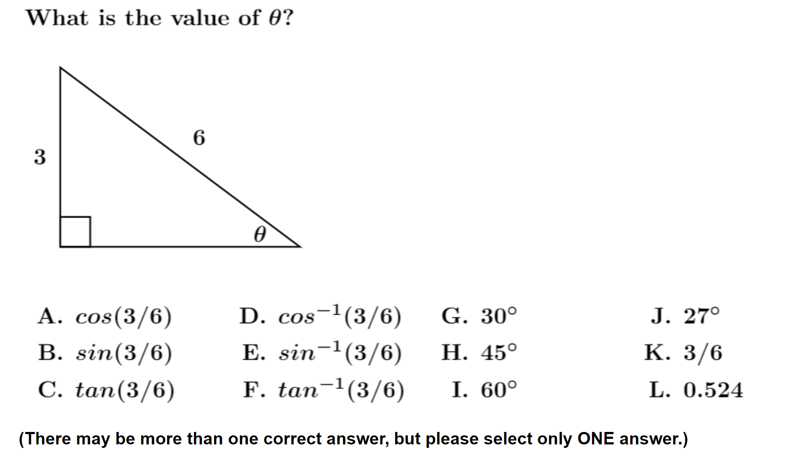
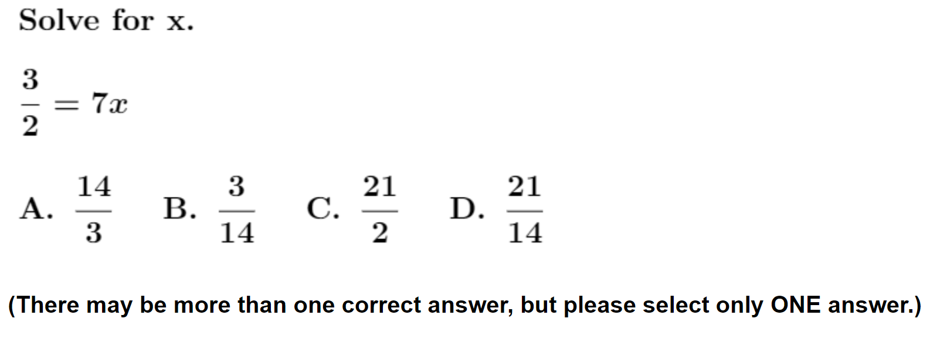
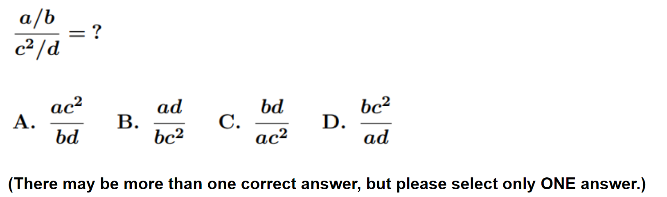
#3
#12
#11

Slide 35
High Course Grade vs. Subset Score
Course | Campus | N | % grade ≥ B+ overall | % grade ≥ B+ 3/3 | % grade ≥ B+ 0/3 or 1/3 | High-grade Ratio 3/3 score vs. 0/3 or 1/3 score
Alg-1 | ASU-P | 78 | 49% | 65% | 35% | 1.9
Alg-2 | ASU-P | 72 | 44% | 54% | 30% | 1.8
Alg-2 | ASU-T | 129 | 74% | 75% | 68% | 1.1
*Calc-1 | UWF | 103 | 32% | 54% | 4% | 12.2
Calc-2 | UWF | 59 | 58% | 70% | 56% | 1.3
*subset optimized for this course
Alg-1: Algebra-based course, first semester
Alg-2: Algebra-based course, second semester
Calc-1: Calculus-based course, first semester
Calc-2: Calculus-based course, second semester
ASU-P: Arizona State University, Polytechnic campus
ASU-T: Arizona State University, Tempe campus
UWF: University of West Florida

Slide 36
High Course Grade vs. Subset Score
Course | Campus | N | % grade ≥ B+ overall | % grade ≥ B+ 3/3 | % grade ≥ B+ 0/3 or 1/3 | High-grade Ratio 3/3 score vs. 0/3 or 1/3 score
Alg-1 | ASU-P | 78 | 49% | 68% | 37% | 1.8
Alg-2 | ASU-P | 72 | 44% | 54% | 30% | 1.8
Alg-2 | ASU-T | 129 | 74% | 75% | 68% | 1.1
*Calc-1 | UWF | 103 | 32% | 54% | 4% | 12.2
Calc-2 | UWF | 59 | 58% | 70% | 56% | 1.3
*subset optimized for this course
Alg-1: Algebra-based course, first semester
Alg-2: Algebra-based course, second semester
Calc-1: Calculus-based course, first semester
Calc-2: Calculus-based course, second semester
ASU-P: Arizona State University, Polytechnic campus
ASU-T: Arizona State University, Tempe campus
UWF: University of West Florida

Slide 37
High Course Grade vs. Subset Score
Course | Campus | N | % grade ≥ B+ overall | % grade ≥ B+ 3/3 | % grade ≥ B+ 0/3 or 1/3 | High-grade Ratio 3/3 score vs. 0/3 or 1/3 score
Alg-1 | ASU-P | 78 | 49% | 68% | 37% | 1.8
Alg-2 | ASU-P | 72 | 44% | 54% | 30% | 1.8
Alg-2 | ASU-T | 129 | 74% | 75% | 68% | 1.1
*Calc-1 | UWF | 103 | 32% | 53% | 4% | 13.3
Calc-2 | UWF | 59 | 58% | 70% | 56% | 1.3
*subset optimized for this course
Alg-1: Algebra-based course, first semester
Alg-2: Algebra-based course, second semester
Calc-1: Calculus-based course, first semester
Calc-2: Calculus-based course, second semester
ASU-P: Arizona State University, Polytechnic campus
ASU-T: Arizona State University, Tempe campus
UWF: University of West Florida

Slide 38
Relation Between Scores and Grades
Performance on full online diagnostic can approximately predict final course grade

Slide 39
High Course Grade vs. Full Diagnostic Score
Course | Campus | N | % grade ≥ A- overall | % grade ≥ A- score ≥ 81% | % grade ≥ A- score ≤ 57% | High-grade Ratio score ≥ 81% vs. score ≤ 57%
Alg-1 | ASU-P | 78 | 35% | 63% | 15% | 4.2
Alg-2 | ASU-P | 72 | 39% | 64% | 25% | 2.6
Alg-2 | ASU-T | 129 | 60% | 65% | 53% | 1.2
Calc-1 | UWF | 103 | 22% | 39% | 0% | ∞
Calc-2 | UWF | 59 | 49% | 60% | 25% | 2.4
Alg-1: Algebra-based course, first semester
Alg-2: Algebra-based course, second semester
Calc-1: Calculus-based course, first semester
Calc-2: Calculus-based course, second semester
ASU-P: Arizona State University, Polytechnic campus
ASU-T: Arizona State University, Tempe campus
UWF: University of West Florida

Slide 40
High Course Grade vs. Full Diagnostic Score
Course | Campus | N | % grade ≥ A- overall | % grade ≥ A- score ≥ 81% | % grade ≥ A- score ≤ 57% | High-grade Ratio score ≥ 81% vs. score ≤ 57%
Alg-1 | ASU-P | 78 | 35% | 63% | 15% | 4.2
Alg-2 | ASU-P | 72 | 39% | 64% | 25% | 2.6
Alg-2 | ASU-T | 129 | 60% | 67% | 55% | 1.2
Calc-1 | UWF | 103 | 22% | 40% | 0% | “∞”
Calc-2 | UWF | 59 | 49% | 61% | 38% | 1.6
Alg-1: Algebra-based course, first semester
Alg-2: Algebra-based course, second semester
Calc-1: Calculus-based course, first semester
Calc-2: Calculus-based course, second semester
ASU-P: Arizona State University, Polytechnic campus
ASU-T: Arizona State University, Tempe campus
UWF: University of West Florida
Students who scored high on math diagnostic pretest had more “A” course grades than those who scored low

Slide 41
Low Course Grade vs. Full Diagnostic Score
Course | Campus | N | % grade ≤ B- overall | % grade ≤ B- score ≥ 81% | % grade ≤ B- score ≤ 57% | Low-grade Ratio score ≤ 57% vs. score ≥ 81%
Alg-1 | ASU-P | 82 | 25% | 19% | 38% | 2.1
Alg-2 | ASU-P | 72 | 33% | 14% | 32% | 2.3
Alg-1: Algebra-based course, first semester
Alg-2: Algebra-based course, second semester
Calc-1: Calculus-based course, first semester
Calc-2: Calculus-based course, second semester
ASU-P: Arizona State University, Polytechnic campus
ASU-T: Arizona State University, Tempe campus
UWF: University of West Florida
Students who scored low on math diagnostic pretest had more “C” course grades than those who scored high

Slide 42
Low Course Grade vs. Full Diagnostic Score
Course | Campus | N | % grade ≤ B- overall | % grade ≤ B- score ≥ 81% | % grade ≤ B- score ≤ 57% | Low-grade Ratio score ≤ 57% vs. score ≥ 81%
Alg-1 | ASU-P | 78 | 25% | 19% | 38% | 2.1
Alg-2 | ASU-P | 72 | 33% | 14% | 32% | 2.3
Alg-1: Algebra-based course, first semester
Alg-2: Algebra-based course, second semester
Calc-1: Calculus-based course, first semester
Calc-2: Calculus-based course, second semester
ASU-P: Arizona State University, Polytechnic campus
ASU-T: Arizona State University, Tempe campus
UWF: University of West Florida
Students who scored low on math diagnostic pretest had more “C” course grades than those who scored high

Slide 43
Low Course Grade vs. Full Diagnostic Score
Course | Campus | N | % grade ≤ B- overall | % grade ≤ B- score ≥ 81% | % grade ≤ B- score ≤ 57% | Low-grade Ratio score ≤ 57% vs. score ≥ 81%
Alg-1 | ASU-P | 78 | 25% | 19% | 38% | 2.1
Alg-2 | ASU-P | 72 | 33% | 14% | 32% | 2.3
Alg-1: Algebra-based course, first semester
Alg-2: Algebra-based course, second semester
Calc-1: Calculus-based course, first semester
Calc-2: Calculus-based course, second semester
ASU-P: Arizona State University, Polytechnic campus
ASU-T: Arizona State University, Tempe campus
UWF: University of West Florida
Students who scored low on math diagnostic pretest had more “C” course grades than those who scored high

Slide 44
Low Course Grade vs. Full Diagnostic Score
Course | Campus | N | % grade ≤ B- overall | % grade ≤ B- score ≥ 81% | % grade ≤ B- score ≤ 57% | Low-grade Ratio score ≤ 57% vs. score ≥ 81%
Alg-1 | ASU-P | 78 | 25% | 19% | 38% | 2.1
Alg-2 | ASU-P | 72 | 33% | 14% | 32% | 2.3
Alg-1: Algebra-based course, first semester
Alg-2: Algebra-based course, second semester
Calc-1: Calculus-based course, first semester
Calc-2: Calculus-based course, second semester
ASU-P: Arizona State University, Polytechnic campus
ASU-T: Arizona State University, Tempe campus
UWF: University of West Florida
Students who scored low on math diagnostic pretest had more “C” course grades than those who scored high

Slide 45
Summary
Instructors should be wary of assumptions about students’ mathematics preparation before making assessments
Pre-instruction performance on a brief mathematics diagnostic may provide indications of students at risk

