Slide 1
Exploring the Factors Underlying Physics Students' Mathematical Difficulties
David E. Meltzer and Matthew I. Jones
Arizona State University
Supported in part by NSF DUE #1504986

Slide 2
The Problem
Difficulties with basic math skills impact performance of introductory physics students
The difficulties were evidently not resolved by students’ previous mathematical training
Students can’t effectively grapple with physics ideas when they feel overburdened in dealing with calculational issues

Slide 3
Our Approach
Assess nature and scope of difficulties using written diagnostic instruments and one-on-one oral interviews
Address students’ mathematical difficulties within the context of physics classes themselves, using in-class and out-of-class instructional materials

Slide 4
Work to Date
Administer written diagnostic to 1300 students in 14 algebra- and calculus-based physics classes over three semesters at Arizona State University during 2016-2017
Carry out individual interviews with 56 students enrolled in those or similar courses during same period

Slide 5
Written Diagnostic
Questions involving trigonometry, vectors, and algebra; calculators allowed
Administered as no-credit quiz during first week labs and/or recitation sections in four courses (first- and second-semester algebra- and calculus-based introductory physics), at two different campuses of ASU
Total number of courses: 14; total N > 1300

Slide 6
Trigonometry Questions with sample student responses

Slide 8
3.

Slide 9
Factors Affecting Results
Differences in results observed between:
Spring- and fall-semester offerings of same course
Offerings of same course on different campuses (Polytechnic campus in Mesa, main campus in Tempe)
Different type of courses (algebra- and calculus-based) and different semesters of same course (first-semester and second-semester)
Multiple-choice and non-multiple-choice versions of same questions

Slide 10
Trigonometry Questions: Spring/Fall Semester Difference
Error Rate (% incorrect responses)
Algebra-based course, first semester; #1-3 combined:
ASU Polytechnic campus, Spring (N = 72): 67%
ASU Polytechnic campus, Fall (N = 44): 58%
Algebra-based course, second semester; #1-3 combined:
ASU Polytechnic campus, Spring (N = 52): 59%
ASU Polytechnic campus, Fall (N = 27): 44%
Calculus-based course, first semester; #1 only:
ASU Polytechnic campus, Spring (N = 104): 40%
ASU Polytechnic campus, Fall (N = 98): 56%

Slide 11
Trigonometry Questions: Spring/Fall Semester Difference
Error Rate (% incorrect responses)
Algebra-based course, first semester; #1-3 combined:
ASU Polytechnic campus, Spring (N = 72): 67%
ASU Polytechnic campus, Fall (N = 44): 58%
Algebra-based course, second semester; #1-3 combined:
ASU Polytechnic campus, Spring (N = 52): 59%
ASU Polytechnic campus, Fall (N = 27): 44%
Calculus-based course, first semester; #1 only:
ASU Polytechnic campus, Spring (N = 104): 40%
ASU Polytechnic campus, Fall (N = 98): 56%

Slide 12
Trigonometry Questions: Polytechnic/Tempe Campus Difference
Error Rate (% incorrect responses)
Algebra-based course, second semester; #1-3 combined:
ASU Polytechnic campus, Spring (N = 52): 59%
ASU Tempe campus, Spring (N = 61): 35%

Slide 13
Trigonometry Questions: Course Difference
Error Rate (% incorrect responses), #1 only
ASU Polytechnic campus, Spring + Fall average:
Algebra-based course, 1st semester, (N = 166): 59%
Algebra-based course, 2nd semester, (N = 106): 53%
Calculus-based course, 1st semester, (N = 202): 48%

Slide 14
Trigonometry Questions: Multiple-Choice vs. Non-Multiple-Choice (Higher Error Rate on Non-Multiple-Choice [Non-MC])
Error Rate Difference (% incorrect responses), Non-MC−MC
Course #1, Problem #2: +15
Course #1, Problem #3: +18
Course #2, Problem #2: +9
Course #2, Problem #3: +9
Course #3, Problem #2: +5
Course #3, Problem #3: +34
Course #4, Problem #2: +10
Course #4, Problem #3: +5

Slide 15
Algebra: Simultaneous Equations
Error Rate (% incorrect responses)
Algebra-based course, second semester (N = 123): 30%

Slide 16
Algebra: Simultaneous Equations
Error Rate (% incorrect responses)
Algebra-based course, second semester (N = 52): 69%

Slide 17
Algebra: Simultaneous Equations
Error Rate (% incorrect responses)
Algebra-based course, second semester (N = 52): 69%

Slide 18
Algebra: Simultaneous Equations
Error Rate (% incorrect responses)
Algebra-based course, second semester (N =150): 70-80%
(different campuses, slightly different versions)

Slide 19
Algebra: Simultaneous Equations

Slide 20
Algebra: Simultaneous Equations

Slide 21
Algebra: Simultaneous Equations

Slide 22
Algebra: Simultaneous Equations
Error Rate (% incorrect responses)
Algebra-based course, second semester (N =150): 80-90%
(different campuses, slightly different versions)

Slide 23
Sources of Difficulties
Carelessness
Students very frequently self-correct errors during interviews
Evidence of carelessness on written diagnostic
Skill practice deficit: Insufficient repetitive practice with learned skills
E.g., applying definitions of sine and cosine
Conceptual confusion
E.g., not realizing that sides and angles of right triangle are related by trigonometric functions

Slide 24
Example of Carelessness? (Algebra-based Course, 2nd semester)
Error Rate, Multiple-Choice Version (N = 62): 73% Error Rate, Non-Multiple-Choice Version (N = 61): 64%

Slide 25
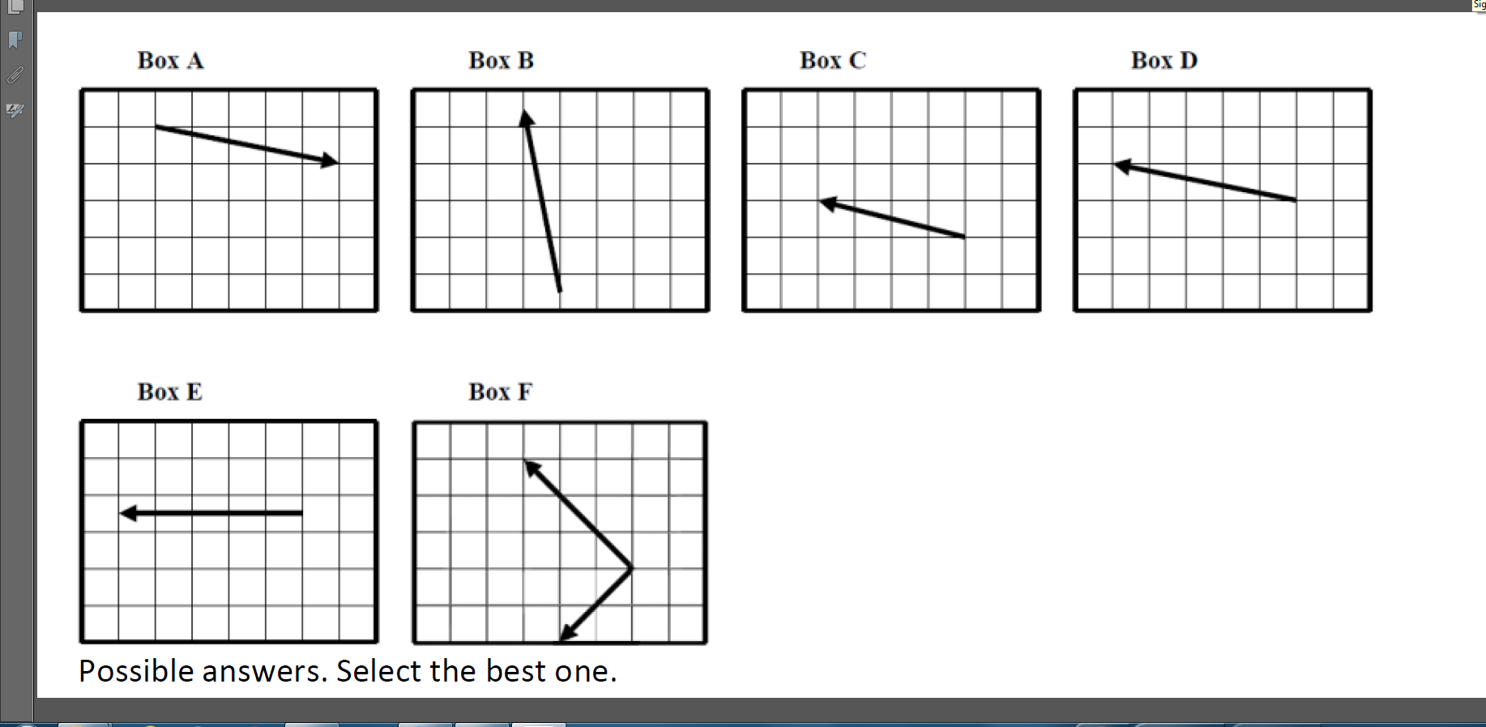
Example of Carelessness? (Algebra-based Course, 2nd semester)
Error Rate, Multiple-Choice Version (N = 62): 73% Error Rate, Non-Multiple-Choice Version (N = 61): 64%
X
✓

Slide 26
How to Address Difficulties?
Carelessness: (1) review and check steps; (2) find alternative solutions; (3) habitual use of estimation; (4) apply dimensional analysis (for physical problems)
Skill deficit: Practice and repetition
Conceptual confusion: Review and study of basic ideas

Slide 27
Summary: What Options do Physics Instructors Have?
Test to assess scope of problem
Take time to review basic math
Assign or suggest out-of-class math review practice
[We will be developing appropriate instructional materials]
Reduce mathematical burden of syllabus
more qualitative problems, fewer problems requiring algebraic manipulation
Nothing: Leave it up to the students

